Slide 1

Module 8 -Text Data Analysis & Inference
CS 620 / DASC 600
Introduction to Data Science & Analytics
Dr. Sampath Jayarathna
Old Dominion University

Slide 2
Overview
Text Analytics involves a set of techniques and approaches towards bringing textual content to a point where it is represented as data and then mined for insights/trends/patterns.
In this module, we will focus on Text Analysis and inference, which is about parsing texts in order to extract machine-readable facts from them. The purpose of Text Analysis is to create structured (or semi-structured) data out of free text content. The process can be thought of as slicing and dicing heaps of unstructured, heterogeneous documents into easy-to-manage and interpret data pieces. Text Analysis is close to other terms like Text Mining, Text Analytics and Information Extraction/Retrieval.

Slide 3
Objectives
Discuss the various ways in which text can be analyzed, and appropriate uses of each
Use open source text analytic tools
Develop simple text analysis tools
Demonstrate understanding of text retrieval models such as Boolean and Vector Space
Build models which take as input textual features

Slide 4
Relevance
Text Analysis is part of Natural Language Processing (NLP) where the final goal is not to fully understand the text, but rather to retrieve specific information from it in the most practical manner. This means making a good balance between the efforts needed to develop and maintain the analytical pipeline. In a later Evaluation module, we will learn to measure the success/failure of these text analysis and inference models.
There are no shortages of text data, we have data being generated from tweets, digital media platforms, blogs, and a whole host of other sources. As a data scientist, it’s important to analyze all this text data to help your organization make data-driven decisions.

Slide 5
8.1 Text Preprocessing

Slide 6
8.1.1 Preprocessing (Cleaning) Text
Cleaning text is really hard, problem specific, and full of tradeoffs.
Remember, simple is better.
Simpler text data, simpler models, smaller vocabularies. You can always make things more complex later to see if it results in better model.
Hopefully, you can see that getting truly clean text is impossible, that we are really doing the best we can based on the time, resources, and knowledge we have.

Slide 7
8.1.2 Common Preprocessing Steps
Break into tokens (keywords) on whitespace.
Strip unwanted characters/markup (e.g. HTML tags, punctuation, numbers, etc.).
Remove common stopwords (e.g. a, the, it, etc.).
Stem tokens to “root” words
Detect common word/phrases (possibly using a domain specific dictionary).
WordNet
Build inverted index (keyword → list of docs containing it).

Slide 8
8.1.3 Install NLTK
The Natural Language Toolkit, or NLTK for short, is a Python library written for working and modeling text.
It provides good tools for loading and cleaning text that we can use to get our data ready for working with machine learning and deep learning algorithms.
There are few ways to do this, such as from within a script:
import nltk
nltk.download()
from the command line (anaconda prompt)
python -m nltk.downloader all

Slide 9
8.1.4 Tokenize
NLTK provides a function called word_tokenize() for splitting strings into tokens.
It splits tokens based on white space and punctuation. For example, commas and periods are taken as separate tokens. Contractions are split apart (e.g. “What’s” becomes “What” “‘s“). Quotes are kept, and so on.
from nltk.tokenize import word_tokenize
sample_text = """Success? I don’t know what that word means. I’m happy. But success, that goes back to what in somebody’s eyes success means. For me, success is inner peace. That’s a good day for me.
"""
tokens = word_tokenize(sample_text)
print(tokens)

Slide 10
8.1.5 Normalizing Case
It is common to convert all words to one case.
This means that the vocabulary will shrink in size, but some distinctions are lost (e.g. “Apple” the company vs “apple” the fruit is a commonly used example).
We can convert all words to lowercase by calling the lower() function on each word.
tokens = [word.lower() for word in tokens]
print(tokens)
['success', 'i', 'don', 't', 'know', 'what', 'that', 'word', 'means', 'i', 'm', 'happy', 'but', 'success', 'that', 'goes', 'back', 'to', 'what', 'in', 'somebody', 's', 'eyes', 'success', 'means', 'for', 'me', 'success', 'is', 'inner', 'peace', 'that', 's', 'a', 'good', 'day', 'for', 'me']

Slide 11
8.1.6 Filter out Punctuations
Running the previous code, we can see that punctuation are now tokens that we could then decide to specifically filter out.
This can be done by iterating over all tokens and only keeping those tokens that are all alphabetic. Python has the function isalpha() that can be used.
tokens = [word for word in tokens if word.isalpha()]
print(tokens)
['Success', 'I', 'don', 't', 'know', 'what', 'that', 'word', 'means', 'I', 'm', 'happy', 'But', 'success', 'that', 'goes', 'back', 'to', 'what', 'in', 'somebody', 's', 'eyes', 'success', 'means', 'For', 'me', 'success', 'is', 'inner', 'peace', 'That', 's', 'a', 'good', 'day', 'for', 'me']

Slide 12
8.1.7 Filter out Stopwords
Stop words are those words that do not contribute to the deeper meaning of the phrase.
They are the most common words such as: “the“, “a“, and “is“.
NLTK provides a list of commonly agreed upon stop words for a variety of languages, such as English.
from nltk.corpus import stopwords
stop_words = stopwords.words('english')
words = [w for w in tokens if not w in stop_words]
print(words)
['Success', 'I', 'know', 'word', 'means', 'I', 'happy', 'But', 'success', 'goes', 'back', 'somebody', 'eyes', 'success', 'means', 'For', 'success', 'inner', 'peace', 'That', 'good', 'day']

Slide 13
8.1.8 Stemming
Stemming refers to the process of reducing each word to its root or base.
For example “fishing,” “fished,” “fisher” all reduce to the stem “fish.”
There are many stemming algorithms, although a popular and long-standing method is the Porter Stemming algorithm.
from nltk.stem.porter import PorterStemmer
porter = PorterStemmer()
stemmed = [porter.stem(word) for word in words]
print(stemmed)

Slide 14
Activity 16
Download the metamorphosis.txt file or load it to your python module.
Create a small pipeline of text preparation including the following steps for the given file.
Load the raw text.
Split into tokens.
Convert to lowercase.
Filter out tokens that are not alphabetic.
Filter out tokens that are stop words.
Display the first 100 terms of the file after preprocessing.
Stem the tokens using the Snowball Stemmer. (Note: from nltk.stem.snowball import SnowballStemmer)
Submit your code to piazza Activity 16 thread.
Notes:
file = open('metamorphosis.txt')
sample_text = file.read()

Slide 15
8.2 Text Retrieval

Slide 16
8.2.1 Retrieval Models
A retrieval model specifies the details of:
Document representation
Query representation
Retrieval function
Determines a notion of relevance to the user.

Slide 17
8.2.2 Classes of Retrieval Models
Boolean models
Vector space models (statistical/algebraic)
Latent Semantic Indexing
Probabilistic models
Basic probabilistic model
Bayesian inference networks
Language models

Slide 18
8.2.3 Types of Retrieval Models: Exact Match vs. Best Match Retrieval
Exact Match (Boolean models)
Query specifies precise retrieval criteria
Every document either matches or fails to match query
Result is a set of documents
Usually in no particular order
Best Match (Vector Space models, Probabilistic models)
Query describes retrieval criteria for desired documents
Every document matches a query to some degree
Result is a ranked list of documents, “best” first

Slide 19
8.2.4 Boolean Model
A document is represented as a set of keywords.
Queries are Boolean expressions of keywords, connected by AND, OR, and NOT, including the use of brackets to indicate scope.
[[Rio & Brazil] | [Hilo & Hawaii]] & hotel & !Hilton]
Output: Document is relevant or not. No partial matches or ranking.

Slide 20
8.2.5 Search with Boolean query
Boolean query
E.g., “obama” AND “healthcare” NOT “news”
Procedures
Lookup query term in the dictionary
Retrieve the posting lists
Operation
AND: intersect the posting lists
OR: union the posting list
NOT: diff the posting list

Slide 21
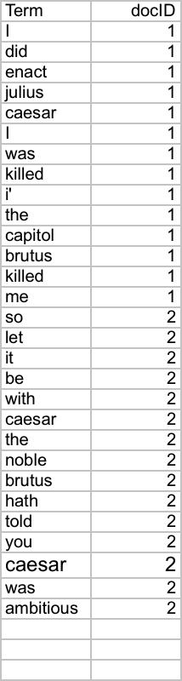
8.2.6 Indexer steps: Token sequence
Sec. 1.2
Sequence of (Modified token, Document ID) pairs.
Doc 1
Doc 2
I did enact Julius
Caesar I was killed
i’ the Capitol;
Brutus killed me.
So let it be with
Caesar. The noble
Brutus hath told you
Caesar was ambitious

Slide 22
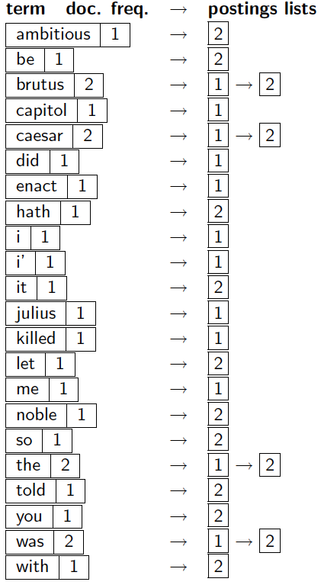
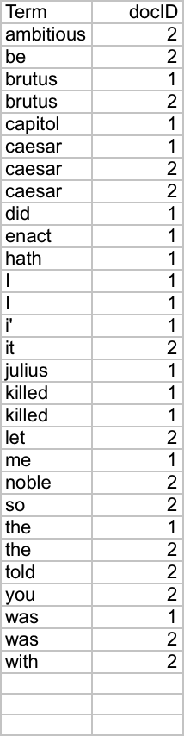
8.2.7 Indexer steps: Dictionary & Postings
Sec. 1.2
Multiple term entries in a single document are merged.
Split into Dictionary and Postings
Doc. frequency information is added.
Why frequency?
Will discuss later.

Slide 23
8.2.8 Search with Boolean query
Example: AND operation
scan the postings
Term1
2
4
8
16
32
64
128
Term2
1
2
3
5
8
13
21
34

Slide 24
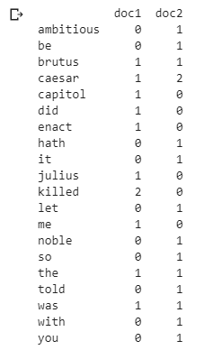
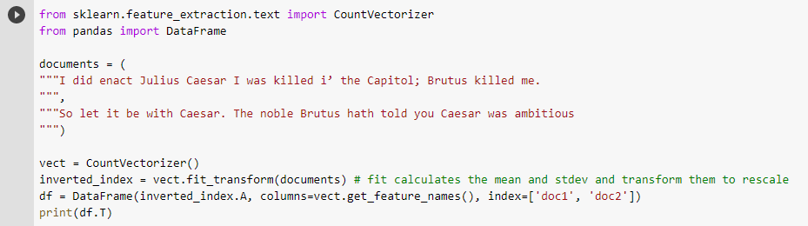
8.2.9 Inverted Index
Text preprocessing, tokenizing and filtering of stopwords are included in scikit-learn, a high level component that is able to build a dictionary of features and transform documents to feature vectors:

Slide 25
8.2.10 Boolean Retrieval Model
Popular retrieval model because:
Easy to understand for simple queries.
Clean formalism.
Reasonably efficient implementations possible for normal queries.

Slide 26
8.3 Vector Space

Slide 27
8.3.1 Vector space model
Represent both doc and query by concept vectors
Each concept defines one dimension
K concepts define a high-dimensional space
Measure relevance
Distance between the query vector and document vector in this concept space

Slide 28
8.3.2 Vector Space Retrieval Model: Introduction
How are documents represented in the binary vector model?
Term₁ Term₂ Term₃ Term₄ … Term_{n}
Doc₁ 1 0 0 1 … 1
Doc₂ 0 1 1 0 … 0
Doc₃ 1 0 1 0 … 0
: : : : : : :
A document is represented as a vector of binary values
One dimension per term in the corpus vocabulary
An unstructured query can also be represented as a vector
Query 0 0 1 0 … 1

Slide 29
8.3.3 Vector Space Representation: Linear Algebra
Formally, a vector space is defined by a set of linearly independent basis vectors.
Basis vectors:
correspond to the dimensions or directions in the vector space;
determine what can be described in the vector space; and
must be orthogonal, or linearly independent, i.e. a value along one dimension implies nothing about a value along another.
Basis vectors
for 2 dimensions
Basis vectors
for 3 dimensions

Slide 30
8.3.4 VS Model: an illustration
Which document is closer to the query?
Finance
D₂
D₄
D₃
Sports
Query
D₅
D₁
Education

Slide 31
8.3.5 What the VS model doesn’t say
How to define/select the “basic concept”
Concepts are assumed to be orthogonal
How to assign weights
Weight in query indicates importance of the concept
Weight in doc indicates how well the concept characterizes the doc
How to define the similarity/distance measure

Slide 32
8.3.6 Graphic Representation
Example:
D₁ = 2T₁ , 3T₂ , 5T₃
D₂ = 3T₁ , 7T₂ , T₃
Q = 0T₁ , 0T₂ , 2T₃
T₃
5
D₁ = (2T₁, 3T₂ , 5T₃ )
Q = (0T₁ , 0T₂ , 2T₃ )
2
3
T₁
D₂ = (3T₁ , 7T₂ , T₃ )
Is D₁ or D₂ more similar to Q?
How to measure the degree of similarity? Distance? Angle? Projection?
7
T₂

Slide 33
8.3.7 Document Collection
A collection of n documents can be represented in the vector space model by a term-document matrix.
An entry in the matrix corresponds to the “weight” of a term in the document; zero means the term has no significance in the document or it simply doesn’t exist in the document.
T₁ T₂ …. T_{t}
D₁ w₁₁ w₂₁ … w_{t1}
D₂ w₁₂ w₂₂ … w_{t2}
: : : :
: : : :
D_{n} w_{1n} w_{2n} … w_{tn}

Slide 34
8.3.8 How to assign weights?
Important!
Why?
Query side: not all terms are equally important
Doc side: some terms carry more information about the content
How?
Two basic heuristics
TF (Term Frequency) = Within-doc-frequency
IDF (Inverse Document Frequency)

Slide 35
8.3.9 Term Weights: Term Frequency
More frequent terms in a document are more important, i.e. more indicative of the topic.
f_{ij} = frequency of term i in document j
Raw TF is inaccurate
Document length variation
“Repeated occurrences” are less informative than the “first occurrence”
Relevance does not increase proportionally with number of term occurrence
May want to normalize term frequency (tf) by dividing by the frequency of the most common term in the document:
tf_{ij} = f_{ij} / max_{i}{f_{ij}}

Slide 36
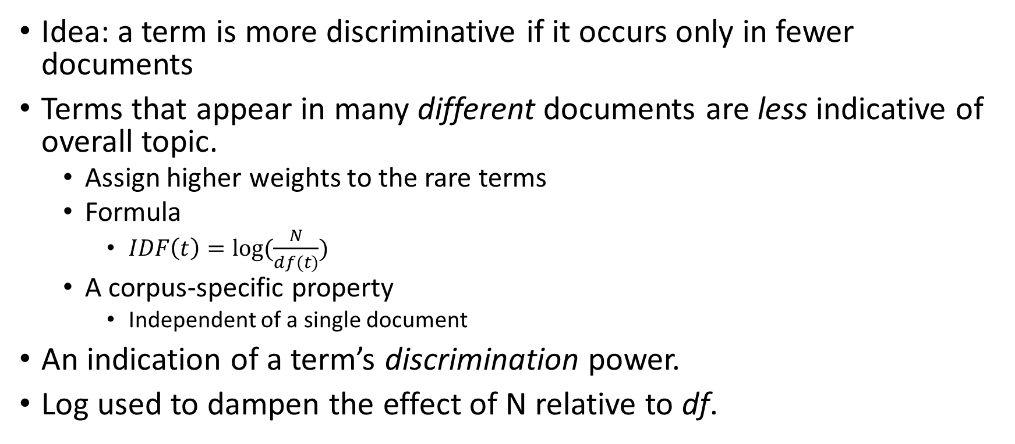

8.3.10 Term Weights: Inverse Document Frequency
Idea: a term is more discriminative if it occurs only in fewer documents
Terms that appear in many different documents are less indicative of overall topic.
Assign higher weights to the rare terms
Formula
$IDF\left(t\right)=log⁡(\frac{N}{df(t)})$
A corpus-specific property
Independent of a single document
An indication of a term’s discrimination power.
Log used to dampen the effect of N relative to df.
Non-linear scaling
Total number of docs in collection
Number of docs containing term $t$

Slide 37
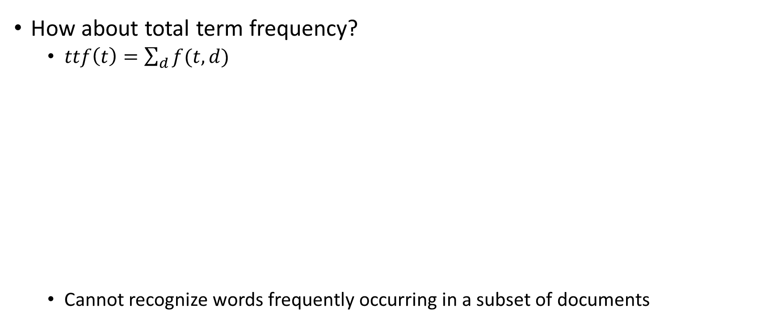
8.3.11 Why document frequency
How about total term frequency?
$ttf\left(t\right)=\sum_{d}{f(t,d)}$
Cannot recognize words frequently occurring in a subset of documents
Table 1. Example total term frequency v.s. document frequency in Reuters-RCV1 collection.
Word | ttf | df
try | 10422 | 8760
insurance | 10440 | 3997

Slide 38
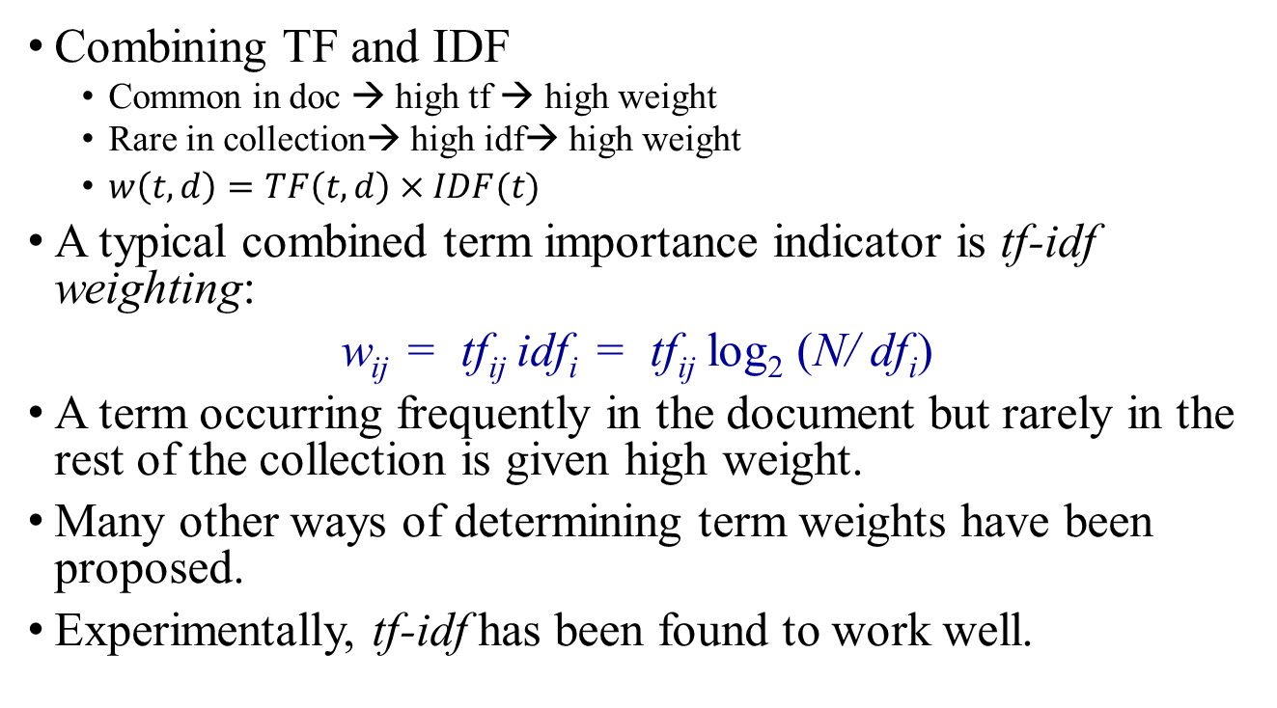
8.3.12 TF-IDF weighting
Combining TF and IDF
Common in doc → high tf → high weight
Rare in collection→ high idf→ high weight
$w\left(t,d\right)=TF\left(t,d\right)×IDF(t)$
A typical combined term importance indicator is tf-idf weighting:
w_{ij} = tf_{ij} idf_{i} = tf_{ij} log₂ (N/ df_{i})
A term occurring frequently in the document but rarely in the rest of the collection is given high weight.
Many other ways of determining term weights have been proposed.
Experimentally, tf-idf has been found to work well.

Slide 39
Activity 17
Given a document X containing terms A,B,C with given frequencies:
A(3), B(2), C(1)
Assume collection contains 10,000 documents and
document frequencies of these terms are:
A(50), B(1300), C(250)
Calculate the tfidf of each term A,B and C in this document.
Answer:
A B C
Document X 7.6 2.0 1.8
Submit your solution to piazza Activity 17 thread.
Notes:
Log(Y) of base 2 = log(y)/log(2)

Slide 40
8.4 Vector Space Similarity

Slide 41
8.4.1 Query Vector
Query vector is typically treated as a document and also tf-idf weighted.
Alternative is for the user to supply weights for the given query terms.

Slide 42
8.4.2 Similarity Measure
A similarity measure is a function that computes the degree of similarity between two vectors.
Using a similarity measure between the query and each document:

Slide 43
8.4.3 How to define a good similarity measure?
Euclidean distance?
Finance
TF-IDF space
D₂
D₄
D₃
Sports
Query
D₅
D₁
Education

Slide 44
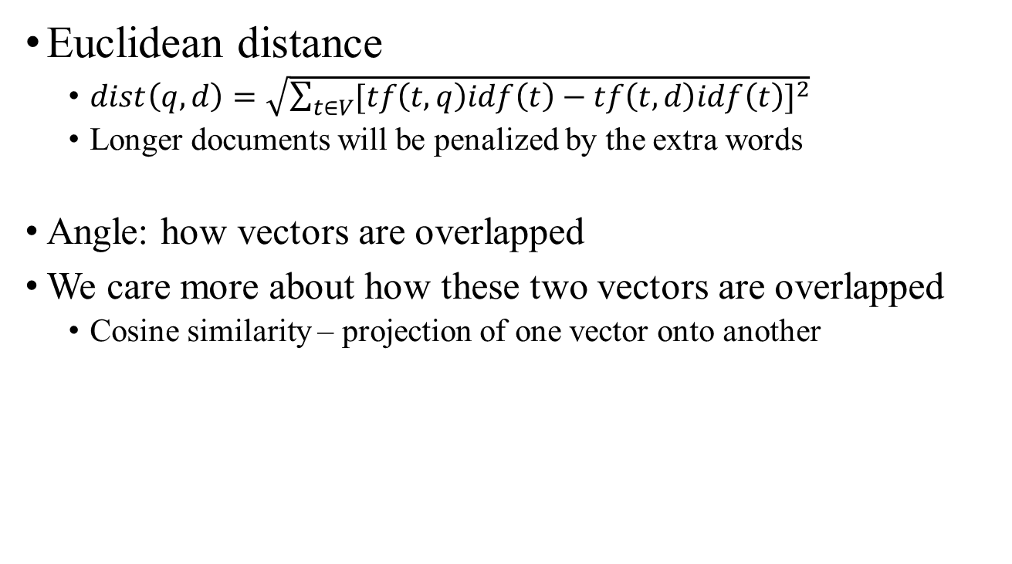
8.4.4 How to define a good similarity measure?
Euclidean distance
$dist\left(q,d\right)=\sqrt{\sum_{t∈V}{{[tf\left(t,q\right)idf\left(t\right)−tf\left(t,d\right)idf\left(t\right)]}^{2}}}$
Longer documents will be penalized by the extra words
Angle: how vectors are overlapped
We care more about how these two vectors are overlapped
Cosine similarity – projection of one vector onto another

Slide 45
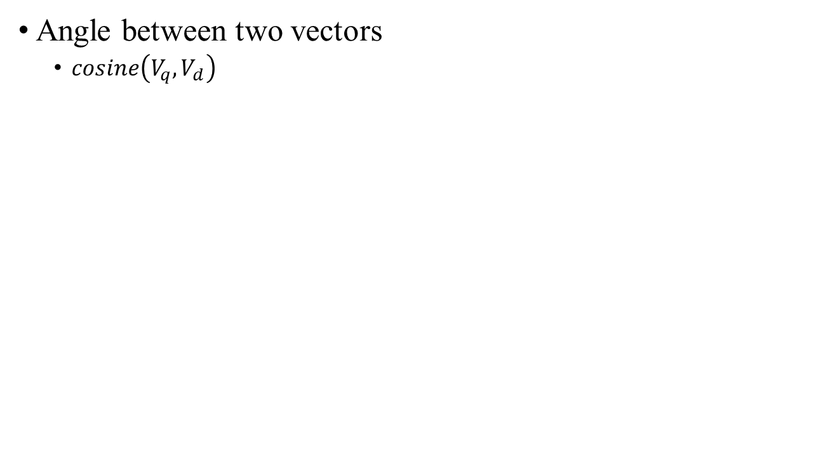
8.4.5 Cosine similarity
Angle between two vectors
$cosine\left(V_{q},V_{d}\right)$
Finance
D₂
TF-IDF space
D₁
Query
Sports

Slide 46
8.4.6 Cosine Similarity Measure
t₃
Cosine similarity measures the cosine of the angle between two vectors.
Inner product normalized by the vector lengths.
θ₁
D₁
Q
CosSim(d_{j}, q) =
θ₂
t₁
t₂
D₂
D₁ = 2T₁ , 3T₂ , 5T₃ CosSim(D₁ , Q) = (0+0+10) / √(4+9+25)(0+0+4) = 0.81
D₂ = 3T₁ , 7T₂ , 1T₃ CosSim(D₂ , Q) = (0+0+2) / √(9+49+1)(0+0+4) = 0.13
Q = 0T₁ , 0T₂ , 2T₃

Slide 47
Activity 18
Given a document X containing terms A,B,C with given frequencies:
A(3), B(2), C(1)
Assume collection contains 10,000 documents and
document frequencies of these terms are:
A(50), B(1300), C(250)
Assume you have a query Q with following terms with given frequencies.
A(1), B(1), C(0), D(5)
Calculate the Cosine similarity Cosine(X,Q) between Document X and Query Q. Note: Don't normalize the term frequencies for the query (use the raw tf values).
Submit your solution to piazza Activity 18 thread.
Notes:
Log(Y) of base 2 = log(y)/log(2)

Slide 48
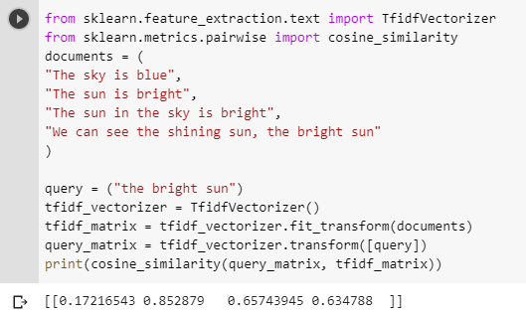
8.4.7 Vector Space Model using scikit-learn
This code will explain the generation of a term-document matrix out of 4 documents using the machine learning python library, scikit-learn and then compare it with a query in a same vector space using cosine similarity.
print(cosine_similarity(tfidf_matrix[0:1], tfidf_matrix))
To compare a document from tfidf matrix with all the other documents
Most similar to the query with highest cosine similarity

Slide 49
8.4.8 Comments on Vector Space Models
Empirically effective!
Intuitive
Easy to implement
Well-studied/Mostly evaluated
Warning: Many variants of TF-IDF!

Slide 50
Summary
Text analysis allows us to automatically extract and classify information from text, such as tweets, emails, support tickets, product reviews, and survey responses. In natural language processing (NLP), text preprocessing is the practice of cleaning and preparing text data. This module introduces NLTK and vector space modeling for text analysis and inference.

