Slide 1


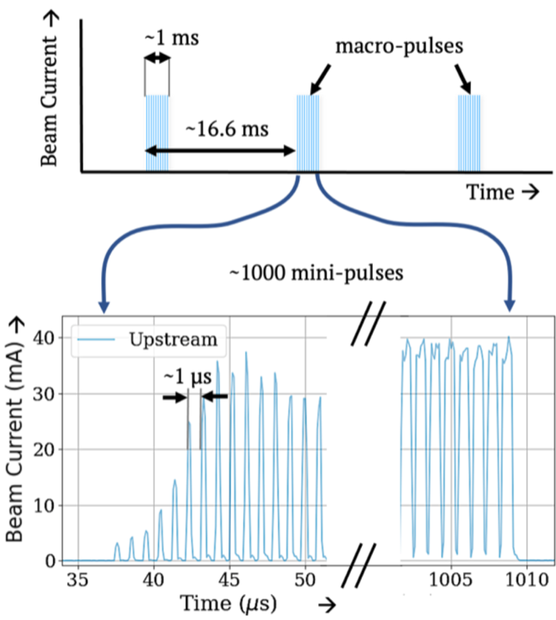
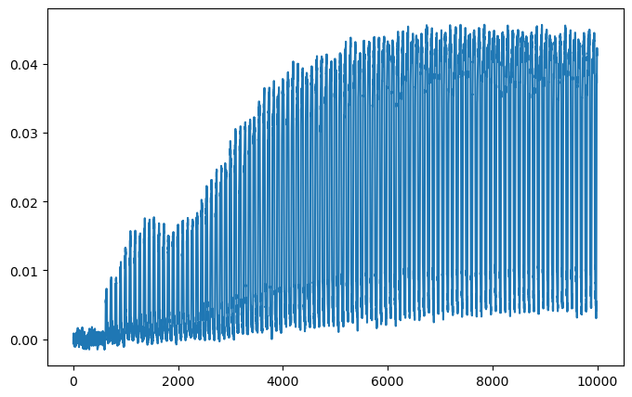
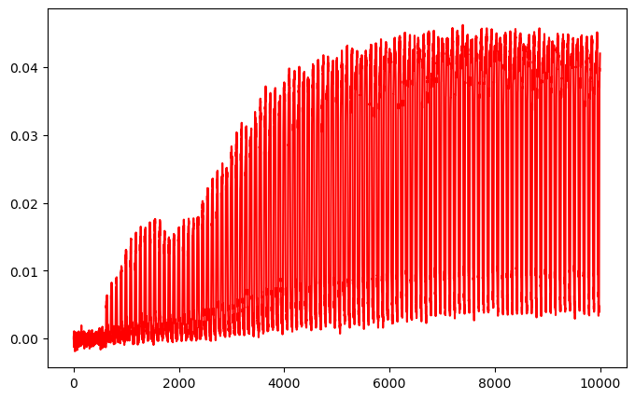
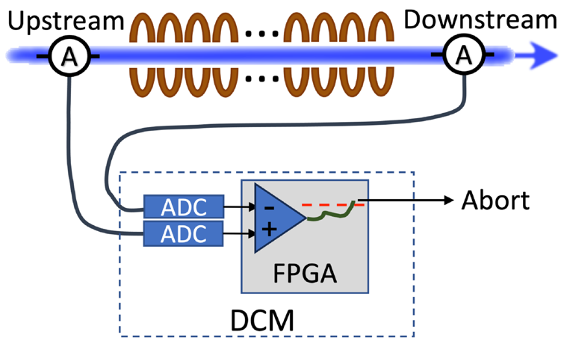

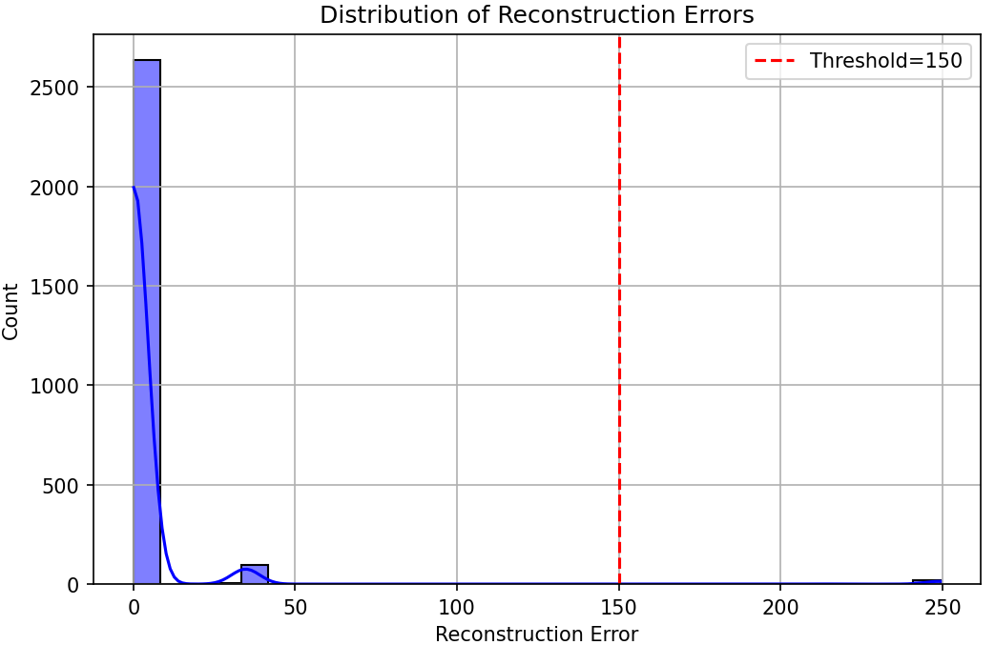
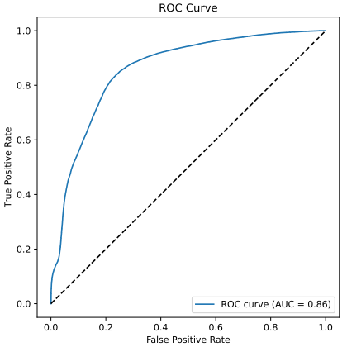
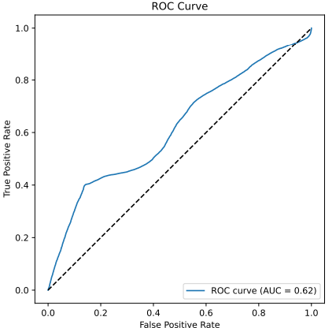
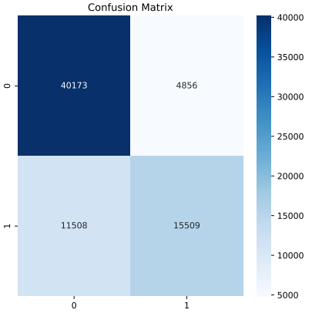
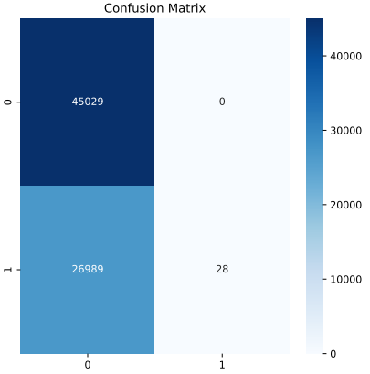

Anomaly Detection at the Spallation Neutron Source Accelerator
AJ Broderick, Arun Thakur, Ashish Verma
School of
Data Science
Technical Advisors: Kishansingh Rajput (Jefferson Lab), Dr. Frank Liu (ODU)
Background
Research Goals
The Spallation Neutron Source (SNS) is an accelerator-based neutron facility that performs spallation of hydrogen ions into neutrons for use of experiments across various applications¹
Spallation utilizes a proton beam, pulsed at 60Hz, to accelerate particles at controlled temperatures and intervals to break the atom into the proton, electron and neutron
As the neutron travels throughout the SNS, there is exist a Differential Current Monitor (DCM) that measures the amperage/current of the beam upstream and downstream
If significant loss in the beam is detected downstream, it aborts the beam to shut it down
Tracing of Normal Pulse
Tracing of Before Errant Pulse
Create model to be trained on past normal and errant beams tracings to predict future errant beams
False Positives must be kept within 0.5%
If the model flags the errant beam, it would shut abort the process and as mentioned earlier would result in longer downtime
Model to provide a “go/no-go” response within 10 milliseconds
Neutron Beam
Configuration
Neutron Beam Pulses
Tracing of Normal Pulse
Tracing of Before Errant Pulse
DCM
ADCs record beam currents
Conclusions
With the data that is captured by the SNS, there exists large class imbalance between the normal and errant records. This resulted in the supervised model to overfit the training weights
VAE - BiLSTM Model performed better, however is requires more work to determine if detection was accurate or not
Modeling was limited from processing constraints of transforming base binary data into DataFrame and arrays
VAE - BiLSTM Model²
CNN LSTM Model³
Results
Variational Autoencoder With Bidirectional Long Short-Term Memory
Convolutional Neural Network and Long Short-Term Memory
1,000 files, resulting in over 13,000 samples, from the SNS were proceeded by models
Waveform
Sensors
Accelerator
Control
Waveform
Sensors
Accelerator
Control
VAE-BiLSTM Model
Data Ingestion
Data Acquisition System
Data Ingestion
Data Acquisition System
Data Preprocessing Pipeline
Data Preprocessing Pipeline
Future Work
Addressing class imbalance within data by utilizing SMOTE
Continue to refine the models that were developed by Optuna/Raytune hyper parameter tuning
Mlflow integration for experiment tracking
Basic Machine Learning with bagging and boosting algorithms
Real time model predictions
Data engineering with streaming rails for feature engineering
Waveform Feature Extraction
Beam Setting Normalization
Waveform Feature Extraction
Beam Setting Normalization
Preprocessing
Feature Vector Construction
Preprocessing
Feature Vector Construction
CNN LSTM Model
Input Buffer
Input Buffer
Training Results
Testing Results
VAE Encoder
Convolutional Layer
BiLSTM Sequence Processor
CNN Layers
Max Pooling Layer
Acknowledgments
Inference Engine
Convolutional Layer
Dr. Nirmala Karunarathna for their guidance and feedback throughout the semester, which contributed to our learning and the success of our project
Threshold Decision Module
Prediction Layer
Max Pooling Layer
Flattening
Alert System
Monitoring Dashboard
Logging Service
LSTM
References
Deployment
Services
LSTM Layer
LSTM
¹ Blokland, W., Rajput, K., Schram, M., Jeske, T., Ramuhalli, P., Peters, C., Yucesan, Y., & Zhukov, A. (2022). Uncertainty aware anomaly detection to predict errant beam pulses in the Oak Ridge Spallation Neutron Source accelerator. Physical Review Accelerators and Beams, 25(12). https://doi.org/10.1103/physrevaccelbeams.25.122802
² Staffini A, Svensson T, Chung U-i, Svensson AK. A Disentangled VAE-BiLSTM Model for Heart Rate Anomaly Detection. Bioengineering. 2023; 10(6):683. https://doi.org/10.3390/bioengineering10060683
³ Mahmoud Abdallah, Nhien An Le Khac, Hamed Jahromi, and Anca Delia Jurcut. 2021. A Hybrid CNN-LSTM Based Approach for Anomaly Detection Systems in SDNs. In Proceedings of the 16th International Conference on Availability, Reliability and Security (ARES '21). Association for Computing Machinery, New York, NY, USA, Article 34, 1–7. https://doi.org/10.1145/3465481.3469190
Operator Interface
Performance Analysis
LSTM
Feedback
Loop
Model Performance Tracker
Model Update Service
Anomaly
Detection
Dense Layers
Classification

