Slide 1
Basics of AI and Neural Networks

Slide 2
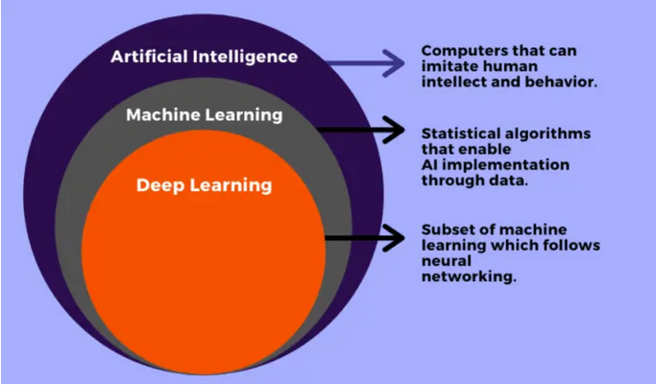
AI vs ML vs DL

Slide 3
AI (Artificial Intelligence)
1) Artificial Intelligence is basically the mechanism to incorporate human intelligence into machines through a set of rules(algorithm).
2) AI is the broader family consisting of ML and DL as it’s components.
3) The efficiency of AI is basically the efficiency provided by ML and DL respectively.
5) Examples - Amazon’s Alexa, Siri
ML (Machine Learning)
1) ML is the study that uses statistical methods enabling machines to improve with experience
2) ML is the subset of AI.
3) Less efficient than DL as it can’t work for longer dimensions or higher amount of data.
4) Examples – Car Price Prediction, Diabetes Prediction
DL (Deep Learning)
1) DL makes use of Neural Networks(similar to human neurons) to imitate functionality just like a human brain.
2) DL is the subset of ML.
3) More powerful than ML as it can easily work for larger sets of data.
4) It attains the highest rank in terms of accuracy when it is trained with large amount of data.
5) Examples Image Classification, Image De-noisning etc.

Slide 4
Supervised Learning
1) Supervised learning is the learning of the model where we are provided with input variable (say, x) and an output variable (say, Y) and an algorithm to map the input to the output. i.e.
Y= f(x)
2) The basic aim is to approximate the mapping function (mentioned above) that when there is a new input data (x) then the corresponding output variable can be predicted.
3) It is called supervised learning because the process of learning (from the training dataset) can be thought of as a supervisor who is supervising the entire learning process. Thus, the “learning algorithm” iteratively makes predictions on the training data and is corrected by the “supervisor”, and the learning stops when the algorithm achieves an acceptable level of performance.
4) It is called supervised because the data is labelled(y column is present/available).
5) Examples of Supervised learning algorithms - Regression and Classification.

Slide 5
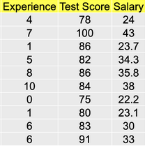
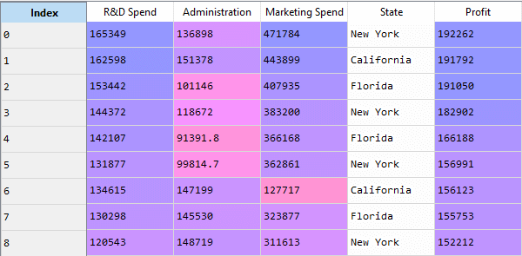
Regression Examples
1) In Regression problems statements, the target variable is continuous in nature

Slide 6
Types of Regression
1) Simple Linear Regression
2) Multiple Linear Regression
3) Ridge Regression
4) Lasso Regression

Slide 7
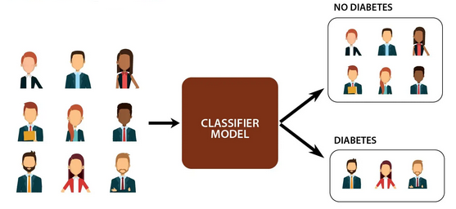
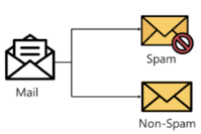
Classification Examples
1) In Classification problems statements, the target variable is categorical in nature

Slide 8
Types of Classification Algorithms
1) Logistic Regression
2) Decision Tree Classification
3) Random Forest Classification
4) KNN Classification
5) SVM Classification
6) Naïve Bayes Classification

Slide 9
Prediction Pipeline
Feature Engineering
Split data into train & test data
Select appropriate ML Model
Fit model on training data
Derive Predictions on test data
Data
Retrain Model
Tune Model Parameters
Generate Algorithm metrics

Slide 10
AI Applications
1) Image Classification
2) Image De-noising
3) Object detection
4) Chatbot
5) Pose Estimation
6) Stock Price Prediction
7) Image Segmentation
8) Text summarization
9) Language Translation

Slide 11
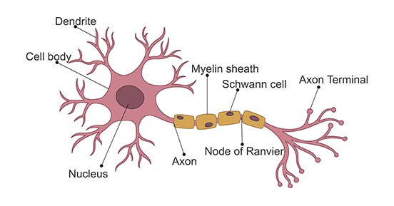
Working of a Neuron
A neuron accepts a signal and sends a message to the brain to act in a particular way.
It accepts a signal, generates a particular response in correspondence from its nucleus and then triggers a response
The response may pass to another neuron and the cycle proceeds in this manner.

Slide 12
Neural Network working -1
1) Neural networks are a set of algorithms, modeled loosely after the human brain, that are designed to recognize patterns. They interpret data through a kind of machine perception and process input data to solve a certain problem. The patterns they recognize are numerical, contained in vectors, into which all real-world data i.e. text, images, sound can fit in.
2) Neural networks are a class of machine learning algorithms used to model complex patterns in datasets using multiple hidden layers and activation functions. A neural network takes an input, passes it through multiple layers of hidden neurons (mini-functions with unique coefficients that must be learned), and outputs a prediction representing the combined input of all the neurons.

Slide 13
Neural Network working - 2
3) Neural networks are trained iteratively using optimization techniques like gradient descent. After each cycle of training, an error metric is calculated based on the difference between prediction and target. The derivatives of this error metric are calculated and propagated back through the network using a technique called backpropagation. Each neuron’s coefficients (weights) are then adjusted relative to how much they contributed to the total error. This process is repeated iteratively until the network error drops below an acceptable threshold.
4) In a neural network, each neuron (except those in the input layer) is actually a sum of all its inputs; which are in fact the outputs from the previous layer multiplied by some weights. An additional term called bias is added to this sum. And a nonlinear function known as activation function is applied to the result.

Slide 14
Layers in Neural Network
1) Input Layer-Holds the data your model will train on. Each neuron in the input layer represents a unique attribute in your dataset (e.g. height, hair color, etc.).
2) Hidden Layer -Sits between the input and output layers and applies an activation function before passing on the results. There are often multiple hidden layers in a network. In general, hidden layers are typically fully-connected layers - each neuron receives input from all the previous layer’s neurons and sends its output to every neuron in the next layer.
3) Output Layer- The final layer in a network. It receives input from the previous hidden layer, optionally applies an activation function, and returns an output representing your model’s prediction.

Slide 15
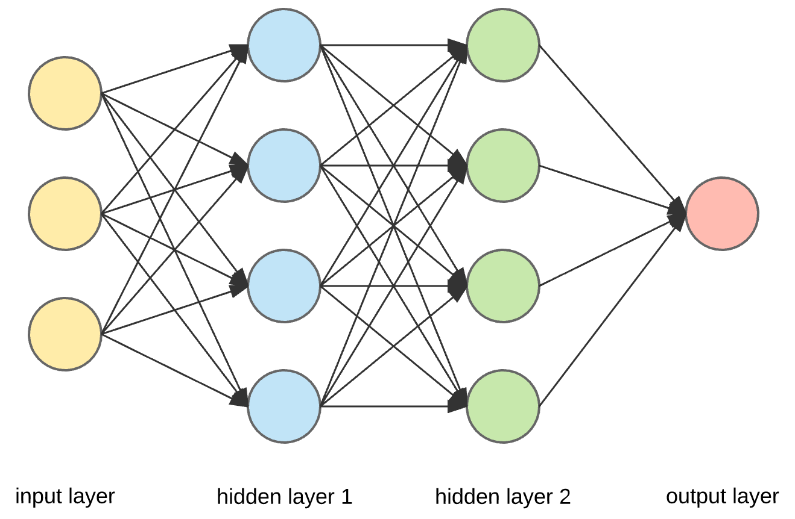

Slide 16
Terminologies
Neuron
A neuron takes a group of weighted inputs, applies an activation function, and returns an output. Inputs to a neuron can either be features from a training set or outputs from a previous layer’s neurons.
Weight
Weights are applied to the inputs as they travel along synapses to reach the neuron and a bias term is added. The neuron then applies an activation function to the “sum of weighted inputs added to the bias” from each incoming synapse and passes the result on to all the neurons in the next layer.
Bias
Bias helps in controlling the value at which activation function will trigger. Bias value allows you to shift the activation function to either right or left

Slide 17
Terminologies
Activation Function
1) An activation function in a neural network defines how the weighted sum of the input is transformed into an output from a node or nodes in a layer of the network.
2) An activation function is a function that is added into an artificial neural network in order to help the network learn complex patterns in the data.
3) Activation function also helps to normalize the output of any input in the range between 1 to -1 or 0 to 1.
Synapse
Synapses are like roads in a neural network. They connect inputs to neurons, neurons to neurons, and neurons to outputs.

Slide 18
Terminologies
Optimizer
1) It is very important to tweak the weights of the model during the training process, to make our predictions as correct and optimized as possible.
2) This is where optimizers come into picture. They tie together the loss function and model parameters by updating the model in response to the output of the loss function.
Loss Function/Cost Function
1) It is a parameter in model’s predict function that tells us “how good” the model is at making predictions for a given set of parameters.
2) The loss function has its own curve and its own derivatives. The slope of this curve tells us how to change our parameters to make the model more accurate. We use the cost function to update our parameters.

Slide 19
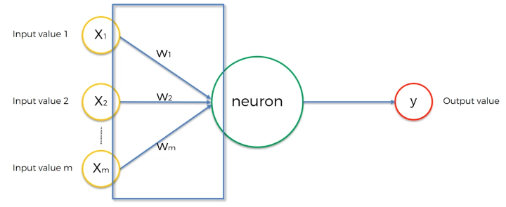
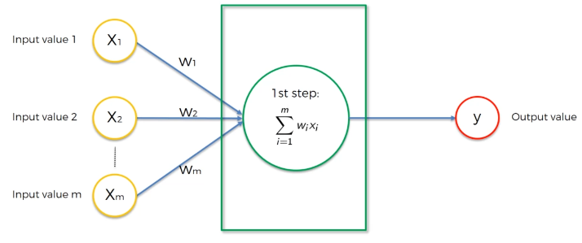
General Equation of Neural Network
𝑦pred = 𝜎(𝑧) = 𝜎(sum(𝑤∗𝑥) + 𝑏)
Where
z = 𝑤∗𝑥+𝑏
w = weight
x = input
b = bias
𝜎 = Activation Function

Slide 20
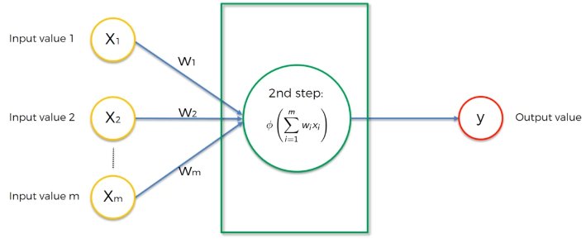
General Equation of Neural Network
𝑦 = 𝜎(𝑧) = 𝜎(sum(𝑤∗𝑥) + 𝑏)
Where
z = 𝑤∗𝑥+𝑏
w = weight
x = input
b = bias
𝜎 = Activation Function

