Slide 1


Fugacity 2026
ML Hackathon
The Chemical Engineering Problem
BEYOND BLACK BOX ML: RECOVERING GOVERNING EQUATIONS TO PREDICT SERIES PARALLEL REACTOR YIELD
TEAM NAME : OUTLIERS
TEAM MEMBERS: ASHISH (24CY10012)
INDIAN INSTITUTE OF TECHNOLOGY KHARAGPUR

Slide 2
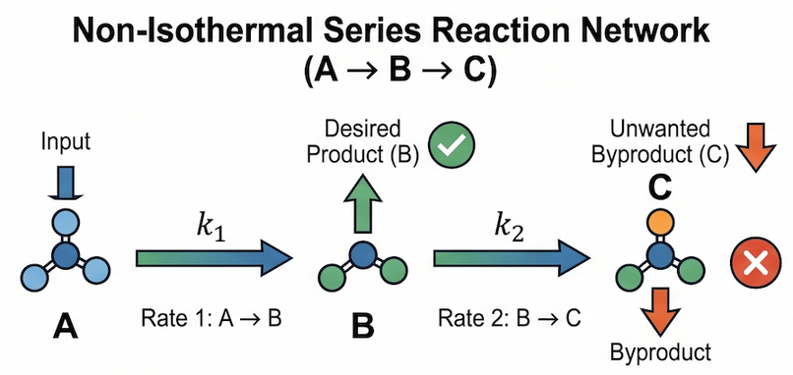

Problem & Industrial Relevance
The Computational Bottleneck
System Complexity
Modern chemical facilities rely on complex computational fluid dynamics and boundary value problem (BVP) simulations. While rigorous, these are too computationally expensive and slow for real time plant optimization.
The kinetic and thermodynamic behaviors of the reactions create complex, non linear trade offs between flow rates, inlet concentrations, and thermal profiles.
The Physical System
The process utilizes a continuous flow, non isothermal reactor involving a highly sensitive series parallel reaction network
The Objective
Build a predictive data driven surrogate model to instantly and accurately forecast the overall yield percentage of Product B at the reactor exit.
Industrial Impact
Bridging chemical engineering and computer science to give process engineers a tool for instant, real time operating setpoint adjustments
Dataset : 150 train / 50 test
Metric : RMSE

Slide 3







Chemical & Process Understanding
Kinetic Tradeoff
Thermally Self Destabilizing Flow
The Jacket Only Fallacy
Residence Time Dynamics
Validating "ZeroYield" Data
E₂ ≫ E₁
Goal Setting
Strategy Design
Preparation
Execution Stage
The side reaction (B → C) is significantly more temperaturesensitive than the desired reaction (A → B). Consequently, raising the temperature destroys Product B faster than it synthesizes it.
The primary reaction A → B is endothermic (β₁ < 0), causing the feed to selfcool upon entry.
The secondary reaction B → C is exothermic (β₂ > 0), releasing heat downstream exactly where Product B concentration peaks and is most vulnerable to degradation.
Models utilizing only a jacket energy balance fail because they are forced to reproduce a sharp thermal switch with a single Arrhenius term. This results in a physically impossible activation energy of E₂ ≈ 634 kJ/mol. Incorporating both reaction enthalpies successfully resolves this.
The yield versus τ (where τ = L/Q) exhibits an interior maximum. This optimum shifts to shorter residence times (τ) as the mixture temperature (T_mix) rises.
The 37 exact zeroyield rows are not sensor failures or missing data. They represent a physical selectivity cliff past 460 K where Product B is completely consumed into Byproduct C.
First Order Kinetics Supported
Yield is independent of inlet concentration (r = 0.009), consistent with first order. Freeing the order worsens CV, so we keep n = 1.

Slide 4
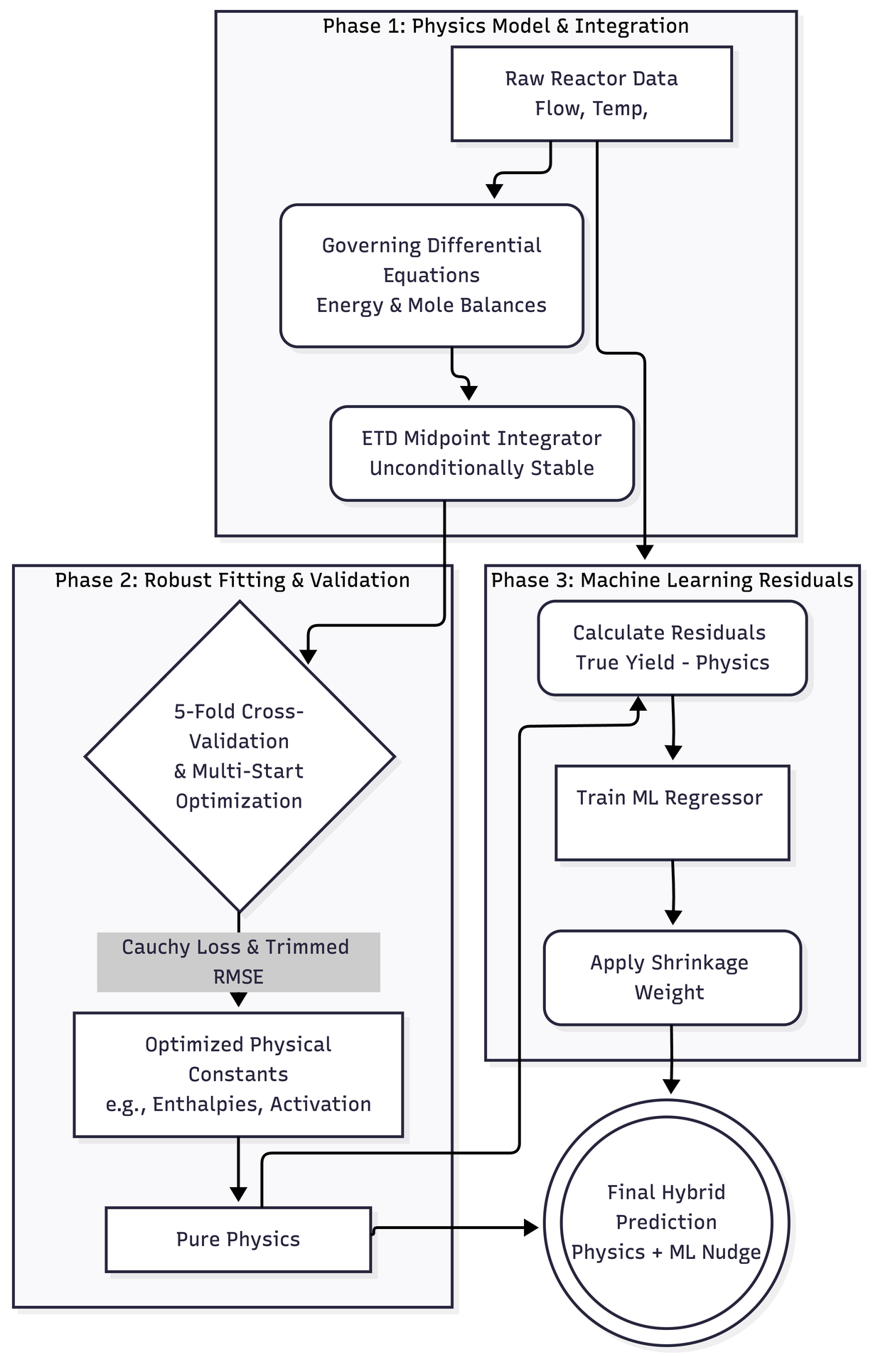

GOVERNING EQUATIONS
STABLE INTEGRATION
ROBUST FITTING
Recovered the exact differential equations for energy and mole balances instead of relying on black box ML
Deployed an unconditionally stable ETD midpoint integrator to accurately handle sharp thermal switches in the reactor.
Inferred data contamination to justify using a Cauchy loss function for highly robust parameter optimization
01
02
03
ML Methodology & Approach
CROSS
VALIDATION
ML RESIDUALS
HYBRID PREDICTION
Executed strict 5-fold crossvalidation alongside 24 wide multistart restarts to secure the true global optimum.
Trained an ExtraTrees regressor solely on physics residuals, using a deliberate shrinkage weight to prevent overfitting
Combined the dominant physical model with the minor ML correction to generate the highly accurate final prediction.
04
05
06

Slide 5
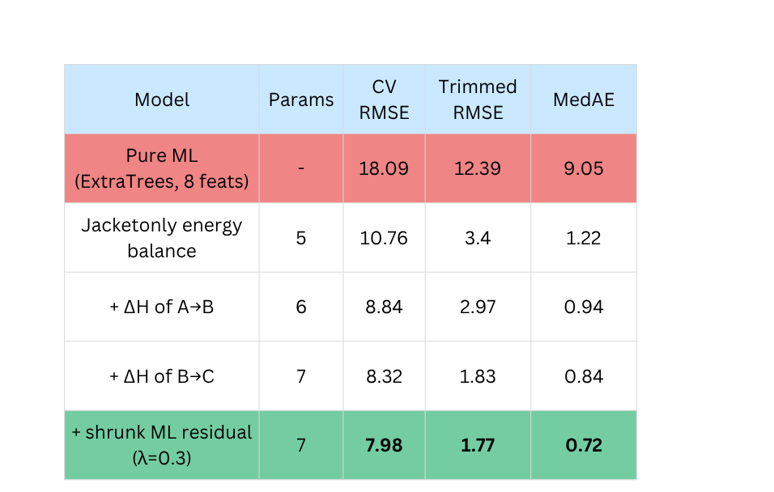








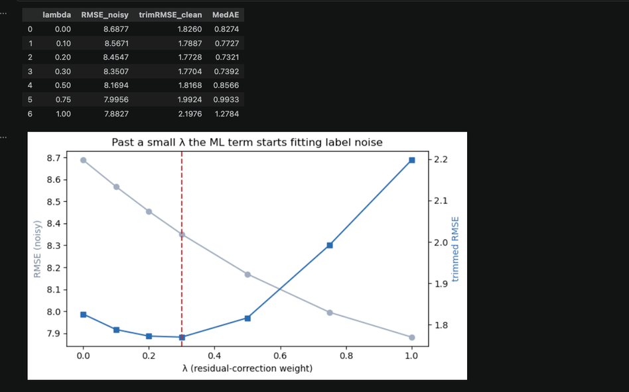


Results & Model Performance
Physics Outperforms ML
Opposing thermal effects
Pure ExtraTrees scores 18.09 RMSE; the 5parameter physics model, with no ML, scores 10.76.
β₁ = −40.8 K, β₂ = +37.4 K: the feed selfcools, then the side reaction reheats downstream.
01
05
The Ablation Ladder
Leak free validation
Every performance gain came from adding a physical term, never from adding model capacity.
5-fold CV repeated over seeds, with the physics refit inside every fold.
02
06
Corrected Kinetics
Physically consistent
Modelling both reaction enthalpies dropped apparent E₂ from 634 to 242 kJ/mol impossible to defensible.
Reproduces the interior optimum in τ shifting shorter with temperature, and the 37 zeroyield runs.
03
07
Why λ = 0.3
Stated limitations
The 5 parameter physics beats ML by 3.6× on trimmed RMSE. ML enters only as a shrunk correction.
λ is weakly identified and tuned on the scoring CV; E₂ stays apparent, not mechanistic.
04
08
Leaderboard RMSE: 11.2

Slide 6


Failure Analysis & Limitations
01
Catalyst deactivation
05
Extrapolation limits
Activity k₁ falls over time; the model assumes it constant and overpredicts yield.
Physics stays valid outside the training box; the tree residual term flattens and misleads.
02
Jacket fouling
06
Weakly identified parameters
Heat transfer h degrades, shifting the thermal switch and moving the optimal residence time.
Reaction order's interval is [0.87, 1.91]; a residual correlation with Q·C₀ survives at r ≈ 0.22.
03
Feed or flow change
Diagnosing the source
Inerts, cofeeds, or laminar flow break the firstorder and idealplugflow assumptions.
07
Refit online and see which constant moves: h means fouling, k₁ means deactivation, offset means sensors.
04
Operating near the cliff
Unmodelled parallel path
Above ~460 K yield collapses steeply; small temperature errors become large prediction errors
08
The brief calls the network series-parallel; we modelled A→B→C. A genuine A→C route would show as a systematic offset.
Thank You!!
Team Name : Outliers

