Slide 1
Linear correlation and linear regression

Slide 2
Continuous outcome (means)
Outcome Variable | Are the observations independent or correlated? |  | Alternatives if the normality assumption is violated (and small sample size):
 | independent | correlated
Continuous (e.g. pain scale, cognitive function) | Ttest: compares means between two independent groups ANOVA: compares means between more than two independent groups Pearson’s correlation coefficient (linear correlation): shows linear correlation between two continuous variables Linear regression: multivariate regression technique used when the outcome is continuous; gives slopes | Paired ttest: compares means between two related groups (e.g., the same subjects before and after) Repeated-measures ANOVA: compares changes over time in the means of two or more groups (repeated measurements) Mixed models/GEE modeling: multivariate regression techniques to compare changes over time between two or more groups; gives rate of change over time | Non-parametric statistics Wilcoxon sign-rank test: non-parametric alternative to the paired ttest Wilcoxon sum-rank test (=Mann-Whitney U test): non-parametric alternative to the ttest Kruskal-Wallis test: non-parametric alternative to ANOVA Spearman rank correlation coefficient: non-parametric alternative to Pearson’s correlation coefficient

Slide 3
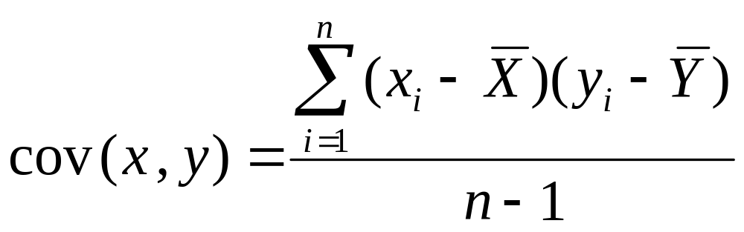
Recall: Covariance

Slide 4
Interpreting Covariance
cov(X,Y) > 0 X and Y are positively correlated
cov(X,Y) < 0 X and Y are inversely correlated
cov(X,Y) = 0 X and Y are independent

Slide 5
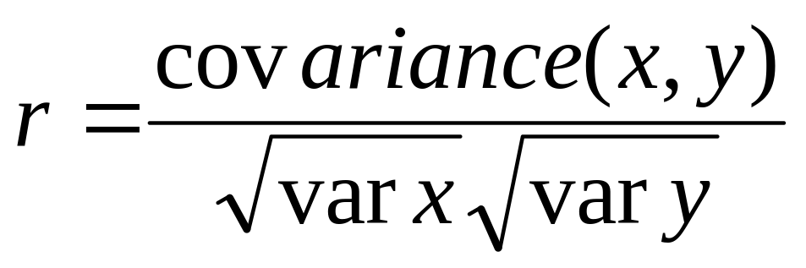
Correlation coefficient
Pearson’s Correlation Coefficient is standardized covariance (unitless):

Slide 6
Correlation
Measures the relative strength of the linear relationship between two variables
Unit-less
Ranges between –1 and 1
The closer to –1, the stronger the negative linear relationship
The closer to 1, the stronger the positive linear relationship
The closer to 0, the weaker any positive linear relationship

Slide 7
Scatter Plots of Data with Various Correlation Coefficients
Y
Y
Y
X
X
X
r = -1
r = -.6
r = 0
Y
Y
Y
X
X
X
r = +1
r = +.3
r = 0
Slide from: Statistics for Managers Using Microsoft® Excel 4th Edition, 2004 Prentice-Hall

Slide 8
Linear Correlation
Linear relationships
Curvilinear relationships
Y
Y
X
X
Y
Y
X
X
Slide from: Statistics for Managers Using Microsoft® Excel 4th Edition, 2004 Prentice-Hall

Slide 9
Linear Correlation
Strong relationships
Weak relationships
Y
Y
X
X
Y
Y
X
X
Slide from: Statistics for Managers Using Microsoft® Excel 4th Edition, 2004 Prentice-Hall

Slide 10
Linear Correlation
No relationship
Y
X
Y
X
Slide from: Statistics for Managers Using Microsoft® Excel 4th Edition, 2004 Prentice-Hall

Slide 11
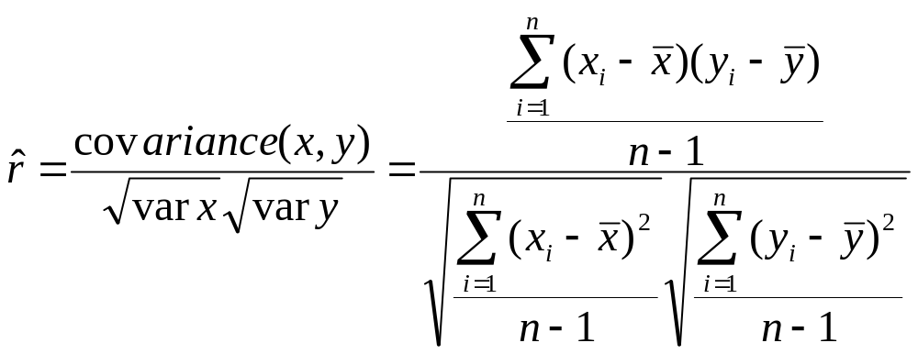
Calculating by hand…

Slide 12
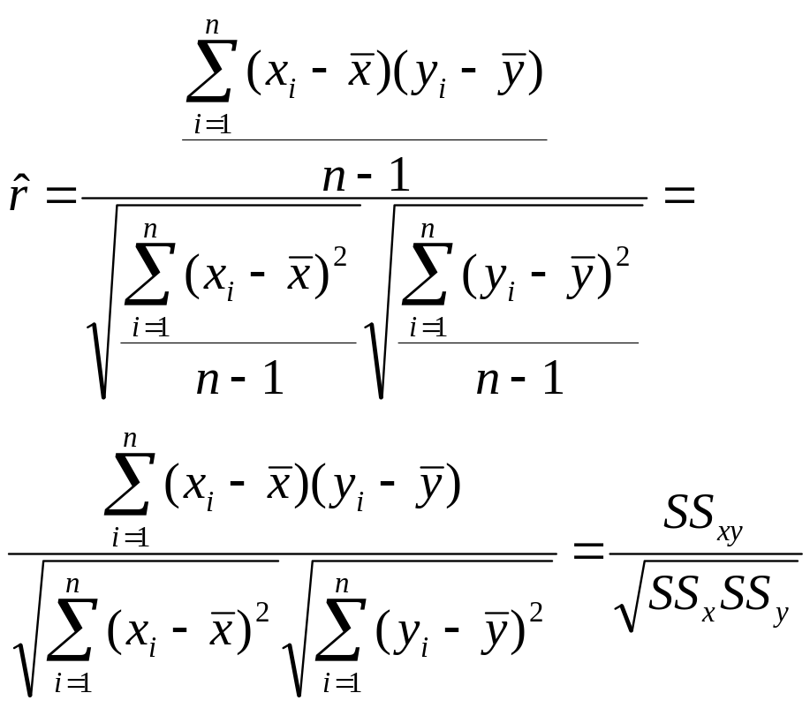
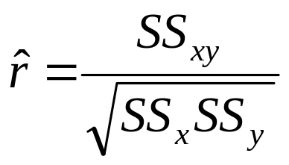
Simpler calculation formula…
Numerator of covariance
Numerators of variance

Slide 13
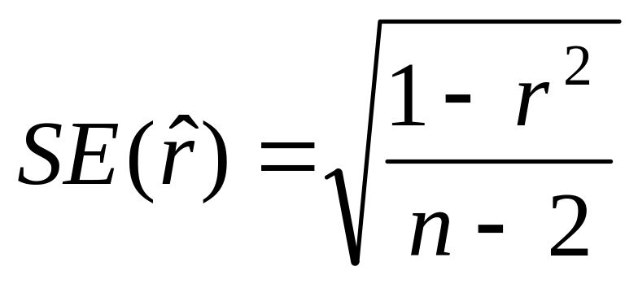
Distribution of the correlation coefficient:
The sample correlation coefficient follows a T-distribution with n-2 degrees of freedom (since you have to estimate the standard error).
*note, like a proportion, the variance of the correlation coefficient depends on the correlation coefficient itself→substitute in estimated r

Slide 14
Continuous outcome (means)
Outcome Variable | Are the observations independent or correlated? |  | Alternatives if the normality assumption is violated (and small sample size):
 | independent | correlated
Continuous (e.g. pain scale, cognitive function) | Ttest: compares means between two independent groups ANOVA: compares means between more than two independent groups Pearson’s correlation coefficient (linear correlation): shows linear correlation between two continuous variables Linear regression: multivariate regression technique used when the outcome is continuous; gives slopes | Paired ttest: compares means between two related groups (e.g., the same subjects before and after) Repeated-measures ANOVA: compares changes over time in the means of two or more groups (repeated measurements) Mixed models/GEE modeling: multivariate regression techniques to compare changes over time between two or more groups; gives rate of change over time | Non-parametric statistics Wilcoxon sign-rank test: non-parametric alternative to the paired ttest Wilcoxon sum-rank test (=Mann-Whitney U test): non-parametric alternative to the ttest Kruskal-Wallis test: non-parametric alternative to ANOVA Spearman rank correlation coefficient: non-parametric alternative to Pearson’s correlation coefficient

Slide 15
Linear regression
In correlation, the two variables are treated as equals. In regression, one variable is considered independent (=predictor) variable (X) and the other the dependent (=outcome) variable Y.

Slide 16
What is “Linear”?
Remember this:
Y=mX+B?
m
B

Slide 17
What’s Slope?
A slope of 2 means that every 1-unit change in X yields a 2-unit change in Y.

Slide 18
Prediction
If you know something about X, this knowledge helps you predict something about Y. (Sound familiar?…sound like conditional probabilities?)

Slide 19
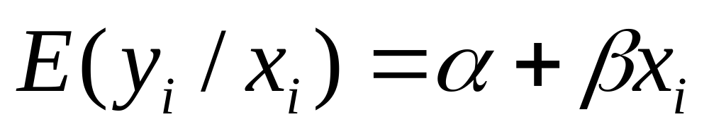
Regression equation…
Expected value of y at a given level of x=

Slide 20
Predicted value for an individual…
y_{i}= α + β*x_{i} + random error_{i}
Fixed – exactly on the line
Follows a normal distribution

Slide 21
Assumptions (or the fine print)
Linear regression assumes that…
  1. The relationship between X and Y is linear
  2. Y is distributed normally at each value of X
  3. The variance of Y at every value of X is the same (homogeneity of variances)
  4. The observations are independent

Slide 22
The standard error of Y given X is the average variability around the regression line at any given value of X. It is assumed to be equal at all values of X.
S_{y/x}
S_{y/x}
S_{y/x}
S_{y/x}
S_{y/x}
S_{y/x}

Slide 23


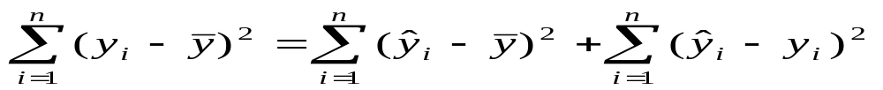
Regression Picture
y_{i}
C
A
B
y
B
A
C
y_{i}
*Least squares estimation gave us the line (β) that minimized C²
x
R²=SS_{reg}/SS_{total}
A² B² C²
SS_{total}
Total squared distance of observations from naïve mean of y
Total variation
SS_{reg}
Distance from regression line to naïve mean of y
Variability due to x (regression)
SS_{residual}
Variance around the regression line
Additional variability not explained by x—what least squares method aims to minimize

Slide 24
Recall example: cognitive function and vitamin D
Hypothetical data loosely based on [1]; cross-sectional study of 100 middle-aged and older European men.
  Cognitive function is measured by the Digit Symbol Substitution Test (DSST).
1. Lee DM, Tajar A, Ulubaev A, et al. Association between 25-hydroxyvitamin D levels and cognitive performance in middle-aged and older European men. J Neurol Neurosurg Psychiatry. 2009 Jul;80(7):722-9.

Slide 25
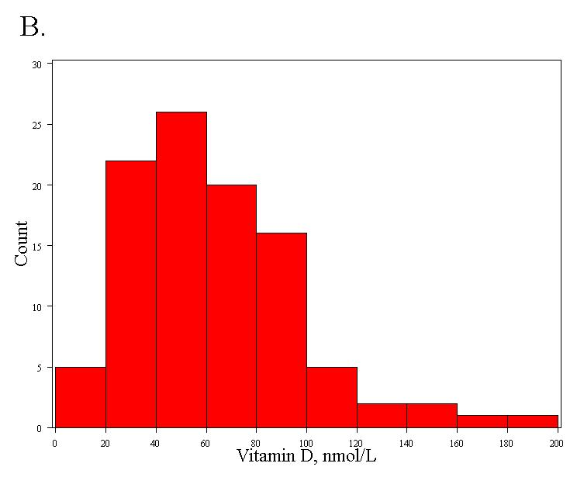
Distribution of vitamin D
Mean= 63 nmol/L
Standard deviation = 33 nmol/L

Slide 26
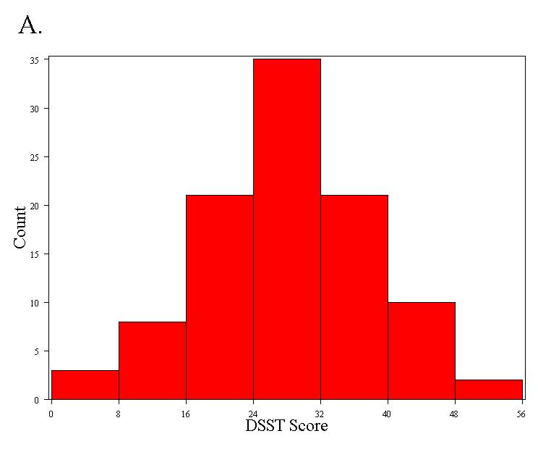
Distribution of DSST
Normally distributed
Mean = 28 points
Standard deviation = 10 points

Slide 27
Four hypothetical datasets
I generated four hypothetical datasets, with increasing TRUE slopes (between vit D and DSST):
  0
  0.5 points per 10 nmol/L
  1.0 points per 10 nmol/L
  1.5 points per 10 nmol/L

Slide 28
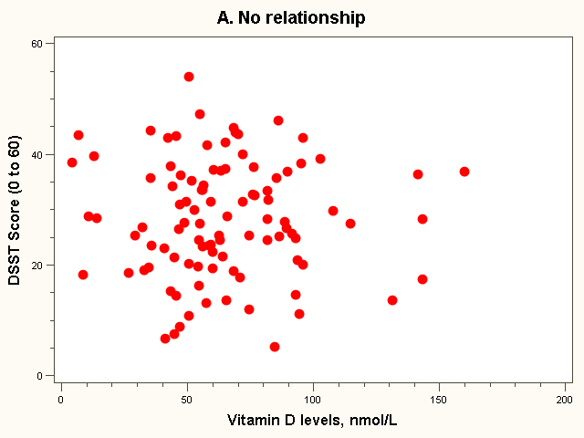
Dataset 1: no relationship

Slide 29
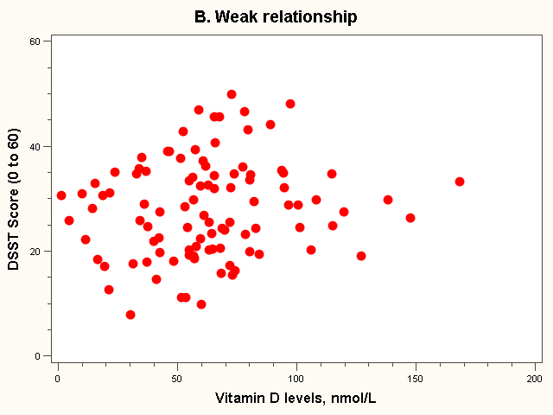
Dataset 2: weak relationship

Slide 30
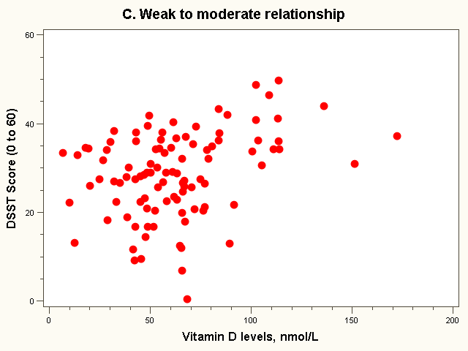
Dataset 3: weak to moderate relationship

Slide 31
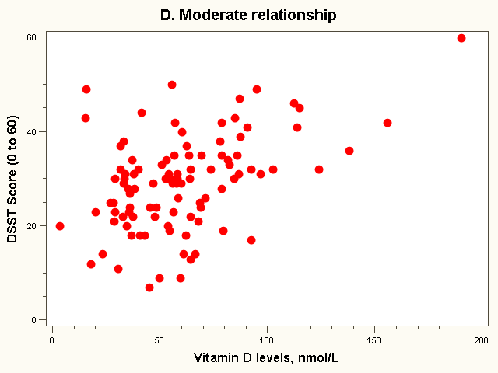
Dataset 4: moderate relationship

Slide 32
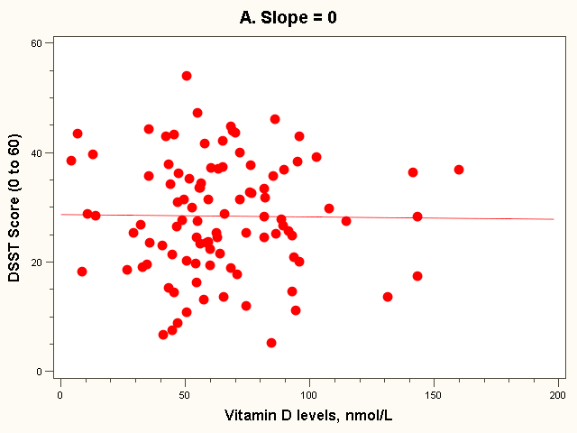
The “Best fit” line
Regression equation:
E(Y_{i}) = 28 + 0*vit D_{i} (in 10 nmol/L)

Slide 33
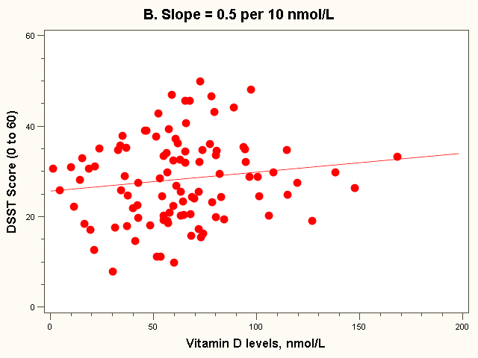
The “Best fit” line
Note how the line is a little deceptive; it draws your eye, making the relationship appear stronger than it really is!
Regression equation:
E(Y_{i}) = 26 + 0.5*vit D_{i} (in 10 nmol/L)

Slide 34
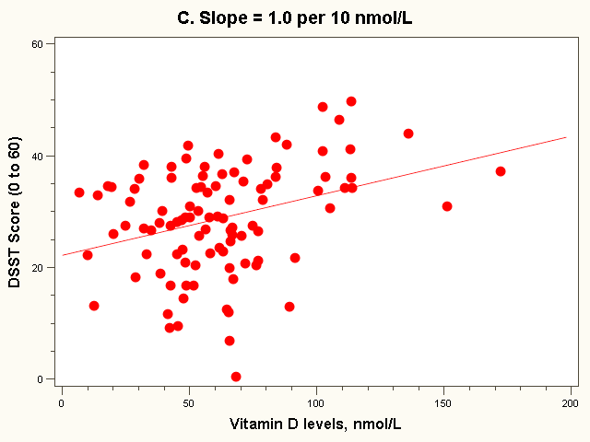
The “Best fit” line
Regression equation:
E(Y_{i}) = 22 + 1.0*vit D_{i} (in 10 nmol/L)

Slide 35
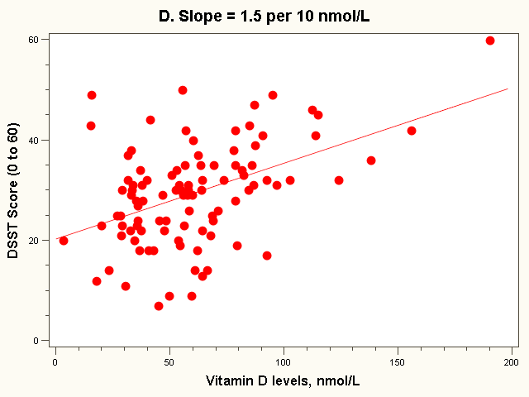
The “Best fit” line
Regression equation:
E(Y_{i}) = 20 + 1.5*vit D_{i} (in 10 nmol/L)
Note: all the lines go through the point (63, 28)!

Slide 36
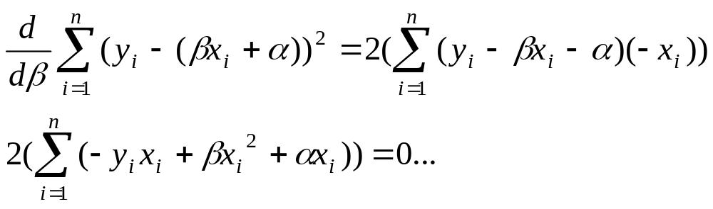
Estimating the intercept and slope: least squares estimation
** Least Squares Estimation
A little calculus….
What are we trying to estimate? β, the slope, from
What’s the constraint? We are trying to minimize the squared distance (hence the “least squares”) between the observations themselves and the predicted values , or (also called the “residuals”, or left-over unexplained variability)
Difference_{i} = y_{i} – (βx + α) Difference_{i}² = (y_{i} – (βx + α)) ²
Find the β that gives the minimum sum of the squared differences. How do you maximize a function? Take the derivative; set it equal to zero; and solve. Typical max/min problem from calculus….
From here takes a little math trickery to solve for β…

Slide 37
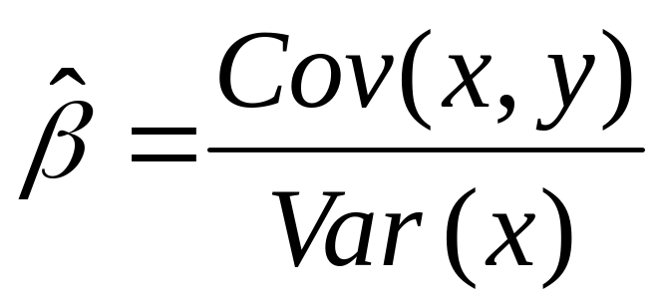
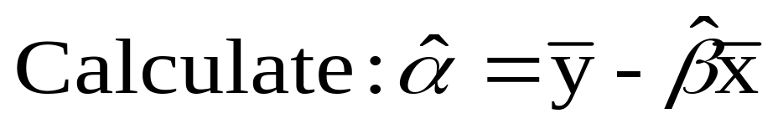
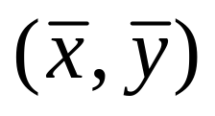
Resulting formulas…
Slope (beta coefficient) =
Intercept=
Regression line always goes through the point:

Slide 38
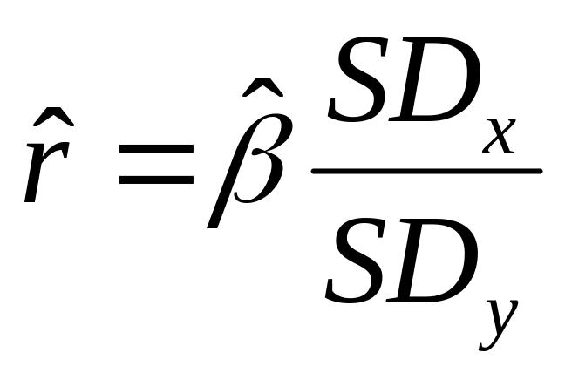
Relationship with correlation
In correlation, the two variables are treated as equals. In regression, one variable is considered independent (=predictor) variable (X) and the other the dependent (=outcome) variable Y.

Slide 39
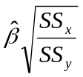
Example: dataset 4
SDx = 33 nmol/L
SDy= 10 points
Cov(X,Y) = 163 points*nmol/L
Beta = 163/33² = 0.15 points per nmol/L
= 1.5 points per 10 nmol/L
r = 163/(10*33) = 0.49
Or
r = 0.15 * (33/10) = 0.49

Slide 40

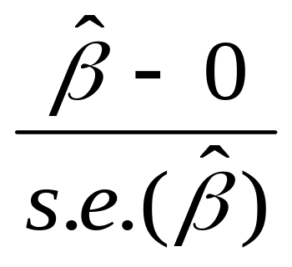
Significance testing…
Slope
Distribution of slope ~ T_{n-2}(β,s.e.( ))
  H₀: β₁ = 0 (no linear relationship)
  H₁: β₁ ≠ 0 (linear relationship does exist)
T_{n-2}=

Slide 41
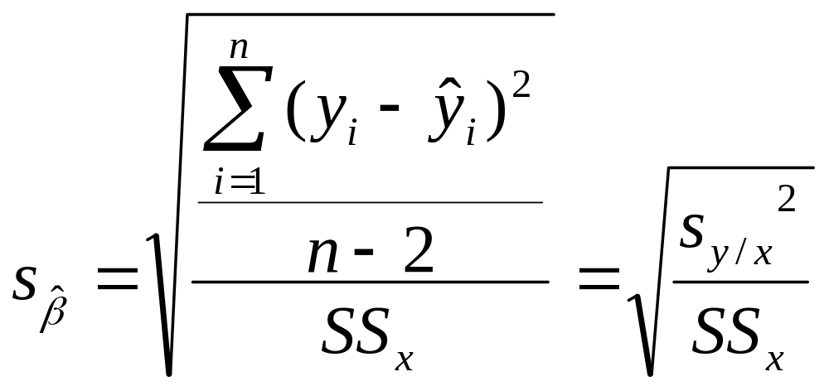
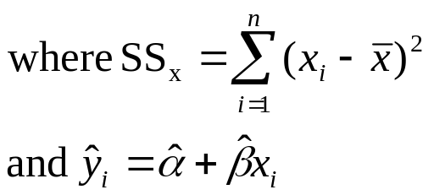
Formula for the standard error of beta (you will not have to calculate by hand!):

Slide 42
Example: dataset 4
Standard error (beta) = 0.03
T₉₈ = 0.15/0.03 = 5, p<.0001
95% Confidence interval = 0.09 to 0.21

Slide 43
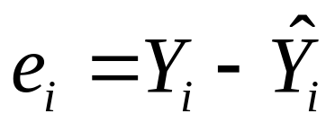
Residual Analysis: check assumptions
The residual for observation i, e_{i}, is the difference between its observed and predicted value
Check the assumptions of regression by examining the residuals
  Examine for linearity assumption
  Examine for constant variance for all levels of X (homoscedasticity)
  Evaluate normal distribution assumption
  Evaluate independence assumption
Graphical Analysis of Residuals
  Can plot residuals vs. X

Slide 44
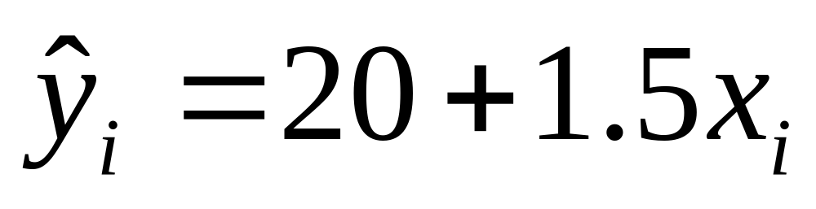
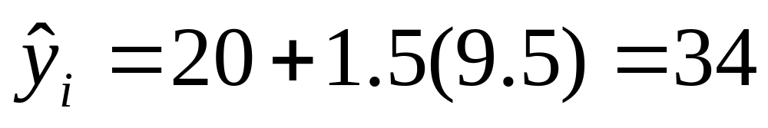
Predicted values…
For Vitamin D = 95 nmol/L (or 9.5 in 10 nmol/L):

Slide 45
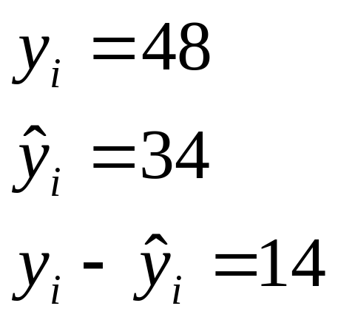
Residual = observed - predicted
X=95 nmol/L
34

Slide 46

Residual Analysis for Linearity
Y
Y
x
x
residuals
x
x
residuals
Not Linear
✓
Linear
Slide from: Statistics for Managers Using Microsoft® Excel 4th Edition, 2004 Prentice-Hall

Slide 47

Residual Analysis for
Homoscedasticity
Y
Y
x
x
residuals
x
x
residuals
✓
Non-constant variance
Constant variance
Slide from: Statistics for Managers Using Microsoft® Excel 4th Edition, 2004 Prentice-Hall

Slide 48

Residual Analysis for Independence
Not Independent
✓
Independent
residuals
X
residuals
X
residuals
X
Slide from: Statistics for Managers Using Microsoft® Excel 4th Edition, 2004 Prentice-Hall

Slide 49
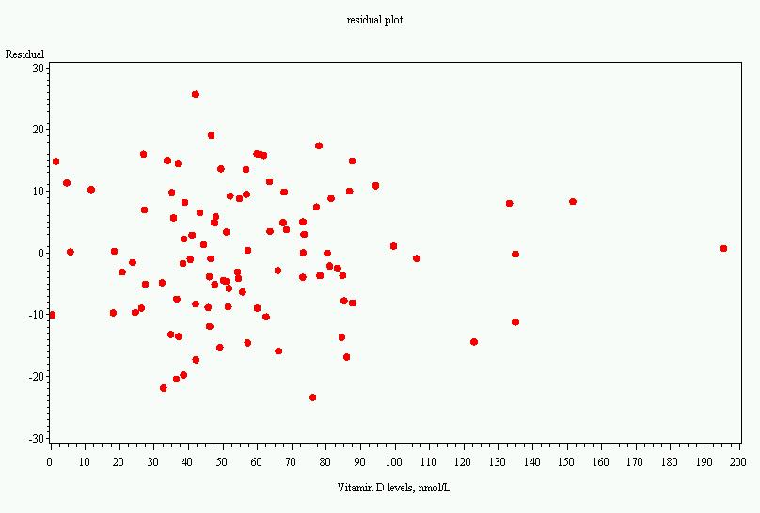
Residual plot, dataset 4

Slide 50
Multiple linear regression…
What if age is a confounder here?
  Older men have lower vitamin D
  Older men have poorer cognition
“Adjust” for age by putting age in the model:
  DSST score = intercept + slope₁xvitamin D + slope₂ xage

Slide 51
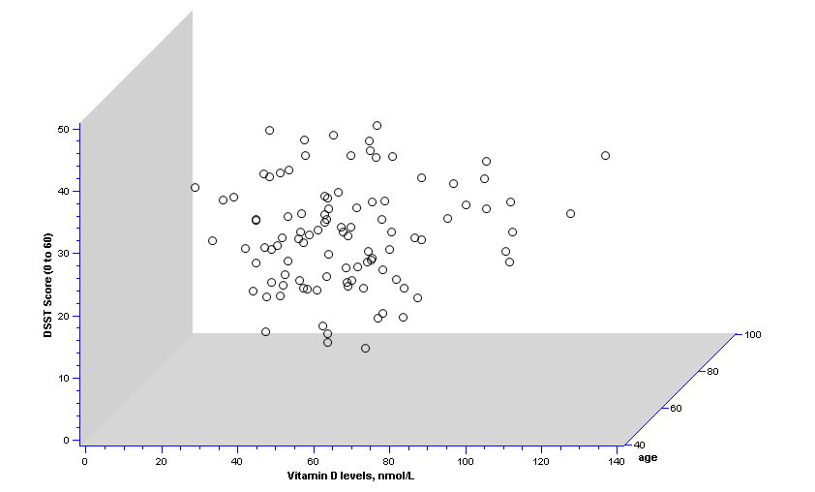
2 predictors: age and vit D…

Slide 52
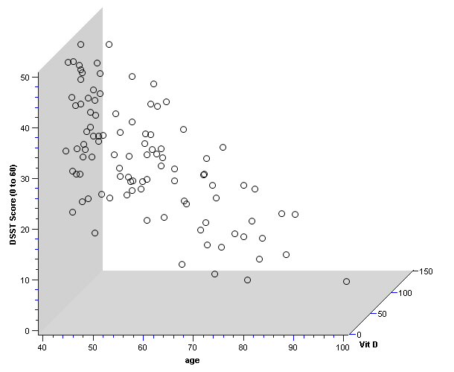
Different 3D view…

Slide 53
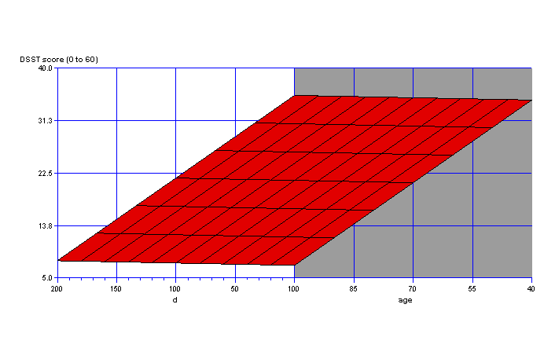
Fit a plane rather than a line…
On the plane, the slope for vitamin D is the same at every age; thus, the slope for vitamin D represents the effect of vitamin D when age is held constant.

Slide 54
Equation of the “Best fit” plane…
DSST score = 53 + 0.0039xvitamin D (in 10 nmol/L) - 0.46 xage (in years)
P-value for vitamin D >>.05
P-value for age <.0001
Thus, relationship with vitamin D was due to confounding by age!

Slide 55
Multiple Linear Regression
More than one predictor…
E(y)= α + β₁*X + β₂ *W + β₃ *Z…
Each regression coefficient is the amount of change in the outcome variable that would be expected per one-unit change of the predictor, if all other variables in the model were held constant.

Slide 56
Functions of multivariate analysis:
Control for confounders
Test for interactions between predictors (effect modification)
Improve predictions

Slide 57
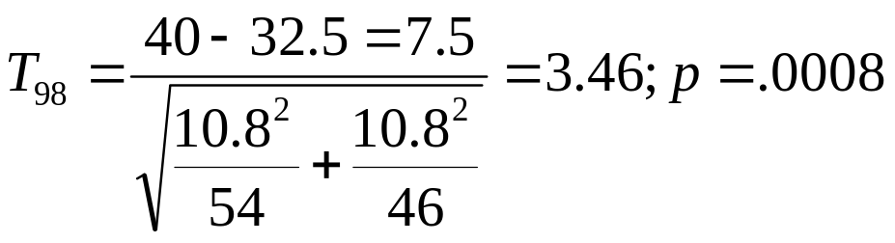
A ttest is linear regression!
Divide vitamin D into two groups:
  Insufficient vitamin D (<50 nmol/L)
  Sufficient vitamin D (>=50 nmol/L), reference group
We can evaluate these data with a ttest or a linear regression…

Slide 58
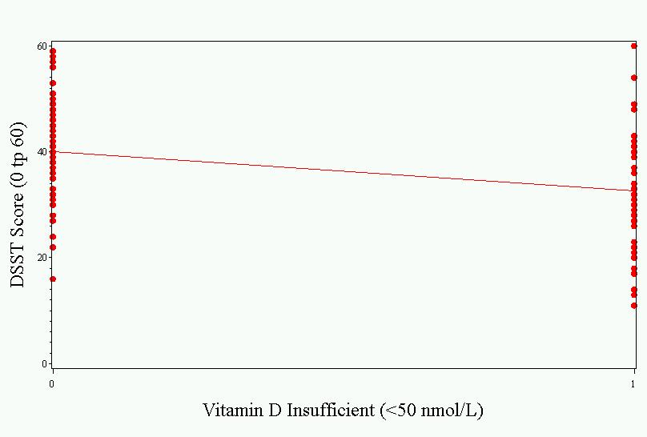
As a linear regression…
Intercept represents the mean value in the sufficient group.
Slope represents the difference in means between the groups. Difference is significant.
Parameter ````````````````Standard
Variable Estimate Error t Value Pr > |t|
Intercept 40.07407 1.47511 27.17 <.0001
insuff -7.53060 2.17493 -3.46 0.0008

Slide 59
ANOVA is linear regression!
Divide vitamin D into three groups:
  Deficient (<25 nmol/L)
  Insufficient (>=25 and <50 nmol/L)
  Sufficient (>=50 nmol/L), reference group
DSST= α (=value for sufficient) + β_{insufficient}*(1 if insufficient) + β₂ *(1 if deficient)
This is called “dummy coding”—where multiple binary variables are created to represent being in each category (or not) of a categorical variable

Slide 60
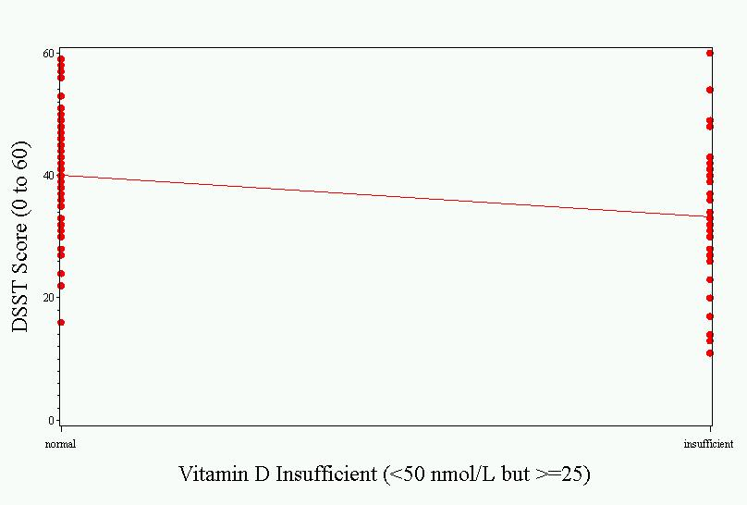
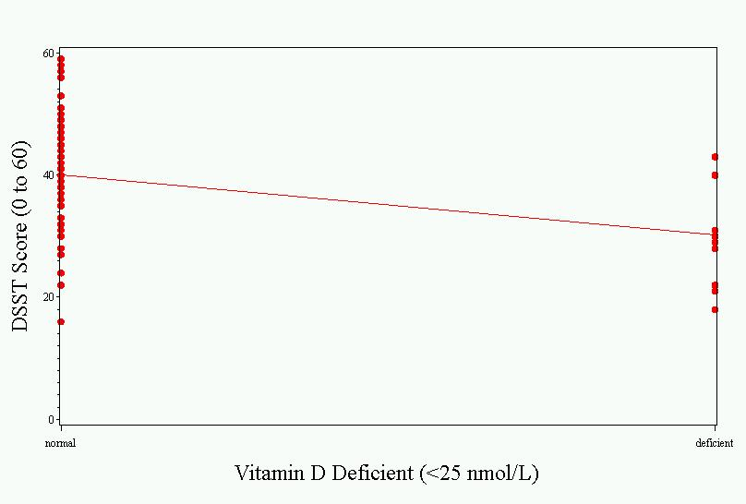
The picture…
Sufficient vs. Insufficient
Sufficient vs. Deficient

Slide 61
Results…
Parameter Estimates
Parameter Standard
Variable DF Estimate Error t Value Pr > |t|
Intercept 1 40.07407 1.47817 27.11 <.0001
deficient 1 -9.87407 3.73950 -2.64 0.0096
insufficient 1 -6.87963 2.33719 -2.94 0.0041
Interpretation:
  The deficient group has a mean DSST 9.87 points lower than the reference (sufficient) group.
  The insufficient group has a mean DSST 6.87 points lower than the reference (sufficient) group.

Slide 62
Other types of multivariate regression
Multiple linear regression is for normally distributed outcomes
Logistic regression is for binary outcomes
Cox proportional hazards regression is used when time-to-event is the outcome

Slide 63
Common multivariate regression models.
Outcome (dependent variable) | Example outcome variable | Appropriate multivariate regression model | Example equation | What do the coefficients give you?
Continuous | Blood pressure | Linear regression | blood pressure (mmHg) = α + βsalt*salt consumption (tsp/day) + βage*age (years) + βsmoker*ever smoker (yes=1/no=0) | slopes—tells you how much the outcome variable increases for every 1-unit increase in each predictor.
Binary | High blood pressure (yes/no) | Logistic regression | ln (odds of high blood pressure) = α + βsalt*salt consumption (tsp/day) + βage*age (years) + βsmoker*ever smoker (yes=1/no=0) | odds ratios—tells you how much the odds of the outcome increase for every 1-unit increase in each predictor.
Time-to-event | Time-to- death | Cox regression | ln (rate of death) = α + βsalt*salt consumption (tsp/day) + βage*age (years) + βsmoker*ever smoker (yes=1/no=0) | hazard ratios—tells you how much the rate of the outcome increases for every 1-unit increase in each predictor.

Slide 64
Multivariate regression pitfalls
Multi-collinearity
Residual confounding
Overfitting

Slide 65
Multicollinearity
Multicollinearity arises when two variables that measure the same thing or similar things (e.g., weight and BMI) are both included in a multiple regression model; they will, in effect, cancel each other out and generally destroy your model.
Model building and diagnostics are tricky business!

Slide 66
Residual confounding
You cannot completely wipe out confounding simply by adjusting for variables in multiple regression unless variables are measured with zero error (which is usually impossible).
Example: meat eating and mortality

Slide 67
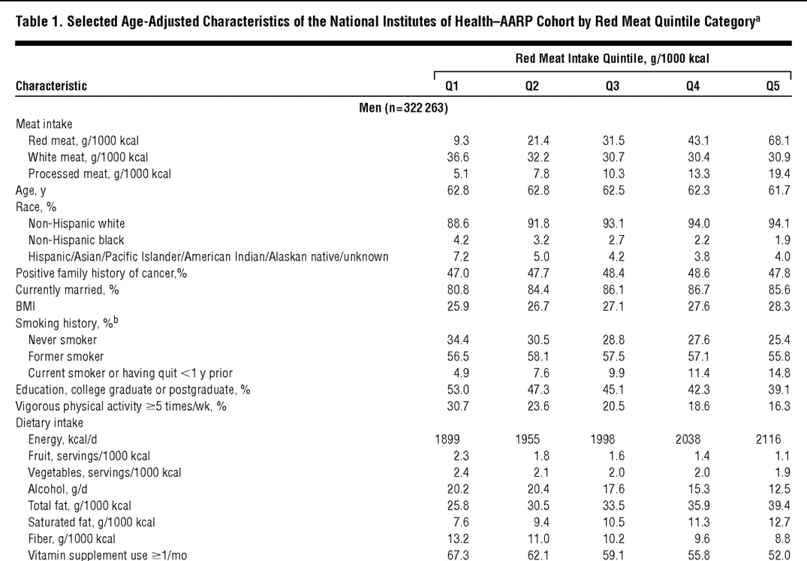
Men who eat a lot of meat are unhealthier for many reasons!
Sinha R, Cross AJ, Graubard BI, Leitzmann MF, Schatzkin A. Meat intake and mortality: a prospective study of over half a million people. Arch Intern Med 2009;169:562-71

Slide 68
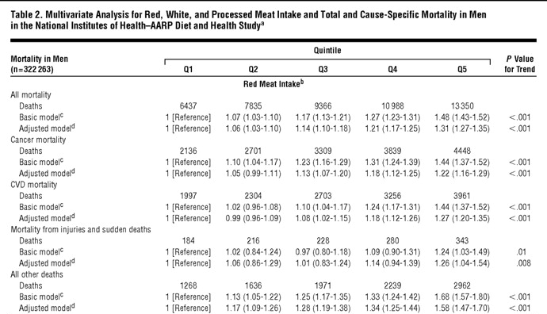
Mortality risks…
Sinha R, Cross AJ, Graubard BI, Leitzmann MF, Schatzkin A. Meat intake and mortality: a prospective study of over half a million people. Arch Intern Med 2009;169:562-71

Slide 69
Overfitting
In multivariate modeling, you can get highly significant but meaningless results if you put too many predictors in the model.
The model is fit perfectly to the quirks of your particular sample, but has no predictive ability in a new sample.

Slide 70
Overfitting: class data example
I asked SAS to automatically find predictors of optimism in our class dataset. Here’s the resulting linear regression model:
Parameter Standard
Variable Estimate Error Type II SS F Value Pr > F
Intercept 11.80175 2.98341 11.96067 15.65 0.0019
exercise -0.29106 0.09798 6.74569 8.83 0.0117
sleep -1.91592 0.39494 17.98818 23.53 0.0004
obama 1.73993 0.24352 39.01944 51.05 <.0001
Clinton -0.83128 0.17066 18.13489 23.73 0.0004
mathLove 0.45653 0.10668 13.99925 18.32 0.0011
Exercise, sleep, and high ratings for Clinton are negatively related to optimism (highly significant!) and high ratings for Obama and high love of math are positively related to optimism (highly significant!).

Slide 71
If something seems to good to be true…
Clinton, univariate:
Parameter Standard
Variable Label DF Estimate Error t Value Pr > |t|
Intercept Intercept 1 5.43688 2.13476 2.55 0.0188
Clinton Clinton 1 0.24973 0.27111 0.92 0.3675
Sleep, Univariate:
Parameter Standard
Variable Label DF Estimate Error t Value Pr > |t|
Intercept Intercept 1 8.30817 4.36984 1.90 0.0711
sleep sleep 1 -0.14484 0.65451 -0.22 0.8270
Exercise, Univariate:
Parameter Standard
Variable Label DF Estimate Error t Value Pr > |t|
Intercept Intercept 1 6.65189 0.89153 7.46 <.0001
exercise exercise 1 0.19161 0.20709 0.93 0.3658

Slide 72
More univariate models…
Obama, Univariate:
Parameter Standard
Variable Label DF Estimate Error t Value Pr > |t|
Intercept Intercept 1 0.82107 2.43137 0.34 0.7389
obama obama 1 0.87276 0.31973 2.73 0.0126
Compare with multivariate result; p<.0001
Love of Math, univariate:
Parameter Standard
Variable Label DF Estimate Error t Value Pr > |t|
Intercept Intercept 1 3.70270 1.25302 2.96 0.0076
mathLove mathLove 1 0.59459 0.19225 3.09 0.0055
Compare with multivariate result; p=.0011

Slide 73
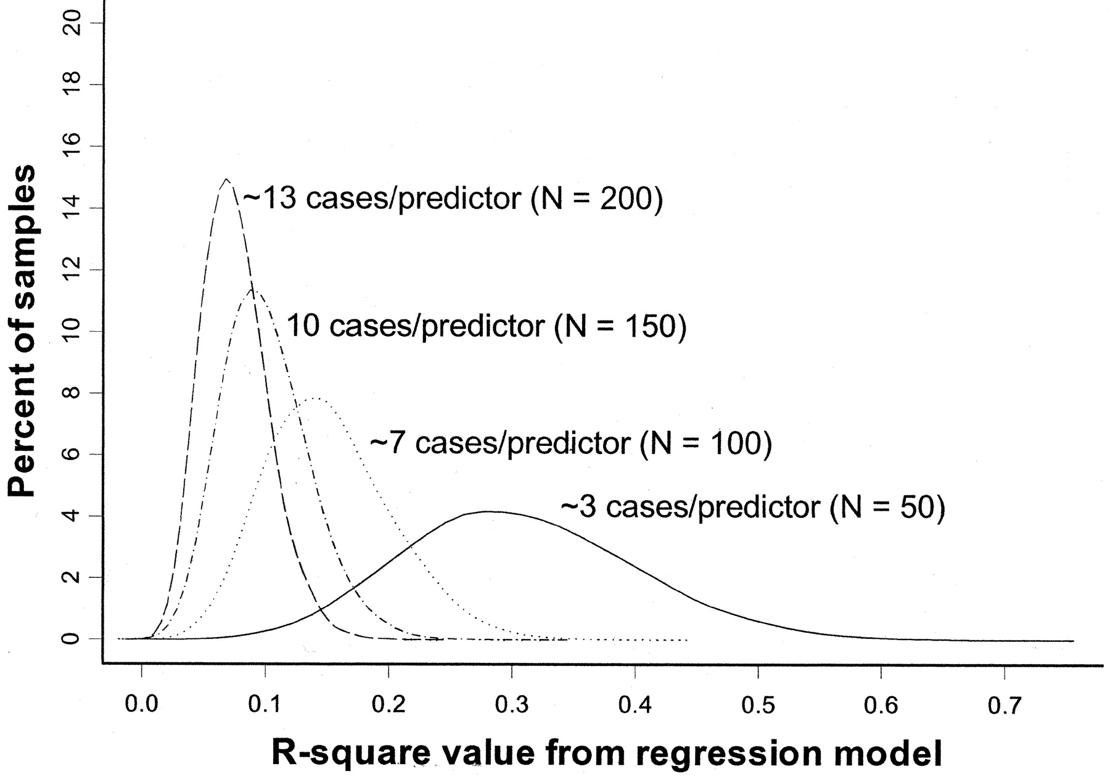
Overfitting
Rule of thumb: You need at least 10 subjects for each additional predictor variable in the multivariate regression model.
Pure noise variables still produce good R² values if the model is overfitted. The distribution of R² values from a series of simulated regression models containing only noise variables.
(Figure 1 from: Babyak, MA. What You See May Not Be What You Get: A Brief, Nontechnical Introduction to Overfitting in Regression-Type Models. Psychosomatic Medicine 66:411-421 (2004).)

Slide 74
Review of statistical tests
The following table gives the appropriate choice of a statistical test or measure of association for various types of data (outcome variables and predictor variables) by study design.
e.g., blood pressure= pounds + age + treatment (1/0)
Continuous outcome
Continuous predictors
Binary predictor

Slide 75
Types of variables to be analyzed
Statistical procedure
or measure of association
Predictor variable/s
Outcome variable
Cross-sectional/case-control studies
Binary (two groups)
Continuous
T-test
Binary
Ranks/ordinal
Wilcoxon rank-sum test
Categorical (>2 groups)
Continuous
ANOVA
Continuous
Continuous
Simple linear regression
Multivariate
(categorical and continuous)
Continuous
Multiple linear regression
Categorical
Categorical
Chi-square test (or Fisher’s exact)
Binary
Binary
Odds ratio, risk ratio
Multivariate
Binary
Logistic regression
Cohort Studies/Clinical Trials
Binary
Binary
Risk ratio
Categorical
Time-to-event
Kaplan-Meier/ log-rank test
Multivariate
Time-to-event
Cox-proportional hazards regression, hazard ratio
Categorical
Continuous
Repeated measures ANOVA
Multivariate
Continuous
Mixed models; GEE modeling

Slide 76
Alternative summary: statistics for various types of outcome data
Outcome Variable | Are the observations independent or correlated? |  | Assumptions
 | independent | correlated
Continuous (e.g. pain scale, cognitive function) | Ttest ANOVA Linear correlation Linear regression | Paired ttest Repeated-measures ANOVA Mixed models/GEE modeling | Outcome is normally distributed (important for small samples). Outcome and predictor have a linear relationship.
Binary or categorical (e.g. fracture yes/no) | Difference in proportions Relative risks Chi-square test Logistic regression | McNemar’s test Conditional logistic regression GEE modeling | Chi-square test assumes sufficient numbers in each cell (>=5)
Time-to-event (e.g. time to fracture) | Kaplan-Meier statistics Cox regression | n/a | Cox regression assumes proportional hazards between groups

Slide 77
Continuous outcome (means); HRP 259/HRP 262
Outcome Variable | Are the observations independent or correlated? |  | Alternatives if the normality assumption is violated (and small sample size):
 | independent | correlated
Continuous (e.g. pain scale, cognitive function) | Ttest: compares means between two independent groups ANOVA: compares means between more than two independent groups Pearson’s correlation coefficient (linear correlation): shows linear correlation between two continuous variables Linear regression: multivariate regression technique used when the outcome is continuous; gives slopes | Paired ttest: compares means between two related groups (e.g., the same subjects before and after) Repeated-measures ANOVA: compares changes over time in the means of two or more groups (repeated measurements) Mixed models/GEE modeling: multivariate regression techniques to compare changes over time between two or more groups; gives rate of change over time | Non-parametric statistics Wilcoxon sign-rank test: non-parametric alternative to the paired ttest Wilcoxon sum-rank test (=Mann-Whitney U test): non-parametric alternative to the ttest Kruskal-Wallis test: non-parametric alternative to ANOVA Spearman rank correlation coefficient: non-parametric alternative to Pearson’s correlation coefficient

Slide 78
Binary or categorical outcomes (proportions); HRP 259/HRP 261
Outcome Variable | Are the observations correlated? |  | Alternative to the chi-square test if sparse cells:
 | independent | correlated
Binary or categorical (e.g. fracture, yes/no) | Chi-square test: compares proportions between two or more groups Relative risks: odds ratios or risk ratios Logistic regression: multivariate technique used when outcome is binary; gives multivariate-adjusted odds ratios | McNemar’s chi-square test: compares binary outcome between correlated groups (e.g., before and after) Conditional logistic regression: multivariate regression technique for a binary outcome when groups are correlated (e.g., matched data) GEE modeling: multivariate regression technique for a binary outcome when groups are correlated (e.g., repeated measures) | Fisher’s exact test: compares proportions between independent groups when there are sparse data (some cells <5). McNemar’s exact test: compares proportions between correlated groups when there are sparse data (some cells <5).

Slide 79
Time-to-event outcome (survival data); HRP 262
Outcome Variable | Are the observation groups independent or correlated? |  | Modifications to Cox regression if proportional-hazards is violated:
 | independent | correlated
Time-to-event (e.g., time to fracture) | Kaplan-Meier statistics: estimates survival functions for each group (usually displayed graphically); compares survival functions with log-rank test Cox regression: Multivariate technique for time-to-event data; gives multivariate-adjusted hazard ratios | n/a (already over time) | Time-dependent predictors or time-dependent hazard ratios (tricky!)

