Slide 1
KoolKanya
Tag Classification & Recommendation Engine Project
Project Update: 26th May 2020

Slide 2
Work So Far
Data Exploration & Descriptive Analysis: 25 Apr to 1 May (1 Week)
Tag Classification (2 week):
  Feature Generation:
    Count Vectors
    Word TFIDF
    N-gram TFIDF
    Character level TFIDF
  ML Algorithms Tried:
    Naive Bayes Classifier
    Support Vector Machines (SVM)
    Random Forest
    XG Boost
    Shallow Neural Networks
  NLP based hashtag classification model
  The Model predicts only the primary hashtags as the data around secondary hashtag is too sparse
  The model predicts the top 3 hashtags for each post

Slide 3
Work So Far
Recommender Engine (2 weeks):
    Popularity Based Model – Popularity of the Posts based on interactions on post by user
    Content Based Recommender Engine – Recommend Post based on the content of post with which the user had interacted in the past
    User to User Collaborative Filtering – Determine the closest N Users based on the kind of post the users have interacted in the past
    SVD based Collaborative Filtering – With Matrix Factorisation determine the implicit rating (liking) of user for each post. Use the affinity matrix for Post recommendation
    Hybrid (Content + SVD based) Recommender Engine – Using both Content based recommendations and SVD based collaborative filtering technique

Slide 4
Challenges / Inputs Needed
Challenges
  Relatively low data in terms of Feed data
  Low interaction of users with the post i.e. Out of the users who had interacted with the Feeds more than 50% of the users have interaction with a single post / feed
  Class imbalance in Hashtags i.e. few hashtags like starting-out and career growth are more frequent compared to other hashtags
Inputs
  Need access to Tag classification API
  Need inputs on any parameters for finalising the recommendations and ranking them e.g. recency, promoted, etc.

Slide 5
Next Steps
Tag Classification:
  Explore the API based Tag classification (Kool Kanya to provide access)
  Evaluate the accuracy of Tag classification API and decide if the NLP based classification can assist in improving accuracy
Recommender System
  Optimise the algorithms for Accuracy improvement
  Currently new customers without historical interactions are predicted using popularity model
  Introduce recency to recommendation prediction
  Any other factors to be considered for generating final recommendation List as per Kool Kanya
Code Standardisation & Automation
  Automate and Standardise codes for implementation
  Develop model APIs for deployment

Slide 6
Some Numbers
No of Feeds stabilised in April and May with very low numbers in Jan, Feb
Average Post per day in April, May – approx 30 per day
Average Hashtag per post – approx 3
Average Likes per post – 2 to 3
Average Comments per post – 3 to 4
No of Feeds till date – approx 2,500
Likes on Post – approx 3,800
Bookmarks of Post – 250
Comments/Subcomments on Post – approx 7,200

Slide 7
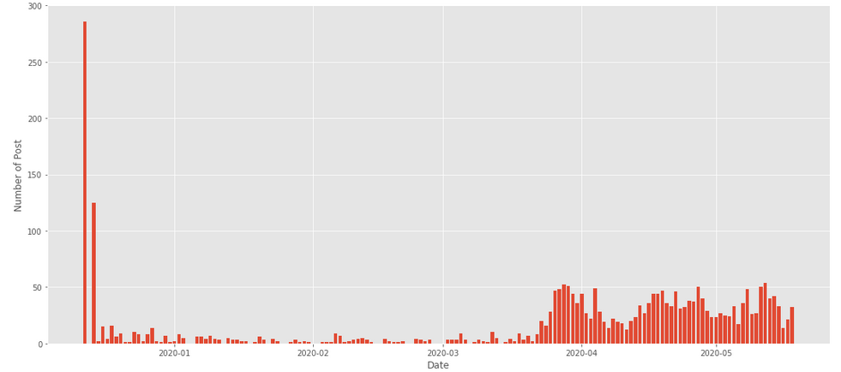
Post per Day

Slide 8
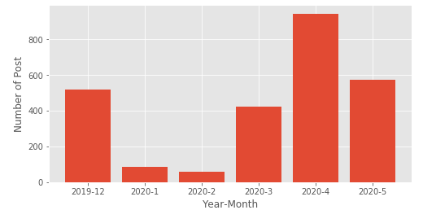
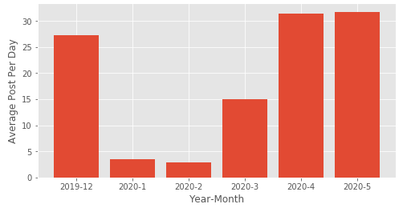
Post Per Month

Slide 9
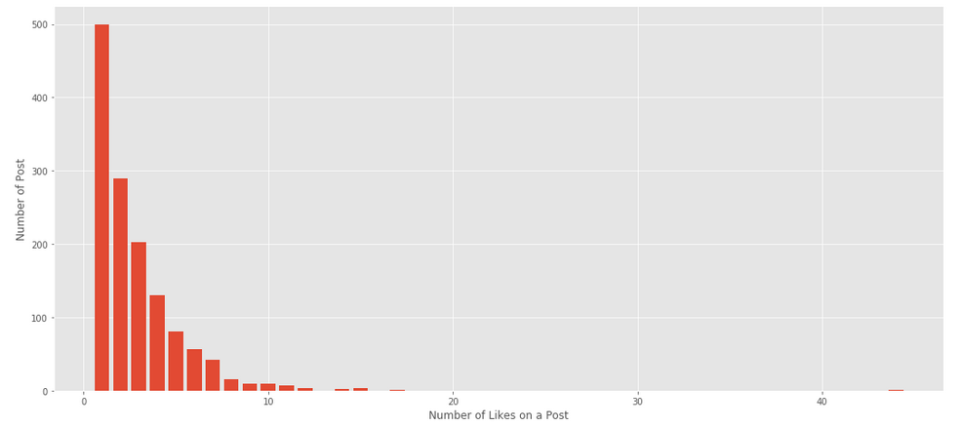
Likes in a Post

Slide 10
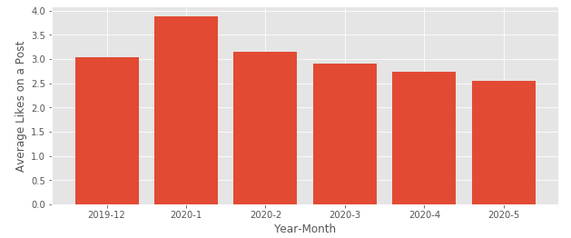
Avg Likes Per Post by Month

Slide 11
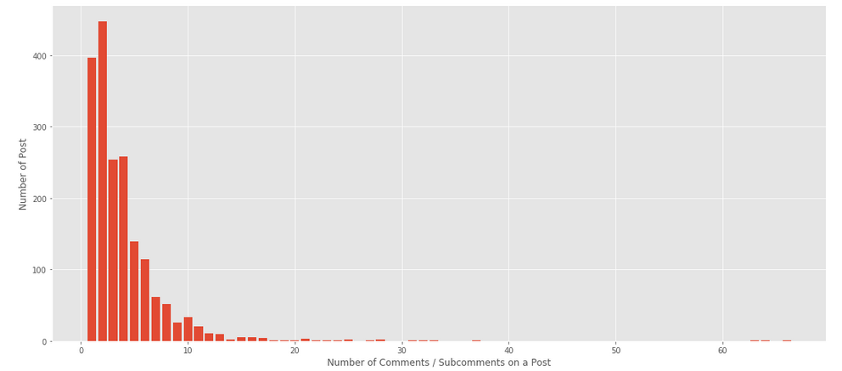
Comments in a Post

Slide 12
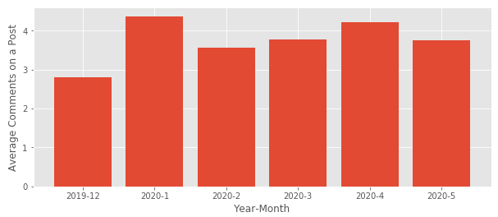
Avg Comments in a Post by Month

Slide 13
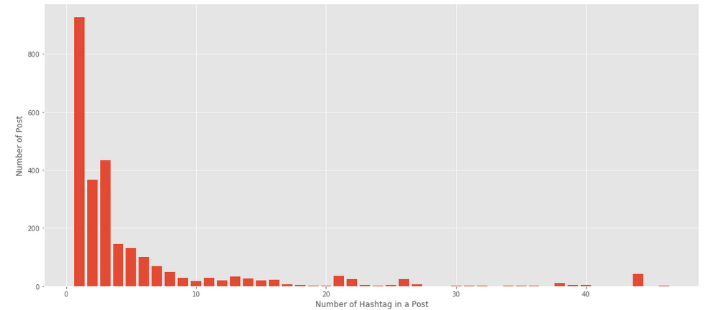
Hashtag in a Post

Slide 14
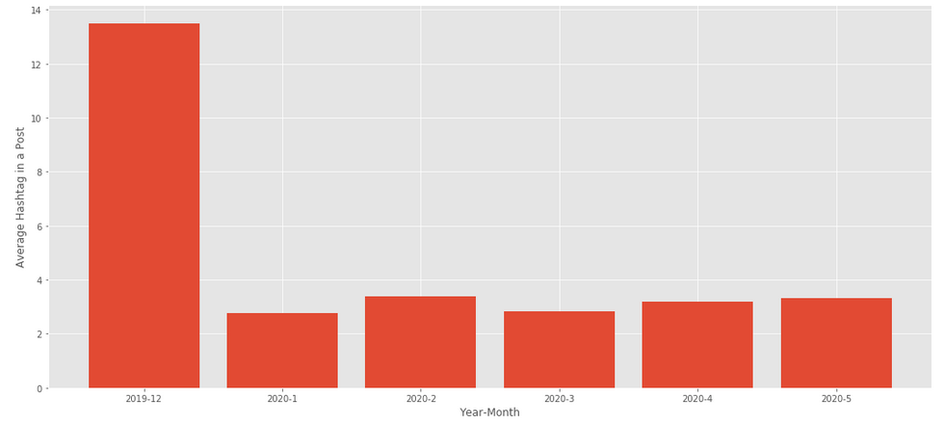
Avg Hashtags in a Post by Month

Slide 15
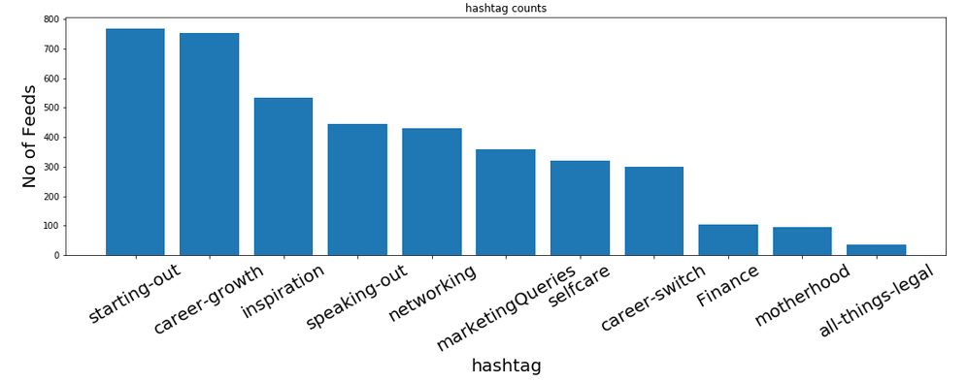
Primary Hashtag Distribution

Slide 16
Thank You

