Slide 1
KoolKanya Tag Classification & Recommendation Engine Project Project Update: 26th May 2020

Slide 2
Work So Far
Data Exploration & Descriptive Analysis: Start 25 Apr (1 Week)
Tag Classification (2 week):
Feature Generation:
Count Vectors
Word TFIDF
N-gram TFIDF
Character level TFIDF
ML Algorithms Tried:
Naive Bayes Classifier
Support Vector Machines (SVM)
Random Forest
XG Boost
Shallow Neural Networks
NLP based hashtag classification model
The Model predicts only the primary hashtags as the data around secondary hashtag is too sparse
The model predicts the top 3 hashtags for each post

Slide 3
Work So Far
Recommender Engine (2 weeks):
Popularity Based Model – Popularity of the Posts based on interactions on post by user
Content Based Recommender Engine – Recommend Post based on the content of post with which the user had interacted in the past
User to User Collaborative Filtering – Determine the closest N Users based on the kind of post the users have interacted in the past

Slide 4
Next Steps
Tag Classification
Explore the API based Tag classification (Kool Kanya to provide access)
Evaluate the accuracy of Tag classification API and decide if the NLP based classification can assist in improving accuracy
Recommender Engine
SVD based Collaborative Filtering – With Matrix Factorisation determine the implicit rating (liking) of user for each post. Use the affinity matrix for Post recommendation
Hybrid (Content + SVD based) Recommender Engine – Use combination of techniques
Optimise the algorithms for Accuracy improvement
Currently new customers without historical interactions are predicted using popularity model
Introduce recency to recommendation prediction
Any other factors to be considered for generating final recommendation List as per Kool Kanya
Code Standardisation & Automation
Automate and Standardise codes for implementation
Develop model APIs for deployment

Slide 5
Challenges / Inputs Needed
Challenges
Relatively low data in terms of Feed data
Low interaction of users with the post i.e. Out of the users who had interacted with the Feeds more than 50% of the users have interaction with a single post / feed
Class imbalance in Hashtags i.e. few hashtags like starting-out and career growth are more frequent compared to other hashtags
Inputs
Need access to Tag classification API
Need inputs on any parameters for finalising the recommendations and ranking them e.g. recency, promoted post, etc.

Slide 6

Appendix

Slide 7
Some Numbers
No of Feeds stabilised in April and May with very low numbers in Jan, Feb
Average Post per day in April, May – approx 30 per day
Average Hashtag per post – approx 3
Average Likes per post – 2 to 3
Average Comments per post – 3 to 4
No of Feeds till date – approx 2,500
Likes on Post – approx 3,800
Bookmarks of Post – 250
Comments/Subcomments on Post – approx 7,200

Slide 8
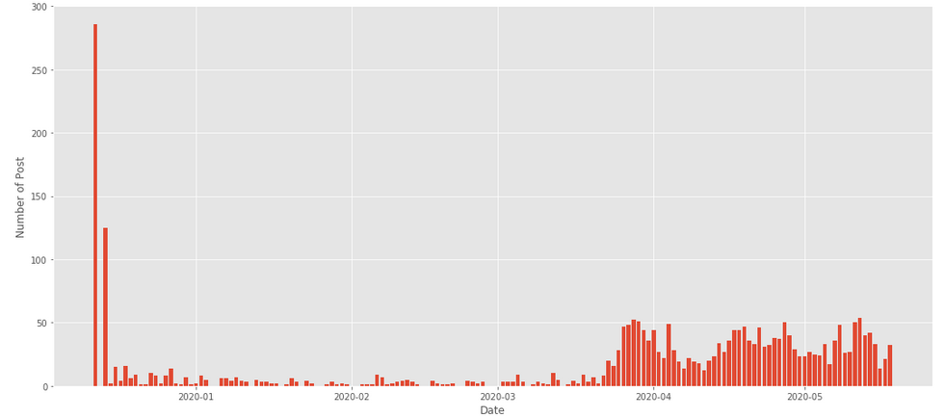
Post per Day

Slide 9
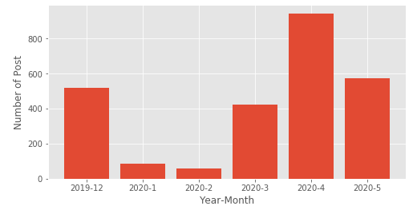
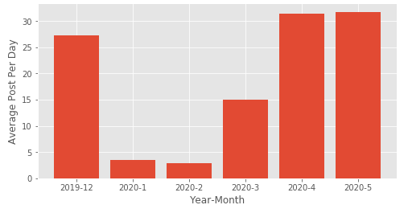
Post Per Month

Slide 10
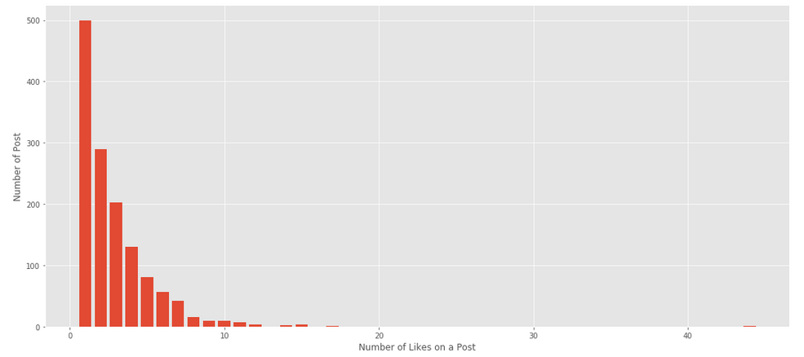
Likes in a Post

Slide 11
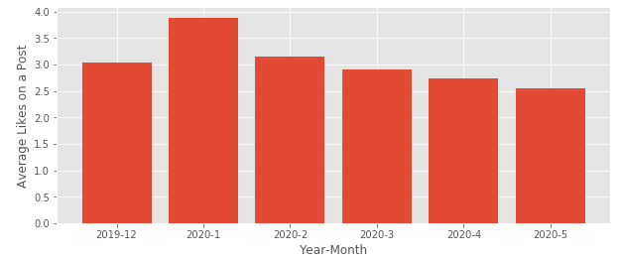
Avg. Likes Per Post by Month

Slide 12
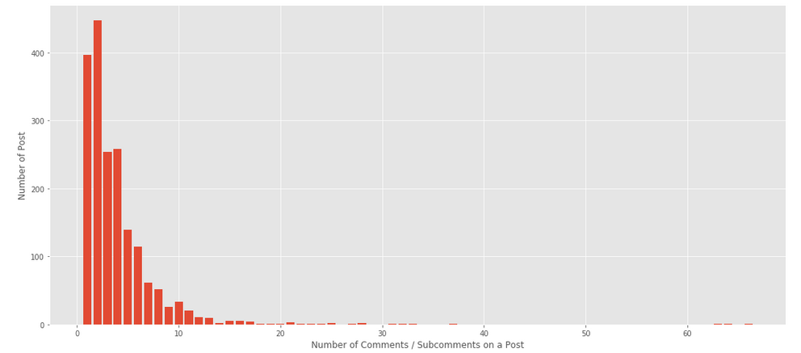
Comments in a Post

Slide 13
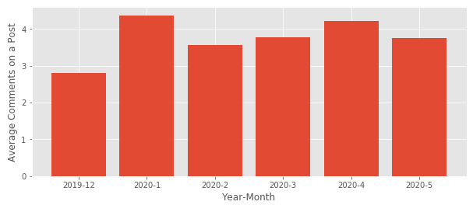
Avg. Comments in a Post by Month

Slide 14
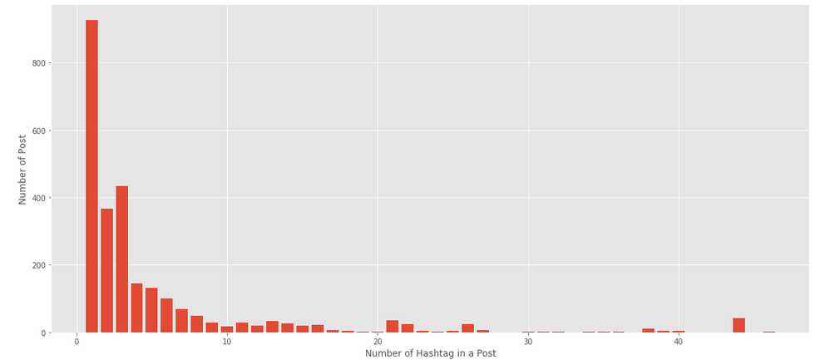
Hashtag in a Post

Slide 15
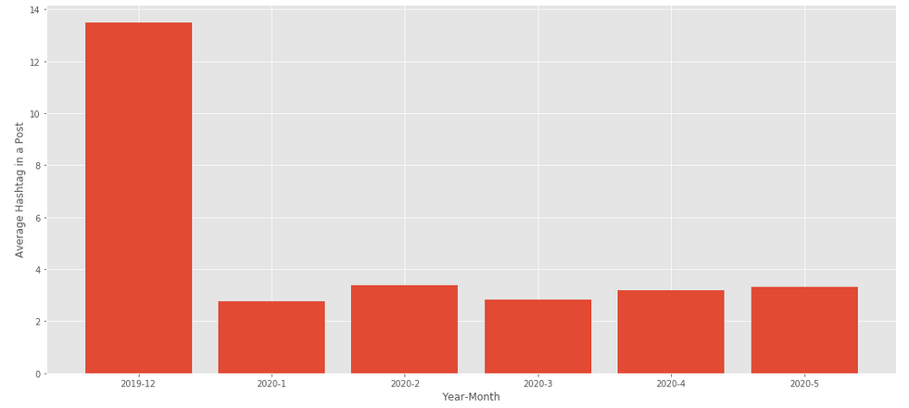
Avg. Hashtags in a Post by Month

Slide 16
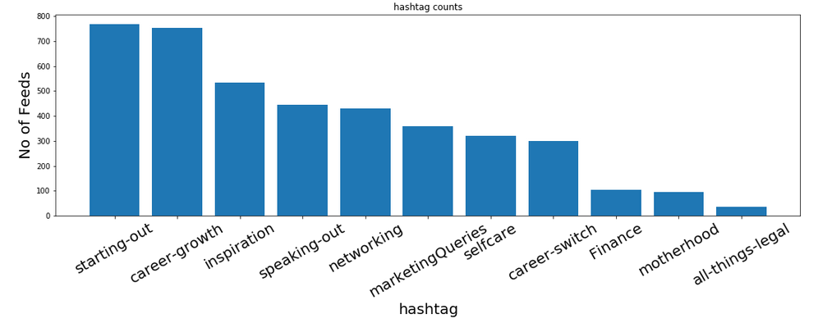
Primary Hashtag Distribution

Slide 17

Thank YOU

