Slide 1





Intrusion Detection System Using Machine Learning
-By Ashish Kumar Pandey

Slide 2
Understanding Network Intrusion Detection System
Definition of Intrusion
An intrusion detection system (IDS) is a software application that monitors network or system activities for malicious activities or policy violations and produces reports to a management station
Types of Intrusions
Network intrusions can be categorized as unauthorized access, denial of service, and malicious software activities, all of which pose significant threats to network security.
Importance of IDS
IDS plays a crucial role in identifying and responding to security breaches, providing an additional layer of defense against cyber threats.

Slide 3
Traditional IDS vs. ML-Based IDS
Traditional IDS
Signature-based IDS relies on a database of known attack patterns, making it effective but limited in detecting new and unknown threats.
ML-Based IDS
Machine learning-based IDS leverages algorithms to analyze network traffic patterns, enabling the detection of anomalies and previously unseen attack patterns, enhancing the overall security posture.

Slide 4
Advantage of ML-Based IDS
1.Improved Detection Accuracy
2. Adaptability to Evolving Threats
3. Reduced False Positives
4. Detection of Unknown Threats
5. Automated Response and Remediation
6. Scalability and Efficiency

Slide 5



Supervised Learning for IDS
Training Data
Supervised learning algorithms utilize labeled datasets to train models to recognize patterns associated with normal and malicious network behavior.
Classification Algorithms
Techniques such as decision trees, random forests, and support vector machines are commonly employed to classify network traffic as benign or malicious.

Slide 6
Unsupervised Learning for Anomaly Detection
Identifying Anomalies
Unsupervised learning algorithms, including clustering and autoencoders, are adept at detecting deviations from normal network behavior without the need for labeled data.
Novelty Detection
Anomaly detection techniques are instrumental in identifying previously unseen attack patterns and zero-day exploits, enhancing the IDS's ability to adapt to evolving threats.

Slide 7









Actual Vs Predicted

Slide 8
Mitigatin Steps for Any Intrusion
Isolation and Containment: Immediately isolate affected systems or networks to prevent further read of the intrusion. Disconnect compromised devices from the network to contain the damage and limit the attacker's ability to move laterally.
Change Credentials: Reset passwords and revoke compromised credentials to prevent unauthorized access. Encourage users to update their passwords following best practices for password hygiene, such as using strong and unique passwords for each account.
Patch and Update: Identify and patch vulnerabilities exploited by the intruder to prevent similar attacks in the future. Apply security updates and patches to software, operating systems, and firmware to address known vulnerabilities and strengthen the security posture of the infrastructure.
Implement Defense in Depth: Deploy multiple layers of defense, including firewalls, antivirus software, intrusion detection systems, and access controls, to protect against various attack vectors. Implementing a defense-in-depth strategy helps mitigate the risk of successful intrusions by providing multiple layers of protection.

Slide 9
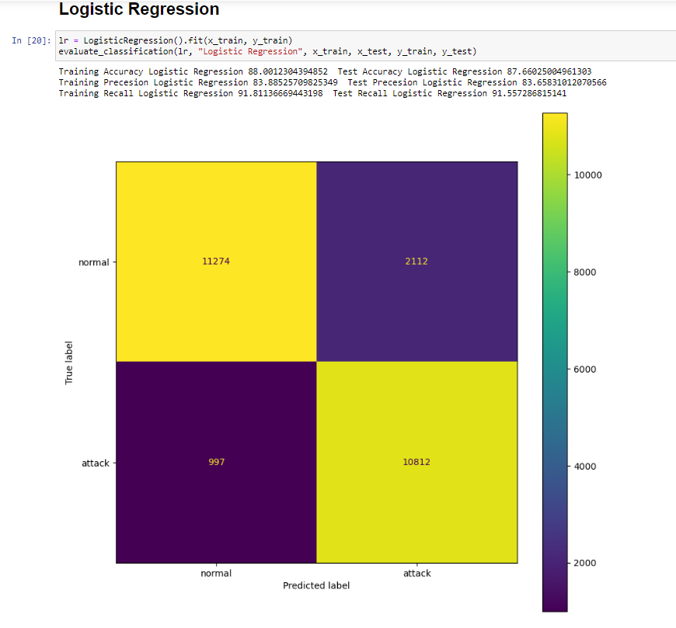
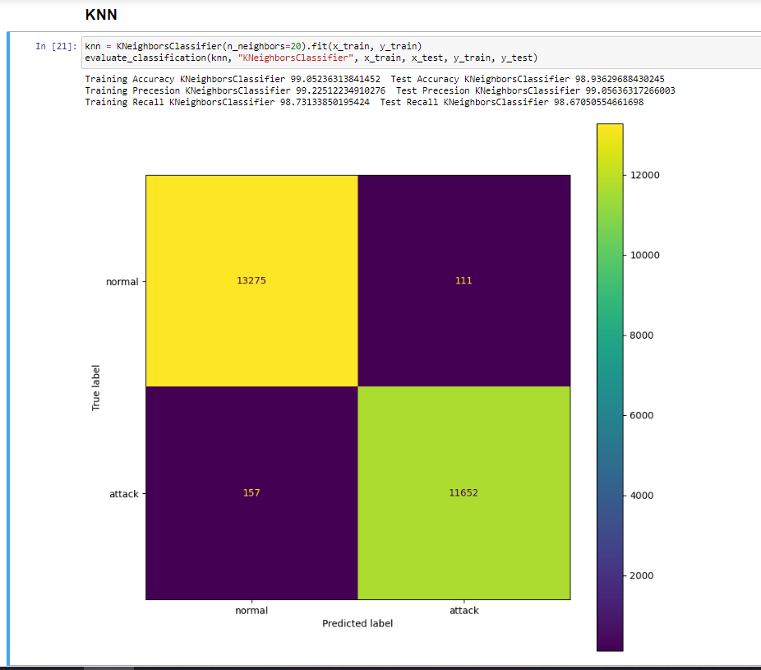
Screenshots of Code

Slide 10
Conclusion
IDS systems leveraging machine learning represent a critical component of modern cybersecurity defenses, providing organizations with the tools and intelligence needed to detect and respond to cyber threats effectively.

Slide 11

Thank You!!

