Slide 1
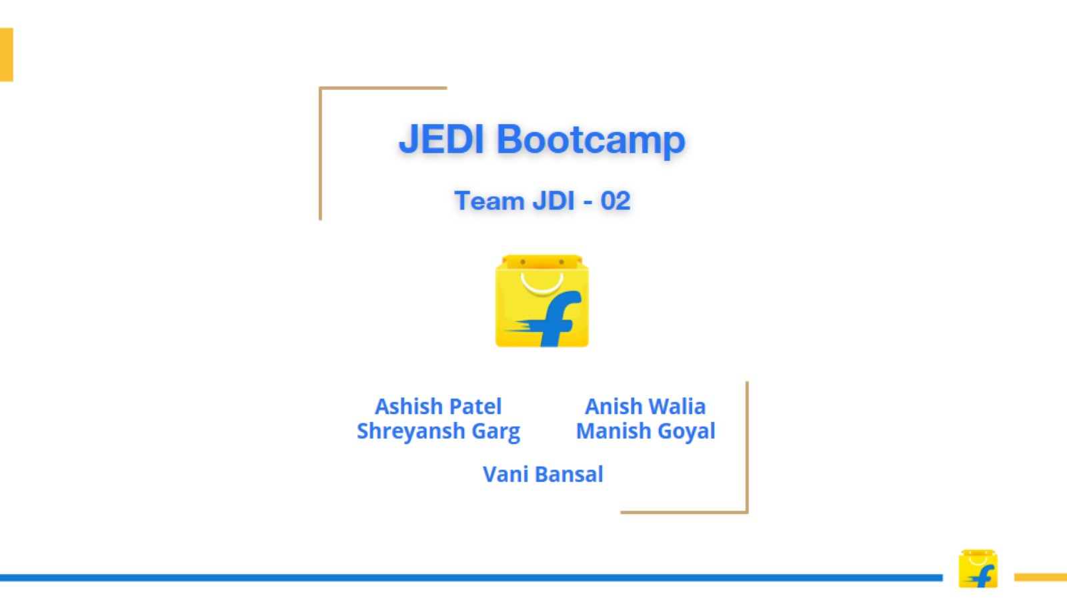

Slide 2
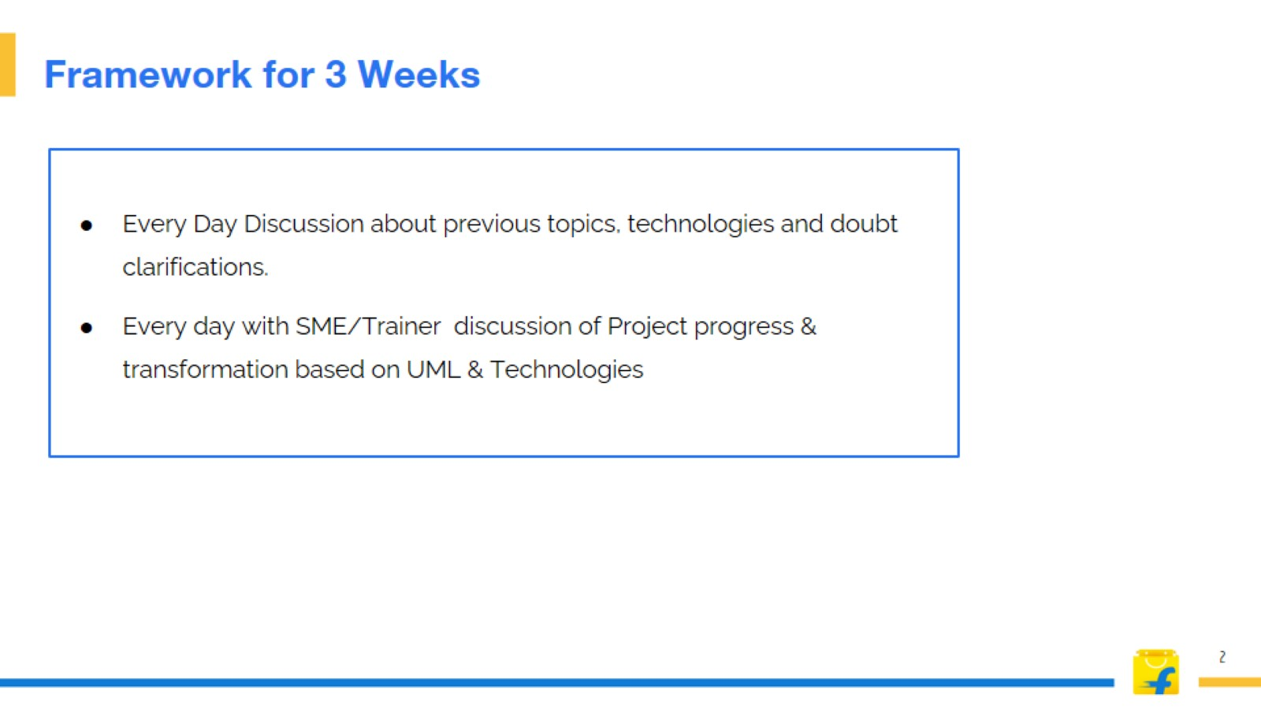
Framework for 3 Weeks

Slide 3

Stakeholders

Slide 4
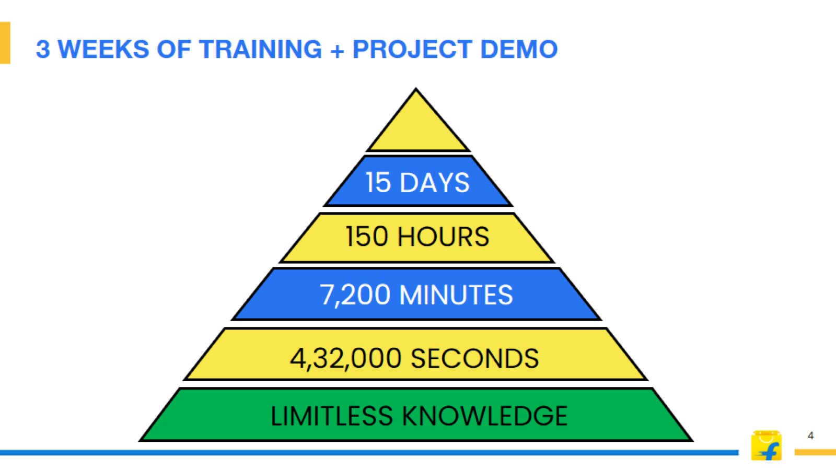
3 WEEKS OF TRAINING + PROJECT DEMO

Slide 5
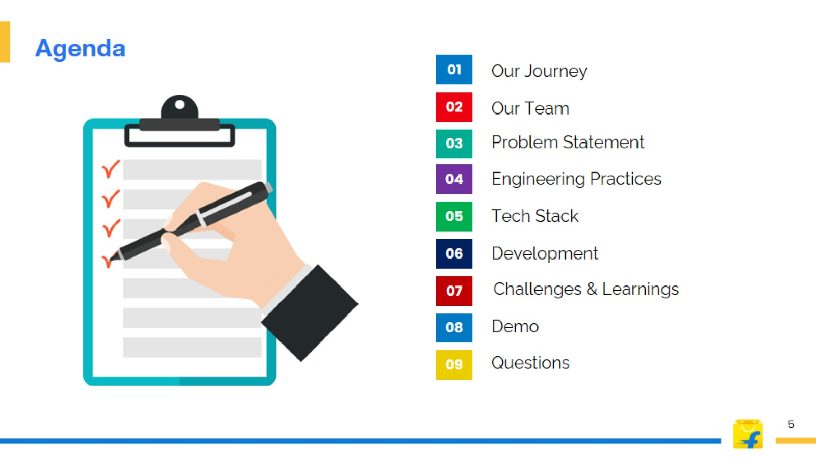
Agenda

Slide 6
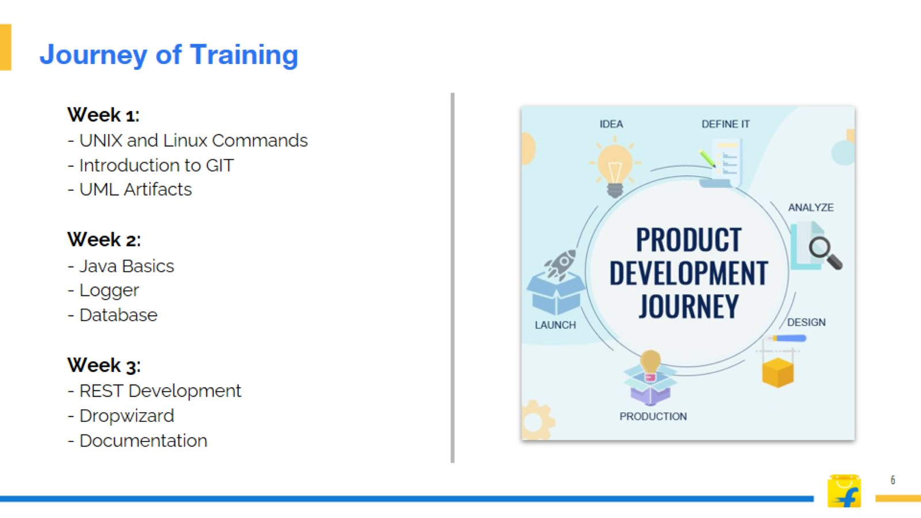
Journey of Training

Slide 7
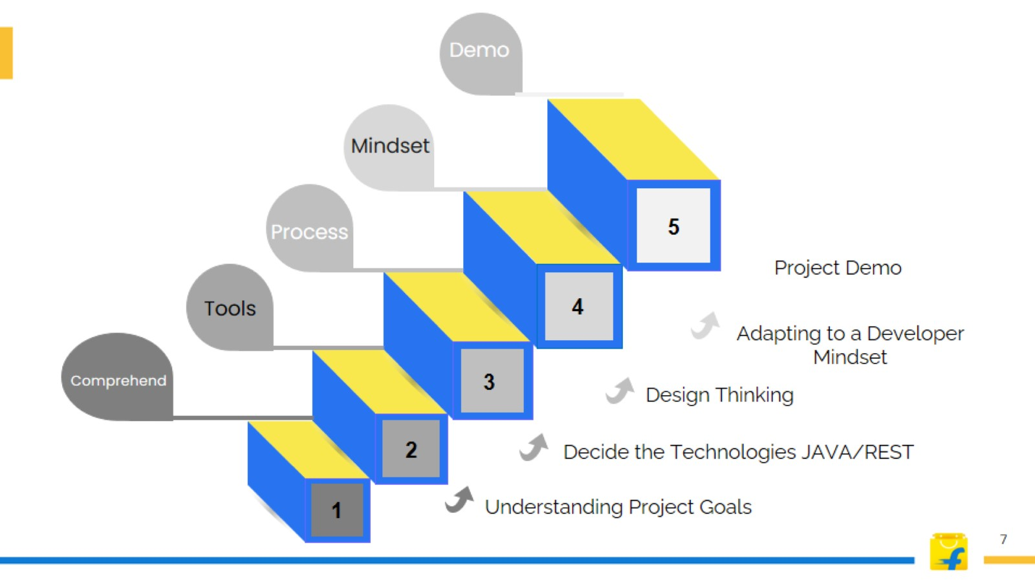

Slide 8
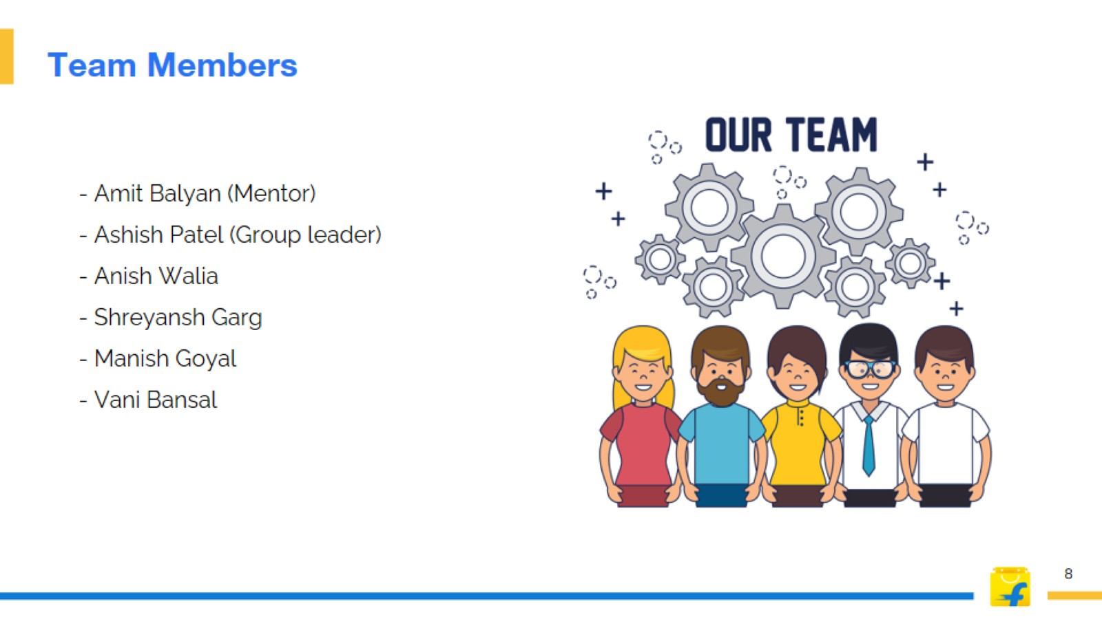
Team Members

Slide 9
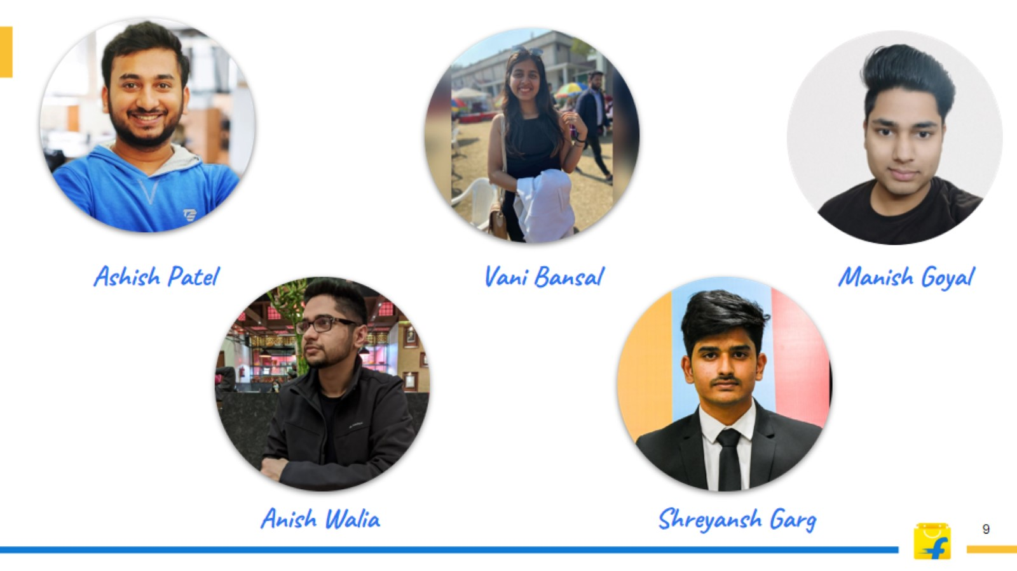

Slide 10
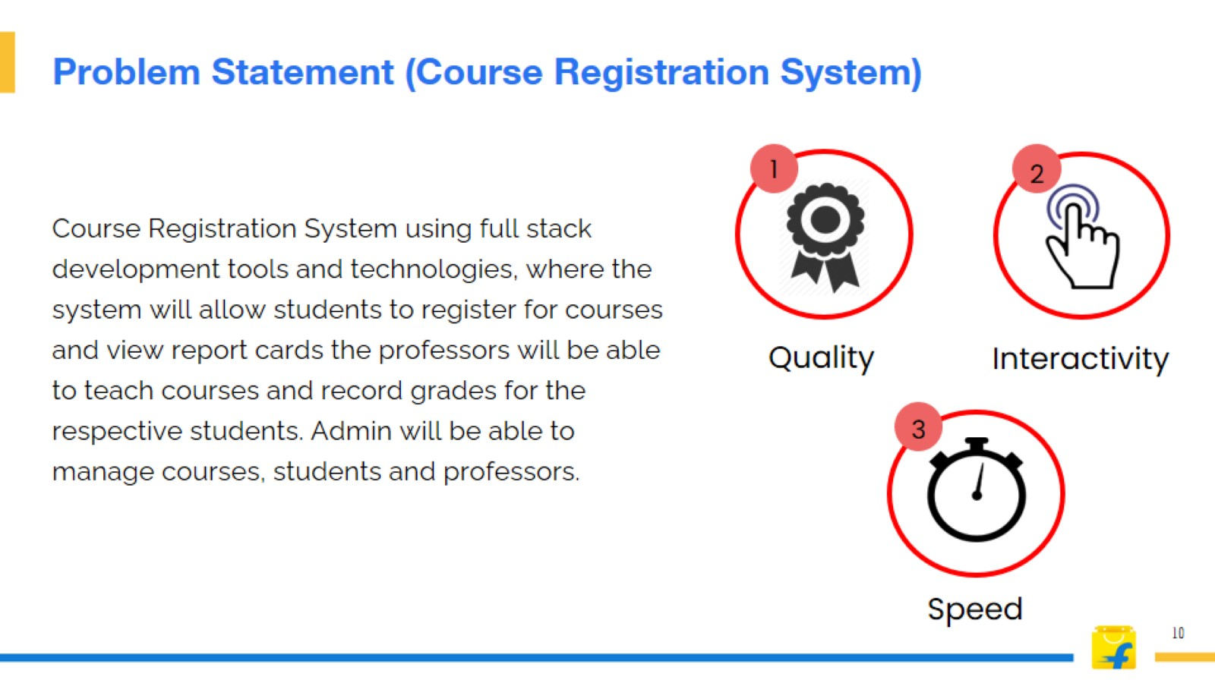
Problem Statement (Course Registration System)

Slide 11

Engineering
Practices

Slide 12
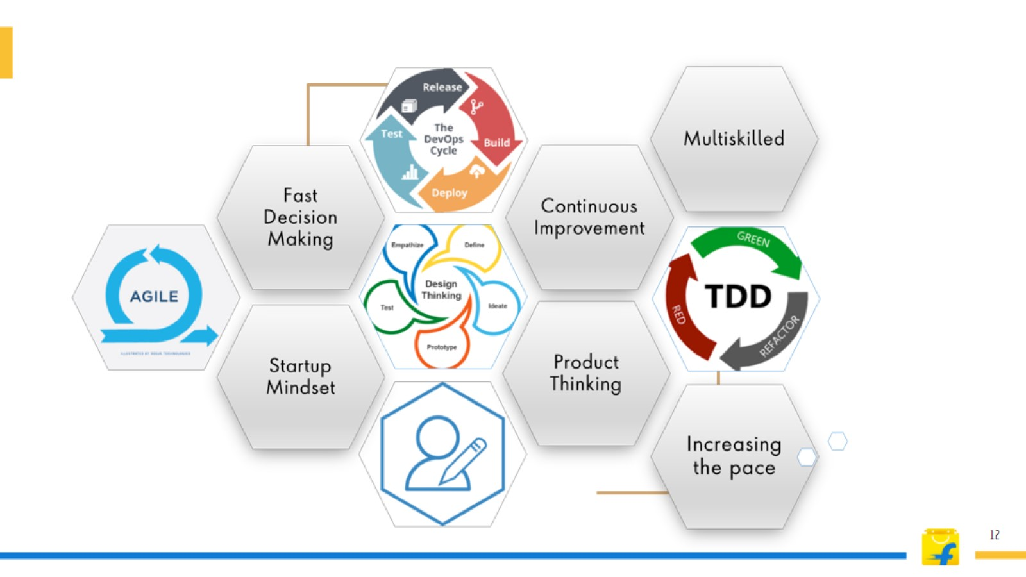

Slide 13
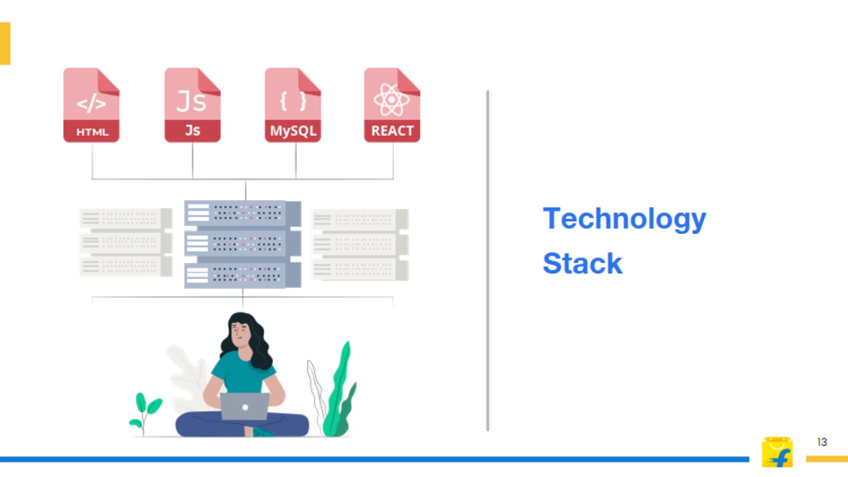
Technology
Stack

Slide 14


Slide 15
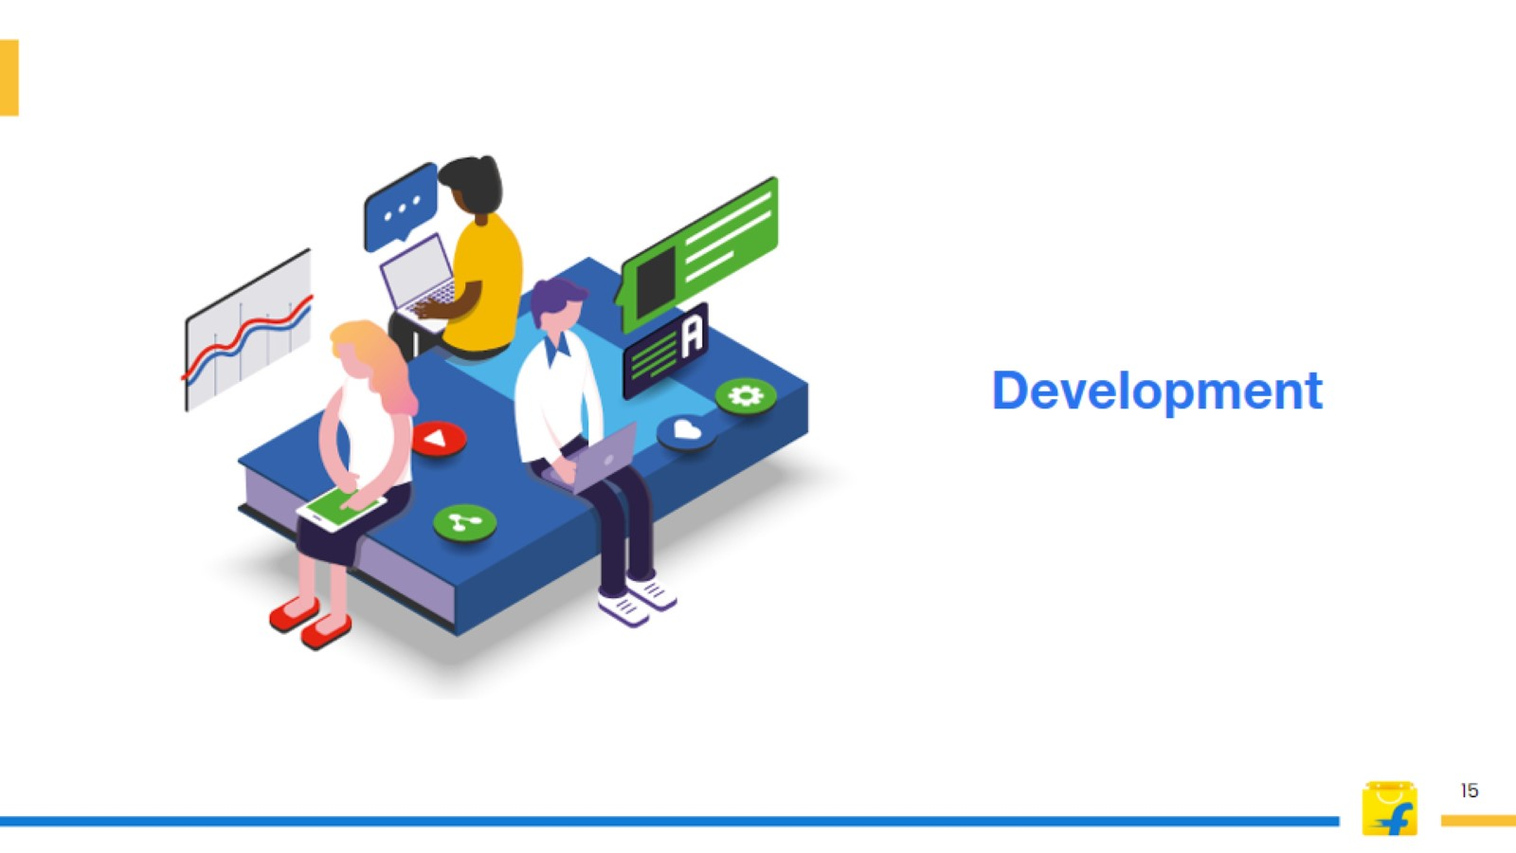
Development

Slide 16
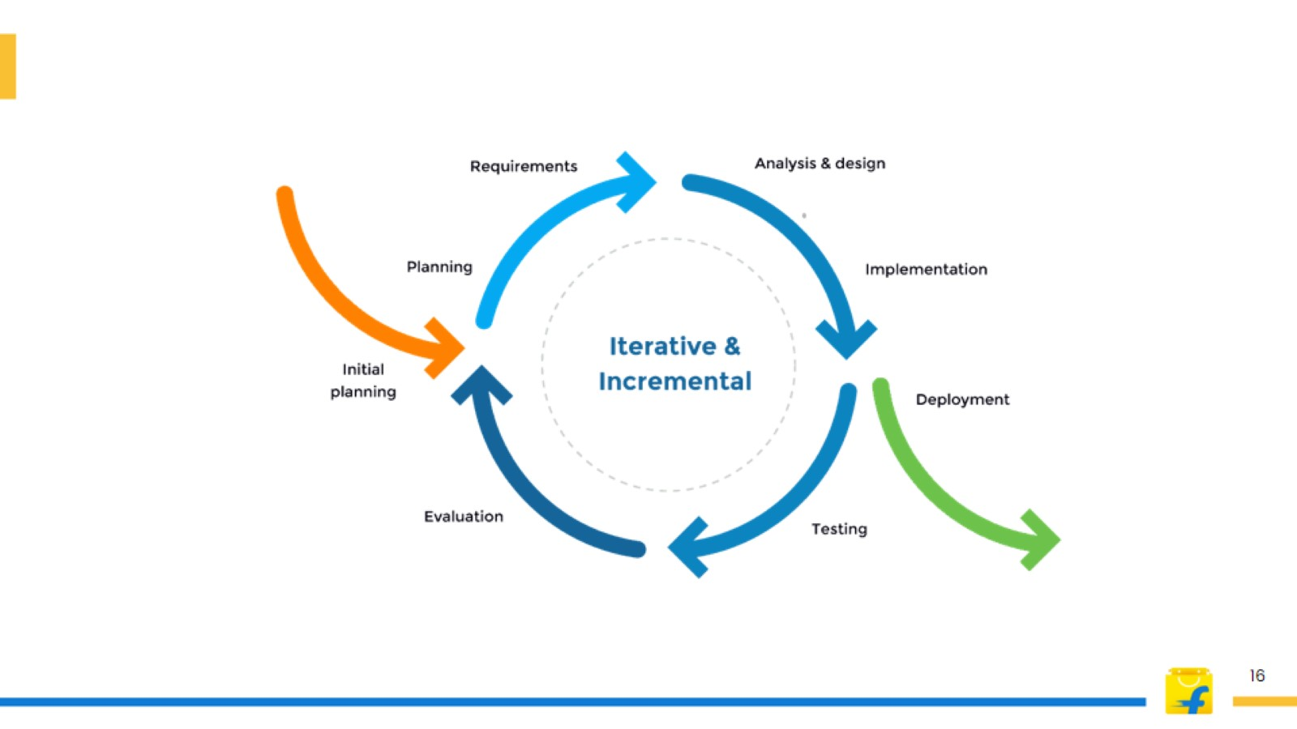

Slide 17
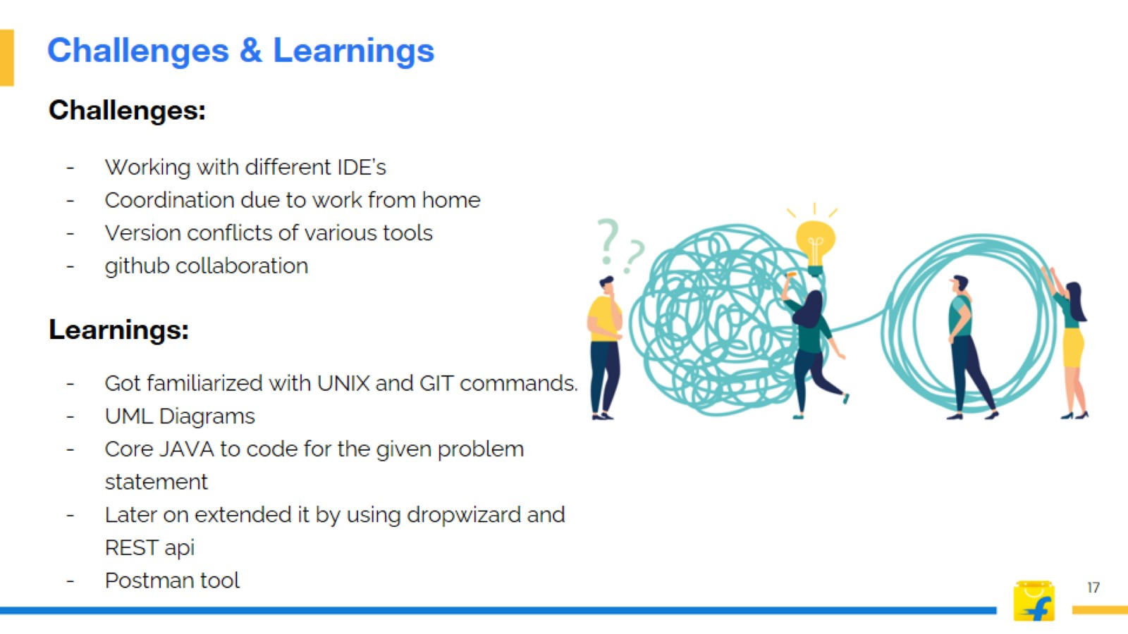
Challenges & Learnings

Slide 18
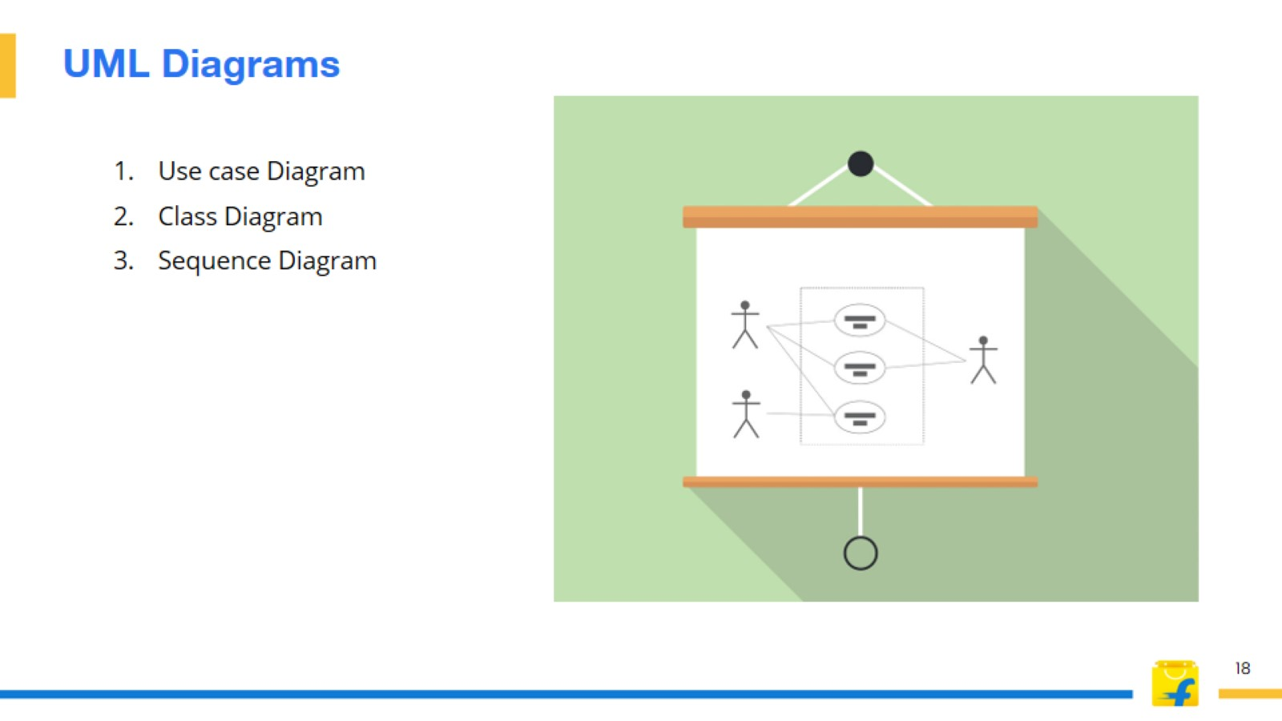
UML Diagrams

Slide 19
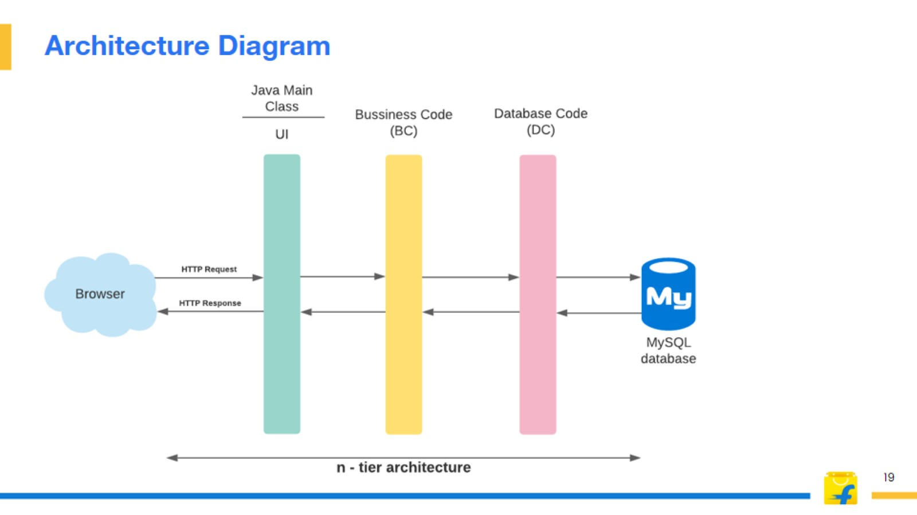
Architecture Diagram

Slide 20

Project
Demonstration

Slide 21

Questions?

Slide 22


