Slide 1
Open Source
NITA – Aayam - 2018
@tapaswenipathak
tapaswenipathak@gmail.com

Slide 2
What is open source?

Slide 3
choosealicense.com

Slide 4







Slide 5

c@github

Slide 6
Git on a Server

Slide 7
Open Source Projects

Slide 8
How to get involved with Open Source?

Slide 9
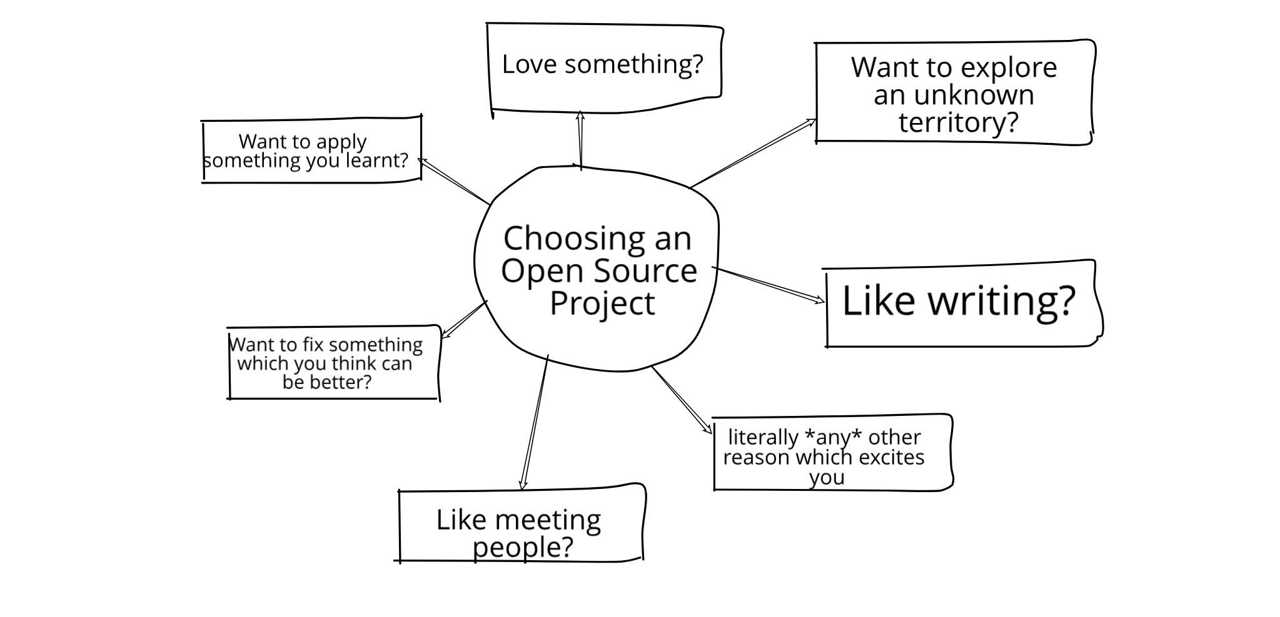

Slide 10
Programming

Slide 11
Writing

Slide 12
Community Outreach

Slide 13
Testing

Slide 14
Saying Hi & Asking Questions

Slide 15
Things you need to know

Slide 16
Things you shouldn’t care about

Slide 17
Helpful Platforms

Slide 18






Slide 19
Open Source Internships and Competitions

Slide 20
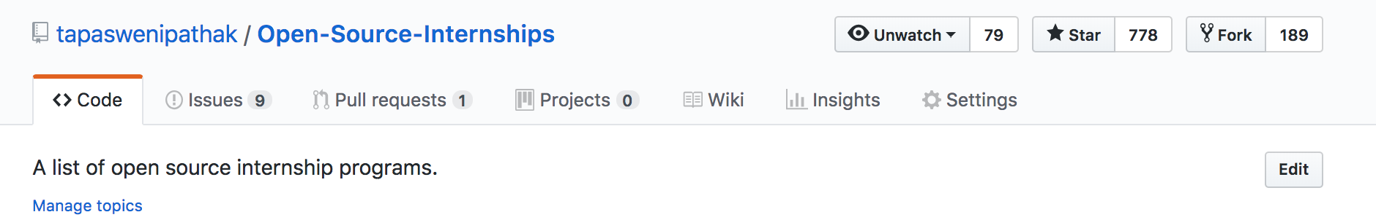
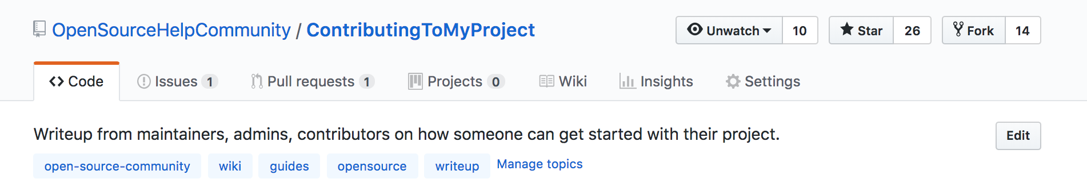
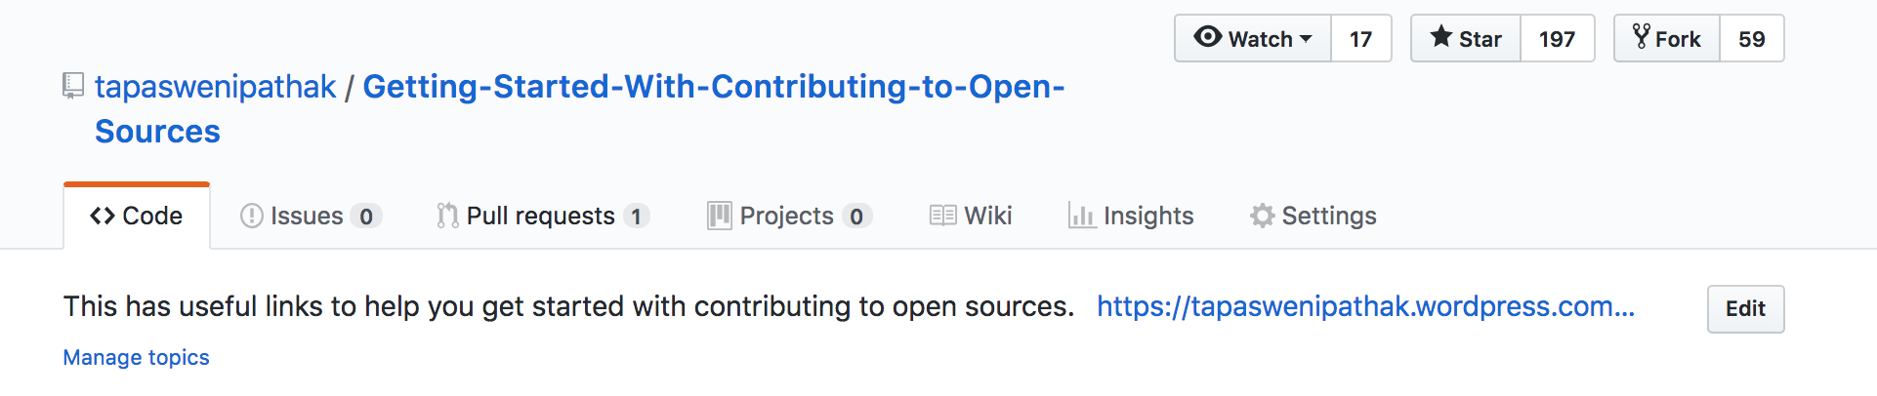

Slide 21

Open Source at JIO

Slide 22
Questions

Slide 23
Thank you!

