Slide 1
Sprint 5

Slide 2
US ID | Sprint Task | User Stories | Priority | Issue Encountered | Start Date | End Date | Status | Task Points
6 | Task 1 | Faculty Registration authentications | 1 | None | 01/27/2021 | 02/03/2021 | Completed | 3
6 | Task 2 | Faculty Login authentications | 1 | None | 02/04/2021 | 02/08/2021 | Completed | 2
7 | Task 3 | Create faculty options page | 1 | None | 02/08/2021 | 02/12/2021 | Completed | 3
7 | Task 4 | Linking faculty options page to provide options to Capture image/ browse image to upload | 1 | None | 02/13/2021 | 02/20/2021 | Completed | 5

Slide 3


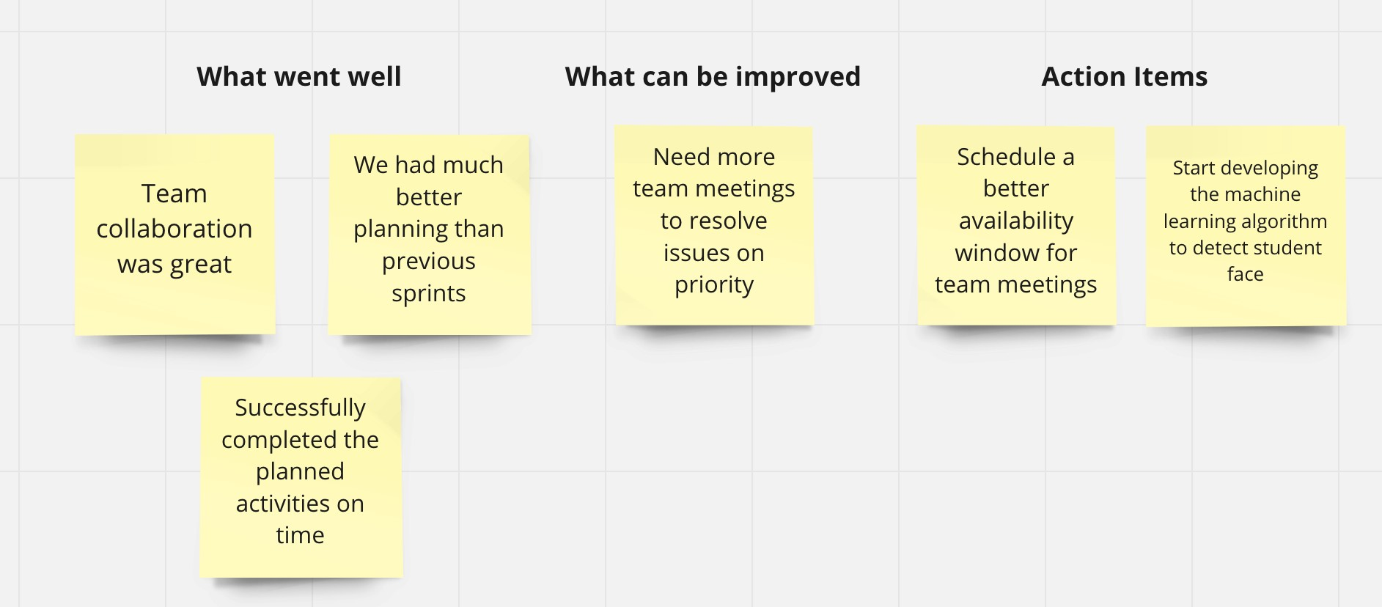

5

