Slide 1
Sprint 6

Slide 2
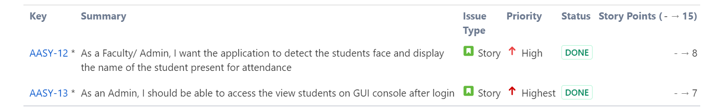

SPRINT 6

Slide 3
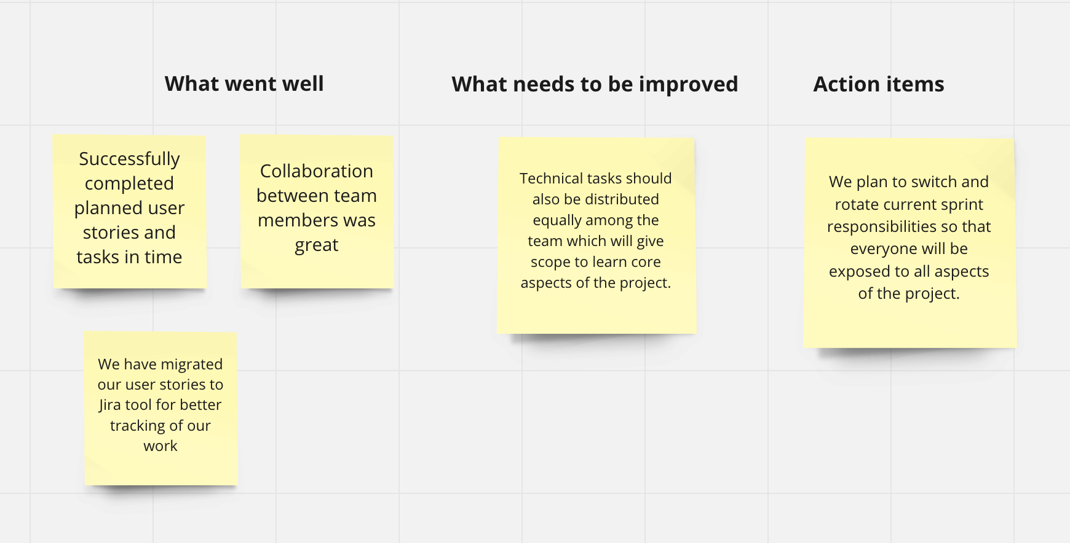

Sprint Retrospective

