Slide 1
Sprint 8

Slide 2

Sprint 8 Artifacts
Type | Description | Priority | Status | Story Points
US - 17 | As a Faculty, I want to receive the email to my registered email id with the list of students who are absent for the class immediately once attendance is captured and submitted | Highest | Completed | 8
US - 18 | Complete Redesign of attendance automation system | Highest | Completed | 5
US - 19 | As a Faculty/Admin, I want the application to be available as a executable file so that it is easier to deploy and start using the app | High | Completed | 5
Task | Integrate smtplib python library and configure the base email address to be used for app to send attendance emails to faculty | Highest | Completed | N/A
Task | Completely redesign the attendance automation system with more user-friendly design colors and icons for all the modules | High | Completed | N/A
Task | Convert the main.py python file to executable file(.exe) using pyinstaller | High | Completed | N/A
Task | Update technical paper for sprint 8 | Medium | Completed | 1
Task | Update wikipage on GitHub | Medium | Completed | 2
Task | Update User Manual | Medium | Completed | 2
Task | Prepare presentation slides for sprint 8 | Medium | Completed | 2
Task | Improvement Action Item(Sprint 7 Feedback) | High | Completed | 2

Slide 3
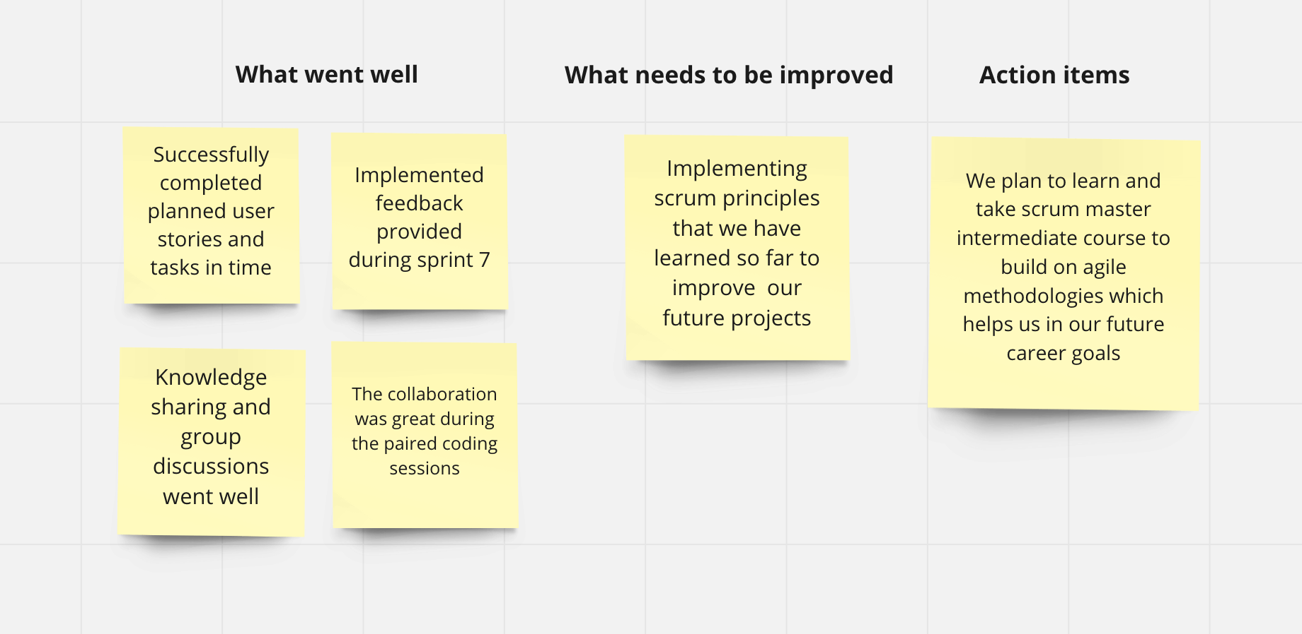

Sprint Retrospective

