Slide 1
ATTENDANCE AUTOMATION SYSTEM
Sprint 7 - Presentation
TEAM : CHARGERS
ASHISH PULLURI
HEMANTH UPPULURI
SHIVA SHANKAR
PREETHAM BONTHULA
SASHWAT MADAAN
VARUN REDDY
Guided by, Prof. Henry Wong

Slide 2
DELIVERABLE 7
AGENDA
Sprint 6 Recap
Completed tasks & Stories
Sprint 6 Screenshots
2. Sprint 7 Deliverables
Completed tasks & Stories
Sprint 7 Screenshots
Sprint 7 Burndown
3. Product Backlog
4. Test Cases
5. Project Demo
6. Sprint Retrospective
7. What’s coming up ?
8. Future Scope
9. Project Links.

Slide 3

SPRINT 6 Recap
Story Number | Description | Priority | Status | Story Points
US - 12 | As a Faculty/Admin, I want the application to detect the students face and display the name of the student present for attendance | Highest | Completed | 8
US - 13 | As an Admin, I should be able to access and view students on GUI console after login | High | Completed | 8

Slide 4
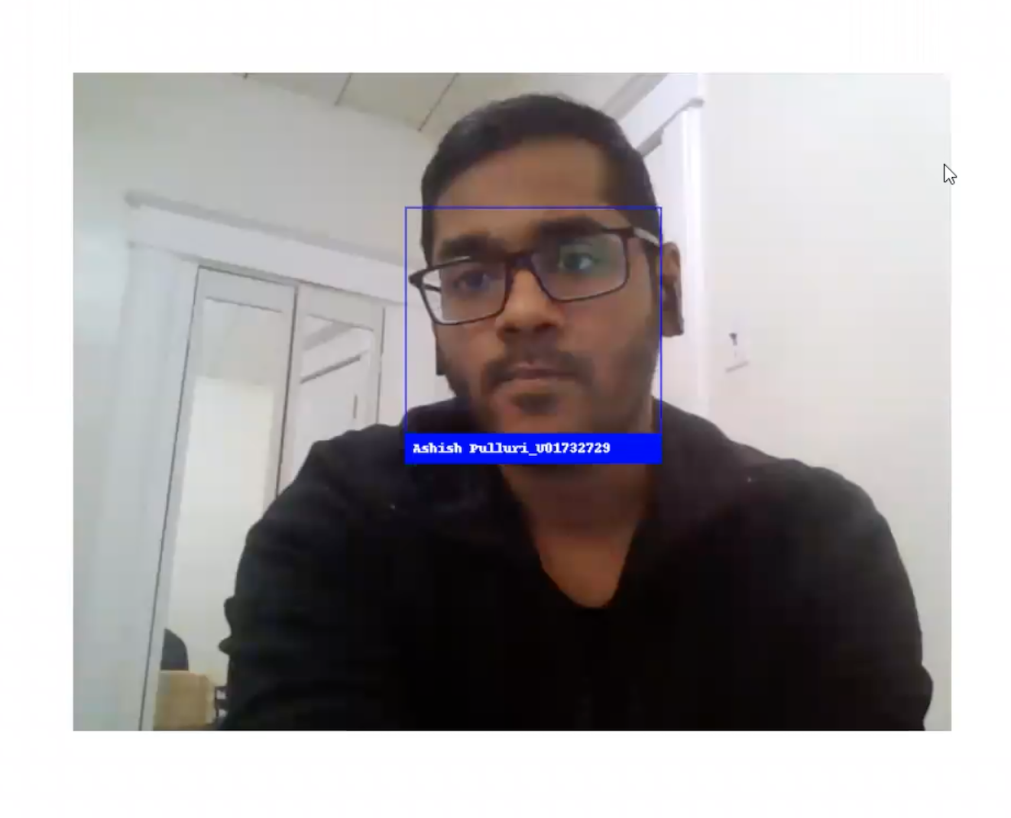
SPRINT 6 - Demo Screenshot 1
Capture Attendance Result Page
- We added a new capability by integrating KNN Machine learning algorithm to our application which will be able to detect the student face registered in the database and display the student’s Name and ID

Slide 5
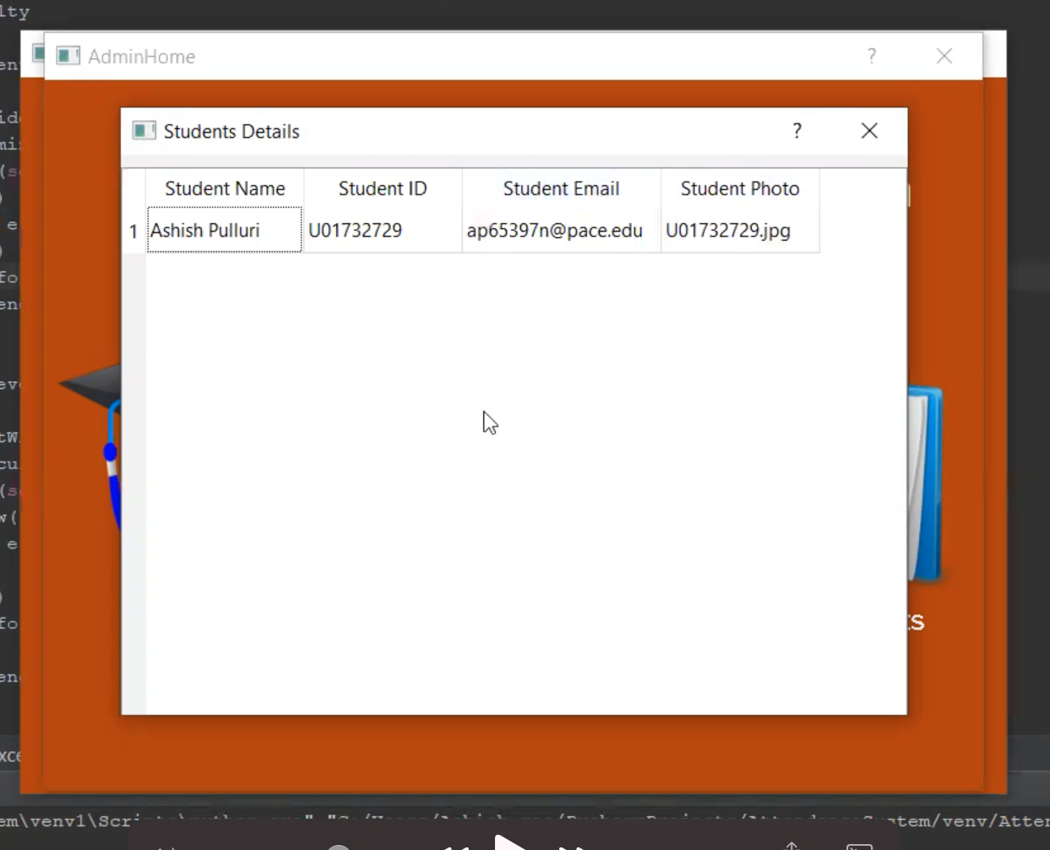
SPRINT 6 - Demo Screenshot 2
Student Details Page
- Admin can now view the registered students directly from the GUI console by clicking on view students in admin options page without any need to manually query from the database

Slide 6
SPRINT 7
Story Number | Description | Priority | Status | Story Points
US - 14 | As a Faculty/Admin, I want to access the options available to either view the current day attendance/ Download consolidated attendance for entire month | Highest | Completed | 5
US - 15 | As a Faculty/ Admin, I want to view attendance reports generated after the student attendance is updated on the GUI Console | Highest | Completed | 5
US - 16 | As a Admin/Faculty, I want to download attendance reports once the attendance is captured and submitted | Highest | Completed | 5

Slide 7
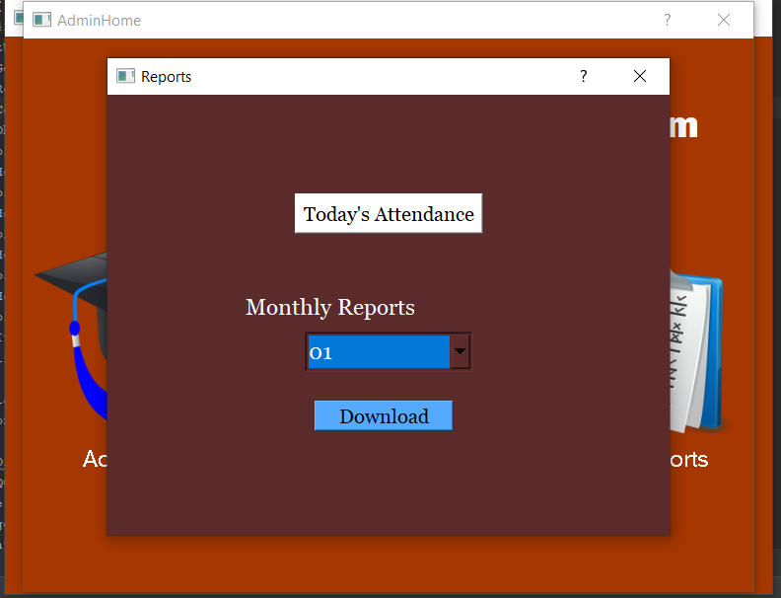
SPRINT 7 - Demo Screenshot 1
Attendance Report Options Page
- Admin/Faculty can now access reports option page to view today’s attendance/Download consolidated attendance for the current month or previous months

Slide 8
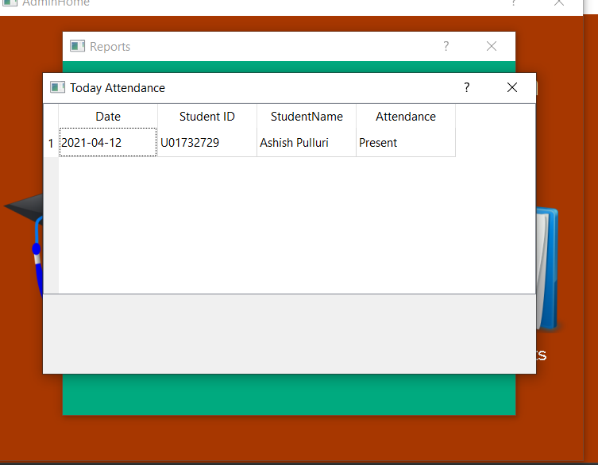
SPRINT 7 - Demo Screenshot 2
Attendance Result Page
- The Admin/Faculty can now view the attendance report in the GUI Console immediately once attendance is captured & submitted by faculty by accessing the report options page

Slide 9
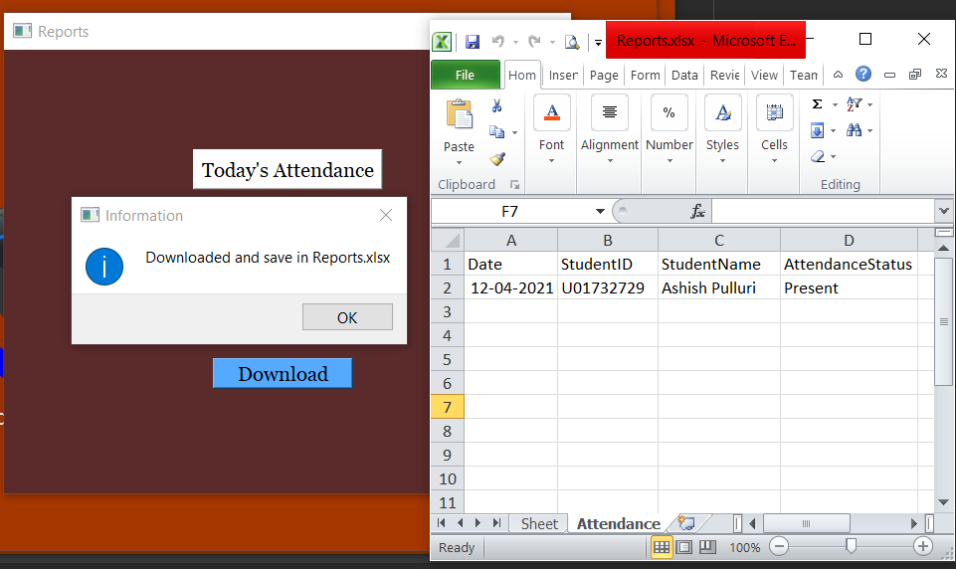
SPRINT 7 - Demo Screenshot 3
Download Attendance Results
A new capability to download the attendance result in excel format has been added by using OpenPyXl python library which can be used to read/write data to the excel sheets
The admin and faculty can download the attendance reports generated immediately after attendance is submitted.

Slide 10
SPRINT 7 - Burndown Chart

Slide 11

PRODUCT BACKLOG
Story Number | Product Backlog Item | User Story | Priority | Status | Sprint
US – 1 | Home page login options for admin/ faculty | As an admin/ faculty I want to access the options available for login/ register into the application so that We can choose if our school admin or the faculty wants to login with necessary credentials | Highest | Completed | 1
US – 2 | Admin login page | As an admin I want a secure login account with username and password for admin and faculty individually so that Our personal credentials are safe and secure denying access to unauthorized persons | Highest | Completed | 1
US – 3 | Admin options page | As an admin, once successfully logged in I should be able to view options to add student/ view registered students or check reports | Medium | Completed | 2
US – 4 | Student registration page | As an admin I want to add/register the students into the database to maintain the student's registration details | High | Completed | 2
US - 5 | Database | As an admin, I want to design a Database where we store all the user data (Admin, Faculty and Student private data) | Highest | Completed | 3
US – 6 | Faculty login page | As a faculty, I would like to login to the application using username and password given during the faculty registration | Highest | Completed | 4

Slide 12
PRODUCT BACKLOG
Story Number | Product Backlog Item | User Story | Priority | Status | Sprint
US– 7 | Faculty Registration authentication | As a Faculty, I want to register as a faculty to be able to have a secure login to my account | Medium | Completed | 5
US– 8 | Student registration details from database | As an admin, I should be able to add and view registered student’s information in database | Medium | Completed | 4
US – 9 | Faculty login authentication | As a Faculty, I want to have a secure login using username and password to access my account to take attendance/view reports | Highest | Completed | 5
US –10 | Faculty registration page | As a faculty, I want to register as a faculty providing required personal details. | Medium | Completed | 4
US – 11 | Capture attendance / browse image to upload | As a faculty, I want to access options available to capture attendance/browse an image to upload for attendance or view reports | High | Completed | 5
US – 12 | Detect the students face | As a Faculty/ Admin, I want the application to detect the students face And display the name of the student present for the attendance | High | Completed | 6

Slide 13
PRODUCT BACKLOG
Story Number | Product Backlog Item | User Story | Priority | Status | Sprint
US – 13 | Display registered students in the GUI Console | As an Admin, I should be able to view registered student's information in the GUI console after login | Highest | Completed | 6
US – 14 | Design attendance reports options page | As a Faculty/Admin, I want to access the options available to either view the current day attendance/ Download consolidated attendance for entire month | Highest | Completed | 7
US – 15 | View attendance reports on GUI Console | As a Faculty/ Admin, I want to view attendance reports generated after the student attendance is updated on the GUI Console | Highest | Completed | 7
US – 16 | Download attendance reports | As a Admin/Faculty, I want to download attendance reports once the attendance is captured and submitted | Highest | Completed | 7
US – 17 | Send automatic email to registered faculty | As a Faculty, I want to receive an email immediately with the list of students who are absent | Highest | To do | 8

Slide 14

TEST CASES (Previous Sprint)
Story Number | Scenario | Test Case | Expected Result | Actual Result | Sprint
US – 11 | Faculty options Page | Should be able to click on capture attendance icon to open the system camera | - System camera should be invoked and able to capture the image | Pass | 6
US – 13 | Display registered students on GUI console | Admin should be able to click on view students in the GUI console to view all the registered students | GUI Console should display all the registered student details including name, student ID, email and student image number | Pass | 6
US – 12 | Detect registered student face | Faculty should be able to capture/upload image and click submit to successfully submit attendance | Display attendance successfully captured message | Pass | 6
US – 12 | Detect registered student face | KNN Machine learning algorithm should be able to detect the student face from the registered student's data stored in the database | Faculty should be immediately able to see the student's image who are present with their names recognized from the database. | Pass | 6

Slide 15
TEST CASES (Sprint 7)
Story Number | Scenario | Test Case | Expected Result | Actual Result | Sprint
US – 14 | Access attendance reports | Admin should be able to click on reports in admin options page to access reports page to view/download reports | Attendance reports page should be displayed to the admin | Pass | 7
US – 14 | Access attendance reports | Faculty should be able to click on reports in faculty options page to access reports page to view/download reports | Attendance reports page should be displayed to faculty | Pass | 7
US – 15 | View attendance reports | Admin/Faculty should be able to click on today’s attendance to view attendance report generated today on GUI Console | Admin/Faculty should be able to view students attendance report captured today with list of students who are present and absent | Pass | 7
US - 15 | View attendance reports | Attendance report on GUI Console should display complete student details with attendance | Date, student id, student name and attendance status should be displayed | Pass | 7

Slide 16
TEST CASES (Sprint 7)
Story Number | Scenario | Test Case | Expected Result | Actual Result | Sprint
US – 16 | Download attendance reports | Admin/Faculty should be able to click on download to successfully download data in excel sheet | Downloaded and saved in reports.xlsx message should be displayed | Pass | 7
US – 16 | Download attendance reports | Admin/Faculty should be able to to access the students attendance reports in excel format | Admin/Faculty should be able to download excel sheet with consolidated attendance data | Pass | 7
US - 16 | Download attendance reports | Downloaded excel sheet should display complete student details with attendance status | Date, Student ID, Student name and attendance status present/absent should be displayed | Pass | 7

Slide 17

Project Demo

Slide 18
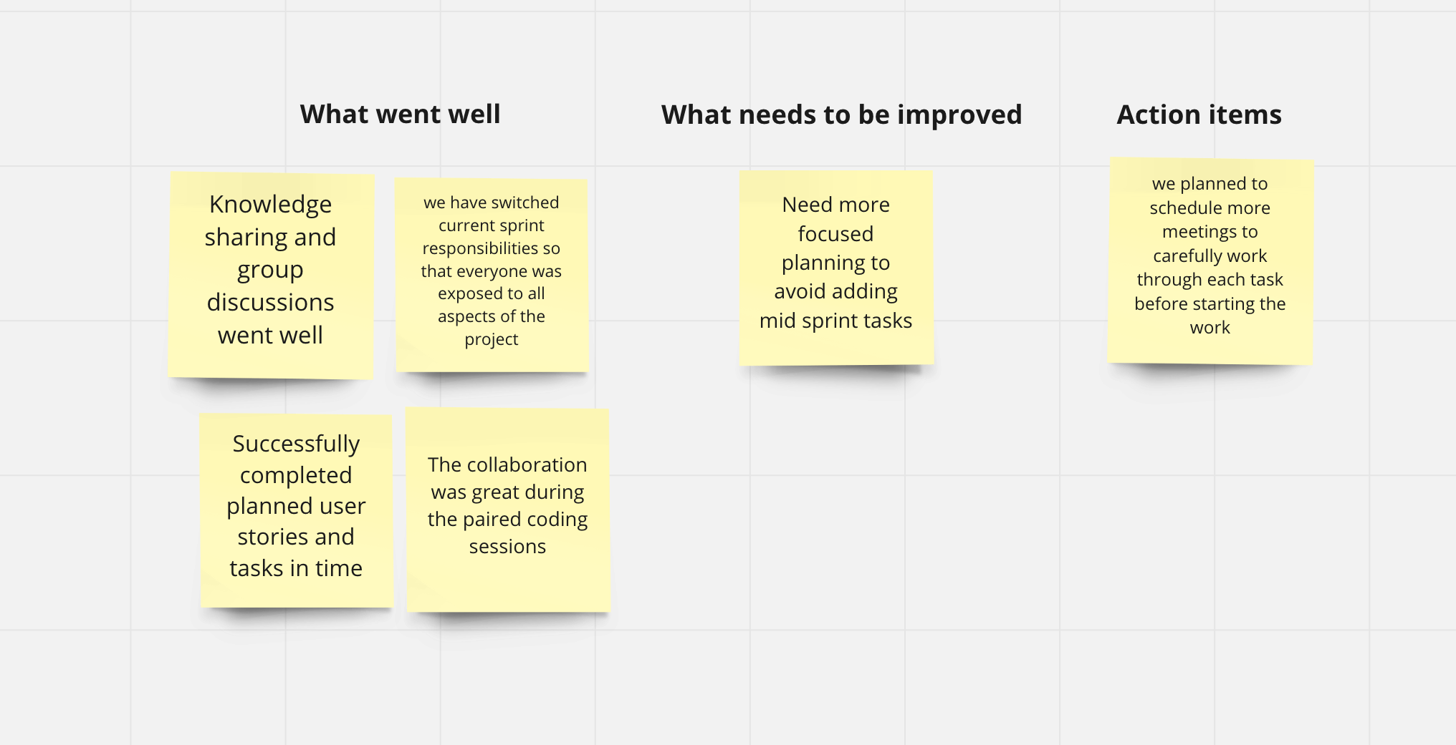

Sprint Retrospective

Slide 19
What’s coming up?
Sending automatic emails to registered faculty
Story Number | Description | Priority | Status | Story Points
US - 17 | As a Faculty, I want to receive an email immediately with the list of students who are absent after the attendance is captured and submitted | Highest | To-do | 8

Slide 20

Future Scope?
Migrating and managing entire tool on cloud platform.
Hosting Attendance Automation System tool on an entirely separate setup build for the application.
Integrating Automation Attendance System tool to a mobile application and enhancing to cater future needs.

Slide 21
Project Links
Tech Paper Link : https://github.com/ashishpulluri/AttendanceAutomationSystem/blob/main/Deliverable-7-TechPaper.docx
Git Hub Link :
HTTPS://GITHUB.COM/ASHISHPULLURI/ATTENDANCEAUTOMATI ONSYSTEM/WIKI/ATTENDANCE-AUTOMATION-SYSTEM#TEAM-2

Slide 22
"The golden rule for every businessman is this: Put yourself in your customer’s place.“
- Orison Swett Marden
Thank You

