Slide 1
Sprint 7

Slide 2
Sprint 7 Artifacts
Type | Description | Priority | Status | Story Points
US - 14 | As a Faculty/Admin, I want to access the options available to either view the current day attendance/ Download consolidated attendance for entire month | Highest | Completed | 5
US - 15 | As a Faculty/ Admin, I want to view attendance reports generated after the student attendance is updated on the GUI Console | Highest | Completed | 5
US - 16 | As a Admin/Faculty, I want to download attendance reports once the attendance is captured and submitted | Highest | Completed | 5
Task | Update Technical Paper for sprint 7 | High | Completed | N/A
Task | Create Deliverable 7 Presentation Slides | High | Completed | N/A
# of User Stories Completed - 3
# of Tasks Completed - 3
Artifacts Completed =100%

Slide 3
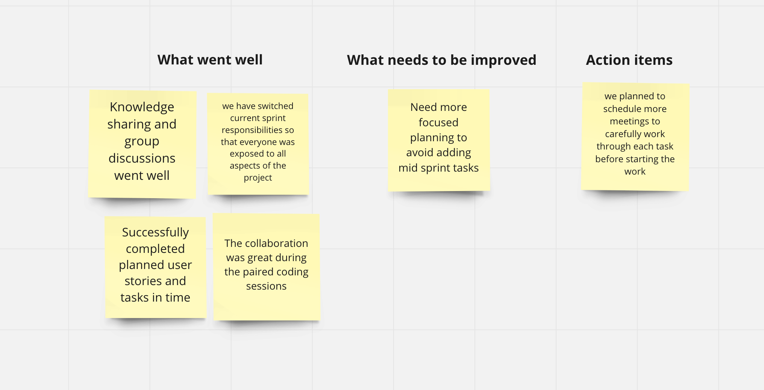

Sprint Retrospective

