Slide 1
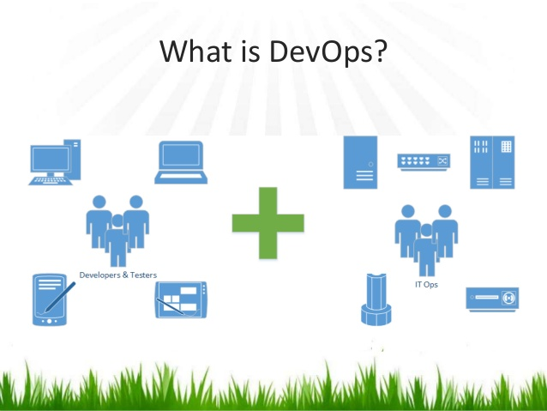

Slide 2
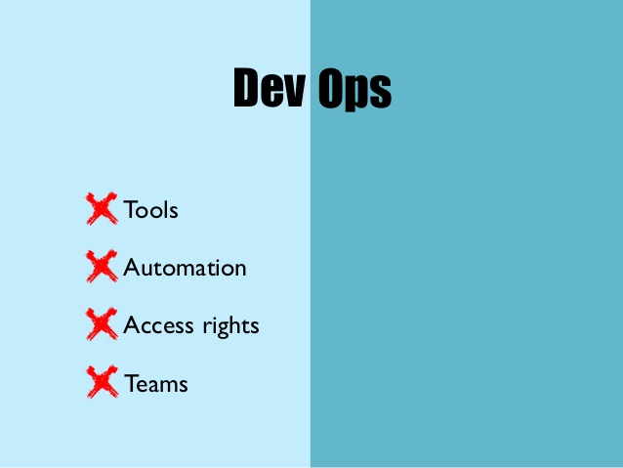
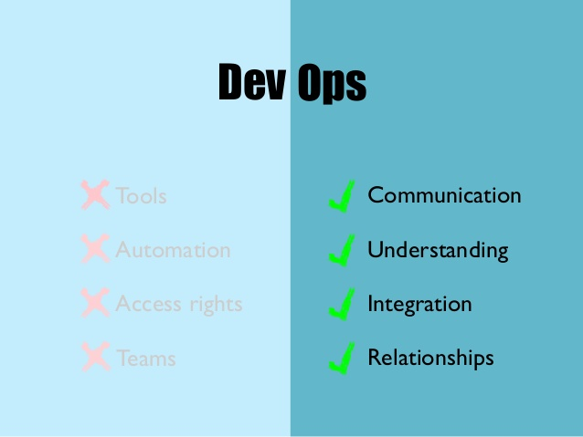

Slide 3
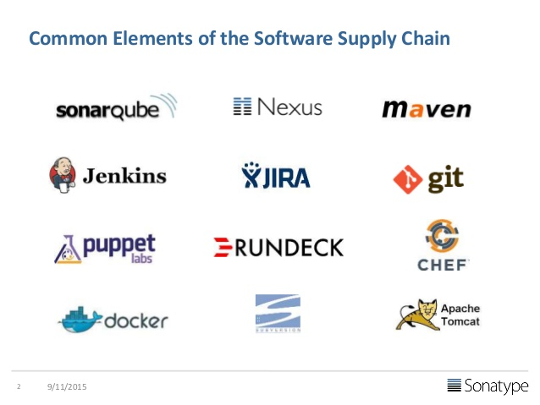

Slide 4
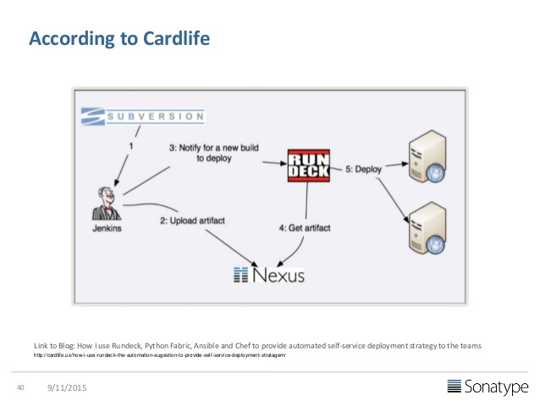
Reference Architectures

Slide 5
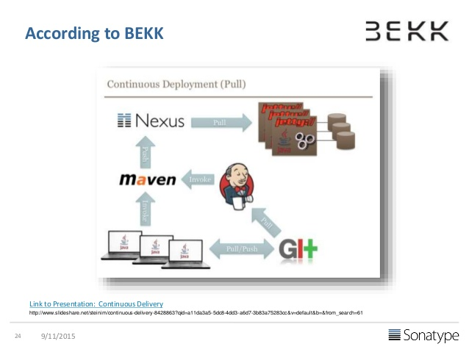

Slide 6
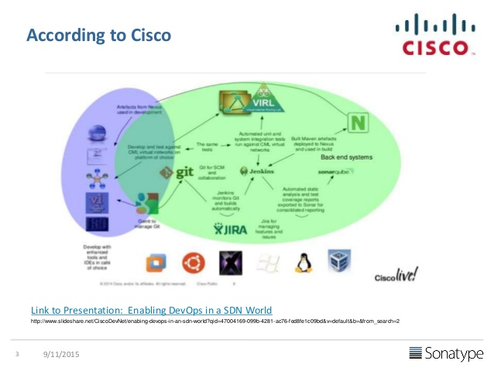

Slide 7
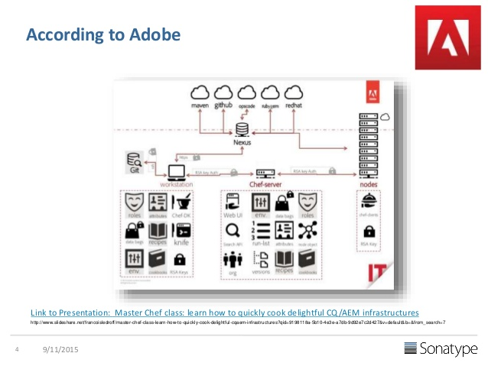

Slide 8
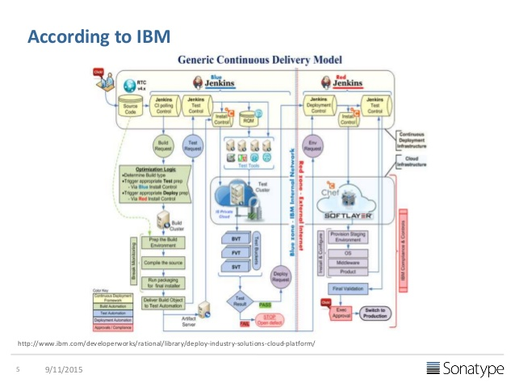

Slide 9
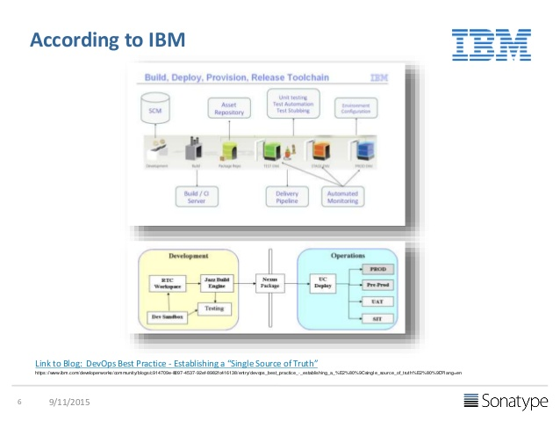

Slide 10
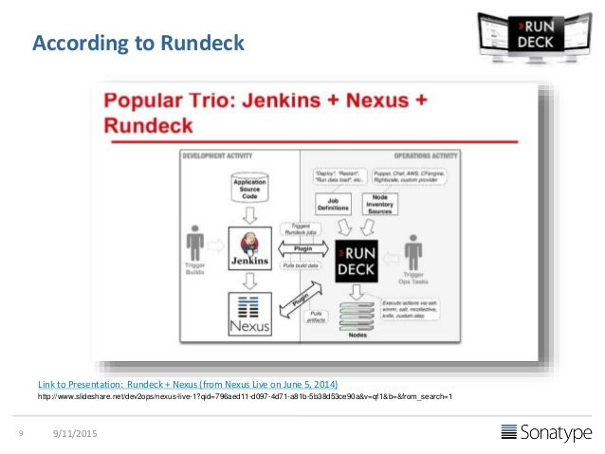

Slide 11
DEV and OPS
Developers work with Ops to understand the impact of code changes
• Developers now work more closely with production-equivalent systems
• Developers focuses on metrics required by Ops team like PSR
• Ops now have more clarity on infrastructure needs
• More automation on deployment
• Closely monitors the Dev – Test – Prod pipeline for each deployment with immediate feedback
• Better collaboration and communication

Slide 12
What is DevOps?
DevOps (a combination of development and operations) is a software development method that stresses communication, collaboration and integration between software developers and information technology(IT) professionals thereby– Enable rapid evolution of products or services– Reduce risk, improve quality across portfolio, and reduce costs

Slide 13
What is DevOps ?
DevOps integration targets product delivery, quality testing, feature development and maintenance releases in order to improve reliability and security and faster development and deployment cycles.
The adoption of DevOps is being driven by factors such as:
Use of agile and other development processes and methodologies
• Demand for an increased rate of production releases from application and business stakeholders
• Wide availability of virtualized and cloud infrastructure from internal and external providers
• Increased usage of data center automation and configuration management tools

Slide 14
WHY DevOps?
A culture and mindset for collaborating between developers and Operations.
To Overcome Delivery Challenges

Slide 15
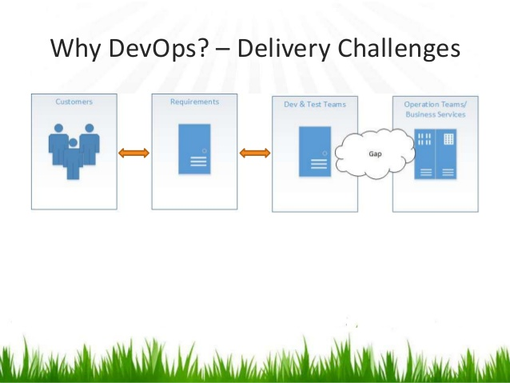

Slide 16
Top 3 delivery challenges
• Release management– Better understanding of risks, dependencies, compliance issues
• Release/Deployment coordination– Better tracking of discrete activities, faster escalation of issues, documented process control and granular reporting
• Release/Deployment Automation– Usually have existing automation but want to flexibly manage and drive this automation that can be invoked by non-operations resources in specific non-production environments

Slide 17
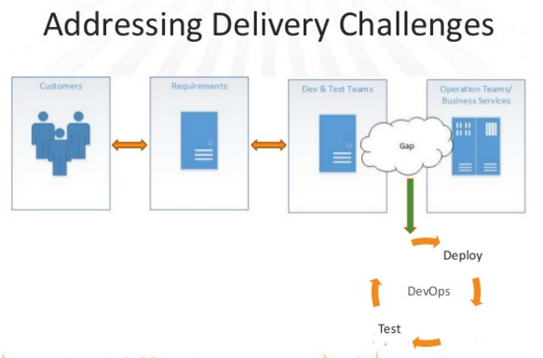

Slide 18
How to over come the Gap?
Agile Development– Addresses the gap between customer requirements and dev + testing teams– Cross-functional teams to design, develop, and test features/stories prioritized by the PO (Customer)– Focuses more on functional and non-functional readiness
• DevOps– Addresses the gap between dev + testing and Ops– Automated release management– Focuses on functional and non-functional plus operational and business readiness– Intensifies reusability and automation

Slide 19
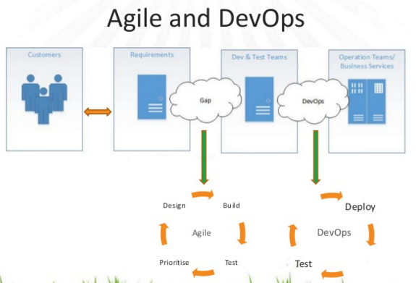

Slide 20
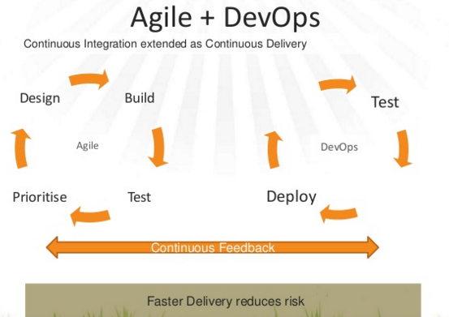

Slide 21
Key Technical Capabilities of DevOps

Slide 22
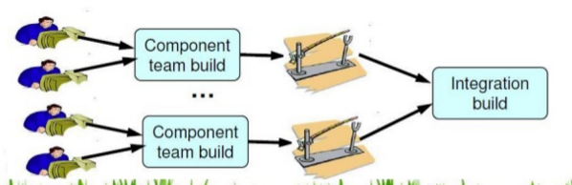
Continuous Integration
Integrate the code changes by each developer so that the main branch remains up-to-date

Slide 23
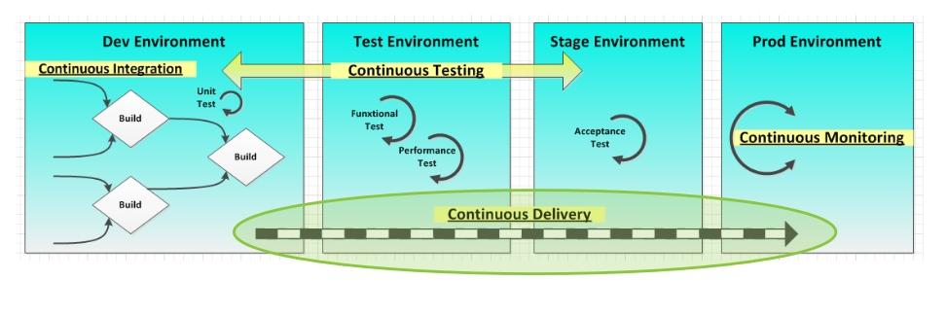
Continuous Delivery
Taking each CI build and run it through deployment procedures on production or production-equivalent environments.

Slide 24
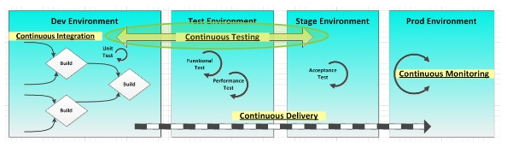
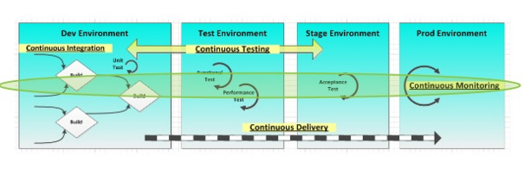
Continuous Testing and continuous Monitoring

Slide 25
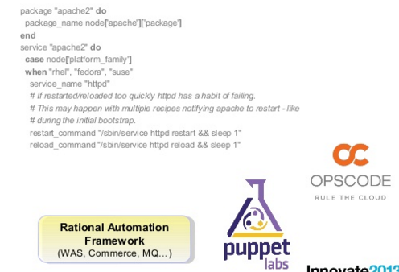
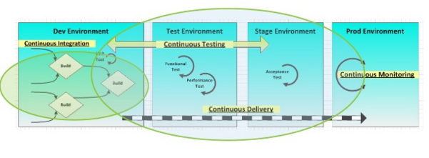
Infrastructure as code and build & delivery pipeline

Slide 26
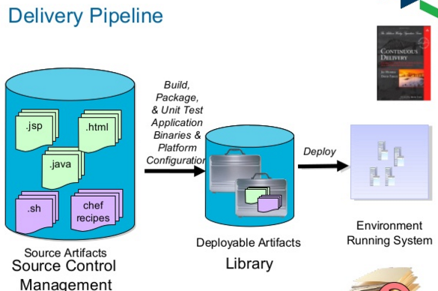

Slide 27
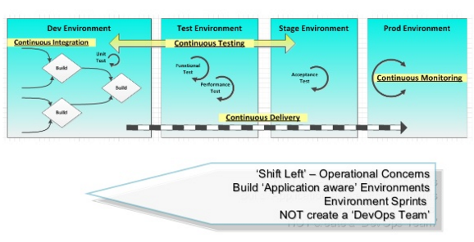
Organizational Change

Slide 28
Principles of DevOps
• Develop and test in an environment similar to production
• Deploy builds frequently
• Validate operation quality continuously

Slide 29
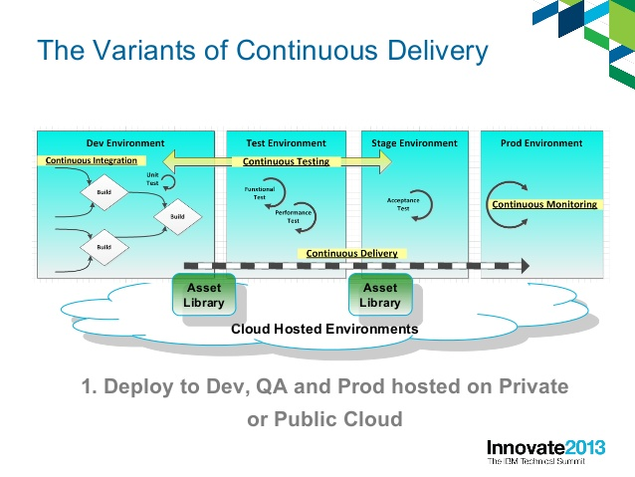

Slide 30
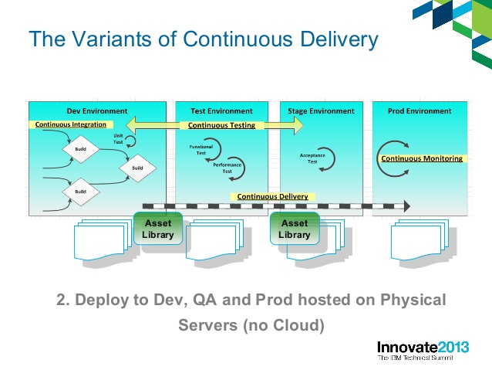

Slide 31
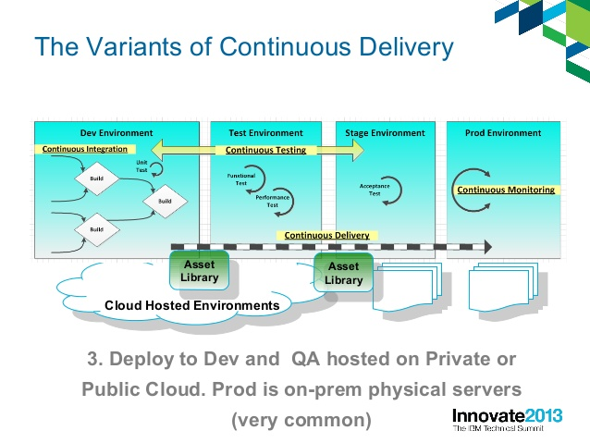

Slide 32
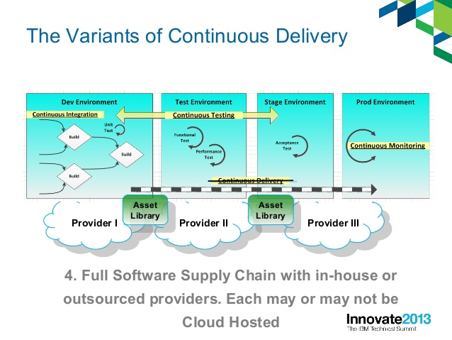

Slide 33
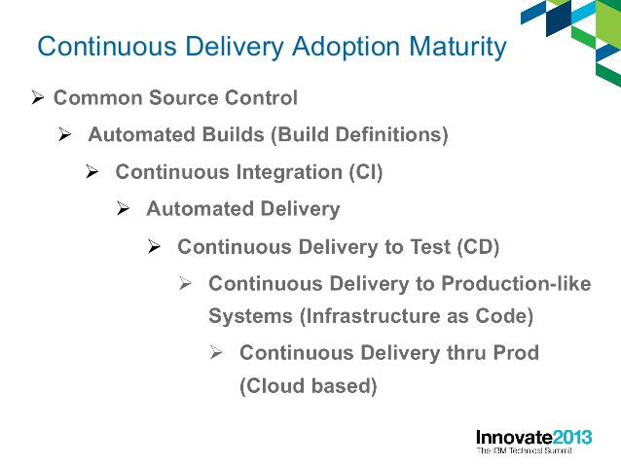

Slide 34
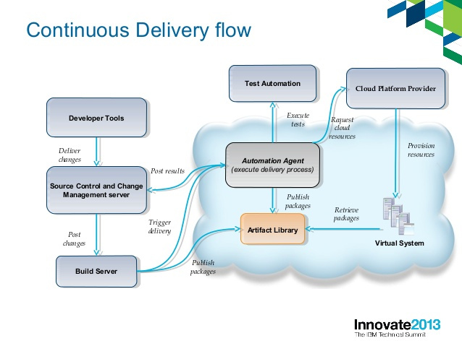

Slide 35
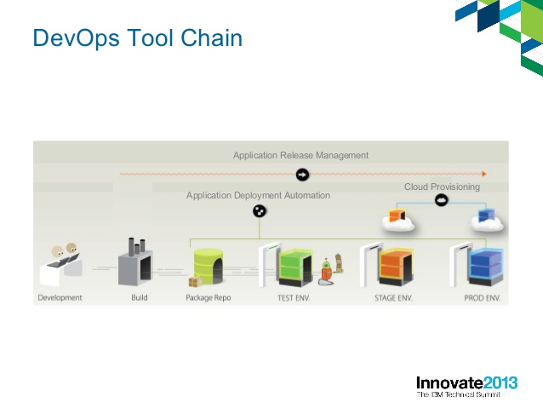

Slide 36
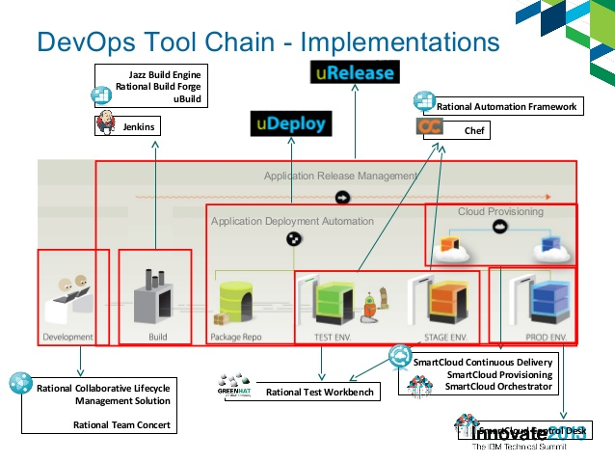

Slide 37
