Slide 1

PROJECT PRESENTATION
Municipal Waste Collection Optimiser
Thatikonda Ashish Reddy
Roll No: 2620030610
Vicharapu Tarun Teja
Roll No: 2620030594
Faculty Guide: Dr. V. Gopikrishna

Slide 2




1
Introduction
Solid waste management is a core responsibility of every municipality
Trucks follow fixed routes, whether bins are full or empty
A Java application that plans efficient collection routes
Lower fuel cost, saved time and a cleaner city
Municipal Waste Collection Optimiser | 2

Slide 3




2
Problem Statement
Static routes: empty bins visited while overflowing bins are skipped
Manual planning wastes fuel, distance and driver hours
No central record of bin status, truck capacity or history
Need: shortest, capacity-aware routes planned automatically
Municipal Waste Collection Optimiser | 3

Slide 4


3
Objectives
Store bins, trucks and zones in one system
Find the shortest route between bins and the dump yard
Prioritise bins that are full or nearly full
Respect truck capacity when assigning bins
Generate reports on distance and waste collected
Municipal Waste Collection Optimiser | 4

Slide 5



4
Existing System
Fixed weekly routes decided manually by supervisors
No real-time knowledge of bin fill levels
Overflowing bins cause complaints and poor hygiene
High fuel use, unnecessary trips, paper-based records
Municipal Waste Collection Optimiser | 5

Slide 6

5
Proposed System
Java application with a database of bins, trucks and zones
City modelled as a graph; Dijkstra / nearest-neighbour routing
Bins assigned to trucks by capacity and fill-level priority
Optimised route list and summary report per truck
Municipal Waste Collection Optimiser | 6

Slide 7






6
System Architecture
User / Admin
Console / Swing UI
Application Layer
Java classes
Optimisation Engine
Route algorithm
Database
Bins | Trucks | Routes
Municipal Waste Collection Optimiser | 7

Slide 8

7
Functionalities
Add, update and delete bins, trucks and zones
Update bin fill levels
Generate an optimised route for each truck
View priority list of bins needing urgent pickup
Report: distance, bins served, waste collected
Municipal Waste Collection Optimiser | 8

Slide 9
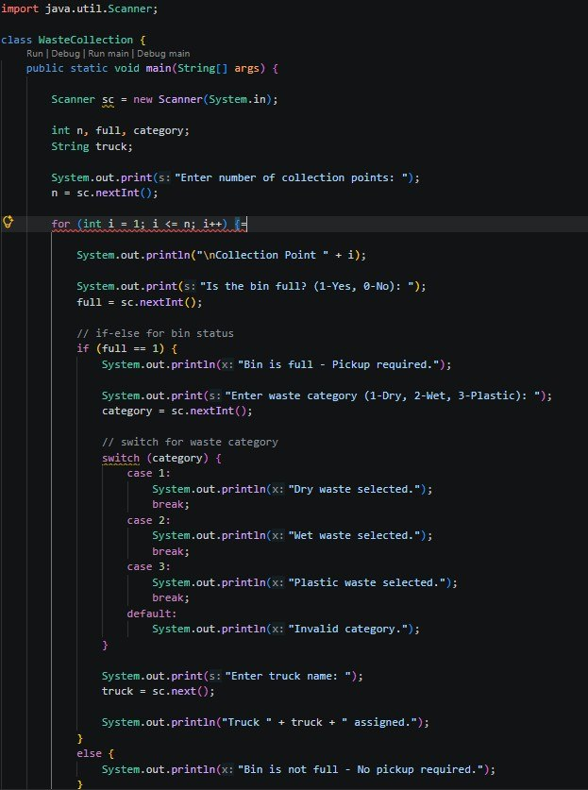
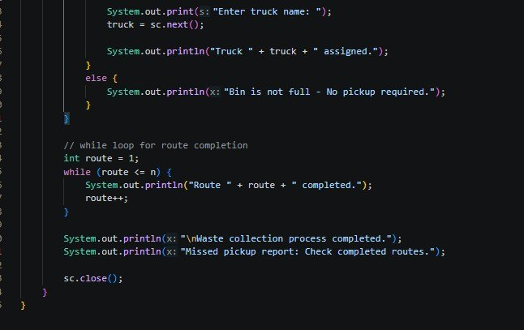
8
Implementation – Java Code Screenshots
Municipal Waste Collection Optimiser | 9

Slide 10
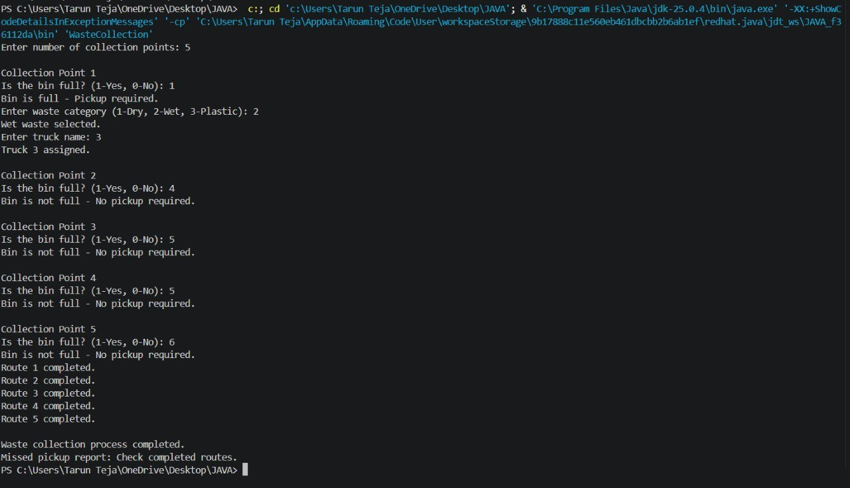
9
Output Screenshots
Municipal Waste Collection Optimiser | 10

Slide 11





10
Future Scope
IoT sensors on bins for live fill-level data
GPS integration and map display of routes
Mobile app for drivers and citizen complaints
Machine learning to predict waste generation
Web dashboard for municipal officers
Municipal Waste Collection Optimiser | 11

Slide 12

11
Conclusion
Replaces fixed routes with data-driven planning
Reduces distance, fuel use and overflowing bins
Built in Java; easy to extend with maps and live sensors
Shows how algorithms improve everyday civic services
Municipal Waste Collection Optimiser | 12

Slide 13

Thank You
Questions are welcome
Thatikonda Ashish Reddy | Vicharapu Tarun Teja

