Slide 1

Voice E-mail System for Blind People

Slide 2
Introduction
Email system using speech recognition could potentially serve as an efficient input method for mailing devices for blind.
The application will be a Interface for visually impaired persons using IVR- Interactive voice response.
Thus enabling everyone to control their mail accounts using their voice only and to be able to read, send, and perform all the other useful tasks. The system will prompt the user with voice commands to perform certain action and the user will respond to the same.

Slide 3
Abstract
The visually challenged people find it very difficult to access the technology because of the fact that using them requires visual perception. Even though many new advancements have been implemented to help them use the computers efficiently no user who is visually challenged can use this technology as efficiently as a normal user can do that. Unlike normal users they require some practice for using the available technologies. This approach aims at developing an email system that will help even a visually impaired person to use the services for communication without prior training. This system will also reduce cognitive load taken by blind to remember and type characters using keyboard. The system will be keyboard independent and will work only on mouse operation and speech recognition. The system is completely based on interactive voice response (IVR) which will make it user friendly and efficient to use.

Slide 4
Existing System
The existing email systems don’t provide any means Talkback service. So, they cannot be used by visually challenged people.
As visually challenged people do not prefer to have laptops and desktops, the use of such developed system are very limited.
Even if the Braille keyboard is used, they have to remember the complex keyboard.

Slide 5
Proposed System
The key opinion kept into consideration while developing the proposed system was accessibility not the look and feel. Such applications will be used efficiently by anyone whether he is able or disable.
Unlike the existing systems which focuses more on GUI friendliness of normal user, our system covers the basic expectations of both normal as well as visually impaired group.

Slide 6
System Requirements
System : Intel Core i5 2.20 GHz
Hard Disk : 1 TB
RAM : 8Gb
Operating System : Windows 10
Gmail Account
Some libraries required from Python
SMTP
Text_to_Speech conversion, Speech_to_text conversion
Word Recognition, easyMapper

Slide 7
Modules
There are 4 Main Modules
Authentication
Sending an email
Reading unread emails
Searching for name related emails

Slide 8
Authentication
In this module, user is asked his username and password.
Once we say the username it will ask us to confirm the username that we said.
Same functionality also with the password.
Then it connects to the server through SMTP server host and authenticates this username and password.
If both are matched then login successful message is said.
Else it will say login failed and will exit the console interface.

Slide 9
Sending an Email
From the main menu, by saying the keyword SEND we can come to this module. In this module, at the first step it will ask the details of the recipient And again it will verify the email address of the recipient. Then it will prompt to say the subject of the email. Then it will prompt to the body of the email. In this process if any network issues takes places it will say that Message is not sent otherwise it will say Message successfully sent. This module is done with SMTP server.

Slide 10
Reading unread emails
From the main menu, by saying the keyword READ we can come to this module. At the first step it will Check the Gmail account for an unread emails with the help of IMAPLIB library in python.
After checking the Gmail it will tell the count of the number of unread emails present in the Gmail account then it will read out the details like Sender, Subject and Message of each mail.

Slide 11
Searching for name related emails
From the main menu, by saying the keyword READ we can come to this module. At the first step it will ask us the username for which the server has to search for the mails. It verifies the username and tells us the number of emails then from the Gmail account and then it displays the username relates emails with the help of IMAPLIB library in python.

Slide 12
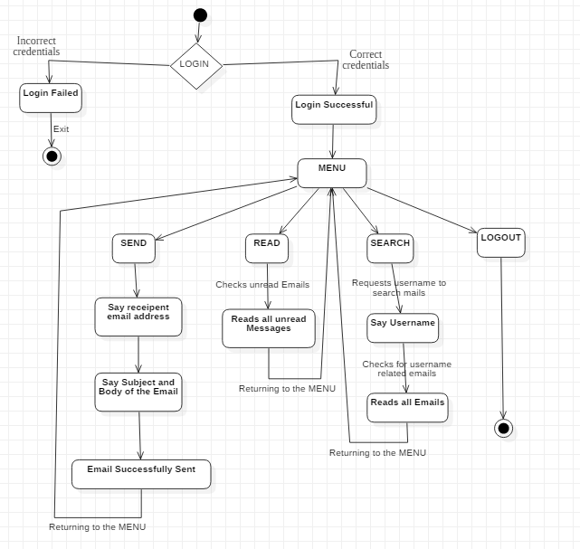
Activity Diagram

Slide 13
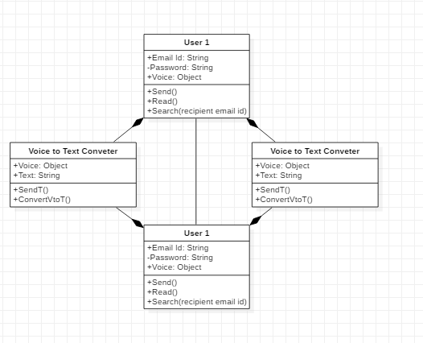
Class Diagram

Slide 14
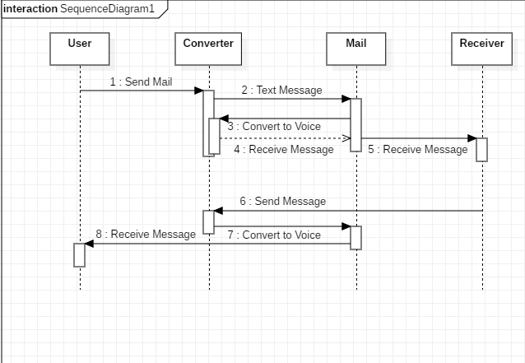
Sequence Diagram

Slide 15
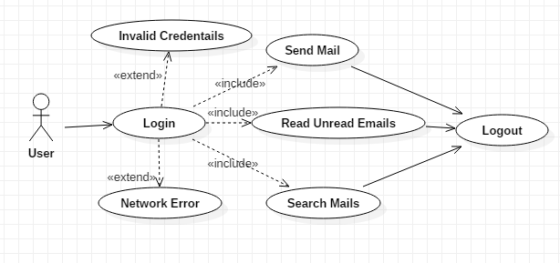
Use-Case Diagram

Slide 16
Sample Code :
try:
username=voice('enter a username')
password=voice('enter password')
server = smtplib.SMTP_SSL(smtp_ssl_host, smtp_ssl_port)
z=server.login(username, password)
server.quit()
except:
speakout('Login Failed please try again later')
sys.exit()
speakout('Login Successful')

Slide 17
Sample Code :
def search(username,password):
search=voice('enter a username to search mails')
count=0
imapper = easyimap.connect('imap.gmail.com',username, password)
for mail_id in imapper.listids(limit=5):
mail = imapper.mail(mail_id)
if(mail.from_addr.find(search)!=-1):
count=count+1
print(count)
speakout('You have')
speakout(count)
speakout('emails with given username')

Slide 18
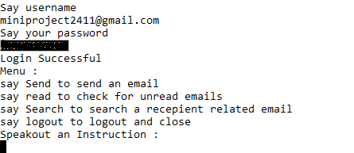
Output screens

Slide 19
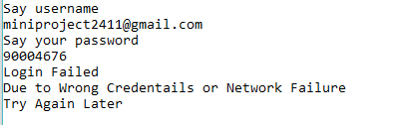
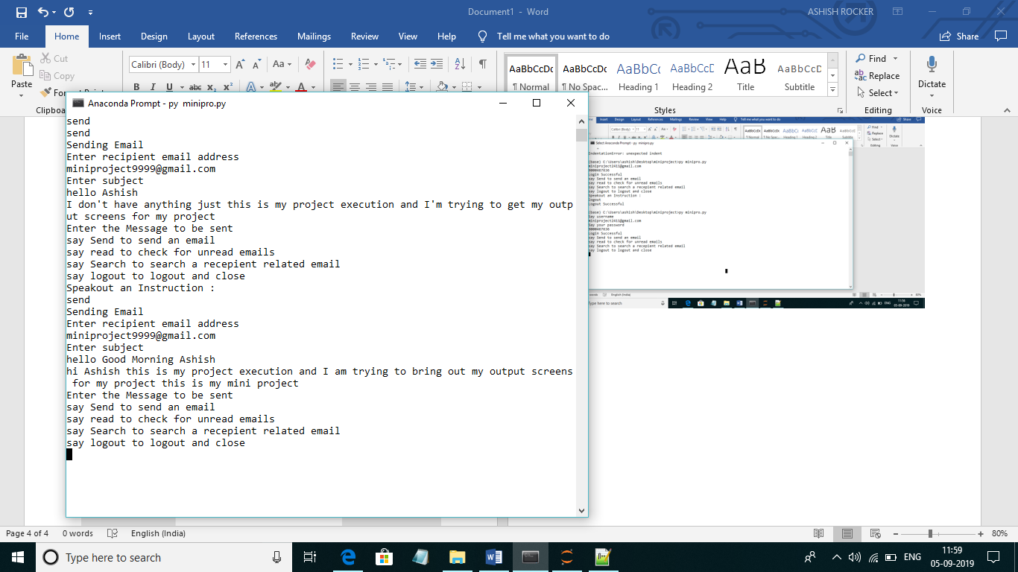

Slide 20
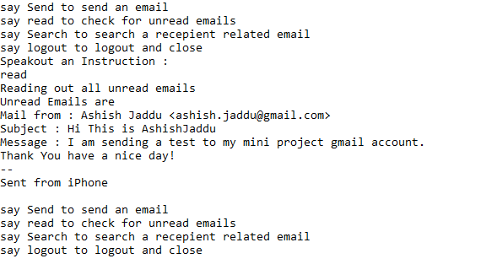

Slide 21
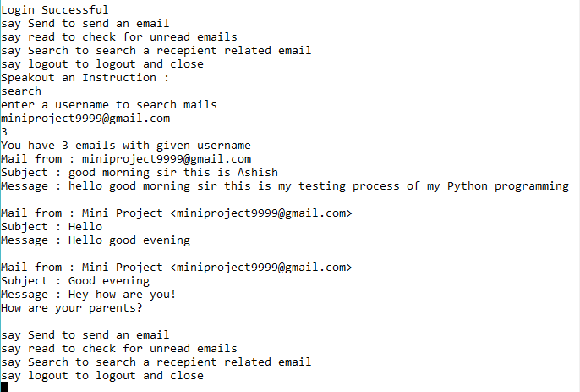

Slide 22
Conclusion
It is basically designed to help handicapped people, who face difficulties in accessing the computer system.
Voice mail architecture helps blind people to access e-mail. It basically describes the voice mail architecture that can be used by blind people to access their e-mails.
This architecture will also reduce cognitive load taken by blind to remember and type characters using the keyboard.

Slide 23
Thank You…

