Slide 1

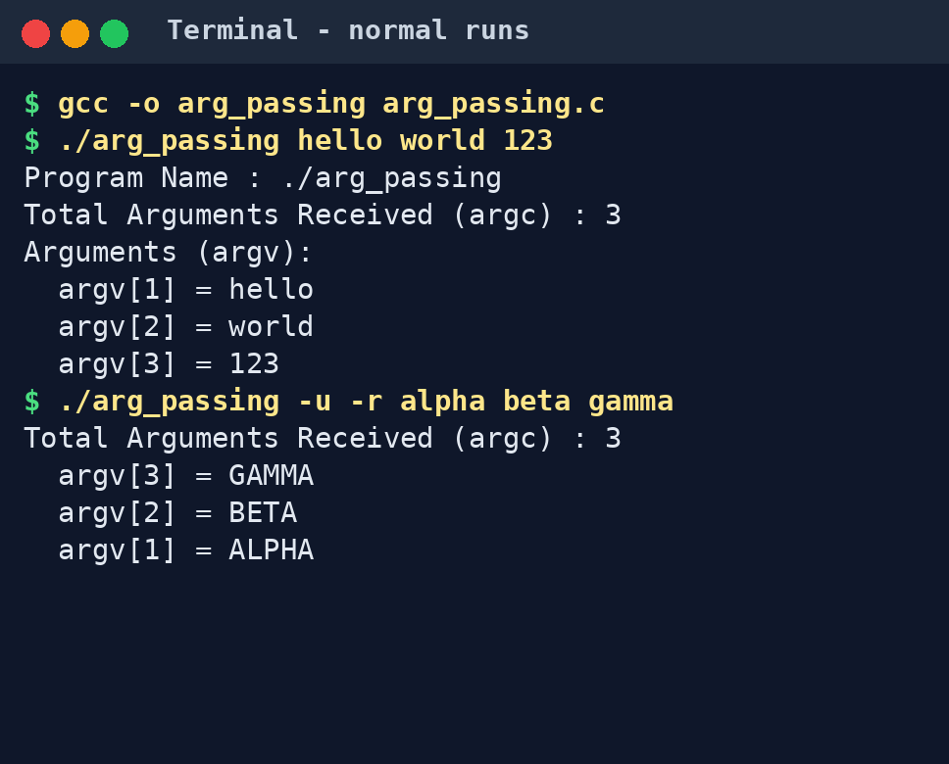
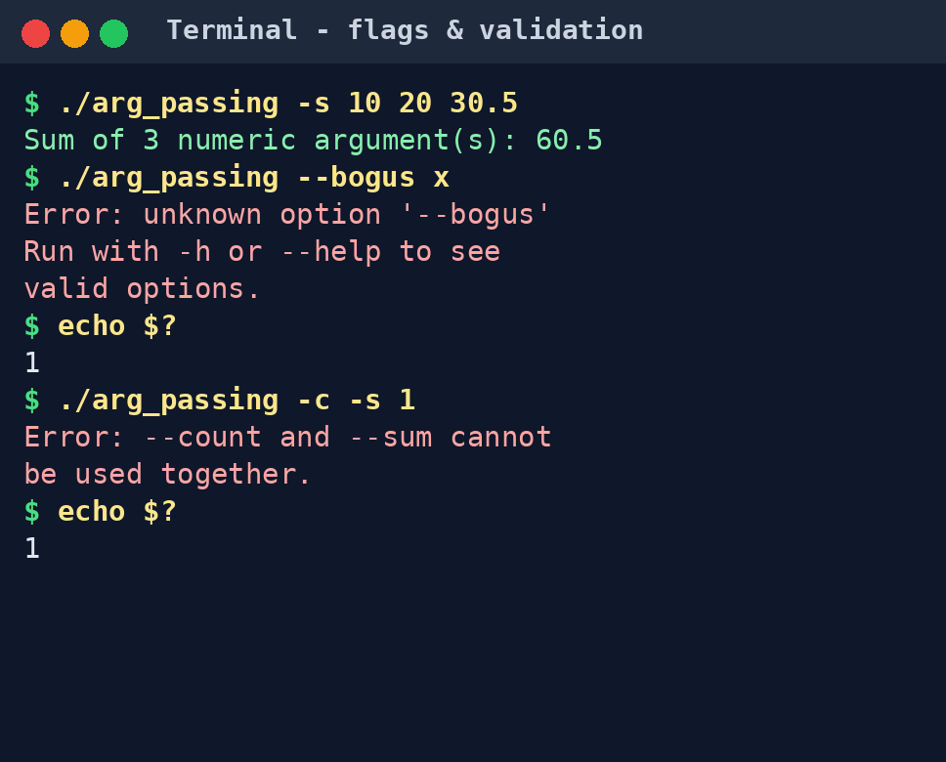

Argument Passing
Team ID: 18 | Section: 4 | Members: Shaik Juneeth – 2520030435, V Ashish Reddy – 2520030415, D Venkata Mahith – 2520030497 | Guide: Ms. Soumya Enukonda
Operating Systems and Systems Programming (OSSP, 25CS2104E) | KLH Bachupally Campus, CSE | PBL 2026–27
Abstract
Tools & Technologies
Argument Passing is a Linux system-programming project showing how command-line values reach a C program through argc and argv when the OS starts a new process. It targets students learning process execution.
Outcome: a C program that receives, validates and processes arguments (flags -h -c -u -r -s), plus a Flask web UI that runs it.
Programming: C (backend), Python/Flask and HTML (web front end)
Platform: Linux / Ubuntu (WSL or native)
OS Concepts: Process creation and execution, command-line arguments, stdout/stderr streams, exit status
System Calls / APIs: argc/argv, getopt_long(), fork()/exec() via shell or subprocess, exit codes
Tools: GCC, VS Code, Git & GitHub
Problem Statement & Objectives
Problem: Programs need input at launch without interactive prompts; scanf() or hard-coded values force recompiling and block scripting.
Objective 1: Pass command-line arguments to a C program via argc and argv.
Objective 2: Compile with GCC, run on Linux and show each argument with its position.
Objective 3: Add flags (-h -c -u -r -s) with input validation and clear errors.
Scope: Linux terminal and Flask web UI; process startup, argv and exit status. No IPC beyond stdout/stderr.
System Workflow / Architecture
User input
Terminal command or web form
Shell / Flask
parses command line, starts process
Linux kernel
fork() + exec() loads program, passes argv
1 → 2 → 3: start-up path
Output
stdout / stderr and exit code
getopt_long()
parses flags, validates input
main(argc, argv)
C program entry point
Existing vs Proposed System
Aspect | Basic / Existing Approach | Proposed Project
Process handling | Input read only after start via scanf()/fgets(); values hard-coded | Arguments handed to the new process at startup via argc/argv
Communication | No standard way to pass several values in at launch | argv[] in; stdout, stderr and exit code returned to the caller
Resource handling | Recompile to change a value; hard to script | One binary reused with any input; no recompiling
Error handling | Bad input silently treated as 0 or ignored | getopt_long checks; stderr message and exit code 1
Key gap | Cannot automate or script input | Flags -h -c -u -r -s plus a web front end
Process, IPC & Resource Design
Parent process
Bash shell or Flask subprocess
fork() + exec(argv)
Child process
./arg_passing
stdout / stderr pipes
exit status via wait()
argv layout in the child (set up by the kernel at exec)
argc
3
argv[0]
./arg_passing
argv[1]
hello
argv[2]
world
argv[3]
NULL
Feasibility Study
Technical: C, GCC and Linux/Ubuntu with standard system interfaces (argc/argv, getopt_long); Flask for the web UI.
Economic: Fully open-source tools (GCC, Flask, VS Code, Git); no hardware or hosting cost.
Operational: Simple to run: one gcc command or python3 app.py; clear help text, error messages and exit codes.
Schedule: Phased within the semester: problem submission, 1st review (basic argc/argv), flags and validation, web UI and testing.
Implementation Screenshots
Results & Testing
Conclusion
Future Scope
Sample: -u -r alpha beta gamma prints GAMMA, BETA, ALPHA; -s 10 20 30.5 gives 60.5.
Tests: normal, no arguments, combined flags, unknown flag, -s with text, -c with -s. Valid runs exit 0; errors exit 1 with a stderr message.
Implemented a C program that receives command-line arguments via argc/argv and extends it with getopt_long flags, validation and a Flask web UI.
It meets all objectives and shows how the OS hands arguments to a new process at exec time.
Enhancement 1: File input and options with values (--name=value).
Enhancement 2: Automated shell test suite; Windows/macOS support.
Enhancement 3: Integrate into larger command-line tools.
References: [1] Linux man-pages (execve(2), getopt_long(3)) [2] Operating Systems textbook / course material (25CS2104E) [3] GCC / GNU documentation [4] Flask documentation
GitHub: github.com/ashishreddy27/Team18_OSSP

