Slide 1
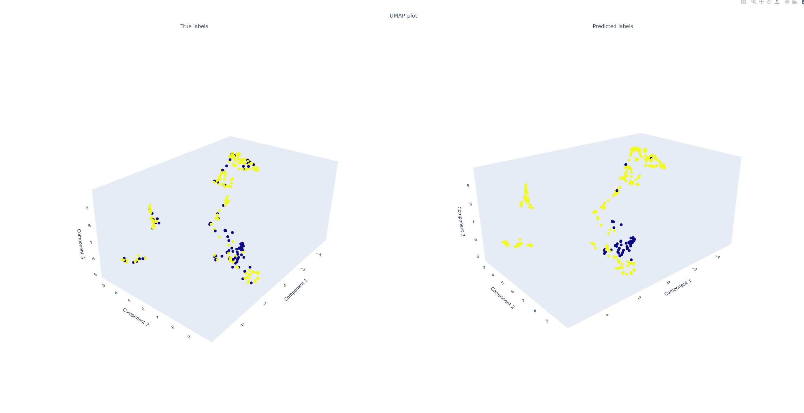
Supervised Learning Classification Model
Read $→$ Process $→$ Learn $→$ Predict
Ashish Kumar February 2, 2022

Slide 2
Outline
Input Data Details
Data Exploration
Data Preprocessing
Model Selection
Coding Ideology
Result and Discussion

Slide 3
Input Data Details
The data seems to be about people data.
The rows were assumed to be i.i.d and not time series (stationarity doesn’t need to be checked)
Contains 560 records
Target is (N – 184 , Y – 398)
First column is assumed to be index
 | feature_0 | feature_1 | feature_2 | feature_3 | feature_4 | feature_5 | feature_6 | feature_7 | feature_8 | feature_9 | feature_10 | feature_11 | feature_12 | target
298 | Female | No | 0 | Graduate | No | 5000 | 2541 | 151 | 480 | 1 | Rural | 0 | No | N
115 | Male | Yes | 1 | Graduate | No | 14583 | 0 | 185 | 180 | 1 | Rural | 1 | No | Y
312 | Female | No | 0 | Graduate | No | 2507 | 0 | 56 | 360 | 1 | Rural | 0 | No | Y
605 | Male | Yes | 0 | Not Graduate | No | 2400 | 3800 |  | 180 | 1 | Urban | 0 | No | N
465 | Male | No | 0 | Graduate | No | 6000 | 0 | 140 | 360 | 1 | Rural | 0 | No | Y
589 | Male | Yes | 2 | Graduate | Yes | 2726 | 0 | 106 | 360 | 0 | Semiurban | 2 | Yes | N
520 | Male | Yes | 2 | Not Graduate | No |  | 1742 | 45 | 360 | 1 | Semiurban | 2 | No | Y
72 | Male | No | 0 | Graduate | No | 3500 | 0 | 81 | 300 | 1 | Semiurban | 0 | No | Y

Slide 4
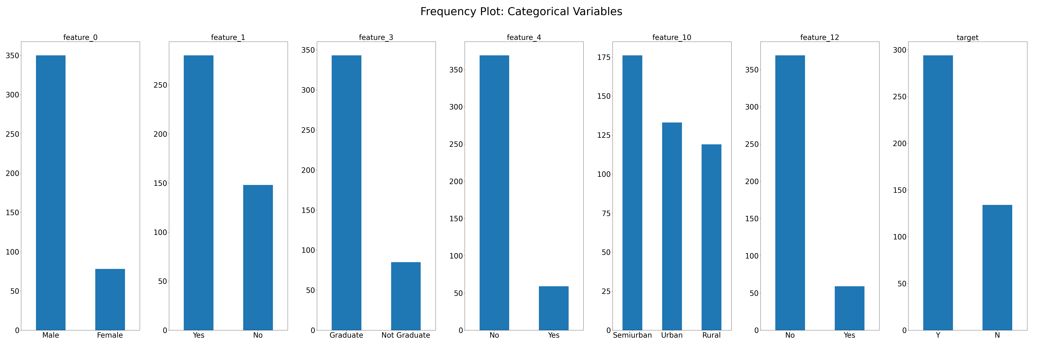
Data Exploration
Frequency plot of categorical variables reveals that:
Most observations are for male who are graduate and lives in semiurban locality
Targets are not distributed equally in the observations
Some features seems redundant

Slide 5
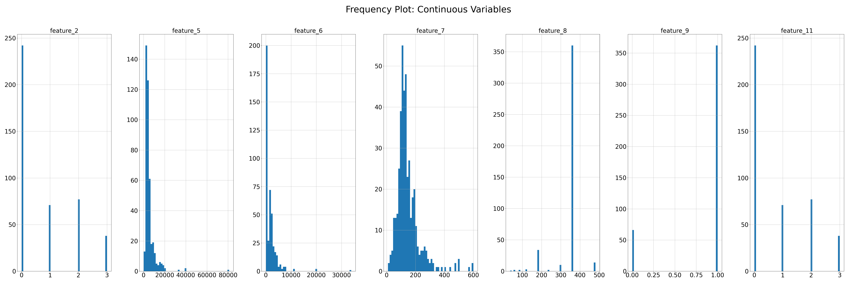
Data Exploration
Frequency plot of continuous variables reveals that:
Features 1, 9 and 11 seems to be categorical variables but already encoded
Feature 5 and 6 seems to have some outlier and skewed
Some features seems redundant

Slide 6
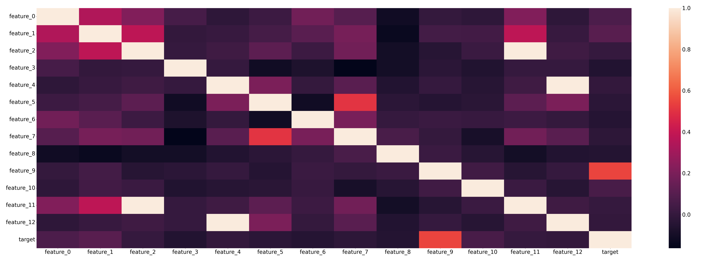
Data Exploration
Correlation plot reveals that:
Features 11 and 2 are identical (highly correlated)
Features 4 and 12 are also identical (highly correlated)

Slide 7
Preprocessing Data
The rows where any feature is not available was dropped
Features 2, 5, 6, 7, 8, 9, 11 was assumed as continuous variables as observed
Features 0, 1, 3, 4, 10, 12 was assumed to be categorical variables
Continuous variables were checked and replaced for non-float values via regex
Continuous variables were converted to numeric data types and then rows were dropped where all features were not available
Final dataset shape is 428 with target distribution of N – 134, Y – 294
Finally remove highly correlated features 11 and 12
 | feature_0 | feature_1 | feature_2 | feature_3 | feature_4 | feature_5 | feature_6 | feature_7 | feature_8 | feature_9 | feature_10 | feature_11 | feature_12 | target
count | 428 | 428 | 428 | 428 | 428 | 428 | 428 | 428 | 428 | 428 | 428 | 428 | 428 | 428
unique | 2 | 2 |  | 2 | 2 |  |  |  |  |  | 3 |  | 2 | 2
top | Male | Yes |  | Graduate | No |  |  |  |  |  | Semiurban |  | No | Y
freq | 350 | 280 |  | 343 | 369 |  |  |  |  |  | 176 |  | 369 | 294
mean |  |  | 0.792056 |  |  | 5429.023 | 1599.143 | 145.6963 | 342.5327 | 0.845794 |  | 0.792056
std |  |  | 1.029419 |  |  | 5738.449 | 2713.845 | 81.98727 | 65.7784 | 0.361568 |  | 1.029419
min |  |  | 0 |  |  | 150 | 0 | 9 | 36 | 0 |  | 0
25% |  |  | 0 |  |  | 2942 | 0 | 100 | 360 | 1 |  | 0
50% |  |  | 0 |  |  | 3901 | 1062 | 127.5 | 360 | 1 |  | 0
75% |  |  | 2 |  |  | 6000 | 2250 | 172 | 360 | 1 |  | 2
max |  |  | 3 |  |  | 81000 | 33837 | 600 | 480 | 1 |  | 3

Slide 8
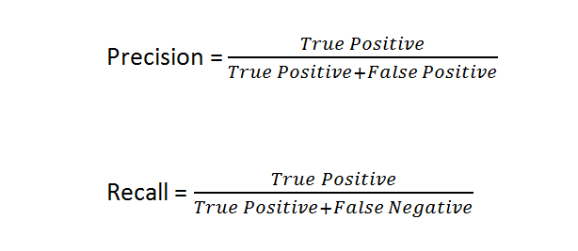
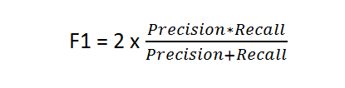
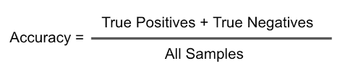
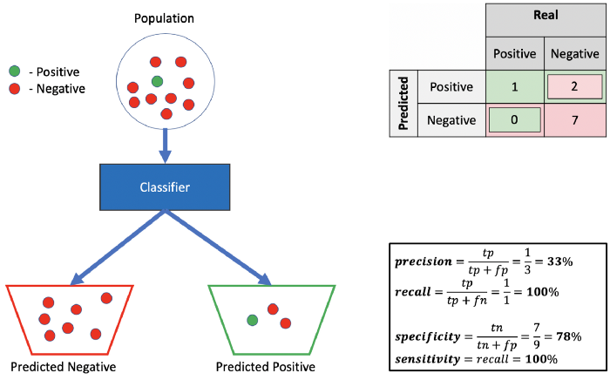
Model Selection
Eight different models were trained and tested:
Nearest Neighbors
Support Vector Machines
Decision Trees
Random Forest
Xtreme Gradient Boosting
Extra Tree
Bagging
Gradient Boosting
Final model was selected based on:
Average accuracy for test set
Simplicity of the model (since training sample size is very small)
Final selected model was Support Vector Machines Classifier
The models hyperparameters were tuned via grid search with cross-validation
For class Positive
https://towardsdatascience.com/should-i-look-at-precision-recall-or-specificity-sensitivity-3946158aace1

Slide 9
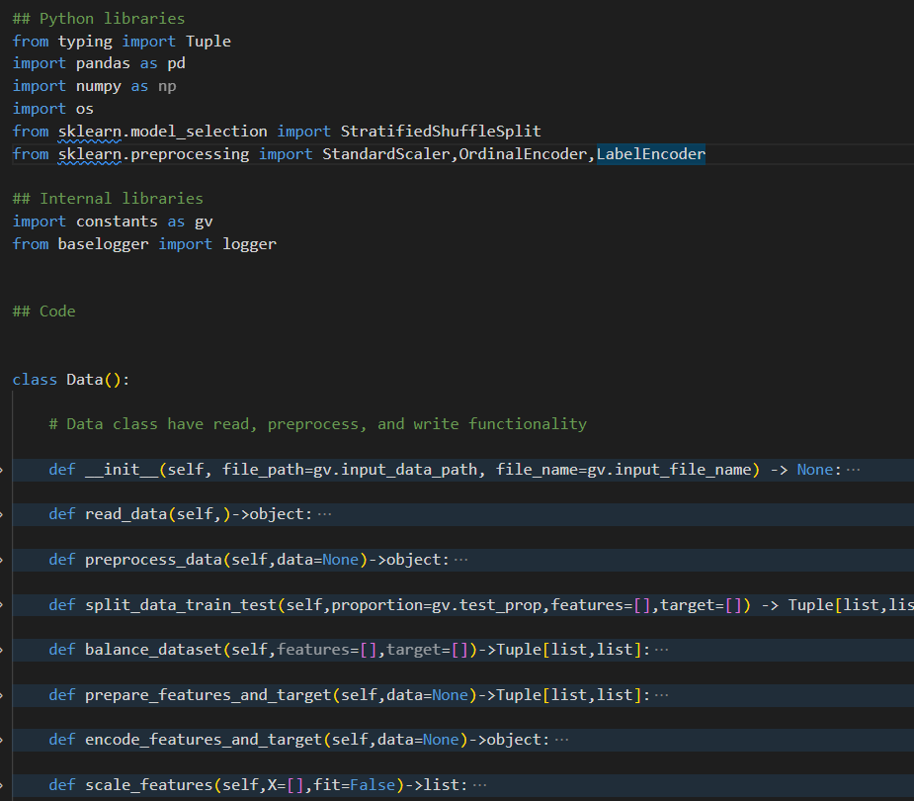



Coding Ideology
The model is coded using object-oriented programming (OOP)
Everything ( data reading, model building, plotting, etc.) is coded as classes
Inheritance is a key element
Easy to find bugs
Easy to add additional features
Use of efficient data structure using dictionaries
Explicit return type definitions
No hard coding
Easy to modify the code for different use cases
Pythonic coding to have least amount of code
Methods /Functions to avoid redundant codes
Logging is key to finding run-time issues

Slide 10
Results and Discussion
Test Statistics
Method | Average Accuracy | Class_N: Precision, Recall, F1-Score | Class_Y: Precision, Recall, F1-Score | Macro Avg: Precision, Recall, F1-Score | Weighted Avg: Precision, Recall, F1-Score
Nearest Neighbors | 0.783333 | 0.80 , 0.41 , 0.55 | 0.78 , 0.95 , 0.86 | 0.79 , 0.68 , 0.70 | 0.79 , 0.78 , 0.76
Gradient Boosting | 0.776667 | 0.70 , 0.50 , 0.58 | 0.80 , 0.90 , 0.85 | 0.75 , 0.70 , 0.72 | 0.77 , 0.78 , 0.76
Random Forest | 0.756667 | 0.82 , 0.29 , 0.43 | 0.75 , 0.97 , 0.85 | 0.78 , 0.63 , 0.64 | 0.77 , 0.76 , 0.71
Support Vector Machines | 0.81 | 0.86 , 0.47 , 0.61 | 0.80 , 0.97 , 0.87 | 0.83 , 0.72 , 0.74 | 0.82 , 0.81 , 0.79
Xtreme Gradient Boosting | 0.773333 | 0.70 , 0.48 , 0.57 | 0.79 , 0.91 , 0.85 | 0.75 , 0.69 , 0.71 | 0.76 , 0.77 , 0.76
Decision Tree | 0.686667 | 0.50 , 0.55 , 0.53 | 0.79 , 0.75 , 0.77 | 0.64 , 0.65 , 0.65 | 0.70 , 0.69 , 0.69
ExtraTree | 0.743333 | 0.67 , 0.36 , 0.47 | 0.76 , 0.92 , 0.83 | 0.71 , 0.64 , 0.65 | 0.73 , 0.74 , 0.72
Bagging | 0.716667 | 0.76 , 0.14 , 0.23 | 0.71 , 0.98 , 0.83 | 0.74 , 0.56 , 0.53 | 0.73 , 0.72 , 0.64

Slide 11
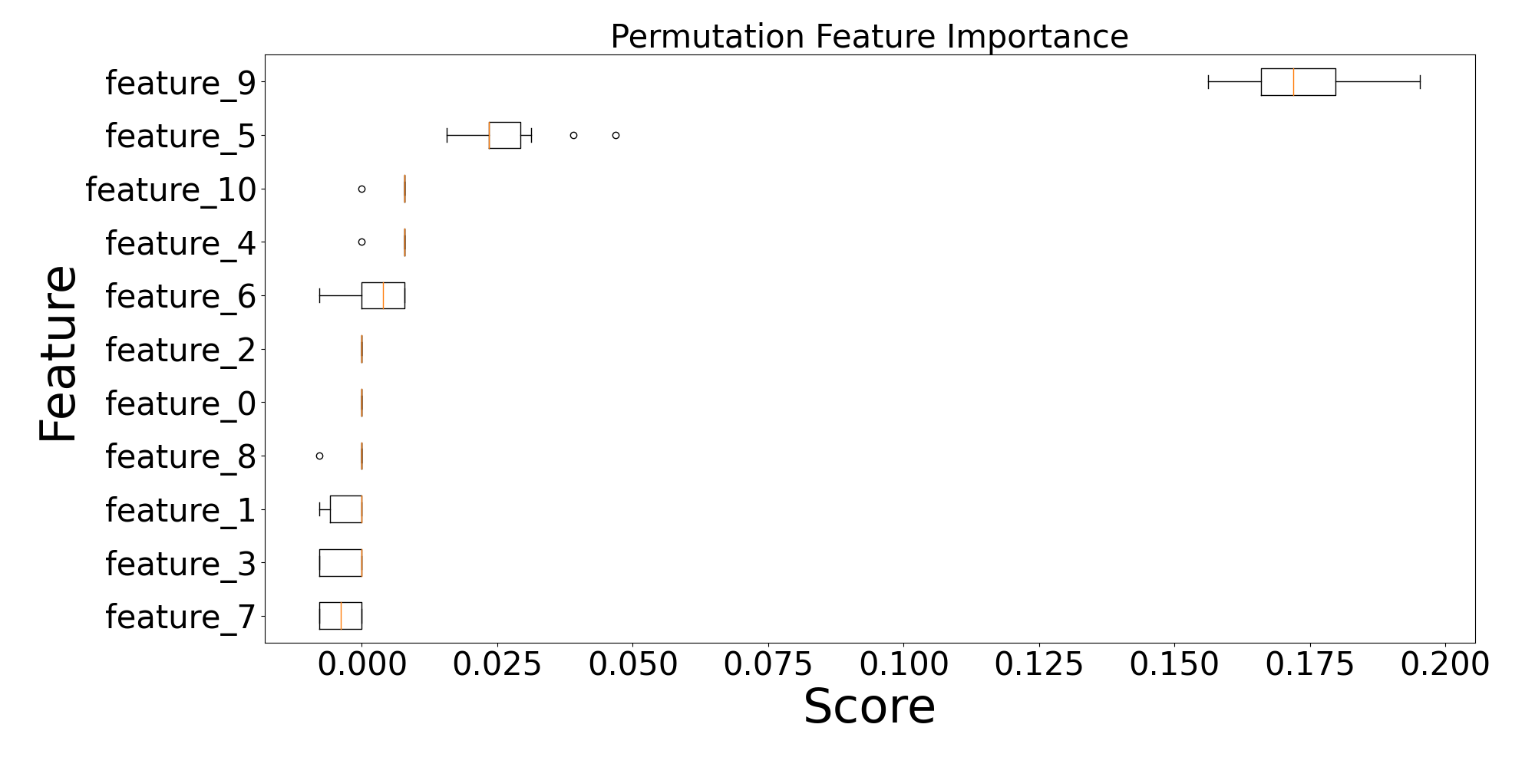
Results and Discussion
Feature Importance

Slide 12
Results and Discussion
Visualization of Predictions

Slide 13
Thank You!

Slide 14
Primary Colours
Secondary Colours
Confidential Information

Slide 15
Dark Background
Confidential Information

Slide 16
Light Background
Confidential Information

