Slide 1
Diffraction is bending of light. For diffraction to occur the size of the obstacle should be
Comparable to wavelength of light.

Slide 2
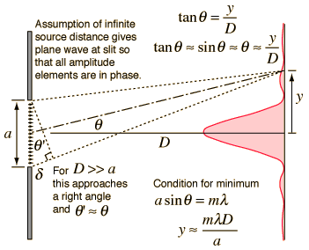
Fraunhofer Diffraction at rectangular aperture
Fraunhofer Diffraction Geometry

Slide 3
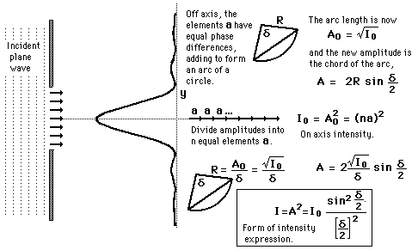
Single Slit Amplitude Construction
The wave arrives at the single slit as a plane wave. It can be divided into segments, each of
which can be regarded as a point source. The amplitudes of the segments will have a constant
phase displacement from each other, and will form segments of a circular arc when added as
vectors. In this way, the intensity of a single slit can be constructed.

Slide 4
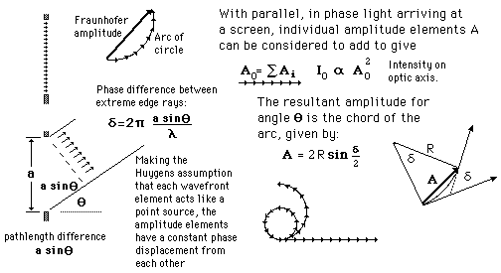
Graphical Amplitudes: Single Slit
The wave arrives at the single slit as a plane wave. Divided into segments, each of which can be
regarded as a point source, the amplitudes of the segments will have a constant phase
displacement from each other, and will form segments of a circular arc when added as vectors.
In this way, the single slit intensity can be constructed.

Slide 5




Single Slit Diffraction Intensity
The wave arrives at the single slit as a plane wave. Divided into segments, each of which can be
regarded as a point source, the amplitudes of the segments will
have a constant phase displacement from each other, and will form segments of a circular arc
when added as vectors. The resulting relative intensity will depend upon the total phase
displacement according to the relationship:

Slide 6
Questions
Q1. Explain Diffraction.
Q2. Explain the intensity pattern for the diffraction at a rectangular aperture.
Q3. Explain the phasor method of finding the resultant amplitude.
University questions
Discuss the Fraunhofer diffraction at a single slit & obtain the conditions for principle maxima
& minima. Draw the intensity distribution curve. (1 dia+2 der+1+1+1+1,
max, min, sec max, Icurve)
2. What is diffraction of light? What are the types of diffraction? Distinguish between them. 4M

Slide 7
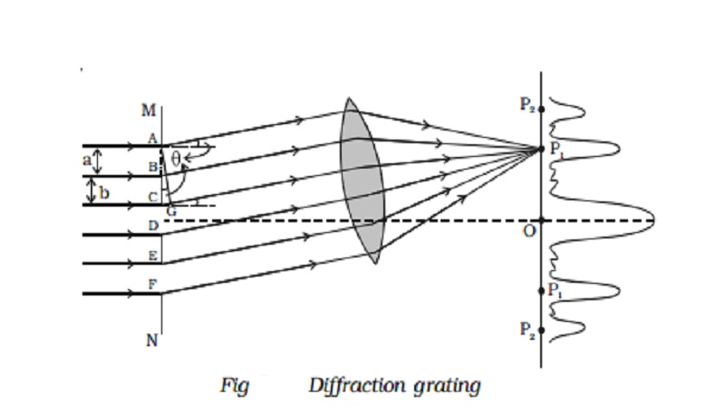
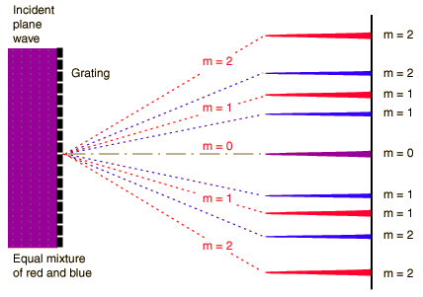

Diffraction Grating
When there is a need to separate light of different wavelengths with high resolution, then a diffraction grating is used. A large number of parallel, closely spaced slits constitutes a diffraction grating. The condition for maximum intensity is the same as that for the double slit or multiple slits, but with a large number of slits the intensity maximum is very sharp and narrow, providing the high resolution for spectroscopic applications. The peak intensities are also much higher for the grating than for the double slit.
Though condition for maximum intensity is the same as that for a double slit. However, angular separation of the maxima is generally much greater because the slit spacing is so small for a diffraction grating.

Slide 8
Questions
Explain what is a diffraction grating and the reason for its invention.
Explain the intensity pattern of a diffraction grating
Why are the secondary maximas not visible.
University Question:
Give the theory of plane diffraction grating. Obtain the conditions for the formation of the principle maxima & minima. (1dia+2 derv+1+1+1 max,min, sec max)

Slide 9
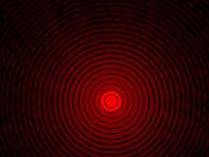

Diffraction due to circular apertures
The diffraction pattern resulting from a uniformly illuminated, circular aperture has a bright central region, known as the Airy disk, which together with the series of concentric rings around is called the Airy pattern. Both are named after George Biddell Airy.
The most important application of this concept is in cameras and telescopes. Due to diffraction, the smallest point to which a lens or mirror can focus a beam of light is the size of the Airy disk. Even if one were able to make a perfect lens, there is still a limit to the resolution of an image created by such a lens. An optical system in which the resolution is no longer limited by imperfections in the lenses but only by diffraction is said to be diffraction limited.

Slide 10
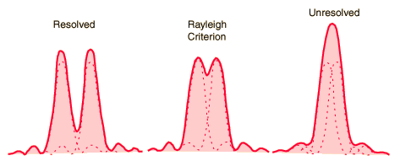
The Rayleigh Criterion
The Rayleigh criterion is the generally accepted criterion for the minimum resolvable detail – the
imaging process is said to be diffraction-limited when the first diffraction minimum of the image of
onesource point coincides with the maximum of another.

Slide 11
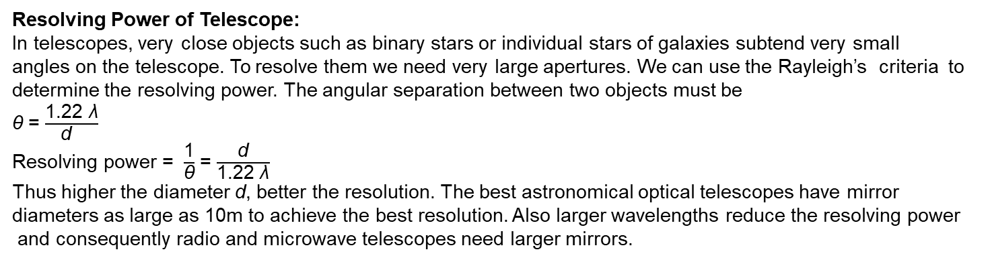
Resolving Power of Telescope:
In telescopes, very close objects such as binary stars or individual stars of galaxies subtend very small
angles on the telescope. To resolve them we need very large apertures. We can use the Rayleigh’s criteria to
determine the resolving power. The angular separation between two objects must be
θ = $\frac{\text{1.22 }\text{λ}}{\text{d} }$
Resolving power = $\frac{\text{1}}{\text{θ}}$ = $\frac{\text{d}}{\text{1.22 }\text{λ}}$
Thus higher the diameter d, better the resolution. The best astronomical optical telescopes have mirror
diameters as large as 10m to achieve the best resolution. Also larger wavelengths reduce the resolving power
and consequently radio and microwave telescopes need larger mirrors.
θ
θ
θ

Slide 12
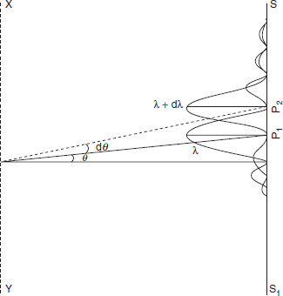
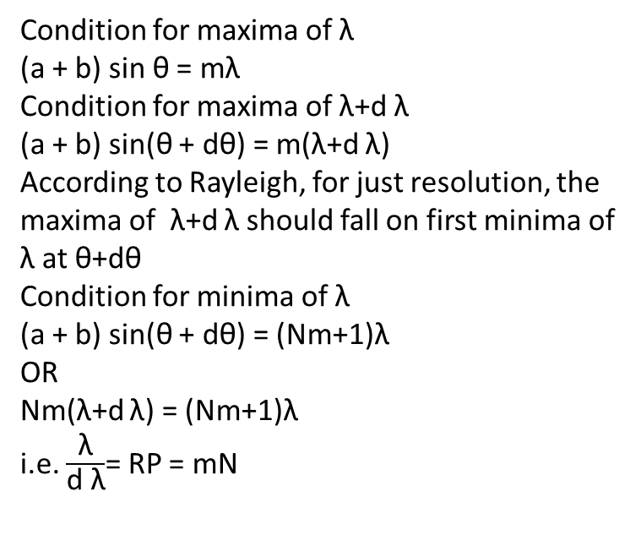
Resolving Power of Diffraction Grating
Condition for maxima of λ
(a + b) sin θ = mλ
Condition for maxima of λ+d λ
(a + b) sin(θ + dθ) = m(λ+d λ)
According to Rayleigh, for just resolution, the maxima of λ+d λ should fall on first minima of λ at θ+dθ
Condition for minima of λ
(a + b) sin(θ + dθ) = (Nm+1)λ
OR
Nm(λ+d λ) = (Nm+1)λ
i.e. $\frac{\text{λ}}{\text{d} \text{λ}}$= RP = mN

Slide 13
Questions
Q1. State Rayleigh’s criterion of resolution. Hence obtain an expression for the resolving power of a grating. (2rayleigh+1dia+3derv)
Q2. State Rayleigh’s criterion of resolution. Hence obtain an expression for the resolving power of a telescope. (2rayleigh+1dia+3derv)

