Slide 1
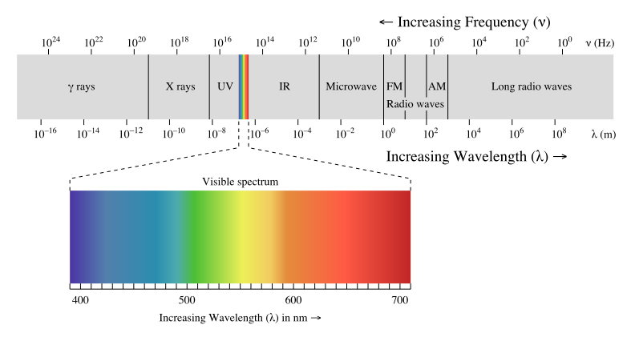
The electromagnetic spectrum is a continuum of all electromagnetic waves arranged according to frequency and wavelength.
7 Types of Electromagnetic Waves are:
Radio Waves: Instant Communication.
Microwaves: Data and Heat.
Infrared Waves: Invisible Heat.
Visible Light Rays. ...
Ultraviolet Waves: Energetic Light. ...
X-rays: Penetrating Radiation. ...
Gamma Rays: Nuclear Energy.
Electromagnetic waves are ubiquitous in nature (i.e., light) and used in modern technology—AM and FM radio, cordless and cellular phones, garage door openers, wireless networks, radar, microwave ovens, etc. These and many more such devices use electromagnetic waves to transmit data and signals.
The Production of EM waves. ... An accelerating charged particle produces an electromagnetic (EM) wave. Electromagnetic waves are electric and magnetic fields traveling through empty space with the speed of light. A charged particle oscillating about an equilibrium position is an accelerating charged particle.

Slide 2
Interference
Superposition of two coherent waves

Slide 3
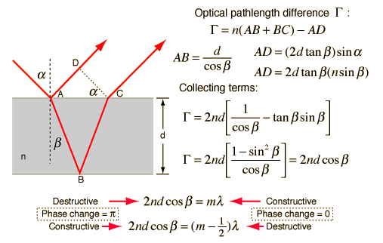
Interference Condition for Thin Films
Colour formation in thin films
Different wavelengths travel with different velocities and separate in the medium of refractive index μ.
Each wavelength produces its interference pattern independent of others and forms colours.

Slide 4
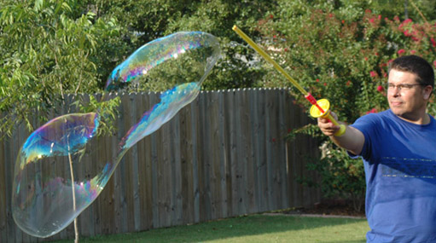
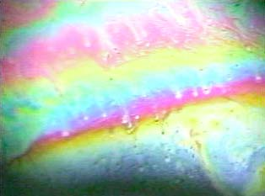
Thick and Thin films:
Very thick film shows general illuminations while very thin film appear black.

Slide 5
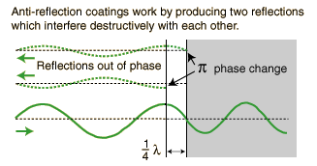
Applications of Interference
Anti-Reflection Coatings
Thin film anti-reflection coatings greatly reduce the light loss in multi-element lenses by making use of phase
changes and the dependence of the reflectivity on index of refraction. A single quarter-wavelength coating of
optimum index can eliminate reflection at one wavelength. Multilayer coatings can reduce the loss over the
visible spectrum.
The idea behind anti-reflection coatings is that the creation of a double interface by means of a thin film gives
you two reflected waves. If these waves are out of phase, they partially or totally cancel. If the coating is a
quarter wavelength thickness and the coating has an index of refraction less that the glass it is coating then
the two reflections are 180 degrees out of phase.

Slide 6
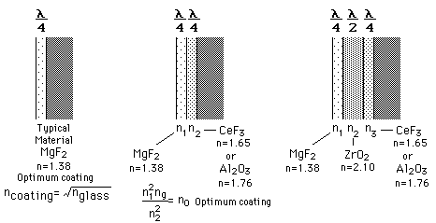
Multi-Layer Anti-Reflection Coatings
A single layer anti reflection coating can be made non-reflective only at one wavelength, usually at the middle
of the visible. Multiple layers are more effective over the entire visible spectrum.

Slide 7
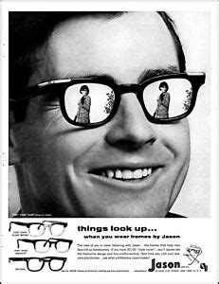

reflector
Anti reflection coating

Slide 8
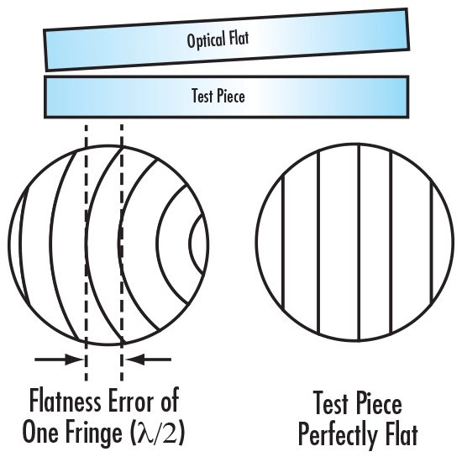
Test optical Flatness of a surface
An optical flat utilizes the property of interference to exhibit the flatness on a desired surface. When an optical flat, also known as a test plate, and a work surface are placed in contact, an air wedge is formed. Areas between the flat and the work surface that are not in contact form this air wedge. The change in thickness of the air wedge will dictate the shape and orientation of the interference bands. The amount of curvature that is shown by the interference bands can be used to determine the flatness of the surface.

Slide 9
Questions
1. A thin film of uniform thickness is illuminated by monochromatic light. Obtain the conditions of
darkness and brightness of the film as observed in reflected light. (1dia + 1steps + 2each
for bright and dark bands)
2. Explain the use of thin film as antireflection coating. 1dia+3 exp
3. When seen by reflected light, why does an excessively thin film appear to be perfectly black
When illuminated by white light? 3M
5. Explain how thin film is used for testing the optical flatness of surfaces…….. 3M
6. Short notes (3marks each)
(i)Color formation in thin films
(ii)Use of extended source
(iii) Application of optically flat surfaces and non reflecting films.

