Slide 1
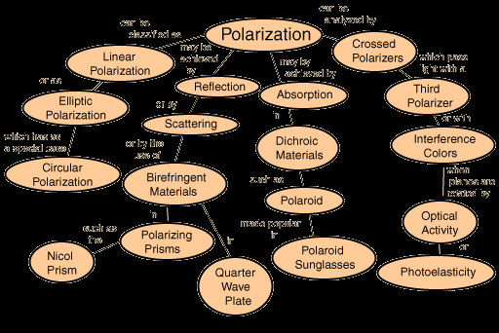

Slide 2
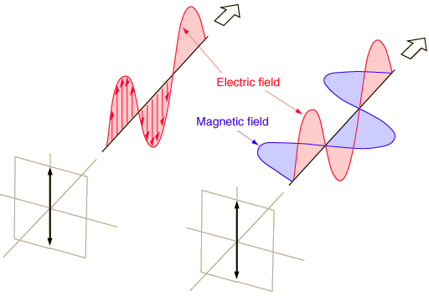
Linear Polarization
A plane electromagnetic wave is said to be linearly polarized. The transverse
electric field wave is accompanied by a magnetic field wave as illustrated.

Slide 3
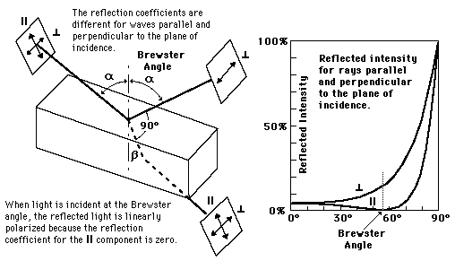
Polarization by Reflection

Slide 4
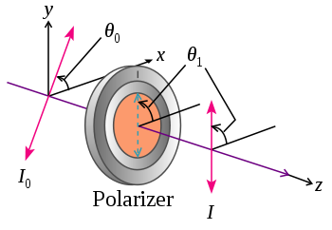

Law of Malus
Malus' law, which is named after Etienne-Louis Malus, says that when a perfect polarizer
is placed in a polarized beam of light, the intensity, I, of the light that passes through is
given by
where
I₀ is the initial intensity,
and θ_{i} is the angle between the light's initial polarization direction and the axis of the
polarizer.
A beam of unpolarized light can be thought of as containing a uniform mixture
of linear polarizations at all possible angles. Since the average value of cos²θ
is 1/2, the transmission coefficient becomes
In practice, some light is lost in the polarizer and the actual transmission of unpolarized light will be somewhat lower than this, around 38% for Polaroid-type polarizers but considerably higher (>49.9%) for some birefringent prism types.

Slide 5
Question
1. Explain the terms unpolarised light & plane polarized light. State Brewster’s law.
Hence obtain a relation between polarizing angle & the refractive index of the transparent
medium. (1+1+1+1dia+2)

Slide 6
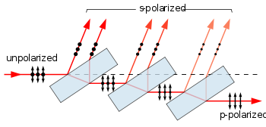
Polarization by reflection
A stack of plates at Brewster's angle to a beam reflects off a fraction of the s-polarized light at each surface, leaving a p-polarized beam. Full polarization at Brewster's angle requires many more plates than shown. The arrows indicate the direction of the electrical field, not the magnetic field, which is perpendicular to the electric field

Slide 7
Question
Q1. Explain how the phenomenon of refraction can be used to polarize light. (1dia+3)

Slide 8
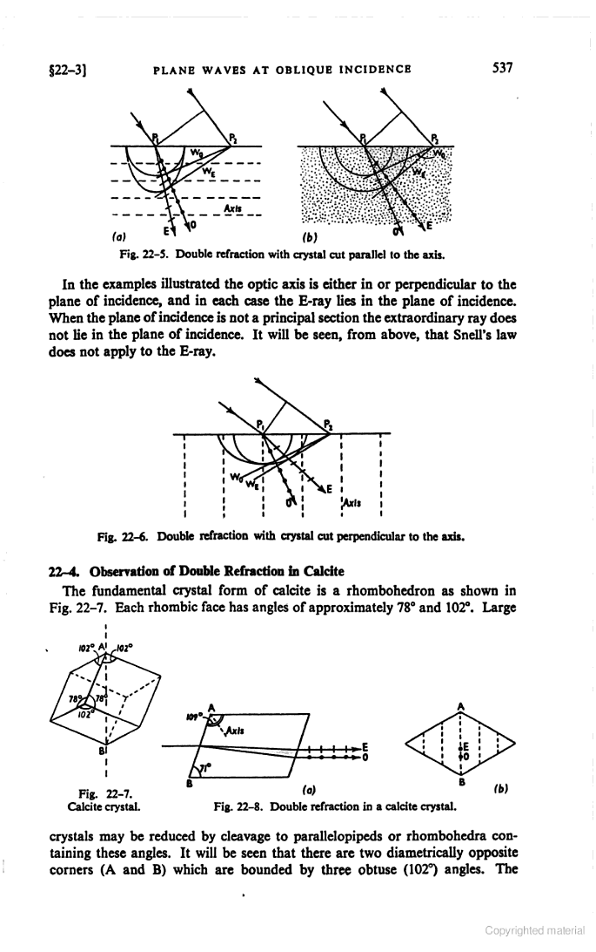
Geometry of calcite crystal
The optic axis of a crystal is the direction in which a ray of transmitted light suffers no birefringence (double refraction). Due to the internal structure of the crystal (the specific structure of the crystal lattice, the form of atoms or molecules of its components), light propagates along the optical axis differently than in other directions. So if the light would propagate along the optical axis of a uniaxial crystal (e.g. calcite, quartz), then nothing unusual happens. Light propagates along that axis with a speed independent of its polarization. However, if the light beam is not parallel to the optical axis, then, when passing through the crystal the beam is split into two rays: the ordinary and extraordinary, to be mutually perpendicular polarized. A crystal which has only one optic axis is called uniaxial crystal. An uniaxial crystal is isotropic within the plane orthogonal to the optical axis of the crystal. A crystal which has only two optic axes is called biaxial crystal

Slide 9
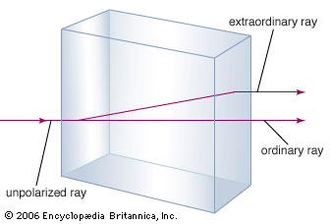

Birefringent polarizers or double refractors
Other linear polarizers exploit the birefringent properties of crystals such as quartz
and calcite. In these crystals, a beam of unpolarized light incident on their surface
is split by refraction into two rays. Snell's law holds for one of these rays, the
ordinary or o-ray, but not for the other, the extraordinary or e-ray. In general the
two rays will be in different polarization states, though not in linear polarization
states except for certain propagation directions relative to the crystal axis. The
two rays also experience differing refractive indices in the crystal.

Slide 10
Positive Crystal | Negative Crystal
v_{o}>v_{e} | v_{o}<v_{e}
μ_{e}>μ_{o} | μ_{e}<μ_{o}
Eg: Calcite | Eg: Quartz

Slide 11
Questions
Q1. Explain the geometry of calcite crystal and hence explain the terms optic axis and principal
section (1 dia+1 exp +2 each)
Q2. Differentiate between the positive and negative crystals

Slide 12
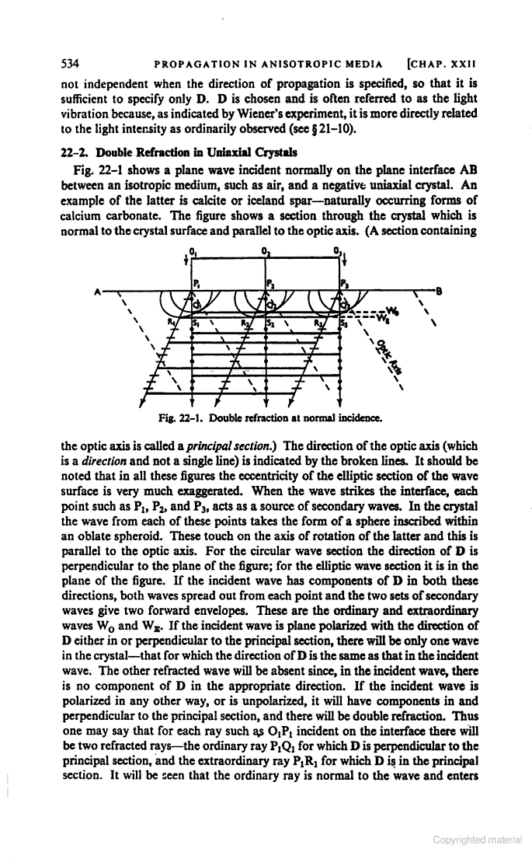
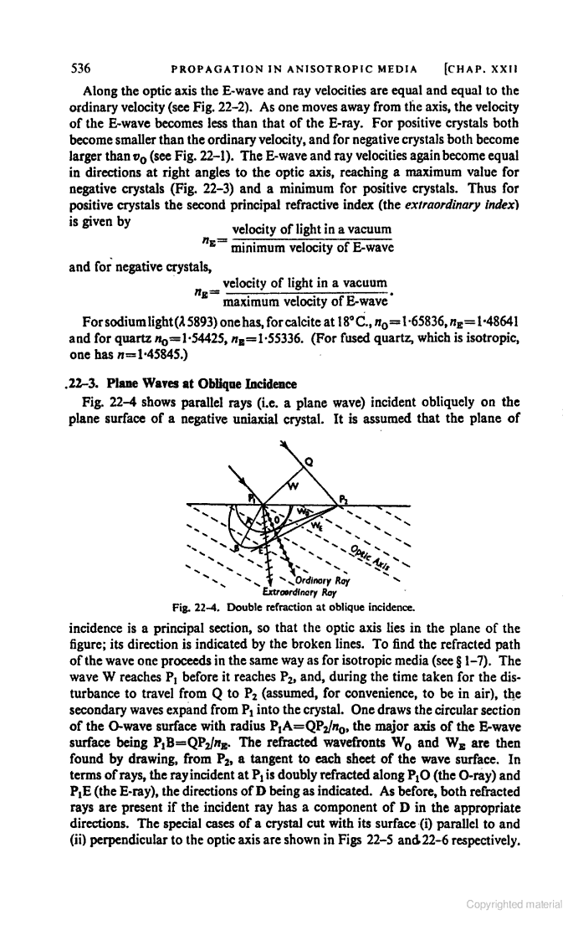
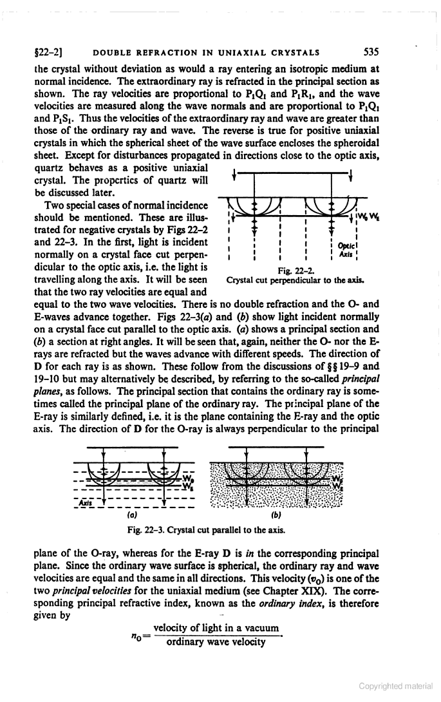
Propagation of light with reference to optic axis
The refractive index of the ordinary ray is constant for any direction in the crystal, and the extraordinary ray variable and depends on the direction. In a uniaxial crystal for the direction parallel to the optical axis of the refractive indices are equal.

Slide 13
Questions
Explain the phenomenon of double refraction on the basis of Huygen’s wave theory.
(2dia+4 exp)

Slide 14
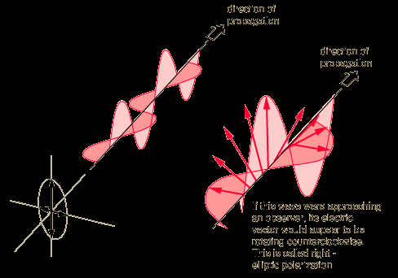
Elliptical polarization
In electrodynamics, elliptical polarization is the polarization of electromagnetic
radiation such that the tip of the electric field vector describes an ellipse in any
fixed plane intersecting, and normal to, the direction of propagation. An elliptically
polarized wave may be resolved into two linearly polarized waves in phase
quadrature, with their polarization planes at right angles to each other. Since the
electric field can rotate clockwise or counterclockwise as it propagates, elliptically
polarized waves exhibit chirality.
Other forms of polarization, such as circular and linear polarization, can be
considered to be special cases of elliptical polarization.

Slide 15
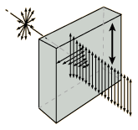
Polarization by Absorption
A number of crystalline materials absorb more light in one incident plane than another, so that
light progressing through the material become more and more polarized as they proceed. This
anisotropy in absorption is called dichroism. There are several naturally occurring dichroic
materials, and the commercial material polaroid also polarizes by selective absorption.
Dichroic Materials
Materials which have different absorption for perpendicular incident planes for light are
said to be dichroic. The mineral tourmaline is the best known of natural materials.
Tourmaline refers to a class of boron silicates. A tourmaline crystal has a unique optic axis,
and any electric field vector which is perpendicular to that axis is strongly absorbed.
Polaroid is strongly dichroic and therefore an effective polarizer. If the transmission axes
of ideal polarizers are perpendicular, no light is transmitted. The light tranmitted at other
angles follows the Law of Malus.

Slide 16
Question
Q1. Define Dichroism & The Law Of Malus. (2 each)

Slide 17
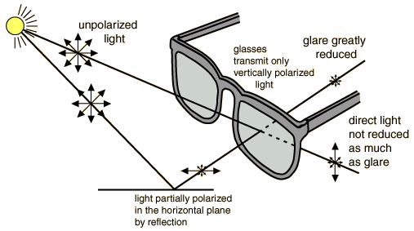
Polaroid Sunglasses
The polaroid material used in sunglasses makes use of dichroism, or selective absorption, to achieve polarization.

Slide 18
Question
Q1. Give some of the applications of Polaroid/polarisation

Slide 19
Optical Activity
A material which rotates the plane of incident linearly polarized light is said to be optically active. Viewing the light head-on, some substances rotate the electric field clockwise (dextrorotatory) and some produce a counterclockwise rotation (levorotatory). The property was discovered in quartz in 1811 by Arago. Two different crystalline structures of quartz produce d-rotatory and l-rotatory behavior. The two crystalline forms are said to be enantiomorphs of each other. The optical activity of quartz is associated with its crystal structure, as evidenced by the fact that neither molten quartz or fused quartz demonstrate optical activity.
In the case of many naturally occurring organic compounds such as sugar, tartaric acid and turpentine, optical activity is exhibited in the liquid state. This shows that the activity is associated with the individual molecules themselves.

Slide 20
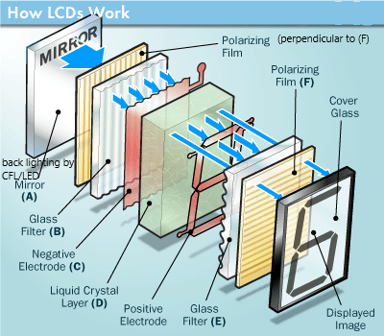
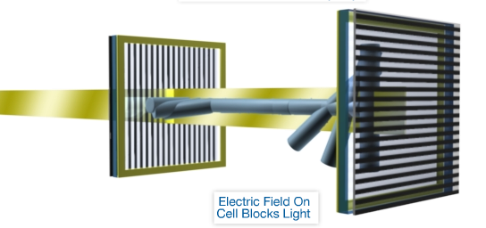
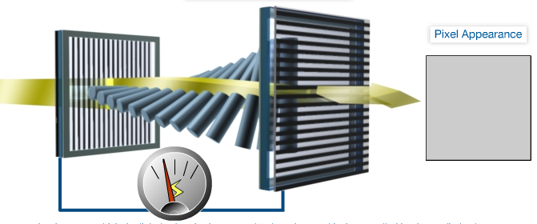
Liquid crystal Display
LCD displays have a polariser and analyser in crossed position. The electric filed is supplied by
Transparent glass electrodes. Source of light is either back or side lighting using CFL or LED.
The space between the polaroids is filled with liquid crystals. Liquid crystal molecules can
move freely while maintaining their orientation.
In absence of electric field the twisted nematic crystal rotates the plane of polarisation of light to make the screen bright
.
In presence of electric field, the crystals orient themselves in the direction of electric field and hence the screen appears dark.

Slide 21
Questions
Q1. Define Optical activity and specific rotation (2+2, definition and for each)
Q2 Explain with diagram, the construction, working and uses of LCD. (6 marks
1 dia+2exp (for each) +1 applications)

