Slide 1
zekeLabs
Learning made Simpler ! www.zekeLabs.com

Slide 2
Docker: Swarm
A swarm is a cluster of Docker engines, or nodes, where you deploy services. The Docker Engine CLI and API include commands to manage swarm nodes (e.g., add or remove nodes), and deploy and orchestrate services across the swarm.
Thus a swarm is a group of machines that are running Docker and joined into a cluster.
After that has happened, you continue to run the Docker commands you’re used to, but now they are executed on a cluster by a swarm manager.
The machines in a swarm can be physical or virtual. After joining a swarm, they are referred to as nodes
Swarm managers are the only machines in a swarm that can execute your commands, or authorize other machines to join the swarm as workers.
Workers are just there to provide capacity and do not have the authority to tell any other machine what it can and cannot do.

Slide 3
Nodes:
To deploy your application to a swarm, you submit a service definition to a manager node. The manager node dispatches units of work called tasks to worker nodes.
Manager nodes also perform the orchestration and cluster management functions required to maintain the desired state of the swarm. Manager nodes elect a single leader to conduct orchestration tasks.
Worker nodes receive and execute tasks dispatched from manager nodes. By default manager nodes also run services as worker nodes, but you can configure them to run manager tasks exclusively and be manager-only nodes.
An agent runs on each worker node and reports on the tasks assigned to it. The worker node notifies the manager node of the current state of its assigned tasks so that the manager can maintain the desired state of each worker.

Slide 4
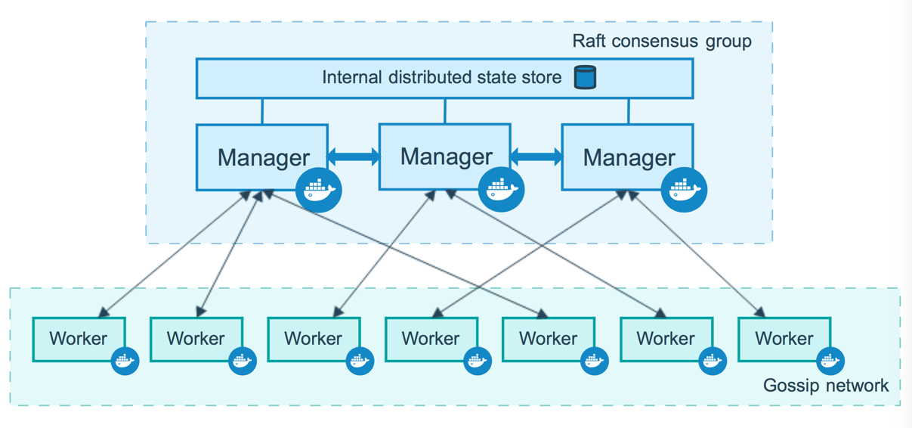
Swarm Architecture

Slide 5
The Voting Application
The voting app is a very handy multi containers application often used for demo purposes.
It basically allow users to vote between cat and dog (but could be “space” or “tab” too if you feel like it).
This application is available on Github and updated very frequently when new features are developed.

Slide 6
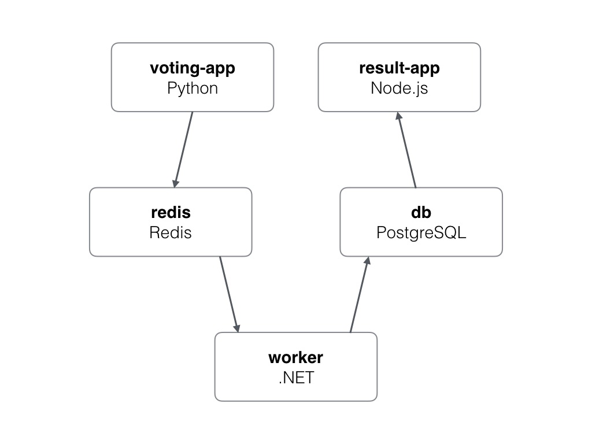
VoterApp application

Slide 7
The application
A Python webapp which lets you vote between two options
A Redis queue which collects new votes
A .NET worker which consumes votes and stores them in…
A Postgres database backed by a Docker volume
A Node.js webapp which shows the results of the voting in real time
A visualizer to check out what container is running on which node

Slide 8
Worker Dockerfile
# Use an official Microsoft runtime as a base image
FROM microsoft/dotnet:2.0.0-sdk
# Set the working directory to /app
WORKDIR /code
# Copy the current directory contents into the container at /app
ADD src/Worker /code/src/Worker
# Install any needed packages specified in requirements.txt
RUN dotnet restore -v minimal src/Worker \
&& dotnet publish -c Release -o "./" "src/Worker/“
# Run app.py when the container launches
CMD dotnet src/Worker/Worker.dll

Slide 9
Voter Dockerfile
# Using official python runtime base image
FROM python:2.7-alpine
# Copy our code from the current folder to /app inside the container
ADD . /app
# Install our requirements.txt
ADD requirements.txt /app/requirements.txt
# Set the application directory
WORKDIR /app
RUN pip install -r requirements.txt
# Make port 80 available for links and/or publish
EXPOSE 80
# Define our command to be run when launching the container
CMD ["gunicorn", "app:app", "-b", "0.0.0.0:80", "--log-file", "-", "--access-logfile", "-", "--workers", "4", "--keep-alive", "0"]

Slide 10
Result Dockerfile
FROM node:8.9-alpine
RUN mkdir -p /app
WORKDIR /app
RUN npm install -g nodemon
RUN npm config set registry https://registry.npmjs.org
COPY package.json /app/package.json
RUN npm install \
&& npm ls \
&& npm cache clean --force \
&& mv /app/node_modules /node_modules
COPY . /app
ENV PORT 80
EXPOSE 80
CMD ["node", "server.js"]

Slide 11
Docker-compose.yml
Check out the notepad file

Slide 12
Docker-stack.yml
Check out the notepad file

Slide 13
Storage driver:
A storage driver handles the details about the way these layers interact with each other. Different storage drivers are available, which have advantages and disadvantages in different situations.
Type of Storage drivers:
Overlay, overlay2, devicemapper, aufs, btrfs etc.
To set the storage driver, set the option in the daemon.json file, which is located in /etc/docker/ on Linux
{
"storage-driver": "devicemapper"
}
Visit : www.zekeLabs.com for more details.

Slide 14
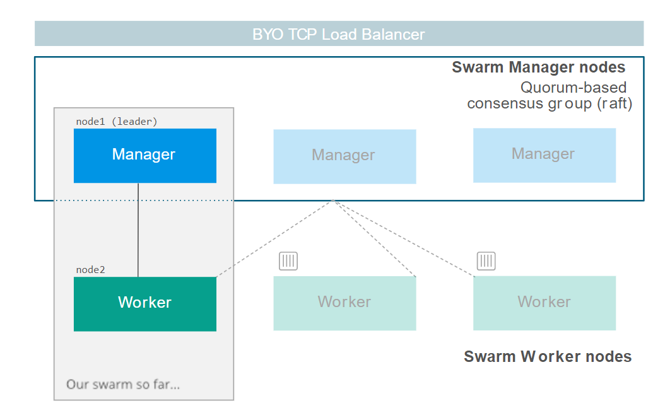
Architecture:
Visit : www.zekeLabs.com for more details.

Slide 15
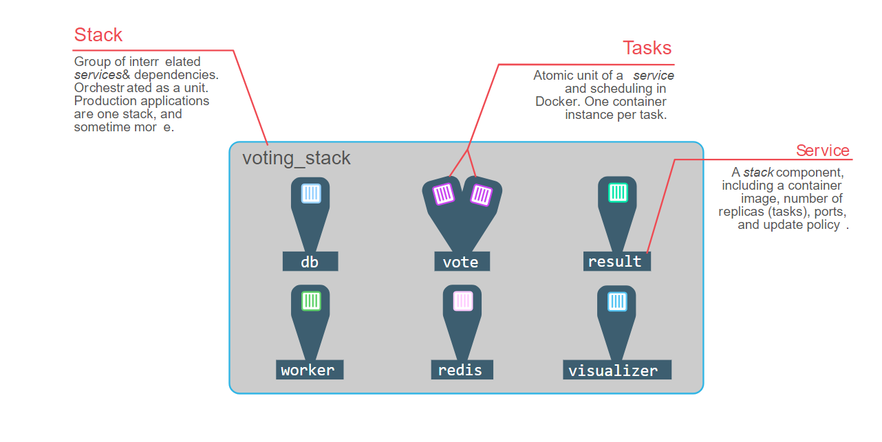
VotingApp Architecture:
Visit : www.zekeLabs.com for more details.

Slide 16
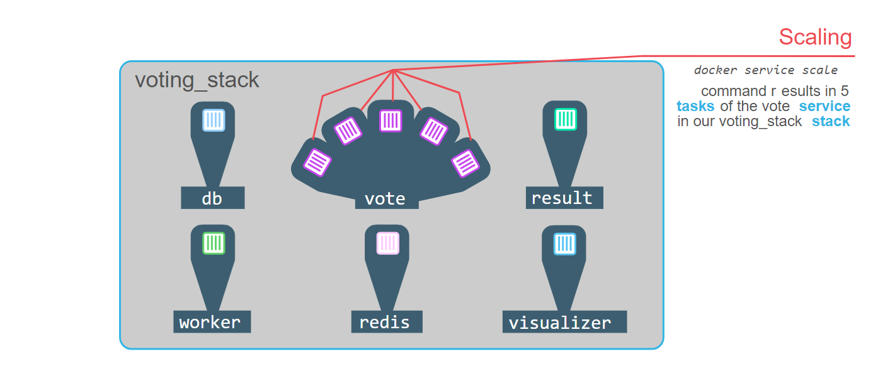
Scaling:
Visit : www.zekeLabs.com for more details.

Slide 17
THANK YOU
Let us know how can we help your organization to Upskill the employees to stay updated in the ever-evolving IT Industry.
Get in touch:
www.zekeLabs.com | +91-8095465880 | info@zekeLabs.com
Visit : www.zekeLabs.com for more details

