Slide 1
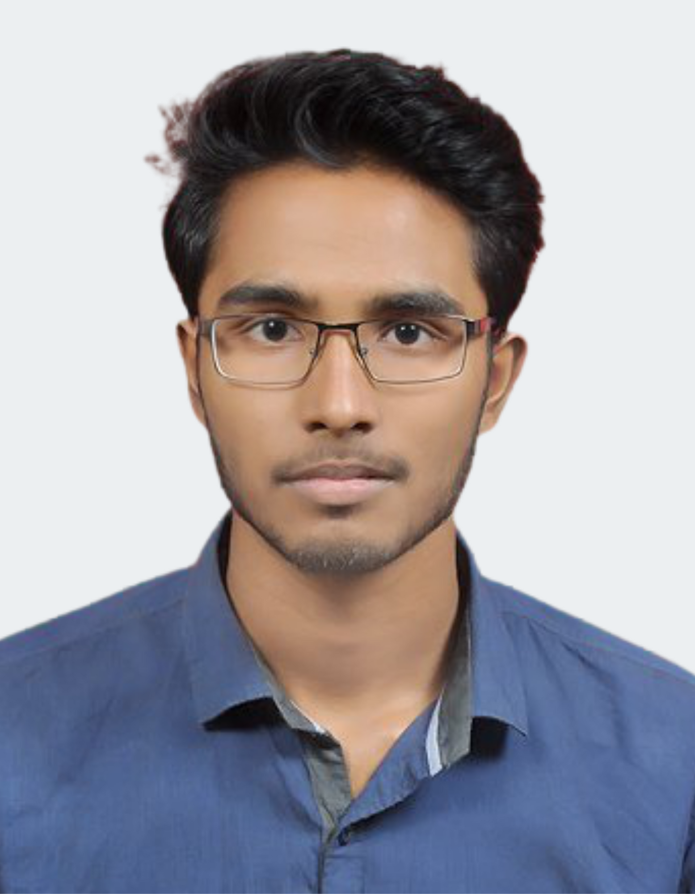
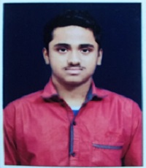

Chat Bot for Java Language Query
Project ID: 22203
By
Student 1:Ashish Sahu Roll No: IT 201810428
Student 2: Subham Mahapatro
Roll No: IT 201810428
Under the guidance of
Prof. Prashant Kumar Mohanty

Slide 2
PROBLEM STATEMENT
Chat Bot for Java language queries
It should able to handle queries related to different syntax, errors and exceptions
It should be interactive to make digital learning more productive
It should also be deployable as web component
201810428 Ashish Sahu
201810440 Subham Mahapatro

Slide 3

OBJECTIVE
Javamate(chatbot) should be more interactive and user friendly
It would be portable and platform independent
It can be accessed from anywhere anytime
It must handle any query related to java
201810428 Ashish Sahu
201810440 Subham Mahapatro

Slide 4





METHODOLOGY
Frontend: HTML, CSS, Javascript
Backend: Flask (Python)
Dataset: Custom JSON dataset with JAVA queries and responses
Model: Neural network architecture
201810428 Ashish Sahu
201810440 Subham Mahapatro

Slide 5
METHODOLOGY
User enter query into the frontend
Frontend sends the query to backend which will further passed to NN model
NN model will predict a tag according to which proper response is selected
Backend receives the response and send back to frontend where User can see the same
201810428 Ashish Sahu
201810440 Subham Mahapatro

Slide 6
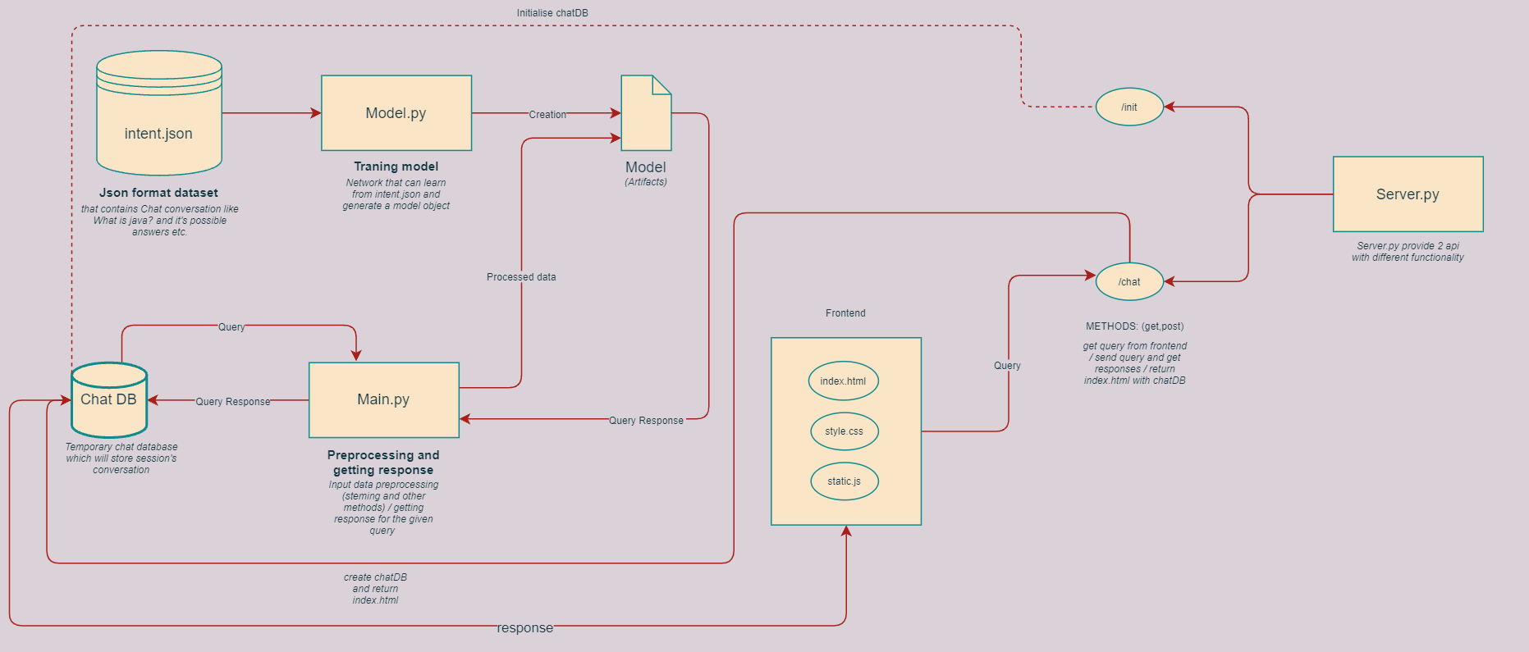
METHODOLOGY
201810428 Ashish Sahu
201810440 Subham Mahapatro

Slide 7
POSSIBLE OUTCOME
Javamate will benefit learners to understand Java Language in a more natural manner.
Any doubt and query can be resolved anytime from anywhere.
Chatbots enhances the learning experiences
It can be deployed on multiple platforms like android, ios etc.
It can also be implemeted with learning bots for discord, telegram etc.
201810428 Ashish Sahu
201810440 Subham Mahapatro

Slide 8
Reference
http://tflearn.org/getting_started/
https://flask.palletsprojects.com/en/2.0.x/
https://github.com/nltk/nltk/wiki
https://developer.mozilla.org/en-US/docs/Web/HTML
201810428 Ashish Sahu
201810440 Subham Mahapatro

Slide 9
Thank You
201810428 Ashish Sahu
201810440 Subham Mahapatro

