Slide 1
W4
Fake News Detection
Using Machine Learning Algorithms
NLP Classification | Bag of Words | TF-IDF | GridSearchCV
Ashish Santikari and Nadya Stoyanova
March 2026

Slide 2
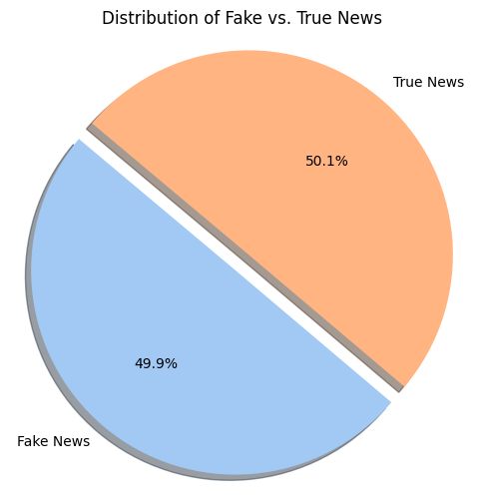
Problem Statement & Dataset
Objective
Classify news articles as Real (1) or Fake (0)
Binary classification using NLP techniques
Dataset
~40,000 articles (19,999 real + 19,943 fake)
Features: title, text, subject, date
Balanced classes - no sampling needed

Slide 3
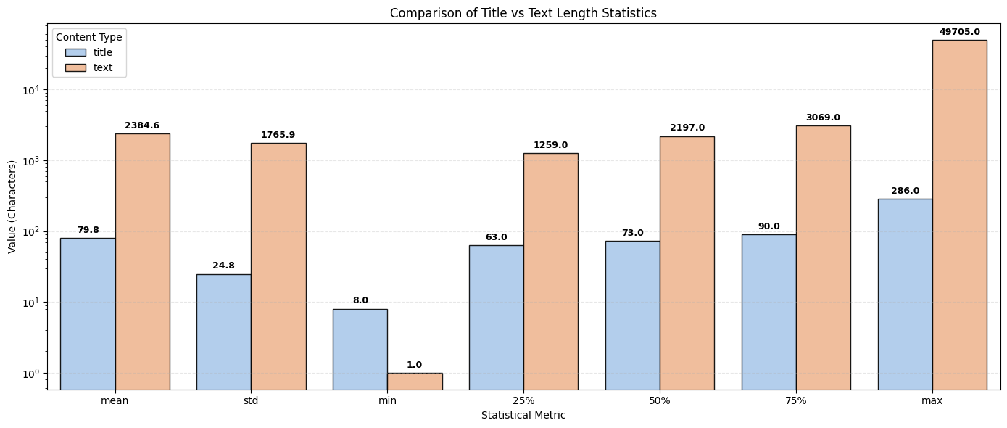
EDA: Title vs Text Length

Slide 4
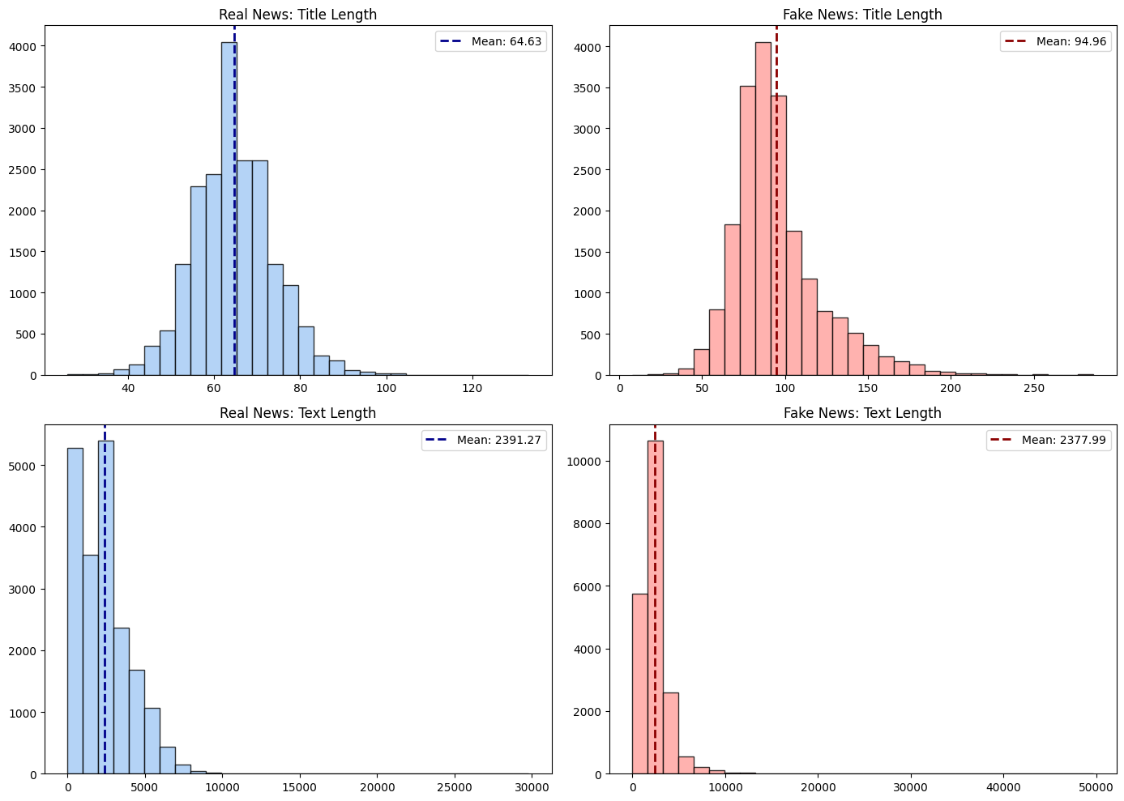
EDA: Real vs Fake News Length Distribution

Slide 5
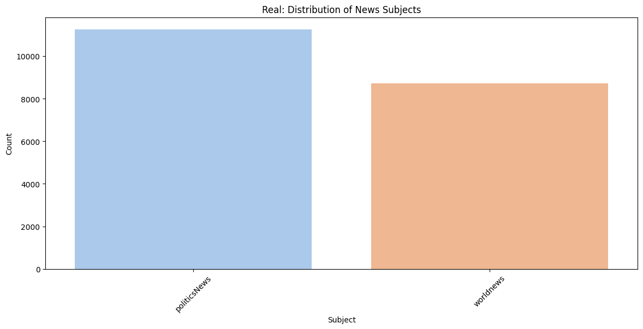
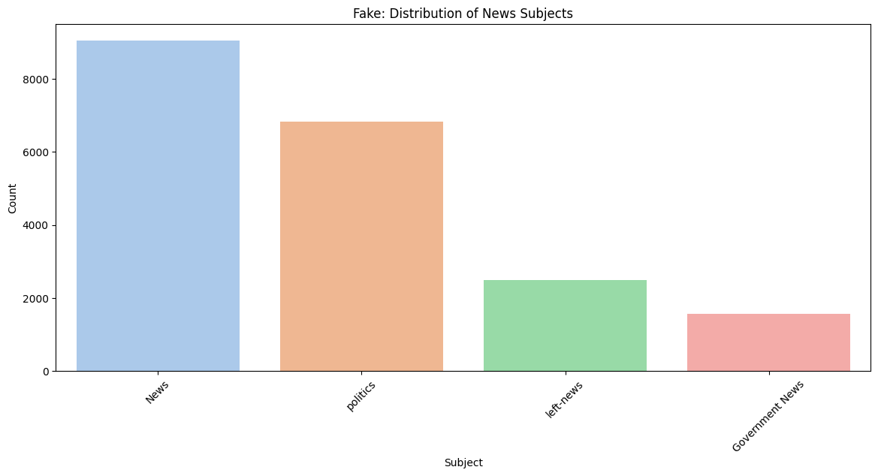
EDA: News Subject Distribution
Key Observations
Real news: primarily politicsNews and worldnews
Fake news: spread across 6 categories including Government News, left-news, politics, US_News
Subject alone can be a strong differentiator
We skipped Subject as a feature as it was causing data overfitting due to 1-1 correlation with news being fake or true

Slide 6
Data Preprocessing & Feature Engineering
Data Cleanup
Lowercase all text
Remove URLs (http/www links)
Remove punctuation
80/20 train-test split
Vectorization Methods
Bag of Words (CountVectorizer)
English stop words removed
Title + Text combined: 205,521 features
TF-IDF (TfidfVectorizer)
Term frequency-inverse document frequency
Title + Text combined: 206,105 features

Slide 7
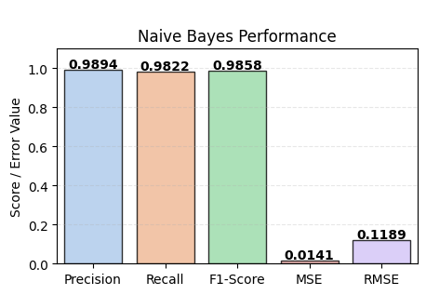
Naive Bayes (BernoulliNB)
Configuration
Vectorizer: TF-IDF
GridSearchCV (5-fold CV)
Best alpha: 0.001
Best CV score: 0.9845
Test Results
Accuracy: 0.99
Confusion Matrix: [3947, 42] / [71, 3929]
Precision: 0.99 | Recall: 0.98 | F1: 0.99

Slide 8
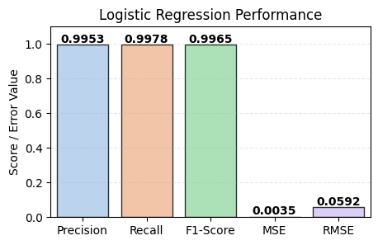
Logistic Regression
Configuration
Vectorizer: TF-IDF
GridSearchCV (5-fold CV)
Best: L1 penalty, liblinear solver, max_iter=3000
Best CV score: 0.9955
Test Results
Accuracy: 1.00
Confusion Matrix: [3970, 19] / [9, 3991]
Precision: 1.00 | Recall: 1.00 | F1: 1.00

Slide 9
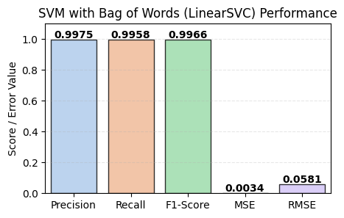
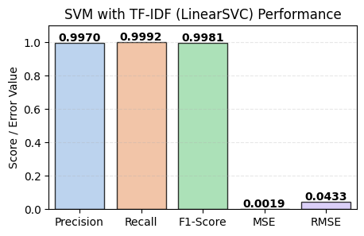
Support Vector Machine (LinearSVC)
With Bag of Words
L1 penalty, max_iter=2000
Best CV score: 0.9967
Accuracy: 1.00
Confusion Matrix: [3979, 10] / [17, 3983]
With TF-IDF
L1 penalty, max_iter=2000
Best CV score: 0.9972
Accuracy: 1.00
Confusion Matrix: [3977, 12] / [3, 3997]

Slide 10
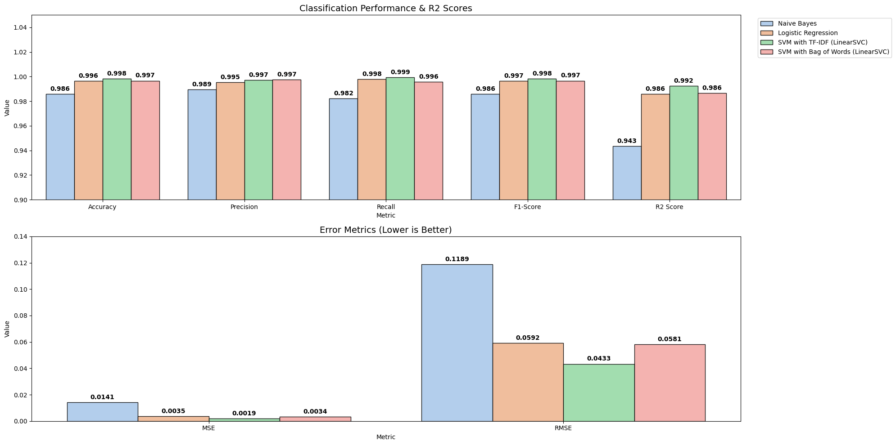
Aggregate Model Comparison

Slide 11
Validation on Unseen Data
Testing with External Validation Data
4,956 articles from a separate validation dataset
Same preprocessing pipeline applied (lowercase, remove URLs, remove punctuation)
Used the TF-IDF vectorizers fitted on training data
Best model (SVM with TF-IDF) used for final predictions
Results exported to CSV for downstream use
Pipeline
Raw text -> Cleanup -> TF-IDF transform (fitted on train) -> SVM predict

Slide 12
Conclusion
Key Findings
Model Performance Ranking
SVM + TF-IDF: Best overall (CV: 0.9972, R2: 0.992)
SVM + BoW: Strong runner-up (CV: 0.9967, R2: 0.986)
Logistic Regression: Excellent (CV: 0.9955, R2: 0.986)
Naive Bayes: Good baseline (CV: 0.9845)
Takeaways
All models achieved >98% accuracy
TF-IDF consistently outperformed Bag of Words
SVM with TF-IDF is the recommended model for production
GridSearchCV was essential for hyperparameter optimization

