Slide 1
SOLID - Introduction
architecture guidelines

Slide 2
What does SOLID stand for?
Single responsibility
Open-closed
Liskov substitution
Interface segregation
Dependency inversion

Slide 3
The rule of thumb
In real-world applications is mostly
impossible to implement an ideal
solution, trying to solve by one principle
you can break another

Slide 4
Therefore...
do not push all the principles to extremes, because in real life is almost impossible to live up to them from all points of view
only apply them from the most meaningful angle

Slide 5
Single responsibility
architecture guidelines

Slide 6
What is Single responsibility?
Every class has:
- responsibility over a single part of the functionality provided by the software
- that responsibility should be entirely encapsulated by the class

Slide 7
What is a responsibility?
by responsibility we mean purpose
mind the reason to change (is there only a functional reason for which am I going to change this piece of code? or multiple?)
a class should have one, and only one responsibility (i.e. a gorilla’s stomach is used only for digesting. it’s not used for hiding things from enemies)

Slide 8
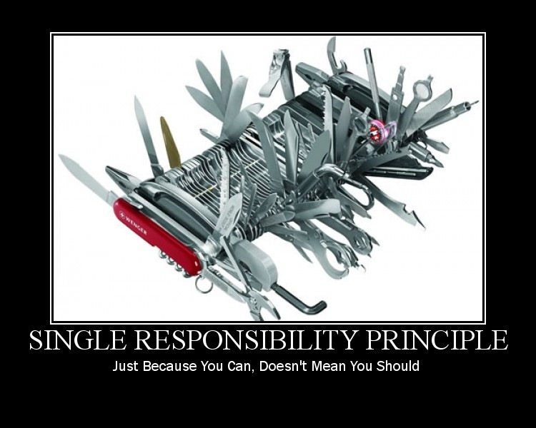
This picture worth a 1000 words

Slide 9
Why is it good?
improves reusability
quick understand and reuse code
ensures maintainability
isolate defects or their cause more easily
correct defects or their cause
without having to replace still working parts
extensibility
adding new features right away

Slide 10
The Good Example
public class Shop {
private Warehouse warehouse;
private Shipment shipment;
public void sell(Client client, Product product) {
if (warehouse.has(product)) {
long productPrice = product.getCost();
if (client.hasMoney(productPrice)) {
client.charge(productPrice);
shipment.perform(client, product);
}
}
}
}

Slide 11
The Bad example
class Shop {
private Warehouse warehouse;
private Shipment shipment;
public void sell(Client client, Product product) {
if (warehouse.has(product)) {
long productPrice = product.getCost();
if (client.hasMoney(productPrice)) {
client.charge(productPrice);
shipment.perform(client, product);
sendEmail();
}
}
}
public void sendEmail() {
// we have erased the code from here just to understand where the principle is violated
}
}

Slide 12
Bad example made good
class Shop {
private Warehouse warehouse;
private Shipment shipment;
private EmailService emailService;
public void sell(Client client, Product product) {
if (warehouse.has(product)) {
long productPrice = product.getCost();
if (client.hasMoney(productPrice)) {
client.charge(productPrice);
shipment.perform(client, product);
emailService.sendEmail();
}
}
}
}
class EmailService {
public void sendEmail() {
//...
}
}

Slide 13
Team work
AS A trainer
I WOULD LIKE the teams to correct the following bad example
SO THAT we can prove that we understood it right

Slide 14
Team work code
class DoorBell {
public void ring() {
playSound();
if (!isSombodyHome()) {
if (haveReachedMaxRetries()) {
sendEmail();
} else {
updateRetries();
}
}
}
public boolean isSomebodyHome() {
}
public void sendEmail() {
}
public void updateRetries() {
}
public playSound() {
}
}

Slide 15
Sounds like SoC?
it is sort of BUT...
Single responsibility is applied only to CLASS level
sir Robert C. Martin introduced it Principles of Object Oriented Design therefore he’s the one that has the “responsibility” of narrowing the scope of SoC :-)

Slide 16
Difference between SoC and SR
class UserPreferences {
private Image avatar;
private SecurityService securityService;
public void setAvatar(User user, Image image) {
if (securityService.isLogged(user)) {
avatar = image;
}
}
... // setter code here for securityService has been erased for clearness of principle
}
class SecurityService {
public void isLogged(User user) {
// …
}
}

Slide 17
Conclusion for above example
above example perfectly valid from SR point of view
invalid from Separation of Concerns point of view

Slide 18

QUESTIONS

Slide 19


