Slide 1
Open / Closed
architecture guidelines

Slide 2
What is Open/Closed?
you should design:
modules, classes and functions
in a way that when a new functionality is needed,
there should be no need to modify existing code but rather write new code that will be used by existing code

Slide 3
In plain English
I have completed some code
OPEN to extension:
is it easy to add new functionality? can it be done as a “plugin”?
CLOSED to changes:
am I confident that when releasing it to the world I won’t change the design so that I break other’s code?

Slide 4
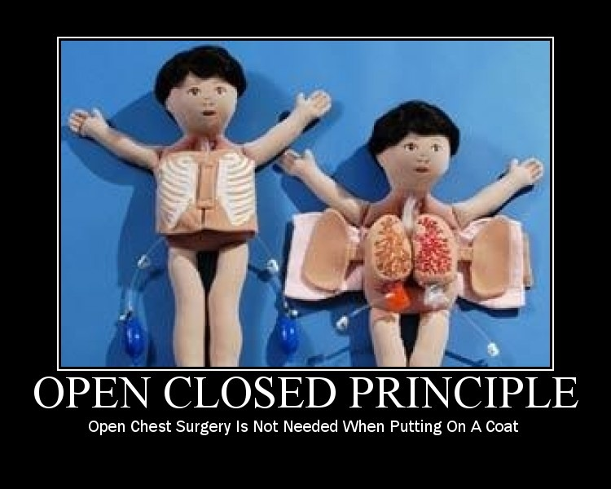
A picture worth a 1000 words

Slide 5
Why is it good?
ensures (better) maintainability (costs)
once entities are tested there is not mandatory to invest time into regression when adding new functionalities
extensibility
adding new features right away

Slide 6
The Good Example
public class Shop {
public void sell(Client client, Product product, PaymentProvider paymentProvider) {
if (warehouse.has(product)) {
long productPrice = product.getCost();
if (client.hasMoney(productPrice)) {
/** paymentProvider can be anything (i.e. Paypal,Webmoney, etc) as long as implements PaymentProvider interface */
client.charge(productPrice, paymentProvider);
shipment.perform(client, product);
}
}
}
}

Slide 7
The Good Example continued
public interface PaymentProvider {
void pay(long amount);
}
public class PaypalPaymentProvider implements PaymentProvider {
void pay(long amount) {
// do whatever it takes to make a payment via Paypal
}
}
// so if one day I would like to add another payment provider without breaking the existing code
public class WebmoneyPaymentProvider implements PaymentProvider {
void pay(long amount) {
// do whatever it takes to make a payment via Webmoney
}
}

Slide 8
The Bad example
public class Shop {
public void sell(Client client, Product product, PaypalPaymentProvider paypalPaymentProvider) {
if (warehouse.has(product)) {
long productPrice = product.getCost();
if (client.hasMoney(productPrice)) {
/** now you’re screwed when adding new payment providers :-) */
client.charge(productPrice, paypalPaymentProvider);
shipment.perform(client, product);
}
}
}
}

Slide 9
So the key is to ...
abstract as much as possible WHEN possible
think ahead of what users may need from you when dealing with your code/library/service
but don’t over engineer abstraction and don’t make assumptions of things that will not be used by the users of your code/library/service

Slide 10
OO languages puzzle:
abstract classes or interfaces?
abstract class ShooterGame {
void shoot(Gun gun, Coordinates coordinates) {
gun.pushTrigger();
if (isEnemyDamaged(coordinates)) {
increaseScore();
}
}
boolean isEnemyDamaged(coordinates) { ... }
void increaseScore() { … }
}
class Doom extends ShooterGame {
/** cool. but what if I would like to inherit a SocialNetwork functionality from another class here as well? */
}
interface ShooterGame {
void shoot(Gun gun, Coordinates coordinates);
boolean damageEnemy(coordinates);
void increaseScore();
}
class Doom implements ShooterGame {
void shoot(Gun gun, Coordinates coordinates) {
gun.pushTrigger();
if (damageEnemy(coordinates)) {
increaseScore();
}
}
void damageEnemy() { … }
void increaseScore() { … }
}

Slide 11
Conclusion for above example
some languages (or versions of those languages) do not support multiple class inheritance therefore you may break the open principle by modifying the abstract class when wanting to have that functionality implemented in the same place
“interfaces” are preferred

Slide 12
Liskov substitution
architecture guidelines

Slide 13
What is Liskov substitution?
Let Φ(x) be a property provable about objects x of type T. Then Φ(y) should be true for objects y of type S where S is a subtype of T
Good news: it made my head break into pieces as well when I first read it

Slide 14
In plain English
The client who consumes your API will rely on the contract of the interfaces you provide
So…
Make sure you don’t break the interface contract when inheriting;
Make sure you’re really abstracting (“is a” relationship stays a “is a” relationship when you switch implementations of the same interface no matter if implementations are siblings in inheritance tree or otherwise)
Make sure when testing your API you switch between implementations of the same interface so that you can check that the code that uses it won’t break and will have the same behaviour

Slide 15
Why is it good?
availability (hand in hand with maintenance)
when refactoring an existing service (adding a new refactored one having the same interface as the old one, leaving the old one intact), when switching between the two of them you know you are compliant with this principle if the “consumer” is not affected
by “consumer” we understand a physical user/or an api that uses that specific code

Slide 16
The Good Example
public interface Shipment {
void perform(Client client, Product product);
}
public class DHLShipment implements Shipment {
void perform(Client client, Product product) {
// ship as DHL specific code here
}
}
public class SnailMailShipment implements Shipment {
void perform(Client client, Product product) {
// ship as SnailMail specific code here - which will run slower as the DHL one :-)
}
}

Slide 17
The Bad example
interface Desert {
void enjoy();
}
class Cake implements Desert {
void enjoy() {
// make the sound made when someone is eating or chewing something and really enjoys it.
nomNomNom();
}
}
class Sahara implements Desert {
void enjoy() {
rideCamel();
}
}

Slide 18
The “official” Bad example
Square “is a” Rectangle
So… Square should be usable anywhere you expect a Rectangle
WRONG.
class Rectangle {
private int width, height;
void getWidth() { … }
void getHeight() { … }
void setWidth(int width) { … }
void setHeight(int height) { … }
}
class Square extends Rectangle {
}

Slide 19
Bad example made good (enough)
class Rectangle {
protected int width, height;
public Rectangle(int width, int height) {
this.width = width;
this.height = height;
}
void getWidth() { … }
void getHeight() { … }
}
class Square extends Rectangle {
public Square(int dim) {
this.width = dim;
this.height = dim;
}
}
sometimes this can be done but it’s not recommended
when it cannot be abstracted then don’t do it

Slide 20
Bad example made good
class Rectangle {
...
}
class Square {
...
}

Slide 21
So the key is to ...
abstract as much as possible WHEN possible and don’t over-engineer abstractions
make sure you have understood how your interfaces are being used and designed so that you can provide an implementation that reflects the contract stated in the interface

Slide 22
Team work
AS A trainer
I WOULD LIKE the teams to correct the following bad example
SO THAT we can prove that we understood it right

Slide 23
Team work code
abstract class Person {
public String address() {
return “Beverly Hills 90210”;
}
}
class Politician extends Person {
private Audience audience;
public String address() {
return audience.deliver(“passionate speech”);
}
}
class Form {
public void autoComplete(Person person) {
form.setAddress(person.address());
}
public static void main(String[] args) {
Form form = new Form();
form.autoComplete(new Politician());
}
}

Slide 24
Conclusion for above example
never violate an interface contract
try to understand it first
check twice how it’s being used
be very meaningful in your interfaces so that no one should ever break them(check for Heteronyms as well)

Slide 25

QUESTIONS

Slide 26


