Slide 1

Handwriting Recognition and Writer Identification on text-independent data
REVIEW-2
Team Members:
-Nag Ashish S V (221003064)
-Satya Viswa Pavan R (221003080)
-Pramodh Sairam P V (221003117)
Project Guide:
-Dr Durga Karthik

Slide 2
Agenda
Abstract
Problem Formulation
Design and Workflow
Analysis
Parameters and Results
Novelty
Conclusion

Slide 3
Abstract
Identification of a person from his writing is one of the challenging problems. Handwriting plays a key role in presentation of learned behavior of the person.
No one can repudiate its applications in a number of domains, such as biometrics, forensic analysis, historical documents analysis, ancient manuscripts analysis, check processing, signature analysis etc.
The primary objective of this project is to develop an ‘Automatic writer identification system that helps in determining and identifying whether the given handwriting is truly matched and assigned to the claimed writer of handwriting.’
Text independent writer identification cope with the images of arbitrary text that do not depend on the text content, but depends on the various styles in writings.

Slide 4
Problem Formulation
To extract discriminate features from the handwritings we use CNN. We followed an architecture similar to AlexNet CNN architecture.
CNN is a type of artificial neural network used in image recognition and processing that is designed to process pixel data.
A sequence of Fully Connected layers(ANN’s) are used in the end of Convolution Layer to classify the handwritings.
With the help of various data augmentation techniques we increase the size of image dataset that will be helpful while training the neural network.
A Web application will be designed to showcase the entire workflow.

Slide 5
Design Workflow
We designed the work flow as below
Stage 1:- Designing the classification model using neural networks
Stage 2:- Designing the backend API for the application using the trained model
Stage 3:- Designing the front end of the application to upload any handwriting
We used handwritings of 10 different people for classification
Stage-1
CNN+ANN
Stage-2
Backend API
Stage-3
Frontend

Slide 6
Stage-1
Stage 1 is executed as a sequence of 4 pipelines
Pipeline 1:- Image Transformation to eliminate noise and extracting edges.
Pipeline 2:- Image Augmentation by rotation and distortion of the input image.
Pipeline 3:- Image Dataset Preparation(training set and testing set)
Pipeline 4:- Building a CNN+ANN model based on AlexNet architecture and saving the trained model to disk.
Image Transformation
Image Augmentation
Creation of dataset
CNN Model based on AlexNet

Slide 7
CNN Model based on AlexNet architecture
The entire Neural Network is designed using Keras Library
Architecture Description:-
Layer Input kernel filters strides OutputDimension
ConvLayer 1 224*224*3 7*7 32 2*2 109*109*32
poolingLayer 109*109*32 3*3 32 2*2 54*54*32
ConvLayer 2 54*54*32 5*5 64 2*2 25*25*64
poolingLayer 25*25*64 3*3 64 2*2 12*12*64
ConvLayer 3 12*12*64 3*3 96 1*1 10*10*96
poolingLayer 10*10*96 2*2 96 2*2 5*5*96
ConvLayer 4 5*5*96 1*1 128 1*1 5*5*128
poolingLayer 5*5*128 3*3 128 2*2 2*2*128
FlattenLayer 2*2*128 - - - 512
ANN-FC-Layer-1 512 - - - 256
ANN-FC-Layer-2 256 - - - 256
Output Layer 256 - - - 10

Slide 8
Stage-2
Stage 2 is executed as a sequence of 3 pipelines
Pipeline 1:- Loading the trained AlexNet based HW classifier model from the disk.
Pipeline 2:- Designing an Image Output Generator(IOG) method which returns classification results of the input HW image
Pipeline 3:- Designing a Flask based API having 2 routes
i. ‘/’ GET route for displaying home page of the app
ii. ‘/predict’ POST route which calls predict function and sends the result string to the frontend.
Loading trained model
Designing IOG Method
Designing API Routes

Slide 9
Stage-3
Stage 3 is executed as a sequence of 3 pipelines
Pipeline 1:- Sending AJAX calls to the backend API to get the result for the input HW image.
Pipeline 2:- The result string will be having the no of votes (out of 20) each possible person has got, the person with more votes will be most prior and possible output.
Pipeline 3:- Displaying appropriate UI elements using HTML CSS and JavaScript
Making AJAX calls to REST API
Formatting the Result String
Rendering UI elements

Slide 10
Model Analysis
In the feature extraction step, the main feature that the CNN algorithms will be using is a Raw Pixel(value of every Image pixel)
Apart from the pixel value, the following features will also play an important role in classification.
Spacing between letters, Words, Sentences, lines etc. Ex:- In cursive handwriting letter space will be 0.
The pressure applied by different writers while writing will change the thickness of letters.
Curvature along with depth and height of letters.
The extracted feature vector is sent to ANN to perform handwriting classification.
The obtained training and testing accuracy is considered as the evaluation parameter for the model

Slide 11
Activation Functions Used:-
-In Convolution Layers:- Relu
-In Output Layer:- Softmax
Optimizer Used:- Stochastic Gradient Descent (SGD)
Loss Function Used :- categorical_crossentropy
No of epochs:- 20
Evaluation Metric Used:- accuracy
To reduce overfitting Batch Normalization and Dropout of 40% are used in CNN and ANN layers respectively
RESULTS:-
Training accuracy:- 0.9919 (~99%)
Testing /Validation accuracy:- 0.9900 (~99%)
Loss:- 0.04208

Slide 12
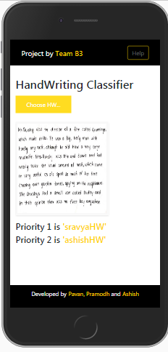
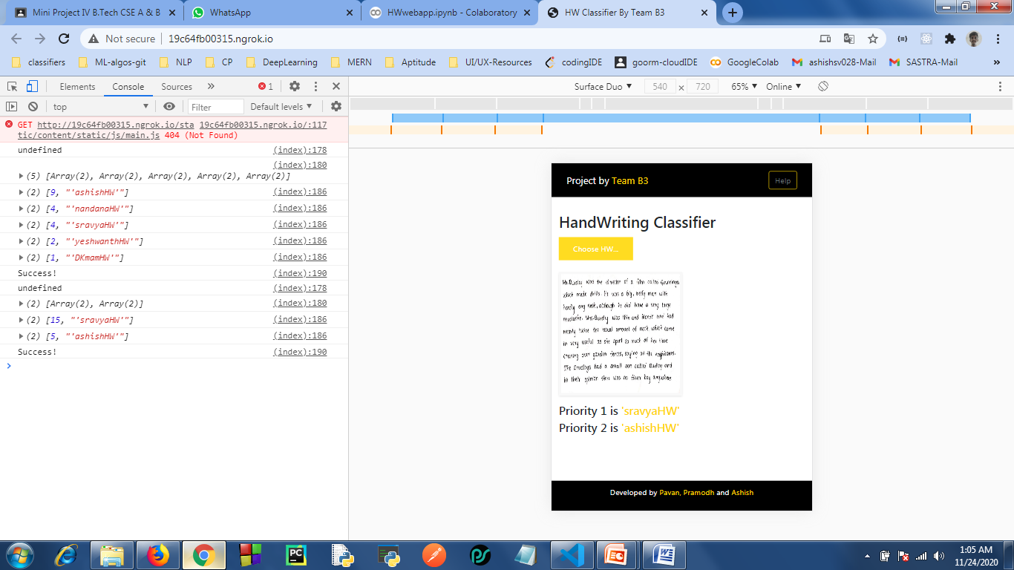
Tech Stack
Backend
Frontend
flask
flask-ngrok
Output from API
HTML
CSS
JavaScript
Jquery
AJAX

Slide 13
Conclusion
Automatic writer identification is very intriguing research problem in the field of document analysis and handwriting recognition.
The effective implementation of writer identification systems can be applicable in forensic and historical analysis, banks, check processing , signature analysis, graphology, legal documents, ancient manuscripts etc
We have implemented a classification model based on AlexNet state of art CNN architecture model and got a decent accuracy.
In future, we will employ various State of Art deep learning models like GoogleNet, VGG, ResNet and other variants for writer identification
Thank You…!!

