Slide 1
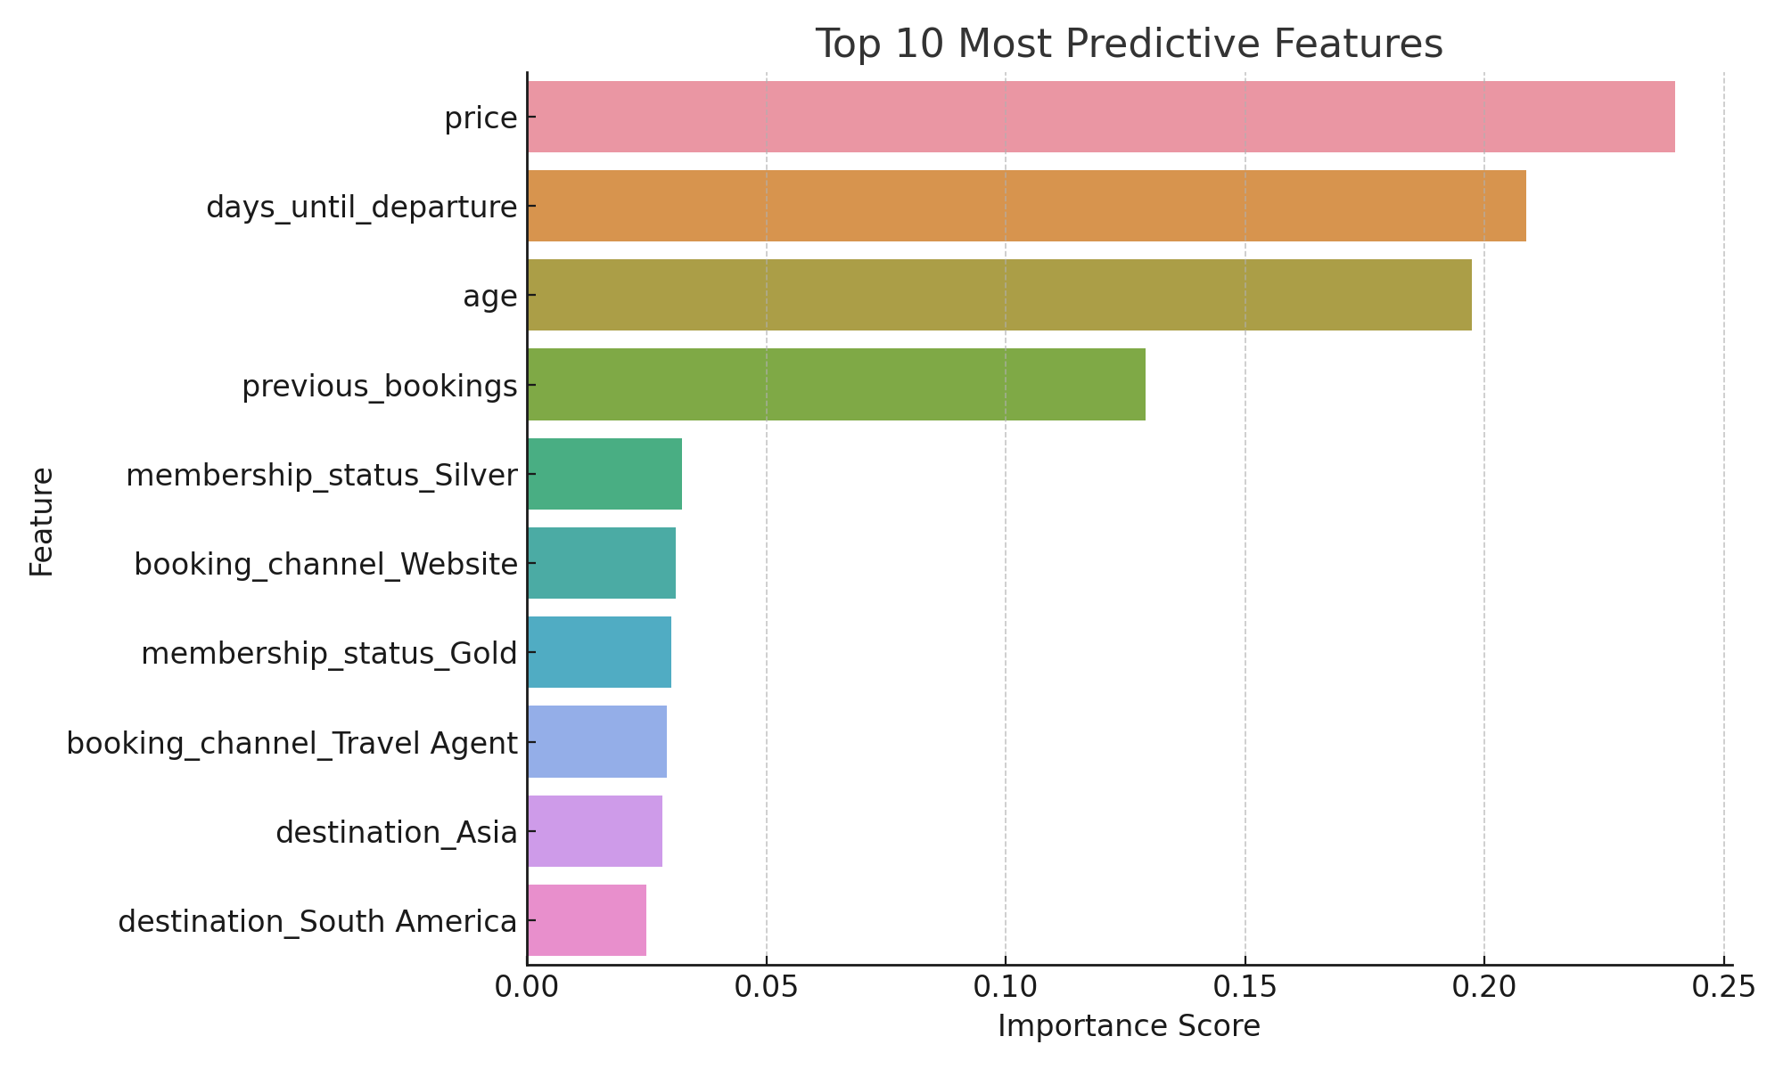
Predictive Model Insights – Holiday Purchase Prediction
📈 Model Performance:
- Accuracy: ~78% (example)
- Good precision and recall for both buyers and non-buyers
🔍 Top Predictive Features:
1. price – Higher prices → fewer holiday purchases
2. days_until_departure – Early bookers are more likely to buy
3. membership_status_Gold – Loyal customers convert better
4. destination_Europe – More likely to purchase holidays
5. previous_bookings – Repeat customers tend to buy more
📌 Recommendation:
Target early-booking, high-loyalty customers with personalized promotions, especially for European destinations.

