Slide 1


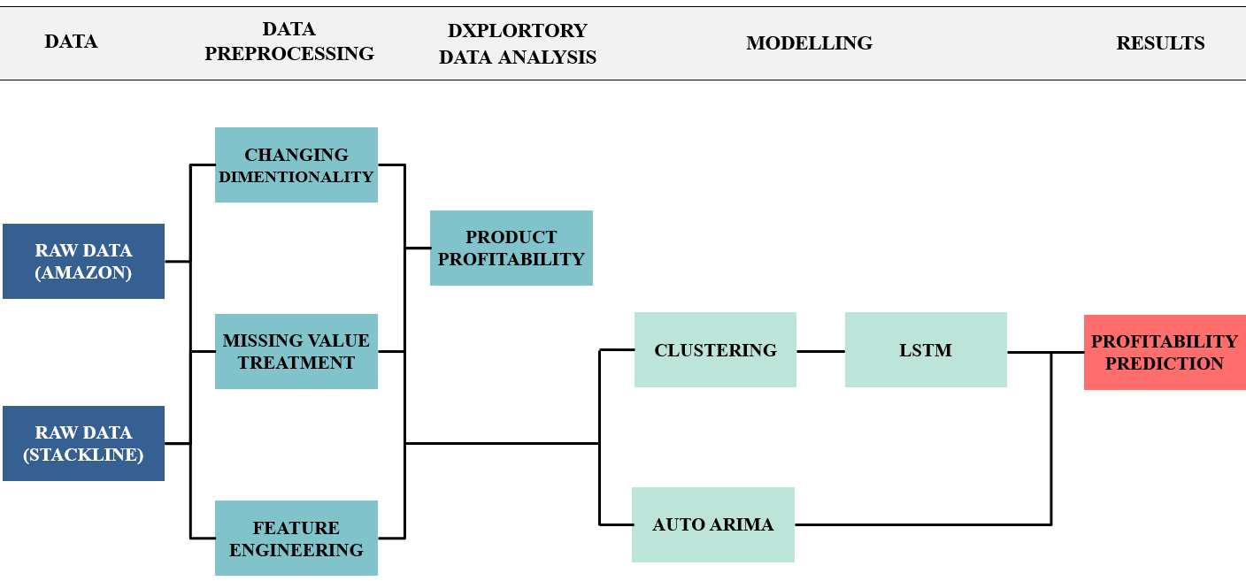
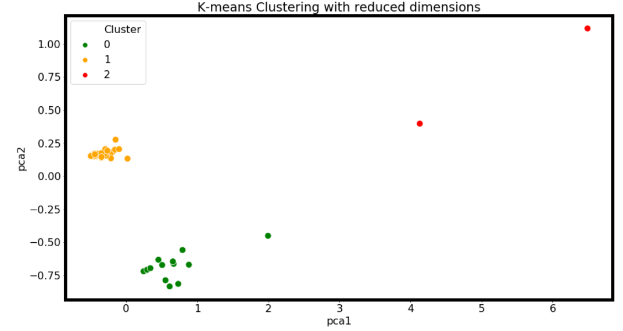
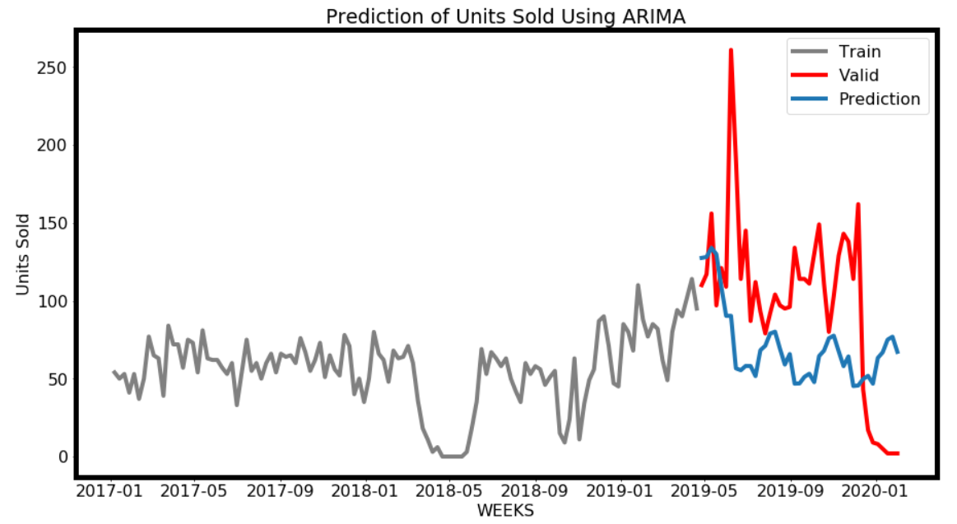
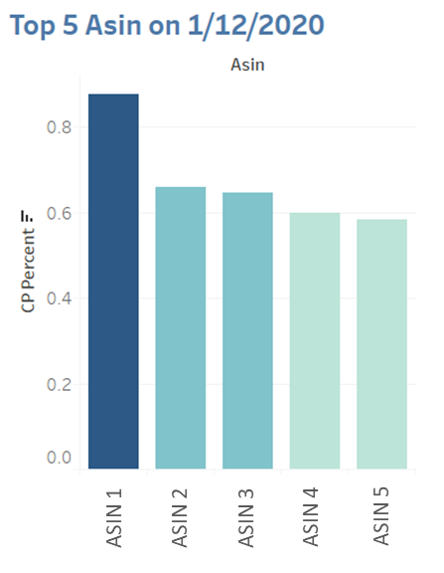
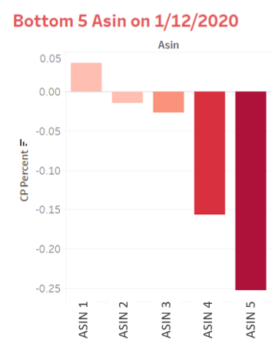
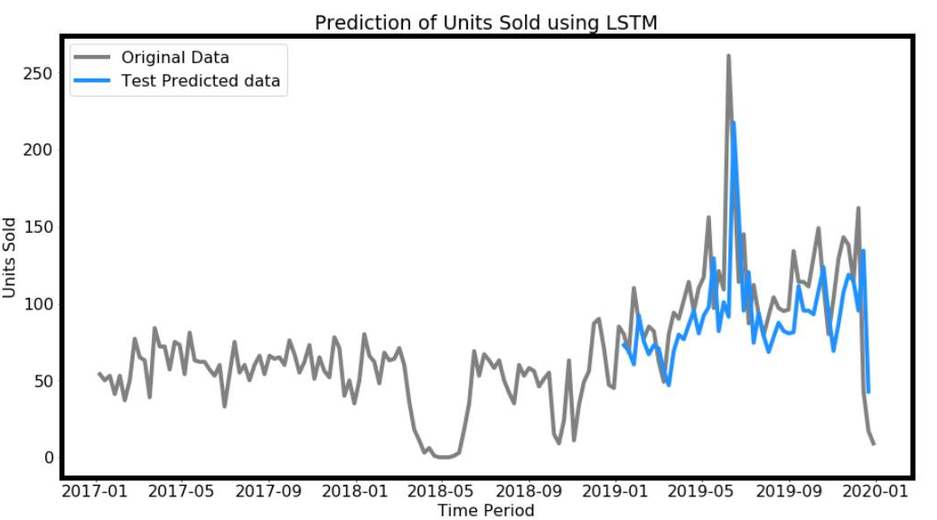
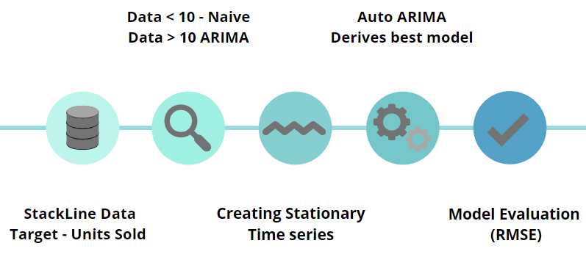
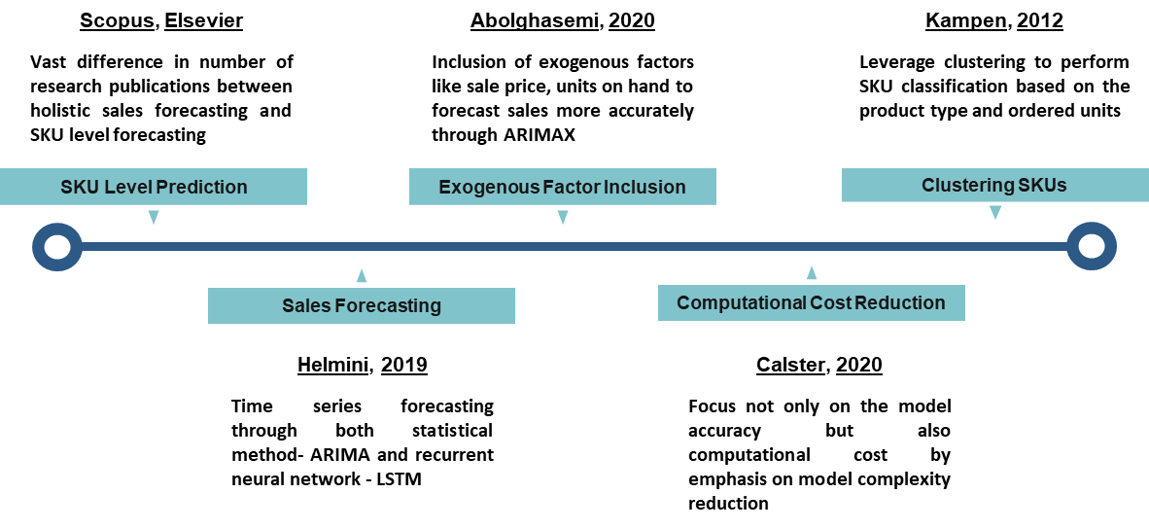
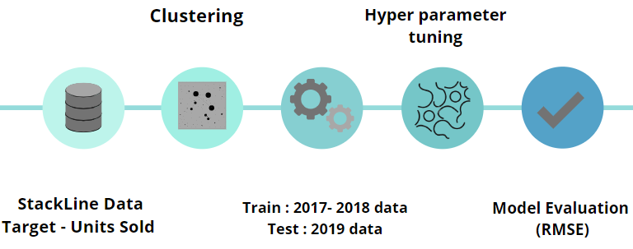
How a Large CPG Company Estimates Profitability of its Products on Amazon Platform
Shubham Sharma, Shivendra Kumar, Akshay Madar, Sobhagya Singh Jamwal, Ashish Tomar, Matthew A. Lanham
Purdue University Krannert School of Management
sharm405@purdue.edu; kumar394@purdue.edu; madar@purdue.edu; ssinghja@purdue.edu; tomar0@purdue.edu; lanhamm@purdue.edu
Abstract
Methodology
Results
In collaboration with a multinational consumer-packaged goods (CPG) company that sells its products on Amazon, this study aims to provide the business an enhanced decision support system for identifying profitable as well as underperforming products, using both statistical and machine learning models.
The scope of the study includes all vendors who sell their products on an ecommerce platform and find it challenging to understand the profitability of their product catalog. It will help them to optimize product strategy and channelize the marketing efforts efficiently, via accurate sales forecasting and profitability prediction at the granular level of stock-keeping units (SKU), in different time frames.
Data Cleaning & Pre-Processing
Structure of the dataset was converted from having long data characteristic to wide structure with null values treatment based on business acumen.
Feature Scaling
Time series data of units sold was scaled using Min-Max scaling to suppress the effect of outliers and avoid updating of weights at irregular rate in the model.
Model Implementation
The following approach was adopted to reduce model complexity and hence the associated computational costs, as per business requirements.
Introduction
CPG companies are increasingly moving their product portfolio to ecommerce platforms to tap into a massive online consumer base, with products spanning over multiple categories and price buckets. Amazon provides the perfect platform to statistically gauge the different attributes associated with a product to understand and maximize the profitability of a SKU. Figure 1. shows the clout of Amazon in the CPG ecommerce space in comparison to minuscule market share of its competitors.
Fig 1. Dominance held by Amazon in CPG ecommerce
Fig 3. Flow Chart
Fig 7. Clustering of SKUs
RMSE- 63
Fig 8. ARIMA Forecasting
Research Questions
RMSE- 38
R1) How to estimate confidential Amazon metrics to better identify top and bottom
performing products?
2) How to forecast weekly sales and product profitability at SKU level?
3) How to optimize profit margin, given specified business constraints?.edu
Literature Review
Fig 4. Best and Worst performing ASINs as per profitability equation
Fig 2. shows the improvements at various stages of the SKU level research study based on several relevant research publications in the past decade.
Fig 9. LSTM Forecasting
Conclusions
Business was provided with real-time BI dashboard to identify best and worst performing SKUs listed on Amazon platform.
Weekly sales forecast was achieved with high accuracy using ASIN drilldown approach, which was fed into profitability model for SKU level granularity.
Weekly margin was optimized for each SKU within given business constraints by controlling key metrics such as unit sold, wholesale price and COGS.
Future scope of the study could include incorporating exogenous factors Like competitor price and product attributes to improve profitability prediction and optimization.
Fig 5. ARIMA Workflow
Fig 2. Improvement flags at various stages of study
Acknowledgements
Fig 2. Literature review summary by method used…
We thank our industry partner and Professor Matthew Lanham for constant guidance and support on this project.
Fig 6. LSTM Workflow

