Slide 1
BIKE SHARING SYSTEMS
Submitted By
Group No. 3 [Batch: September 2018]
Group Members
Abhilash
Arshdeep Kaur Ahuja
Ashish Subudhi Tumula
Sai Ramya Machavarapu

Slide 2
Introduction
Bike sharing systems are new generation of traditional bike rentals, wherein the entire process from membership, rental and return has become automatic.
Through these systems, users can easily rent a bike from one location and return it at another location.
Today, there exists great interest in these systems due to their important role in traffic, environment and health issues. These could be detected via monitoring bike sharing systems.
Hence, analyzing and building machine learning algorithms can benefit the bike rental companies in improving their business by allowing them to keep track of demand for the number of bikes which can be rented based on the environmental conditions, seasonal settings and during specific hours of the day.

Slide 3
Business Problem
The objective of this project is to predict the total hourly bike rental count in a bike sharing system based on the environmental and seasonal settings.
Data Description
Bike sharing dataset contains the hourly count of rental bikes between years 2011 and 2012, and the corresponding weather and seasonal information.
This data set consists of 17379 rows and 17 attributes. Each row gives information about the number of bikes rented each hour with the corresponding weather and seasonal information during that hour.

Slide 4
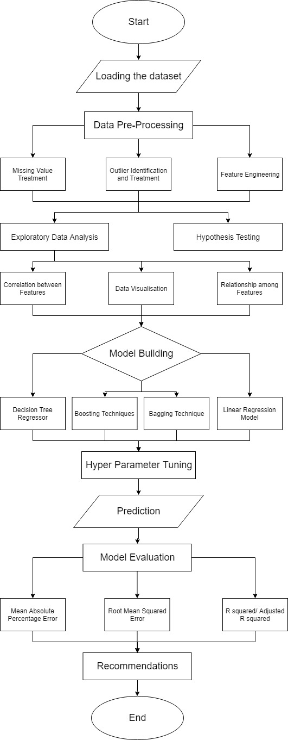
Project Flow

Slide 5
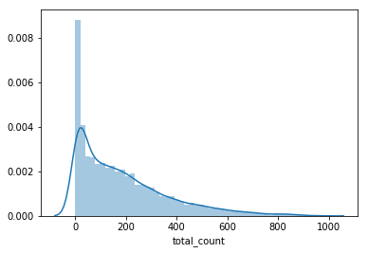
Exploratory Data Analysis
Target Variable (Total count) Distribution
Total count is right skewed, which indicates the presence of outliers. Applying a suitable transformation technique can make it closer to a normal distribution.
Windspeed is also right skewed which can be inferred from the windspeed histogram. While temperature and humidity follow normal distribution.

Slide 6
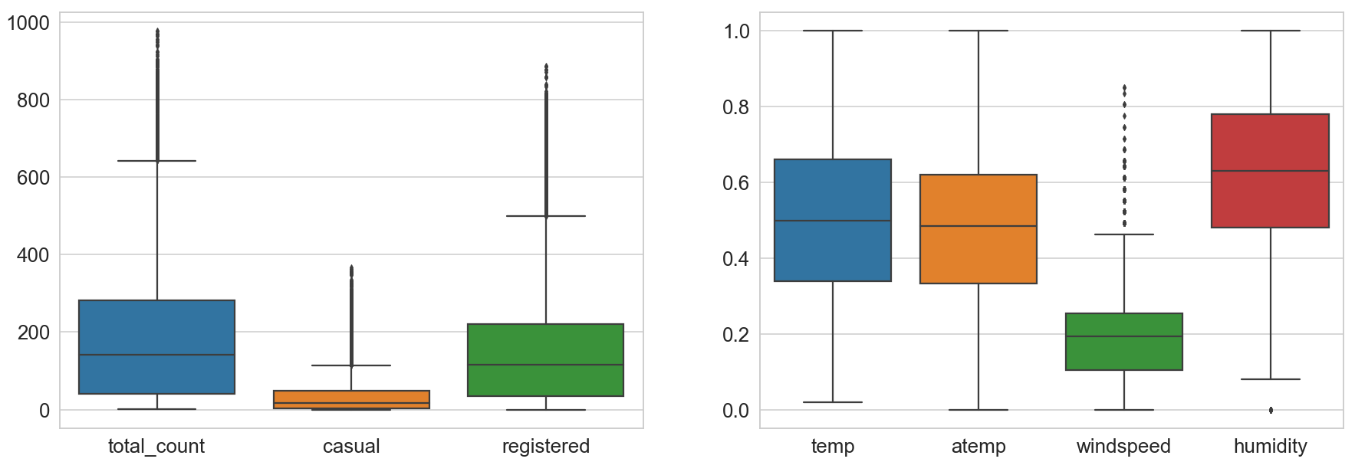
Outliers
There are many outliers in total, casual and registered counts of bike rental. Wind speed also has multiple outliers, but humidity has just one outlier value.
Log transformation is used to make the count and wind speed distributions closer to normal. Square transformation is used for humidity.

Slide 7
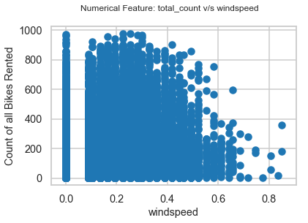
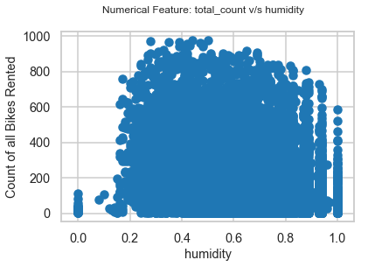
Distribution of count with humidity and windspeed
Humidity and wind speed do not have a significant pattern with respect to the bike rental count.

Slide 8
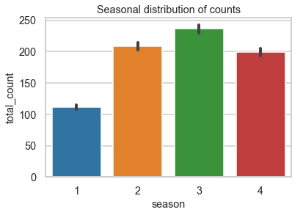
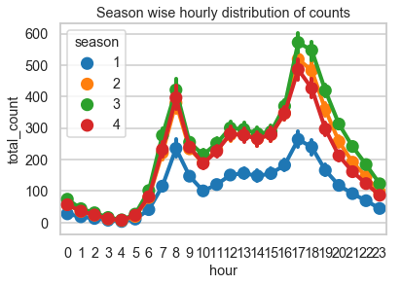
Visualizing Bike Count with Season
1:spring, 2:summer, 3:fall, 4:winter
Bike rental count is lowest in spring and highest in fall. We can conclude that customers are lesser in cold months.
The trend of the hourly customer count is approximately the same throughout all the seasons.

Slide 9
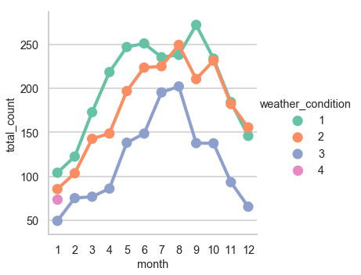
Visualizing bike count with Weather and Months
1: Clear, 2: Misty/ Cloudy, 3: Light Snow/ Light Rain, 4:Heavy Rain/ Ice Pallets / Thunderstorm/ Fog
People enjoy renting and riding bikes majorly during fall, i.e. when the weather is clear.

Slide 10
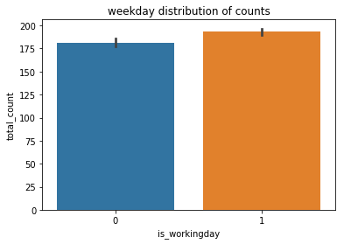
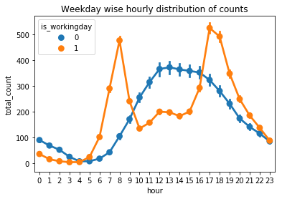
Visualizing bike count with working days
Bike rental demand is higher during working days as opposed to holidays and weekends, only during peak hours i.e. 5-9 in the morning and 5-10 in the evening. The main reason behind this could be that majority of the people who rent the bikes are office-goers. This might also be due to the surge prices on weekends.

Slide 11
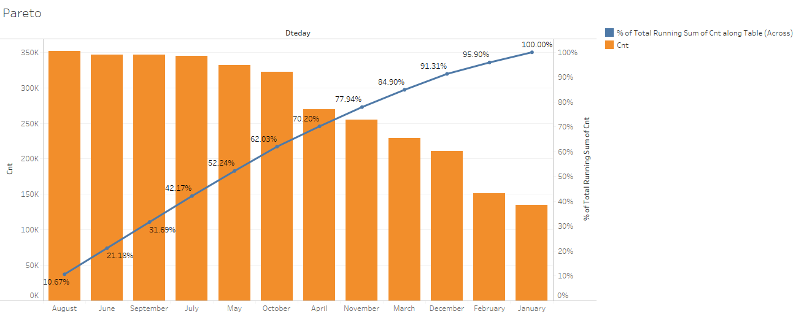
TABLEAU VISUALISATIONS Variation in Bike Rental Count during various Months
70% of the total bike rental count was happening during the months of April, May, June, July, August, September and October i.e. mainly during fall.

Slide 12
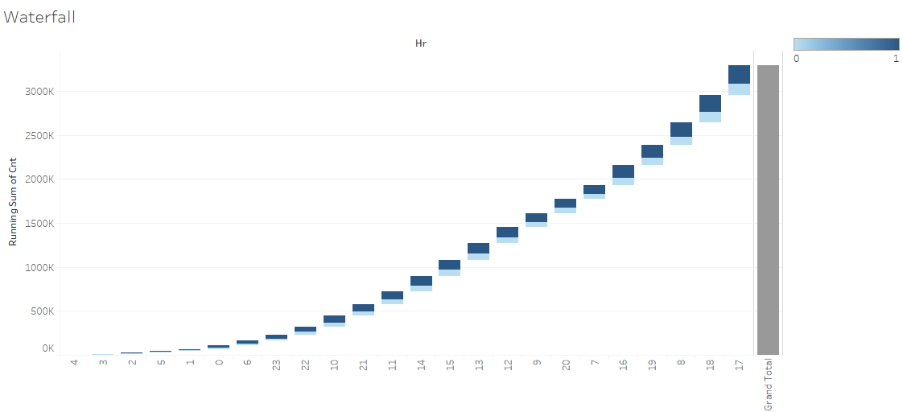
Variation in bike rental count during a day
Based on this visual, a column called hour-buckets has been created with the values 0 (low), 1 (medium) and 2(high). The bike rental count is low during the hour bucket [0,1,2,3,4,5,6,23], medium during the bucket [10,11,12,13,14,15,21,22] and high during the hour bucket [7,8,9,16,17,18,19,20].

Slide 13
Hypothesis Testing
To check if the bike rental count is dependent on the weekday and month
Null Hypothesis: There is no dependency between bike rental count with respect to weekday and month
Alternate Hypothesis: There is dependency between bike rental count with respect to weekday and month
Testing with 1 way ANOVA and by observing p-value 9.391e-05 (< 0.05), 2 way anova - With the change in weekday and month there is significant change in bike rental count
To check if the total bike rental count is dependent on the registered count
Null Hypothesis: There is no dependency between the total bike rental count and registered count.
Alternate Hypothesis: There is dependency between the total bike rental count and registered count.
Since the p-value(0.0) is less than 0.05, we can reject null hypothesis, i.e. there is significant dependency between the total bike rental count and registered count.

Slide 14
Hypothesis Testing
To check if the bike rental count is dependent on the season
Null Hypothesis: There is no dependency between bike rental count and season
Alternate Hypothesis: There is dependency between bike rental count and season
Testing with 1 way ANOVA and by observing p-value 7.4e-2 (< 0.05) we can reject null hypothesis so there is significant dependency between season & count.
To check if the bike rental count is dependent on the Weather condition
Null Hypothesis: There is no dependency between bike rental count with respect to weather.
Alternate Hypothesis: There is dependency between bike rental count with respect to weather
The p-value (1.73e-81) is less than < 0.05, hence, we can reject null hypothesis. There is significant dependency between weather & count .

Slide 15
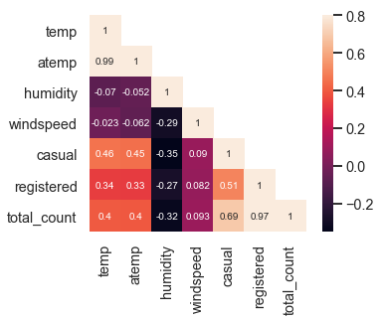
Correlation Plot
There is no strong correlation between total count and wind speed.
There is the problem of multicollinearity in the data.
Temp and atemp are highly correlated. So we engineered a column called mean temperature, which is an average of the actual and the feel temperature.
Casual and registered columns are dropped.

Slide 16
Model Building
The following ML models are used in predicting total rental bike count :-
Linear Regression
Lasso
Ridge
Decision Tree Regressor
Random Forest Regressor,
Gradient Boosting Regressor,
Bagging Regressor
With these models, significant relationships between dependent and independent variables are known. They also indicate the intensity of the impact of multiple independent variables on a dependent variable.
Evaluation Metrics: R Squared, RMSE, MAE.
Evaluation metrics explain the performance of a model. Based on feedback from metrics, models can be tuned and until a desirable accuracy is achieved.

Slide 17
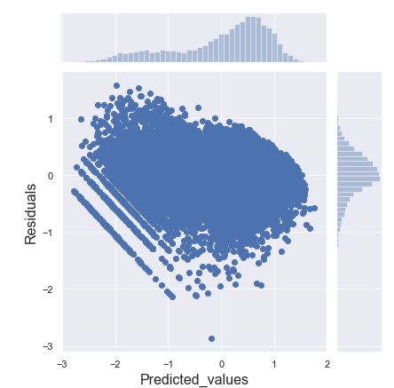
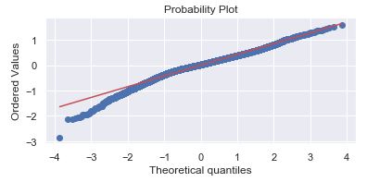
Linear Regression-Residual and QQ plot
Linear Regression
Using step-wise selection, we got the variables which are significant in determining the bike count. They are: humidity, hour, year, season, mean temperature, weekday, weather, holiday and working day.
Got the VIFs of the independent variables to check for the presence of multicollinearity. As per the VIFs, the holiday and working day were removed.
Checking the residual plot and QQ plot, we can observe that the residuals are having a pattern and are not normally distributed, which means the linear model doesn’t fit the data so well.

Slide 18
Decision Tree
Pros : DT can handle both numerical and categorical variables.
Decision trees have no assumptions.
It is not influenced by outliers and missing values to a fair degree.
Cons: Unstable.
Over fitting is one of the most practical difficulties for decision tree model.
Ensemble Models
Random Forest
Pros: Handles large data set with higher dimensionality and identifies the most significant variables, and is hence, considered as one of the dimensionality reduction methods.
In random forest, each tree is built independently, using a random sample of the data. This helps make the model more robust than a single decision tree, and less likely to overfit on the training data.

Slide 19
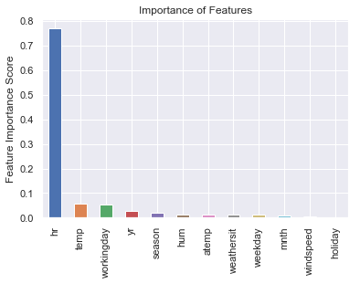
Cons: Random Forest is a black box model, i.e. we have very little control on what the model does since it’s a non parametric model.
Large number of trees may make the algorithm slow for real-time prediction.
Bagging
Pro: Bagging takes the advantage of ensemble learning wherein multiple weak learners outperform a single strong learner. It helps reduce variance and thus, helps avoid overfitting.
Con: There is loss of interpretability of the model.

Slide 20
Boosting
Pros: Boosting builds one tree at a time, where each new tree helps in correcting and minimizing errors made by the previously trained tree.
Cons: Difficult to interpret.
Boosting requires careful tuning of the learning rate and other parameters like number of trees, depth of the trees, etc. and the training process can require a lot of computation.
Training generally takes longer because trees are built sequentially.
More sensitive to overfitting if the data is noisy.

Slide 21
Model Comparison
MODELS | Mean Absolute Error (MAE) | R - Squared | Root Mean Squared Error (RMSE)
Linear Regression | .315 | 82.3 | .424
Lasso | .559 | 48.2 | .719
Ridge | .54 | 49.3 | .712
Decision Tree Regressor | .19 | 91.3 | .293
Random Forest Regressor | .159 | 93.9 | .245
Gradient Boosting Regressor | .19 | 92.3 | .277
Bagging Regressor | .160 | 93.9 | .246
Comparing various regression models, bagging and random forest have almost the same results but bagging, being more stable and faster than random forest, has been selected as our final model. Hence this model can be used in production.

Slide 22
Conclusion
Bike rentals are independent of the wind speed, because there is very little correlation between the two(0.093).
As a conclusion we can say, that the amount of bike rentals depends mainly on the weather, mean temperature, season and working day.
The analysis shows that there is a positive relationship between the amount of bike rentals and temperature. The mean amount of bike rentals increases an decreases with the temperature. So people mainly rent bikes on days when weather is clear and the temperature is moderate.

Slide 23
Recommendations
The EDA analysis shows that there is a positive relationship between the amount of bike rentals and temperature. So, people mainly rent bikes when weather is clear especially during fall. This could be important for Bike sharing on planning new bike rental stations.
Bike rental count is very high during the hour bucket [7,8,9,16,17,18,19,20], i.e. during the hours people commute to and from office. Hence, new bike rental stations closer to office complexes can be opened up. This would attract more customers.
More bike rental stations can be planned close to downtown area of the city and tourist locations as well.
There can be different prices (surge) at the weekends as against the weekdays since the demand is lesser on weekends and only the people who have the necessity rent the bikes.
Also, based on the renting history of the customers, discounts can be offered to the customers in terms of rent charged or the hours rented.

Slide 24
THANKS

