Slide 1

Automatic Essay Multi-Scoring
Team - 4
19K41A05H5-V Ashish
19K41A05G3 - Mohd Amaan

Slide 2

Introduction
Automated essay scoring (AES) is a computer-based assessment system that automatically scores or grades the responses by considering appropriate features using BERT and LSTM

Slide 3
Types of AES
The dominant approaches in AES can be grouped into three categories:
1)Traditional AES
2)Deep neural networks AES
3)Pre-training AES.

Slide 4
BERT
BERT, stands for Bidirectional Encoder Representations from Transformers
It is an open source machine learning framework for natural language processing (NLP).
It is designed to help computers understand the meaning of ambiguous language in text by using surrounding text to establish context.
The BERT framework was pre-trained using text from Wikipedia and can be fine-tuned with question and answer datasets.
BERT learns information from both the left and the right side of a token’s context during the training phase.

Slide 5
LSTM
It is special kind of recurrent neural network that is capable of learning long term dependencies in data. This is achieved because the recurring module of the model has a combination of four layers interacting with each other.
LSTM module has a cell state and three gates which provides them with the power to selectively learn, unlearn or retain information
The cell state in LSTM helps the information to flow through the units without being altered by allowing only a few linear interactions.
Each unit has an input, output and a forget gate which can add or remove the information to the cell state.

Slide 6
LAYERS
LSTM - 1
LSTM - 2
LSTM - 3
LSTM - 4
Dropout Layer
Dense Layer

Slide 7
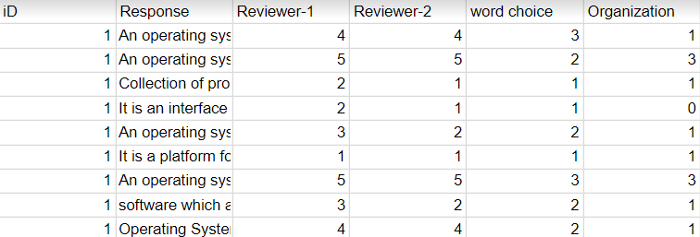
DATASET
There are 6 rows and 2392 columns in the dataset :
ID
Response
Reviewer 1
Reviewer 2
Word Choice
Organization

Slide 8


