Slide 1

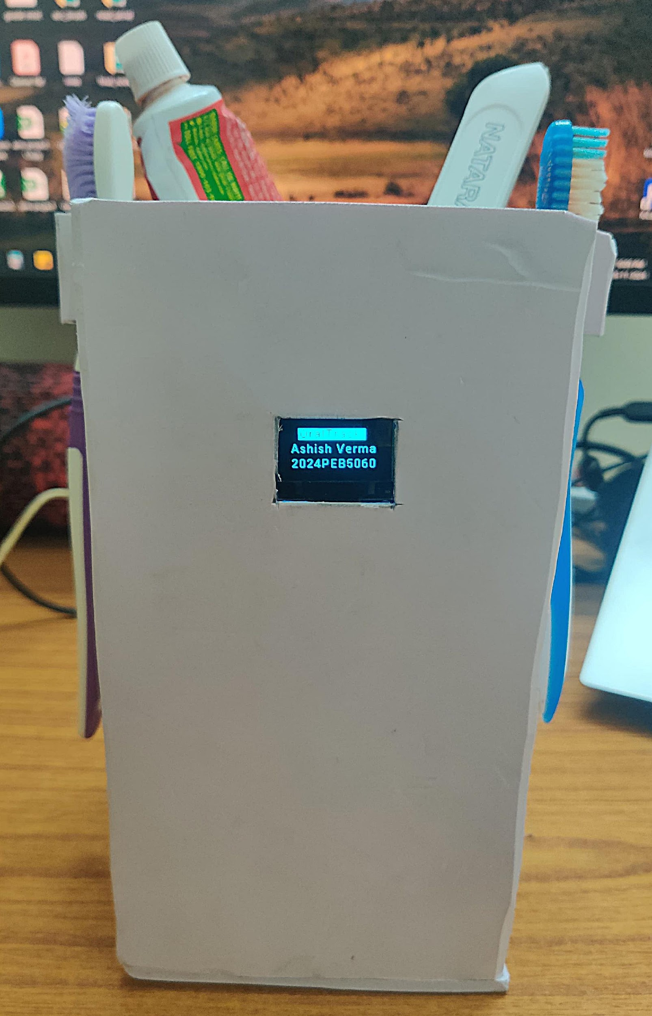
OralTrack
Smart Oral Hygiene Monitoring System
Track. Improve. Optimize.
Name: Ashish Verma Student ID: 2024PEB5060
MNIT Jaipur, ECE Department

Slide 2
Project Overview
Project Name: Smart Oral Hygiene Monitoring System
Objective: To help users brush for the optimal time and track their progress over time.
Key Features:
Timer starts when a user picks up their toothbrush.
Tracks brushing time and logs data for analysis for the past 30 days.
The web interface enables users to edit their profile information.
Additional features: UVC LED light and buzzer control from the web.

Slide 3
Problem Statement
Challenges in Oral Hygiene:
Most people don’t brush for the minimum* recommended 2 minutes.
Lack of awareness of brushing habits and their impact.
Solution Offered:
Real-time brushing monitoring and feedback.
Easy access to brushing history for behaviour improvement.
Promotes ADA recommendations for better dental health. *Minimum does not necessarily mean optimal..

Slide 4




Research References
ADA Recommendation
Brush for at least for two minutes twice daily with a soft-bristled toothbrush.
Study Insights-1
Brushing for 120 seconds removes 26% more plaque than 45 seconds.
Study Insights-2
180 seconds removes 55% more plaque than 45 seconds.
Notes:
https://www.ada.org/resources/ada-library/oral-health-topics/toothbrushes https://www.jacksonavedental.com/post/how-long-you-should-brush-your-teeth

Slide 5
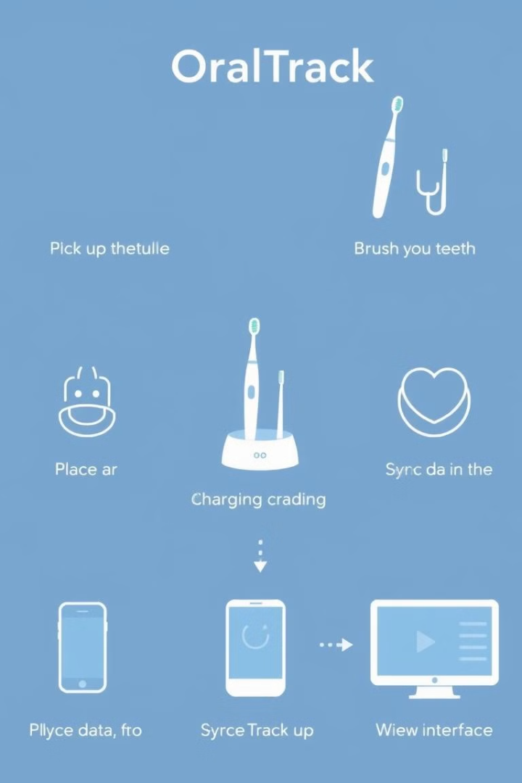
Features
1
Tracks Brushing Duration
2
Sends Data to Server
Sends brushing data to the NODEMCU server.
Graph for past 30 days
Tracks brushing duration for two users.
3
Real-Time Feedback
4
Configurable Settings from Web
Displays real-time brushing timer on OLED
Feedback from buzzer.
User names.
Adjusting timer for each user.
Controlling Buzzer and UVC LED.

Slide 6
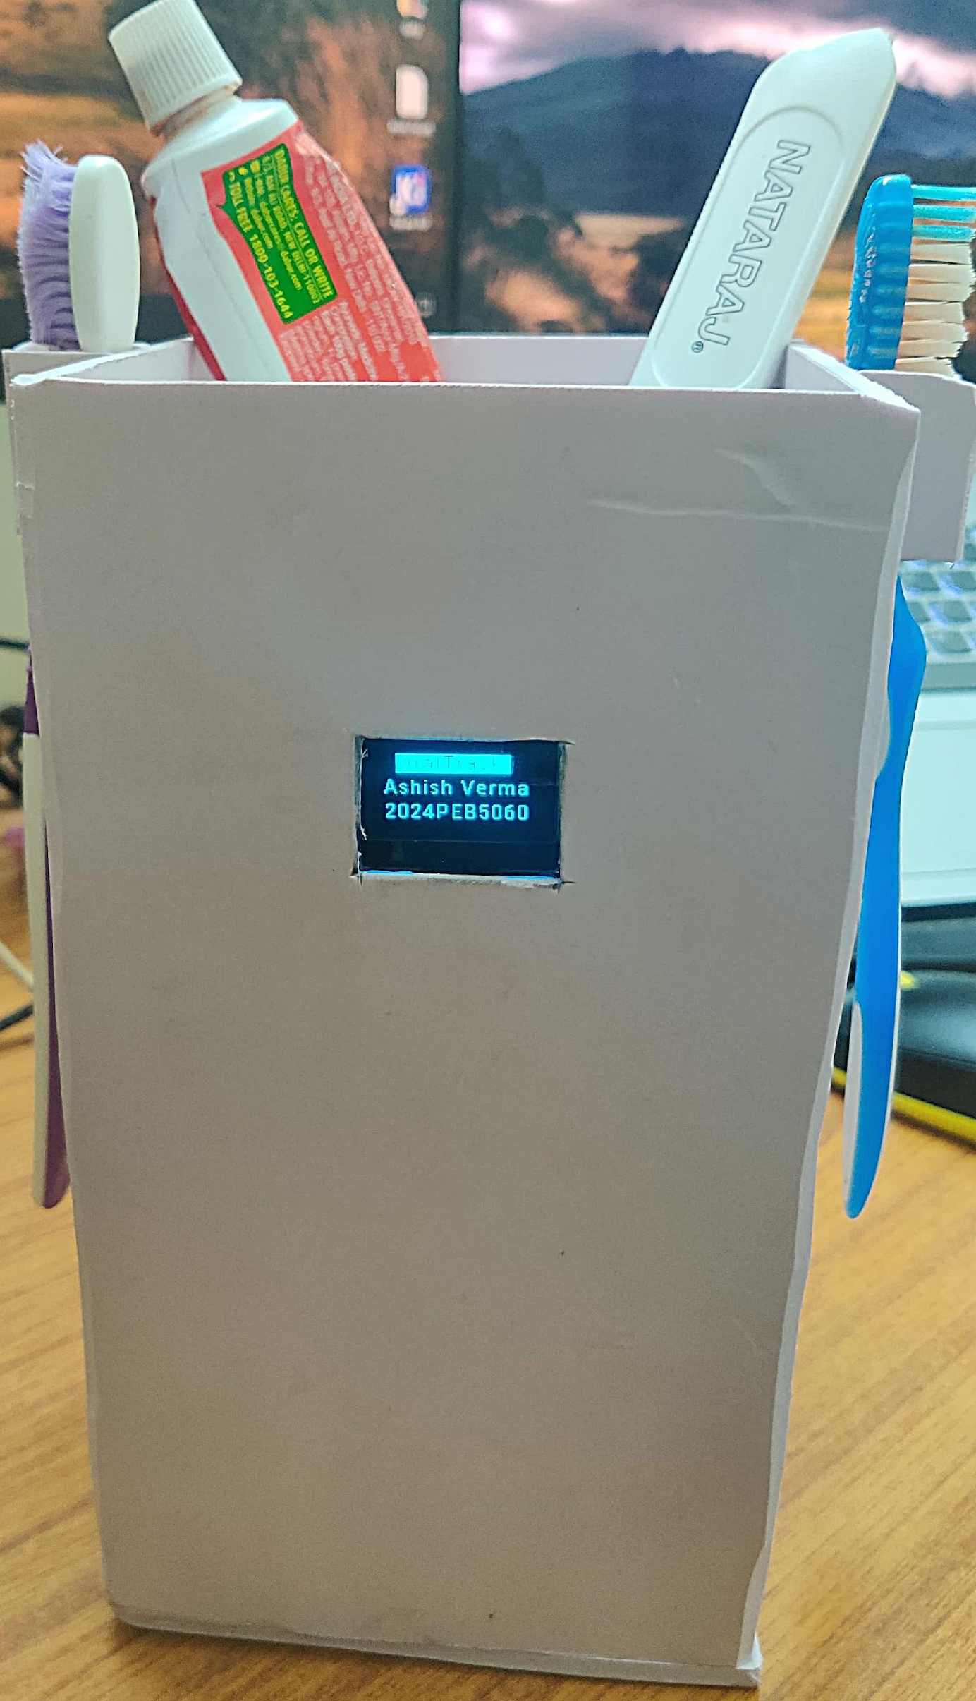
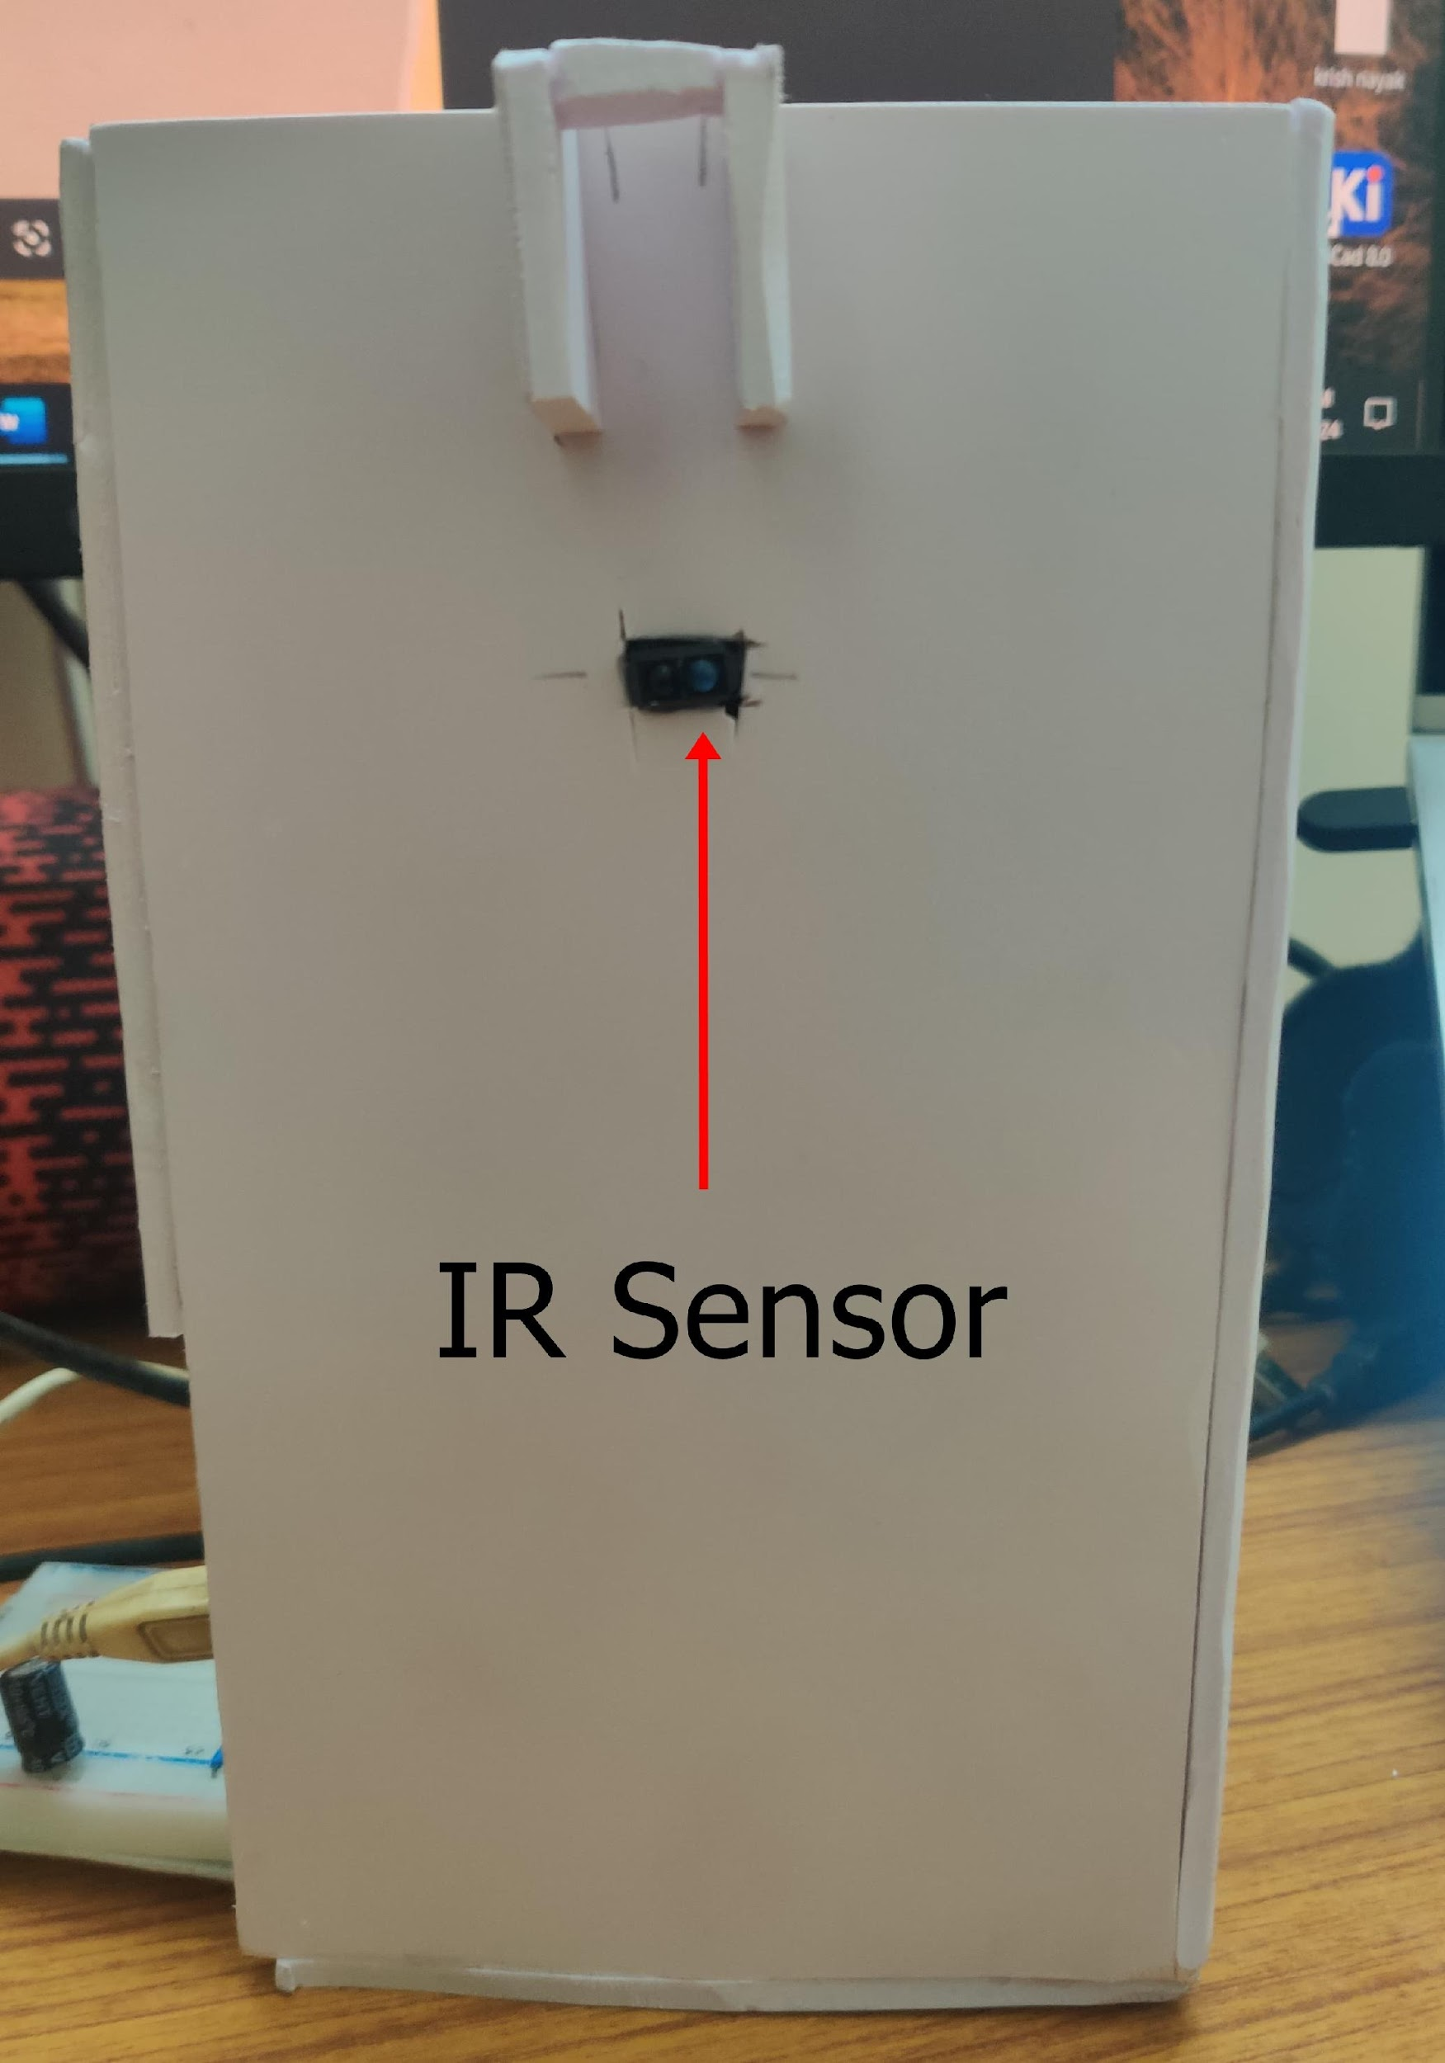
Hardware Overview
MCUs
STM32F051 and
NODEMCU (ESP8266)
Sensors
Two IR sensors for detecting brush pick-up and placement
Display
0.96-inch OLED for real-time feedback
Additional
Buzzer for feedback

Slide 7
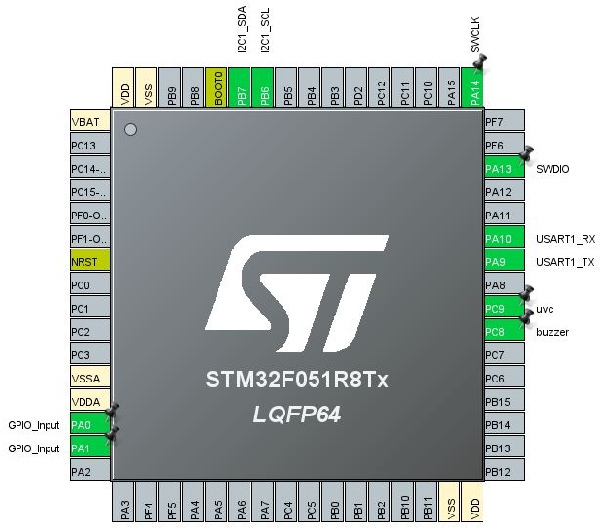
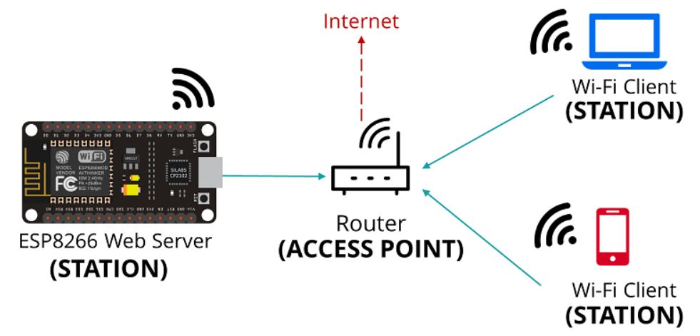
Software Features
STM32
GPIOs: For sensor inputs.
I2C: Interface with OLED display (SSD1366 library).
Timer-1: Core timer for brushing duration.(16 bit)
EEPROM: Stores the user information and brushing logs.
UART: Communication between STM32 and NODEMCU (interrupt mode).
My Custom Libraries: Created for UART and EEPROM functions.
NodeMCU:
Mode Used: Station mode.
Getting date & time from Internet.(NTPClient.h library)
Notes:
256 Kbyte of flash memory Main flash memory block: Up to 64 Kword (64 K × 32 bits)

Slide 8
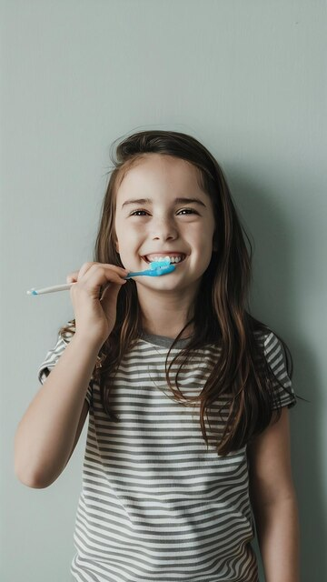
Advantages
1
Healthier Brushing Habits
2
User-Friendly Interface
Promotes healthier brushing habits.
User-friendly interface and real-time feedback.
3
Data-Driven Progress
4
Smart Design
Data-driven progress tracking.
Compact, multifunctional design.

Slide 9
Disadvantages
1
No confirmation
Did user really brush their teeth after picking their brush?
2
Optimum for small family
OLED display can show data for 4 members

Slide 10
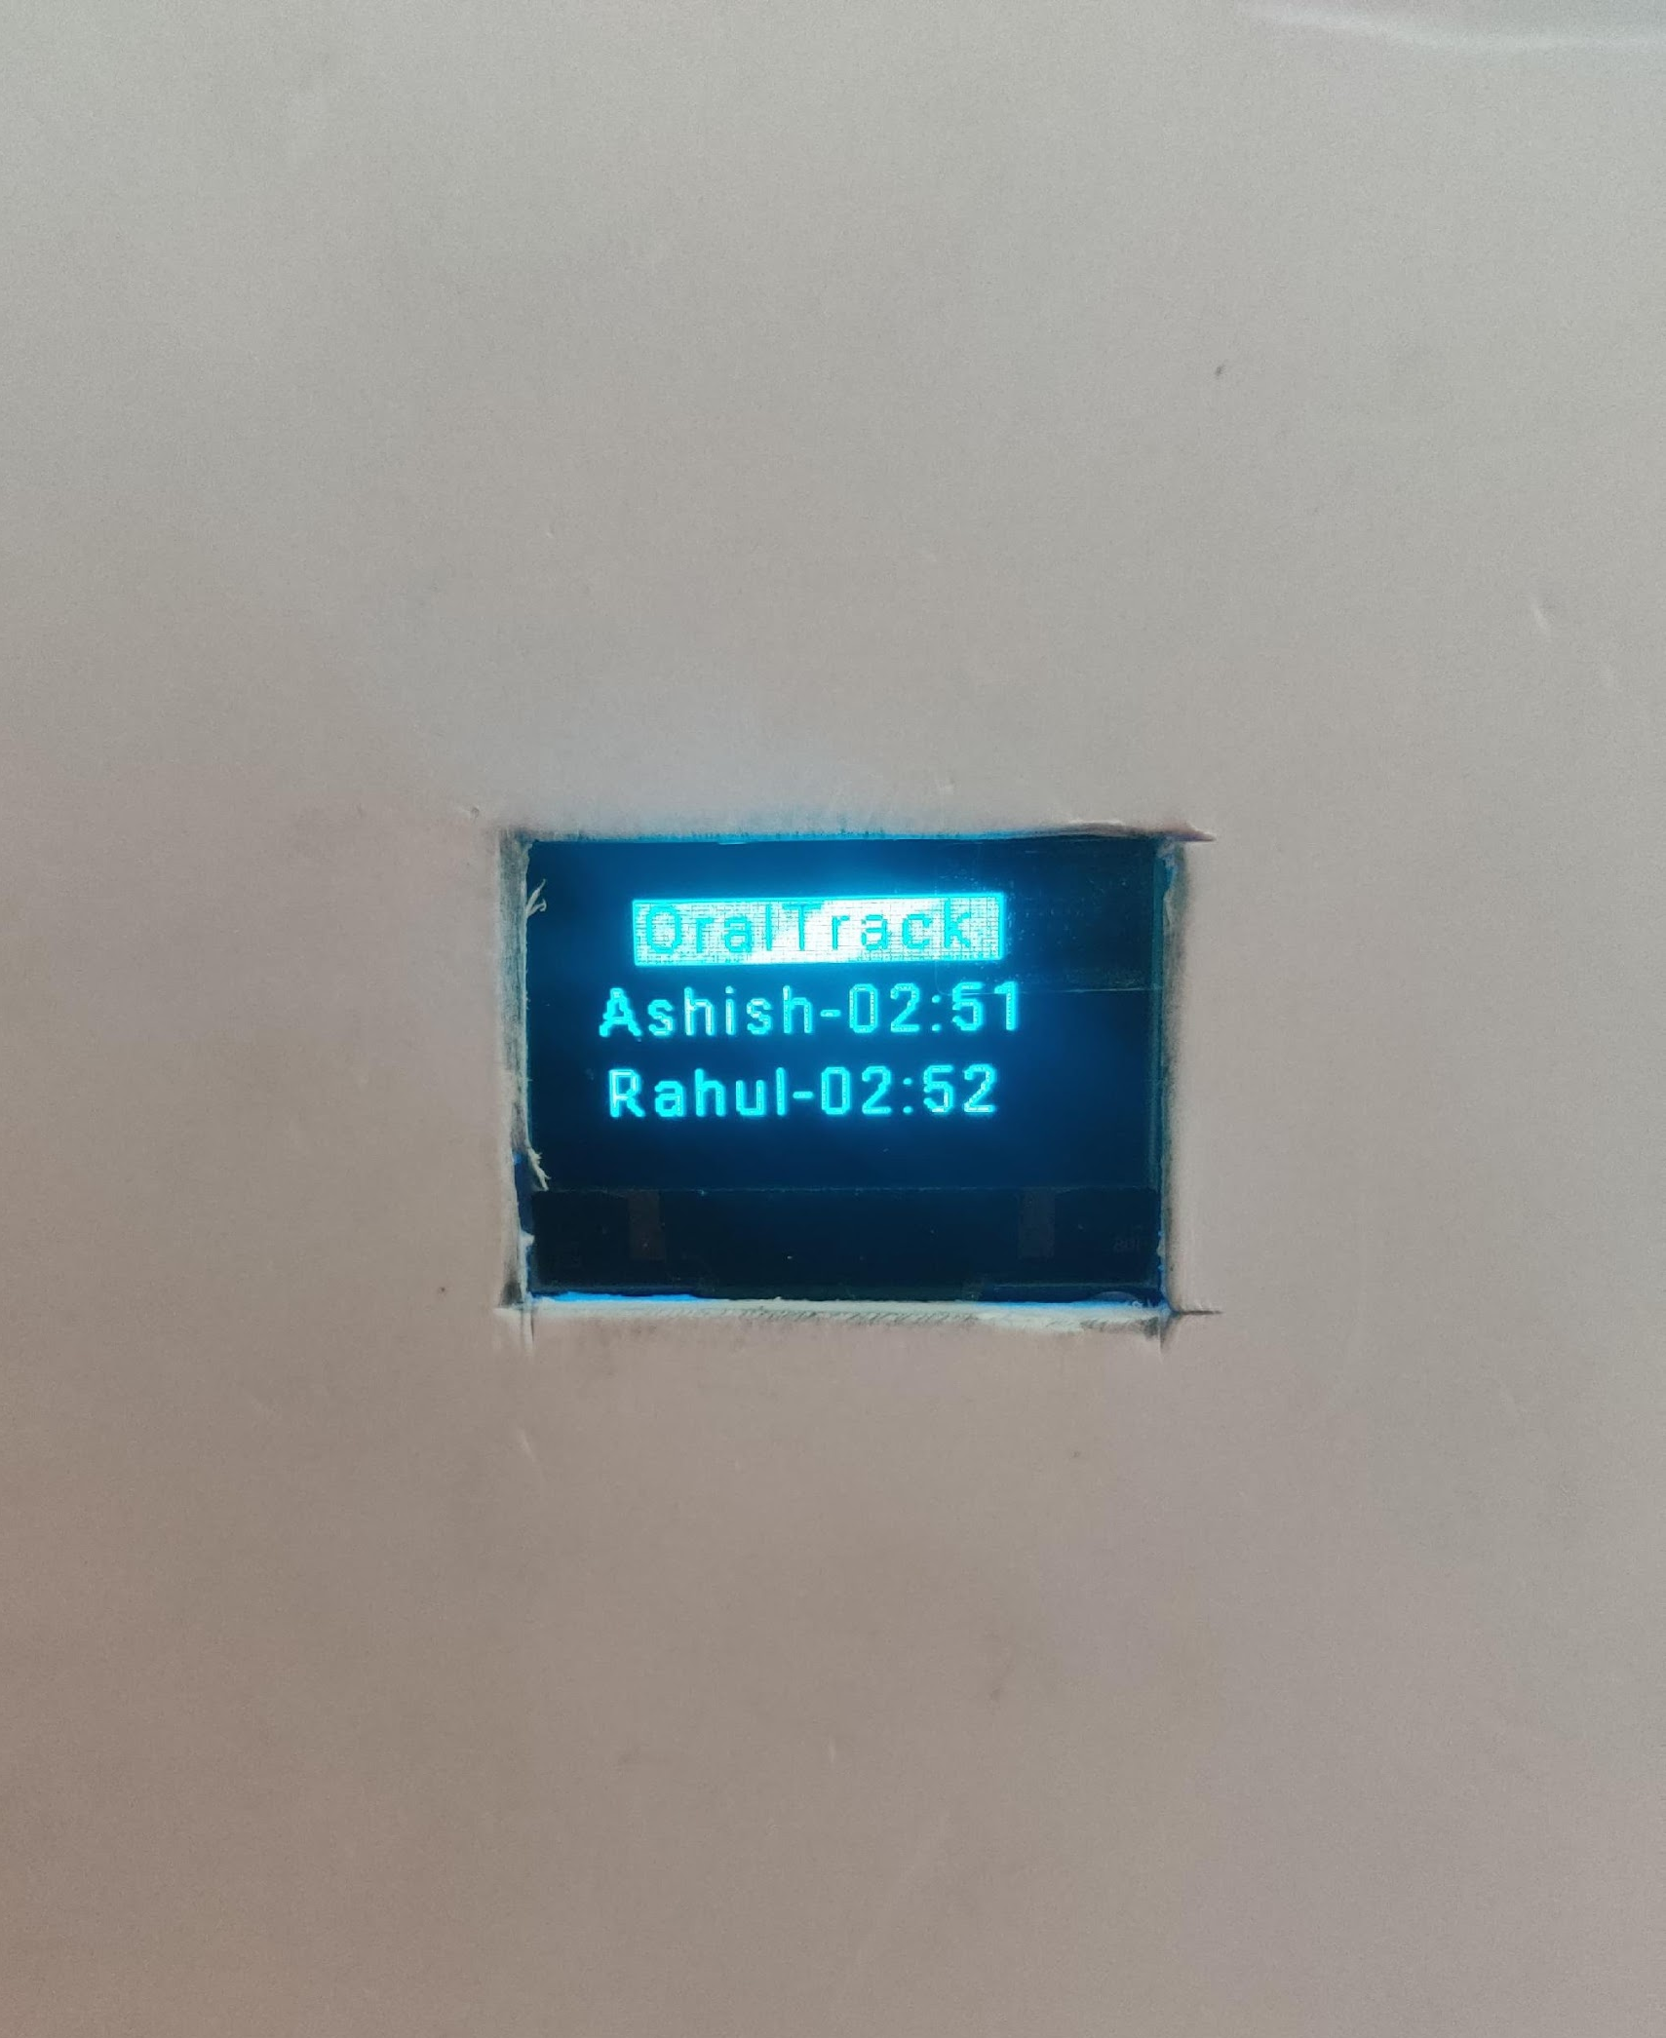
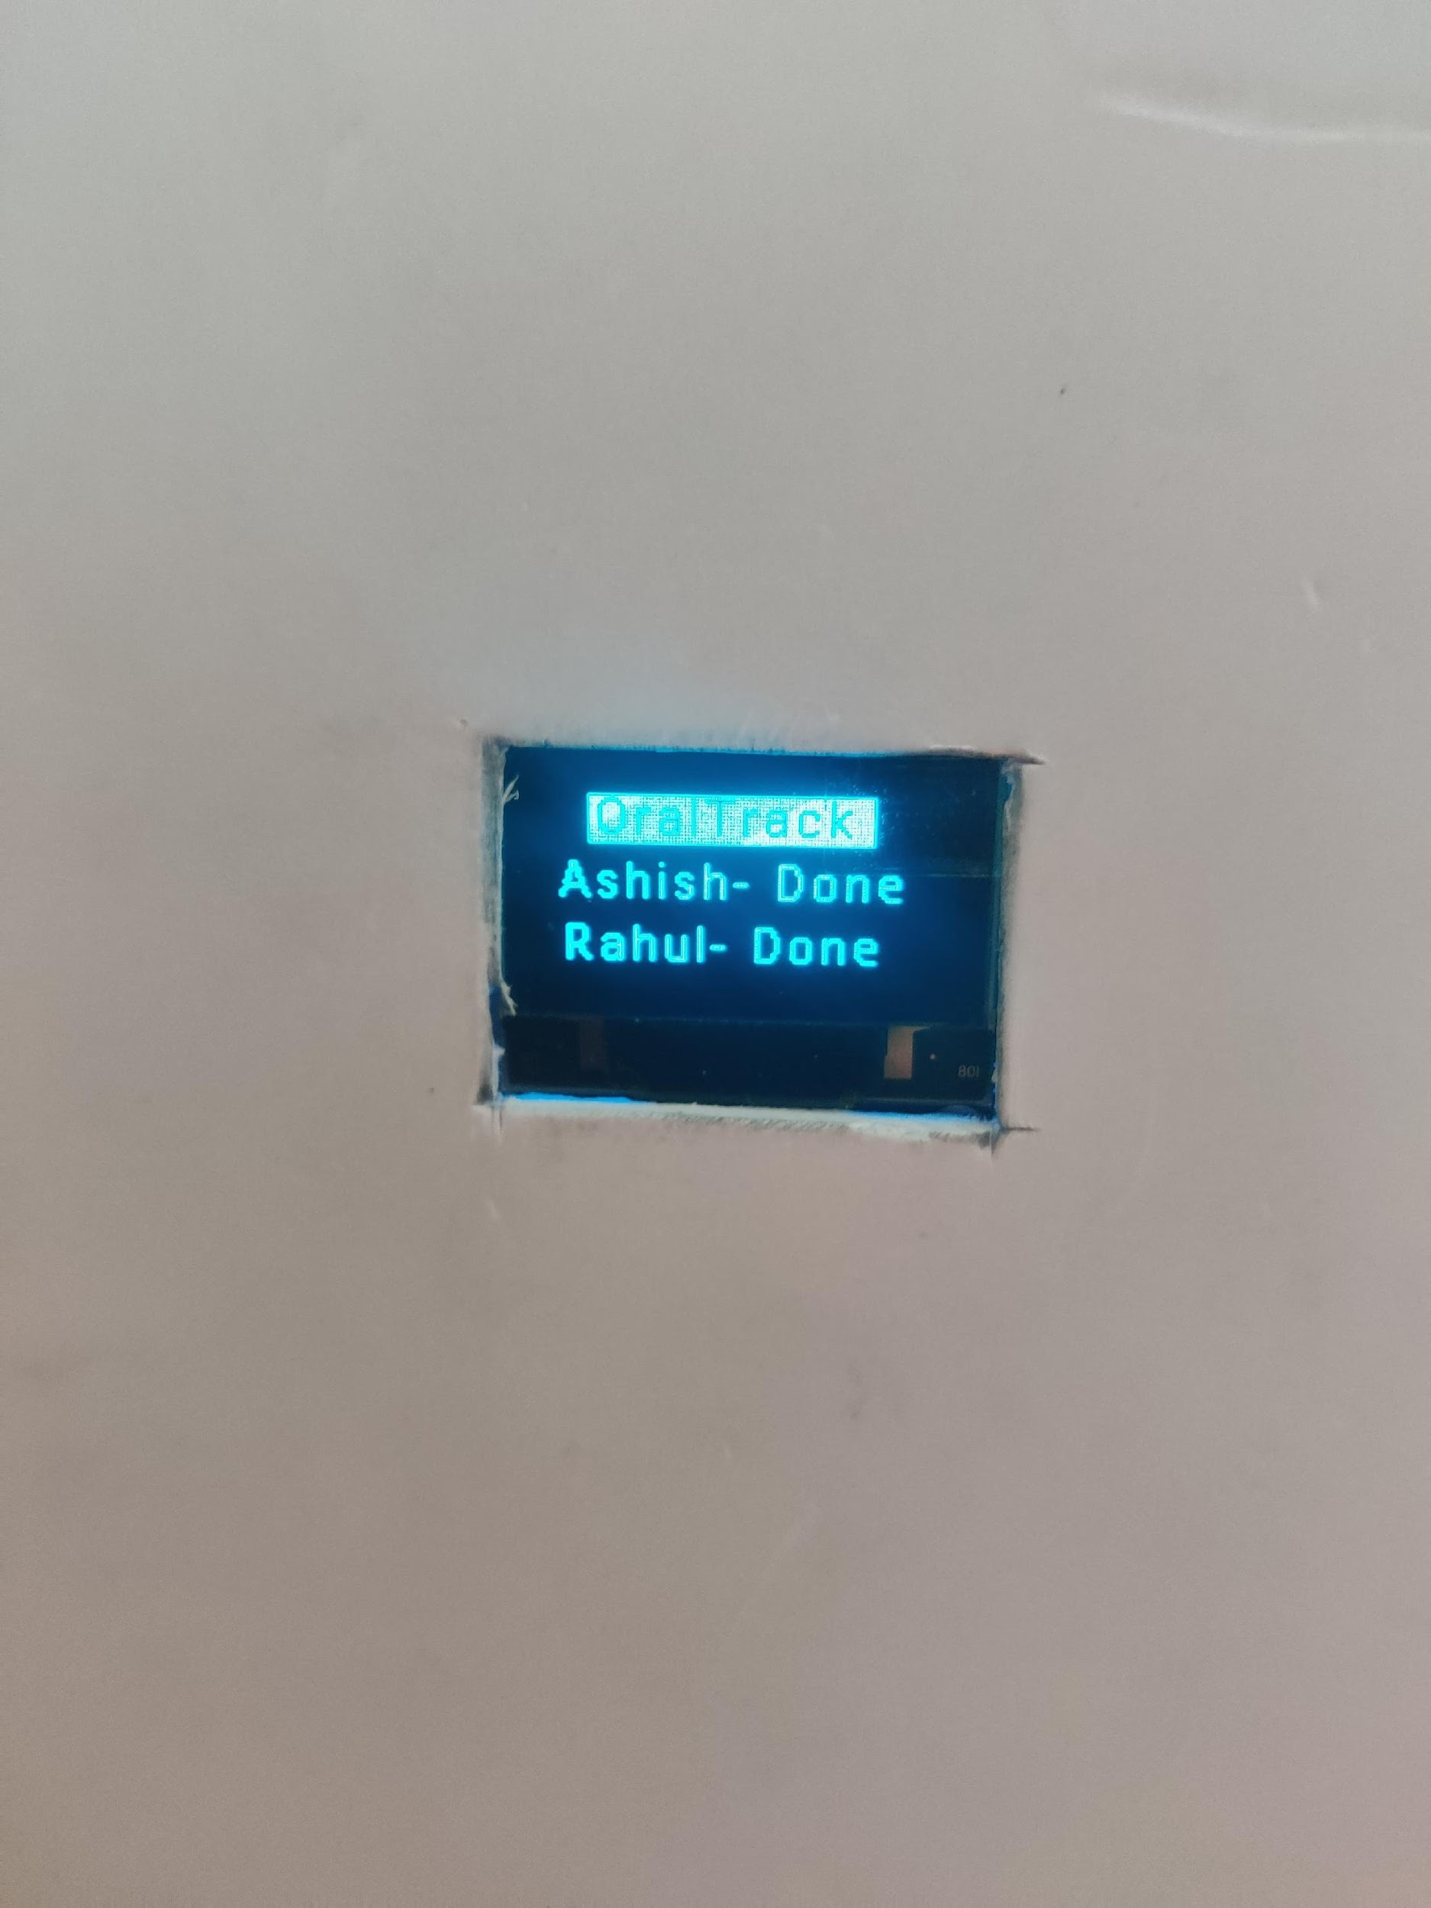
Demo and Results
Home Screen
Timer Running for Users
Time Completed

Slide 11
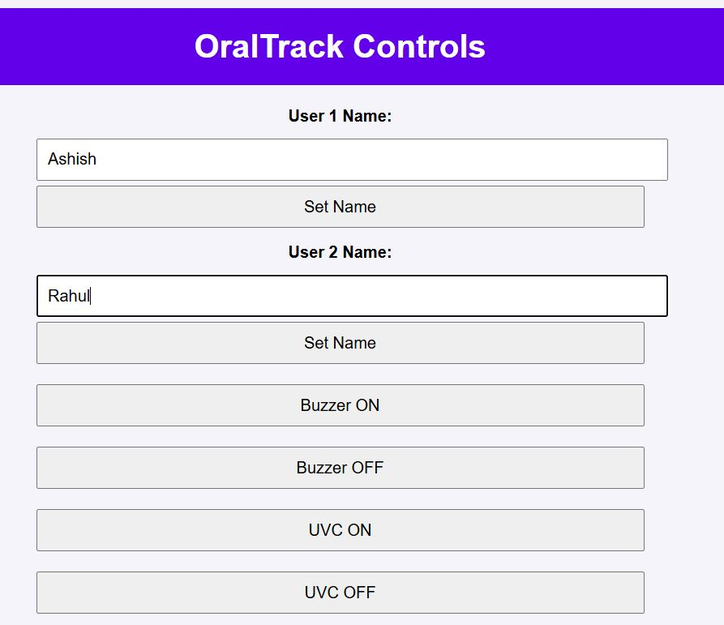
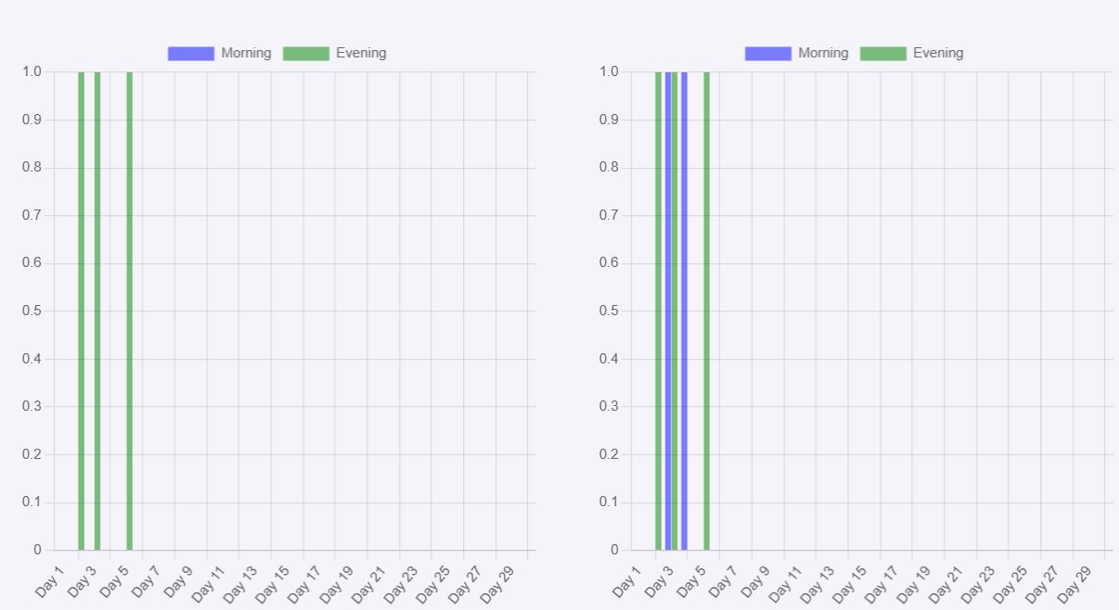
Demo and Results
Web Controls
Brushing History
Screenshots of the web interface
Screenshots of the web interface and brushing history log.

Slide 12
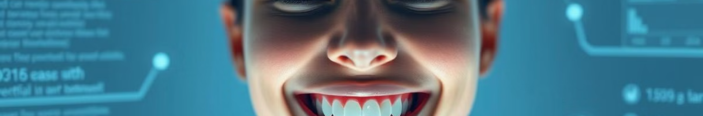
Conclusion
1
Summary
OralTrack helps users improve their oral hygiene by tracking their brushing habits.
2
Future Scope P-1
Making a smart brush which will be able to measure the brushing speed also confirm the brushing after picking. Integration the system with mobile apps for better accessibility.
3
Future Scope P-2
AI-driven analysis of brushing patterns.

