Slide 1
Autism spectrum disorder (ASD) classification from resting state fmri data
By Ashish V
23210025
1

Slide 2


Slide 3
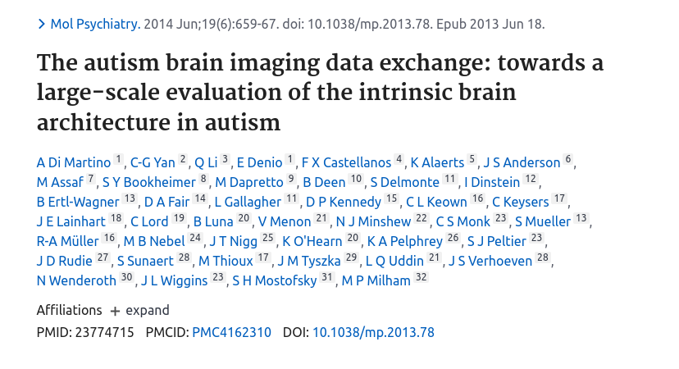

Slide 4
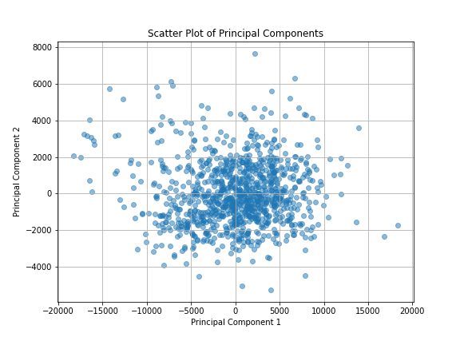
PCA
In PCA, PC1 represents the direction of maximum variance in the data. It captures as much variability in the data as possible along this direction. PC2 represents the direction orthogonal (perpendicular) to PC1 that captures the maximum remaining variance after accounting for PC1.

Slide 5
Recursive feature elimination (RFE)
It is a feature selection technique that recursively removes features from a model based on their importance, typically using model coefficients or feature importances. It’s an iterative approach that starts with all features and gradually eliminates less important ones until the desired number of features is reached.
After obtaining the 100 most important features using the above method, I only
used these features in my feature vector X.

Slide 6
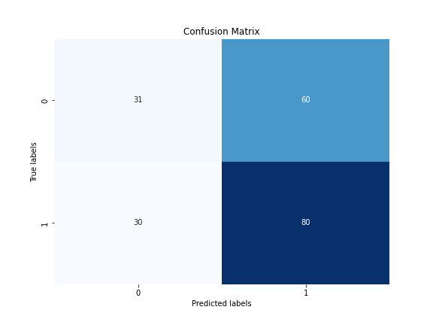
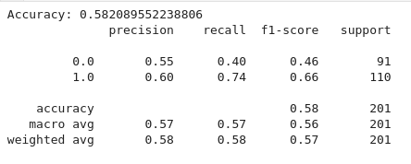
Gaussian Naive Bayes
All features

Slide 7
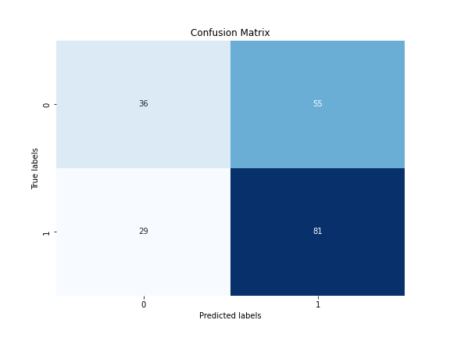
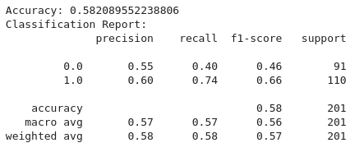
RFE important features
GNB

Slide 8
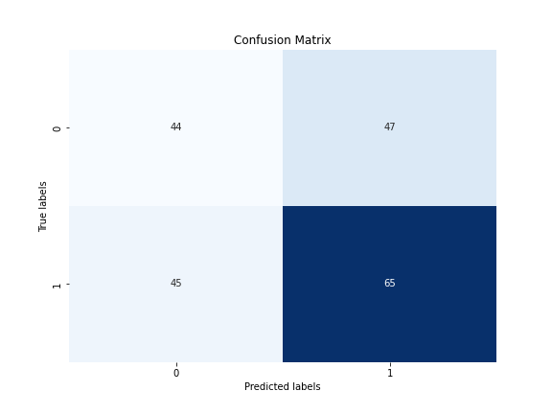
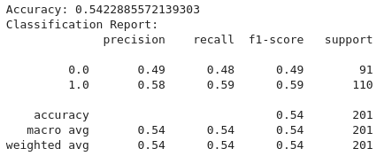
Lasso
Lasso all

Slide 9

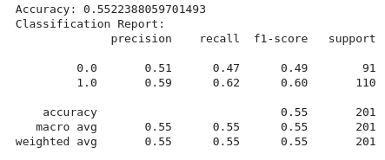
RFE important features
Lasso

Slide 10
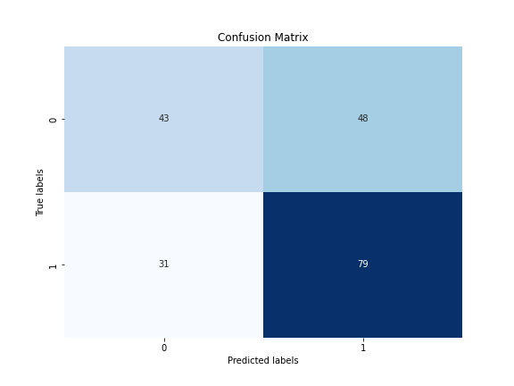
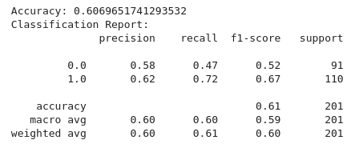
Random forest
All features

Slide 11
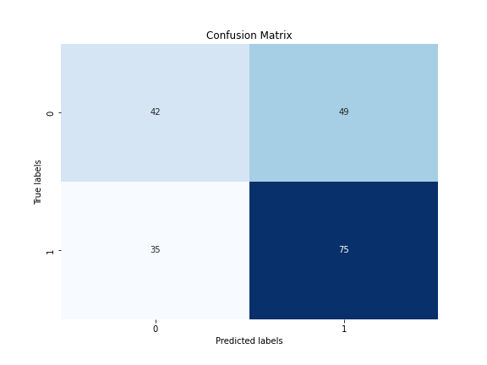
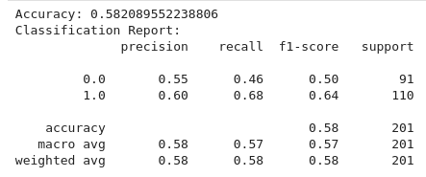
RFE important features
Random forest

Slide 12
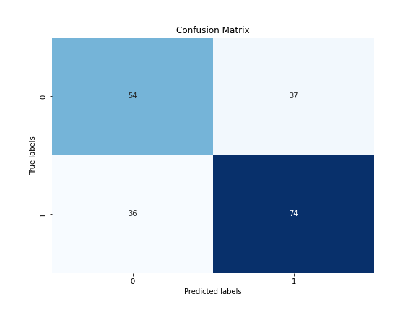
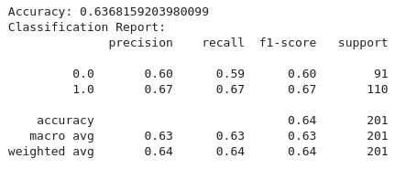
XGBoost
All features

Slide 13
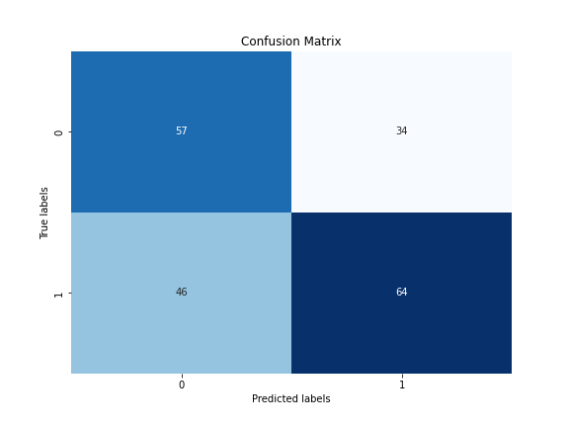
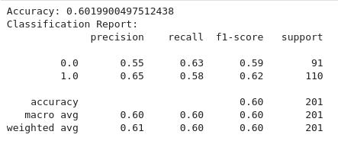
RFE all features
XGBoost

Slide 14
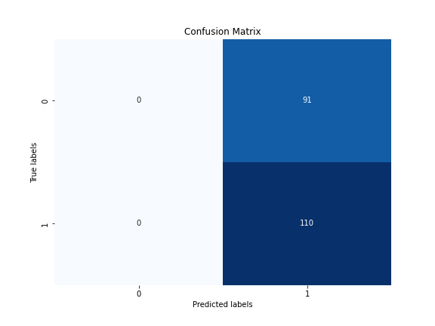
simple feedforward neural network (FNN)
model = Sequential([
Dense(64, activation='relu', input_shape=(X_train.shape[1],)),
Dropout(0.5), # Dropout layer to prevent overfitting
Dense(32, activation='relu'),
Dropout(0.5),
Dense(num_classes, activation='softmax') # Output layer with softmax activation for multi-class classification
]) Test Accuracy: 0.5472636818885803
Neural network

Slide 15
Results
The classification models give around 50 - 60 % accuracy. Which is not really a good outcome for a model.
Need to do more feature optimization like finding out important features using other methods.
This work could be seen as a starting point. The results could be seen as a baseline.

