Slide 1



Analyzing Estrogen Bioassays Across Labs
By Ashish Vinodkumar, Charlie Xie, Jasmine Young, & Leon Zhang

Slide 2
Introduction
Overview
Use rats as an assay to test estrogen agonists and antagonists
Measure hormonal response using weight of the uterus
International multi-laboratory study of different dosage groups
Inference Questions
Does the dose response vary across labs?
Do the protocols differ in their sensitivity to detecting EE and ZM effects?
Does uterus weight exhibit an increasing dose response trend for EE and a decreasing dose response trend for ZM?

Slide 3

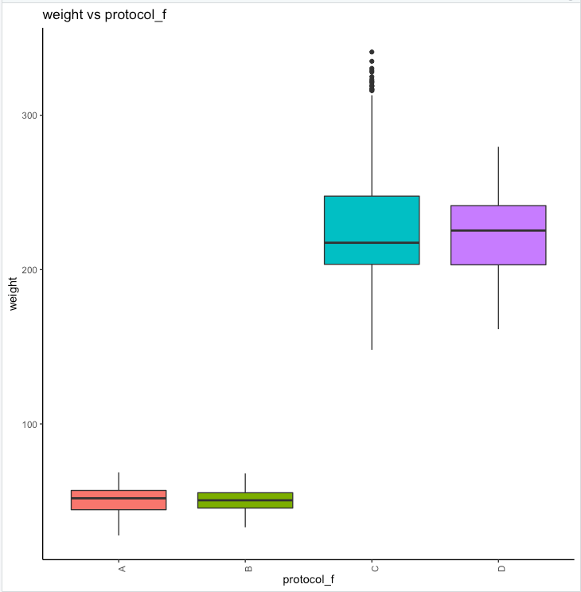
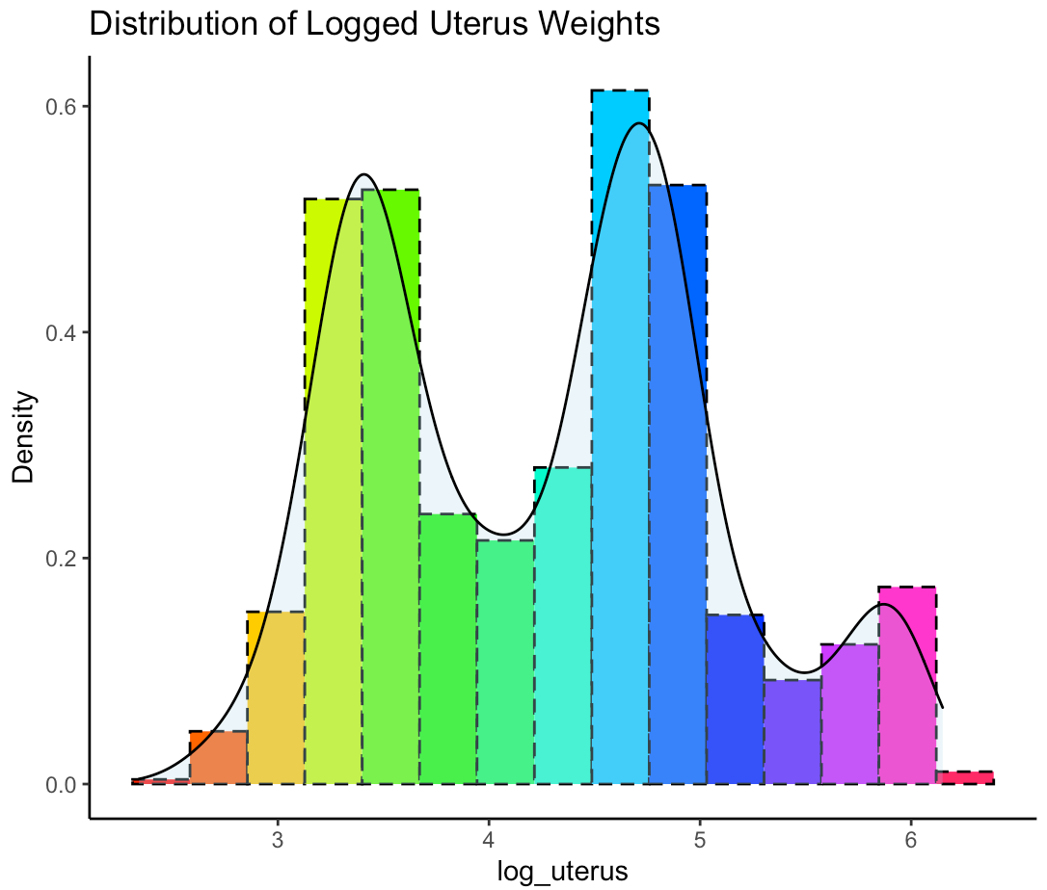
Exploratory data analysis
Observed two peaks amid transformations
High correlation between weight and protocol

Slide 4
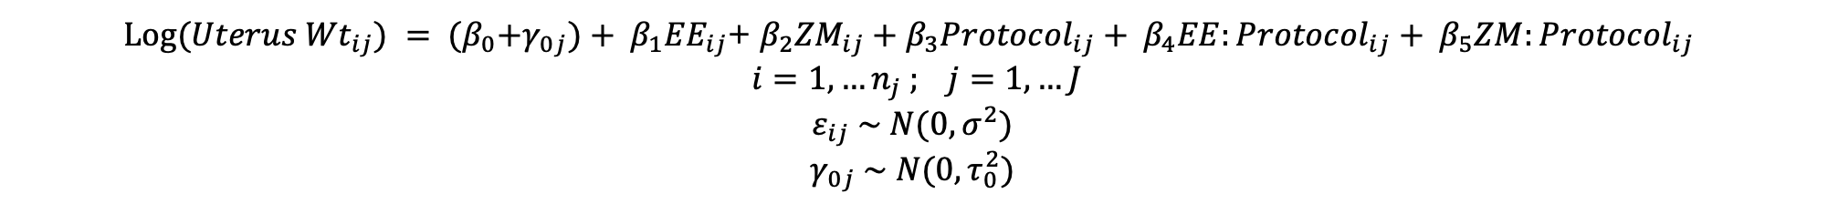
Model Selection
Final Model
ANOVA
Multi-collinearity
Model Assumptions
Michael this took 30 minutes PLEASE give us extra credit!
$Log({Uterus Wt}_{ij}) = {{(β}_{0}+γ_{0j})+ β}_{1}{EE}_{ij}$+ $β_{2}{ZM}_{ij}+β_{3}{Protocol}_{ij}+ {β_{4}{EE:Protocol}_{ij}+ β}_{5}{ZM:Protocol}_{ij}$
$$i=1,…n_{j} ; j=1, …J$$
$$ε_{ij} \sim N(0,σ^{2})$$
$$γ_{0j} \sim N(0,τ_{0}^{2})$$

Slide 5
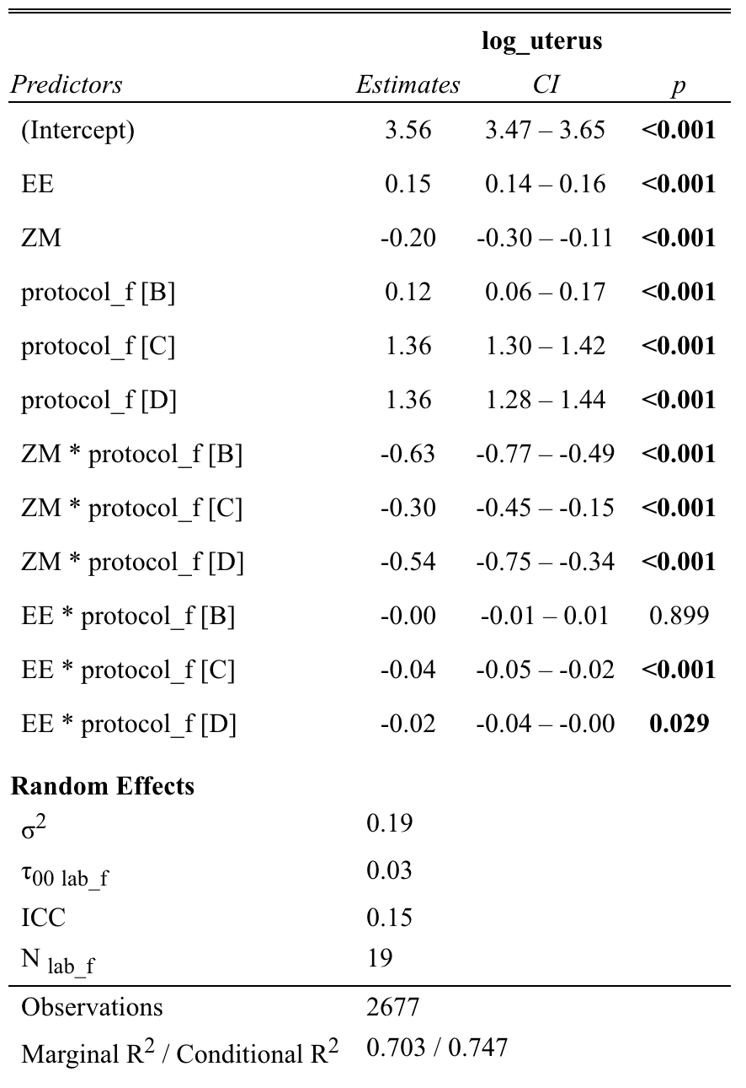
Q1: EE & ZM Response
Does uterus weight exhibit an increasing dose response trend for EE + a decreasing dose response trend for ZM?
EE shows 16% increase
ZM shows 19% decrease

Slide 6
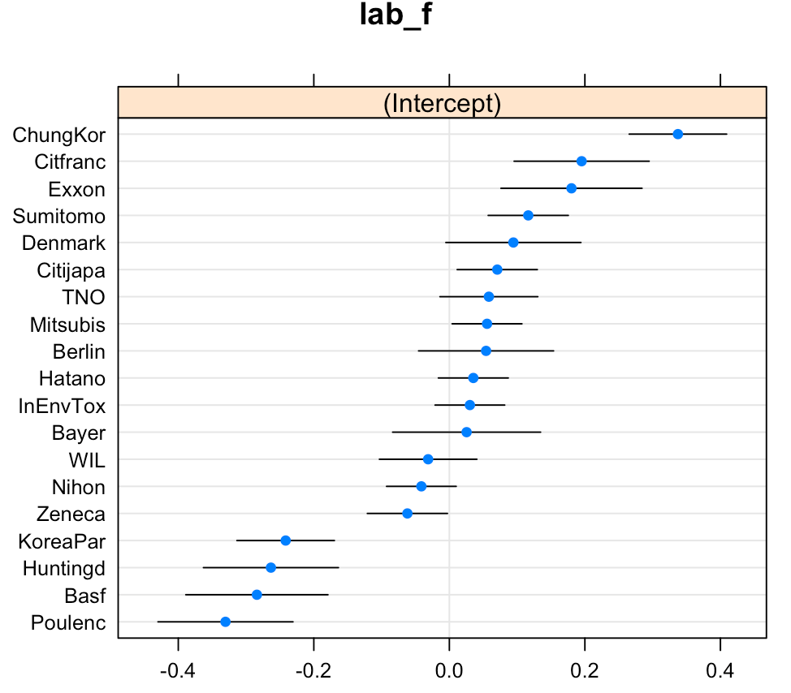
Q2: Looking at Labs
Does the dose response vary across labs?
Some lab ranges exclude zero, we consider these outliers

Slide 7
Q3: Protocols
Do the protocols differ in their sensitivity to detecting EE and ZM effects?
Used interactions to detect protocol differences
Most negative impact (B) best for ZM
Most positive impact (A) best for EE

Slide 8


Thank you! Any Questions?

