Slide 1
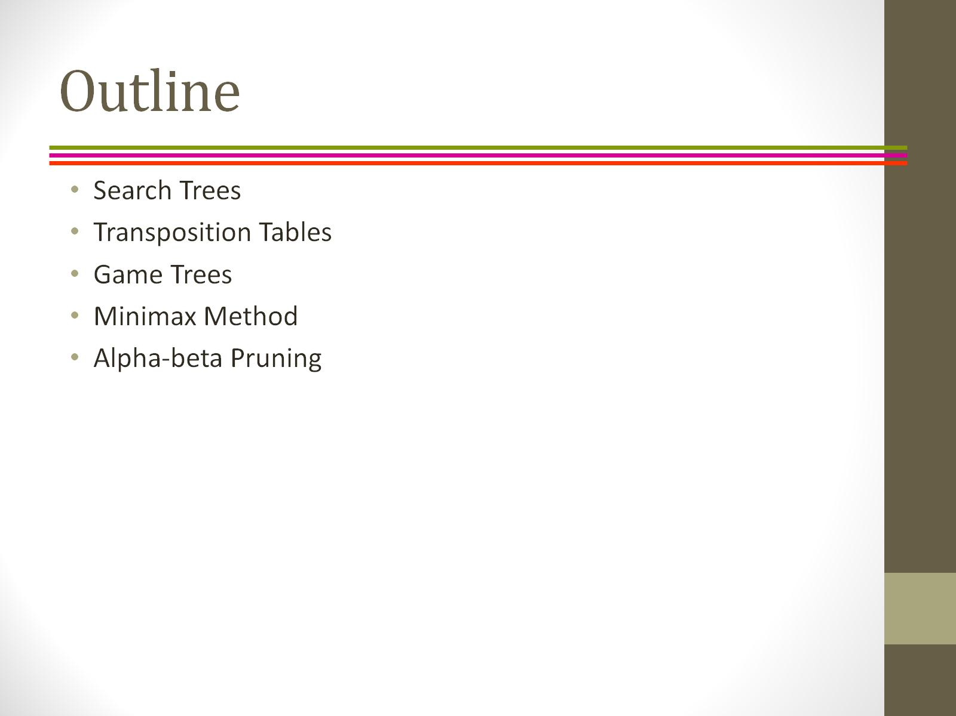
Outline

Slide 2
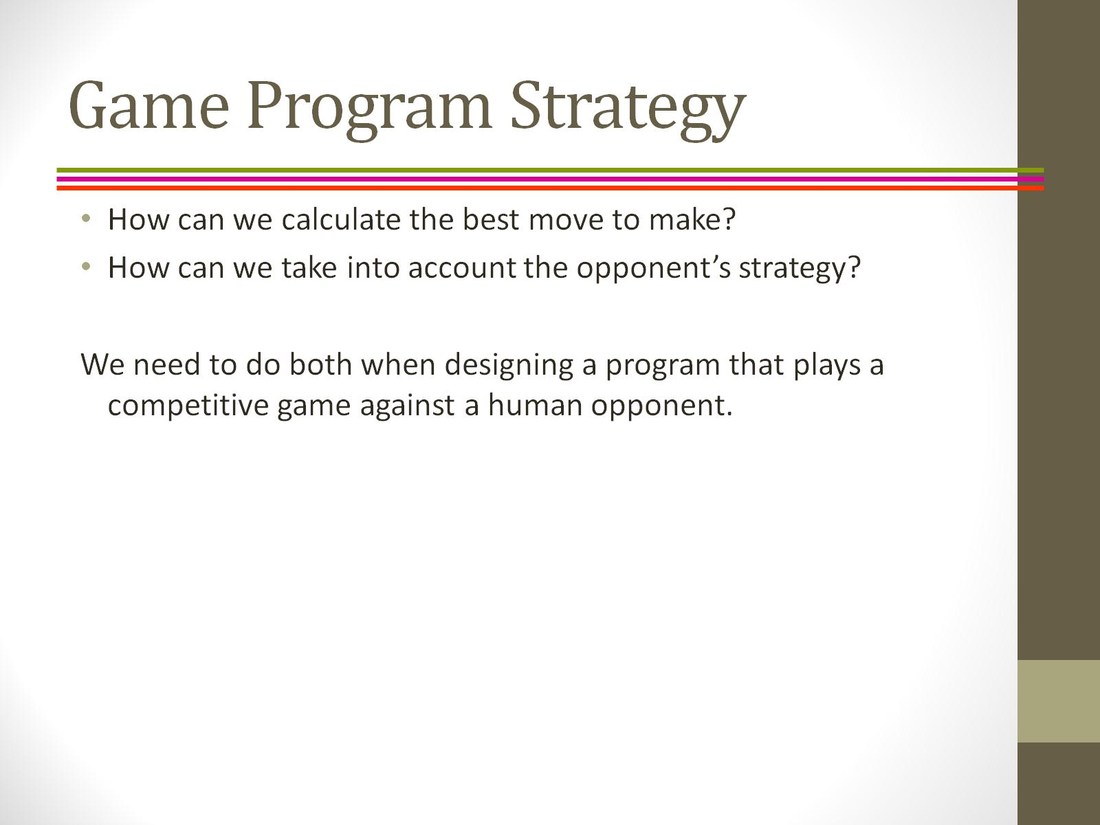
Game Program Strategy

Slide 3
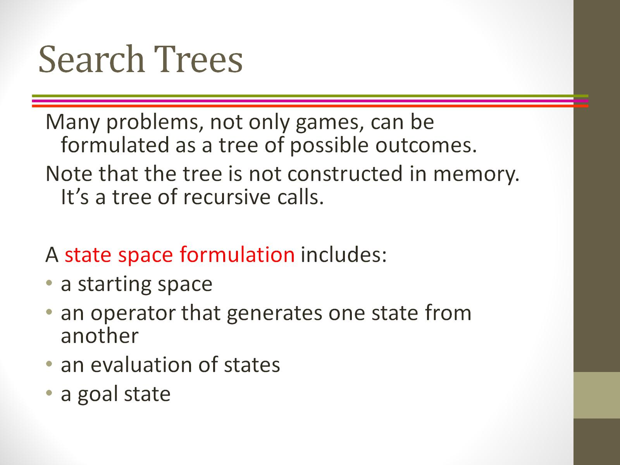
Search Trees

Slide 4
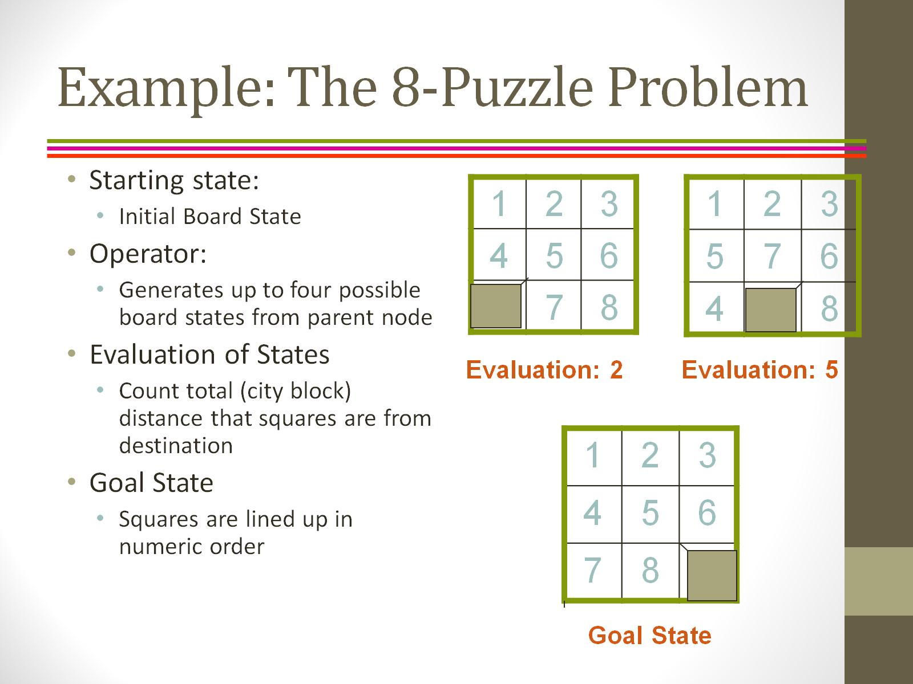
Example: The 8-Puzzle Problem

Slide 5
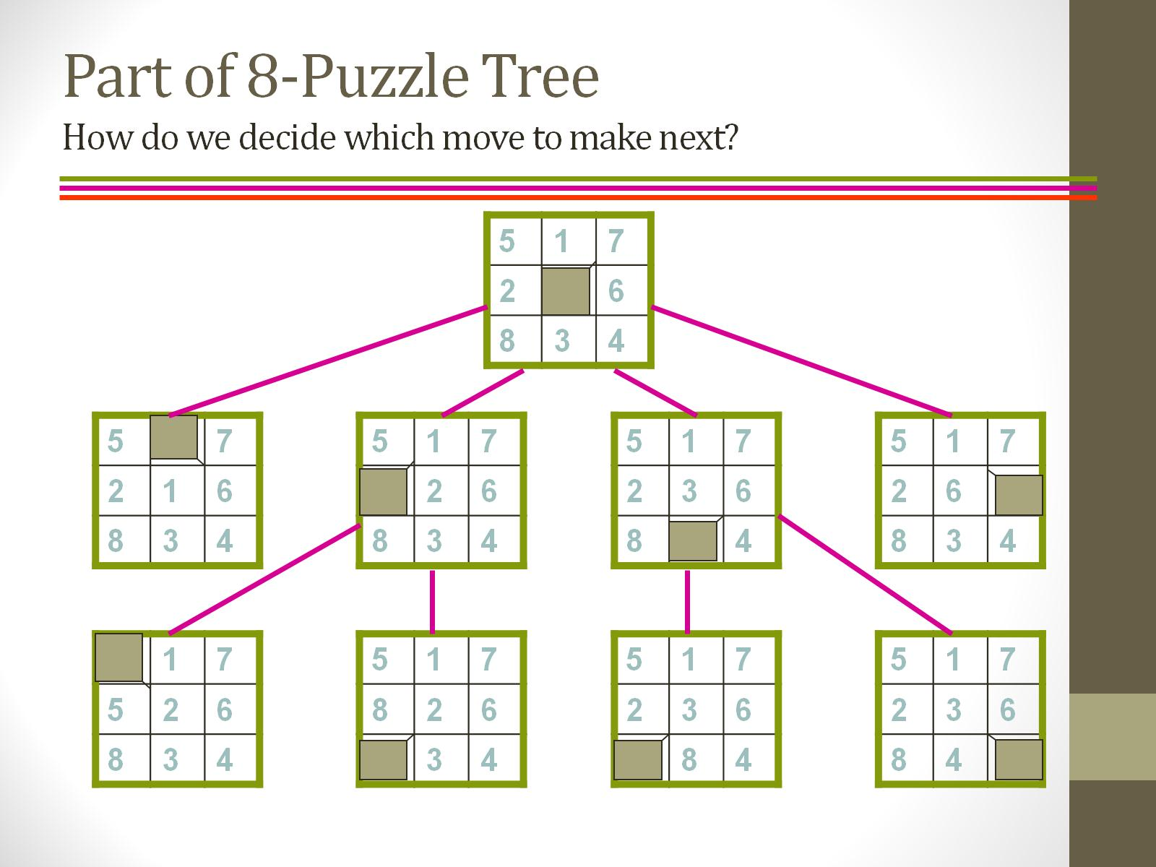
Part of 8-Puzzle Tree How do we decide which move to make next?

Slide 6
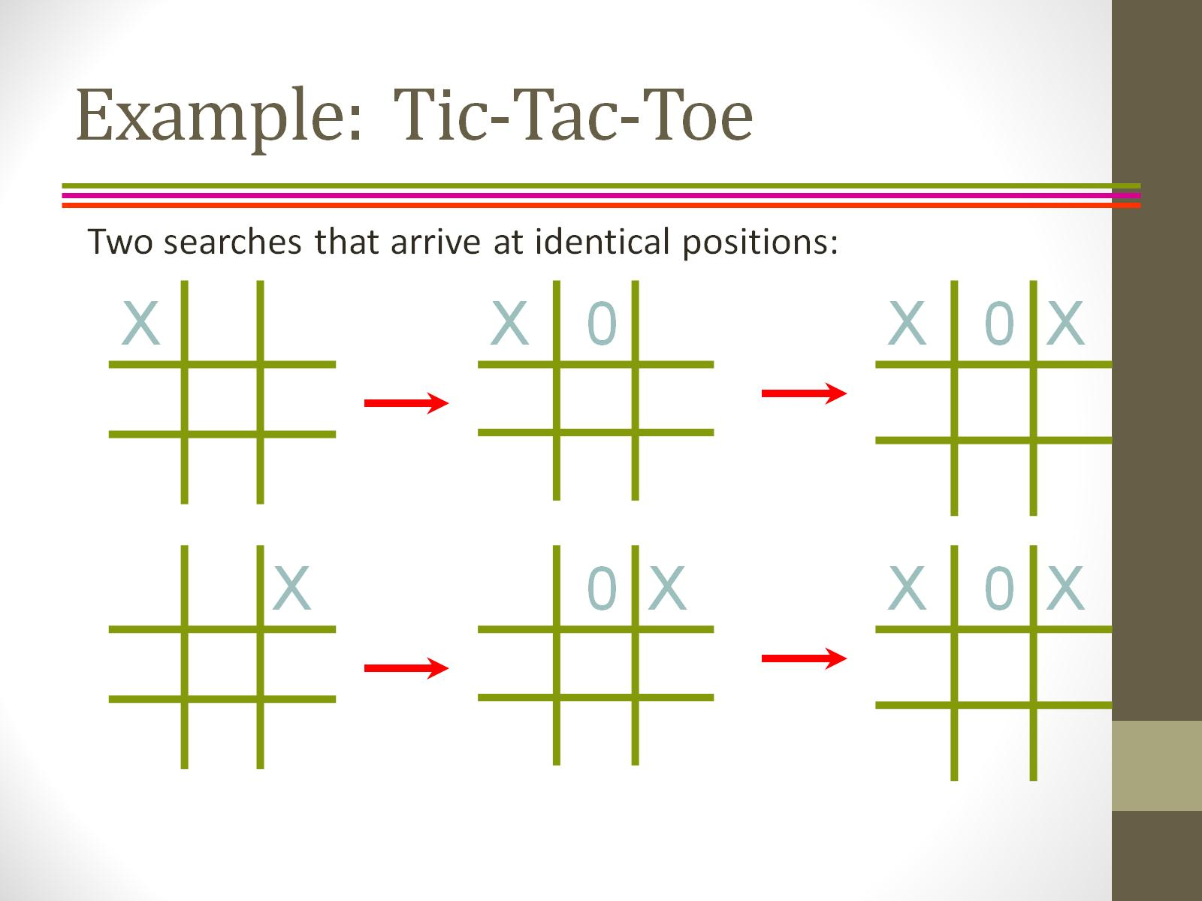
Example: Tic-Tac-Toe

Slide 7
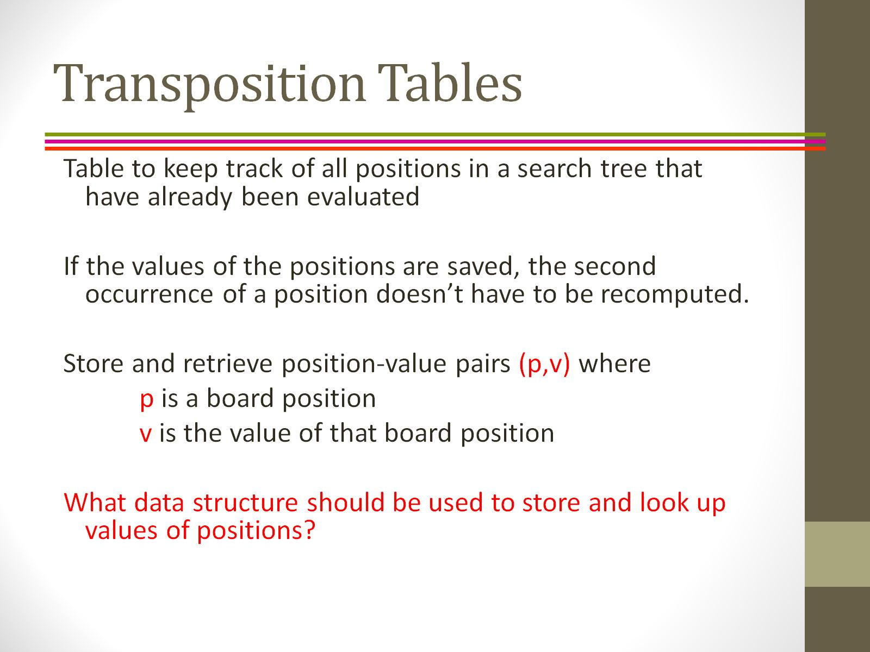
Transposition Tables

Slide 8
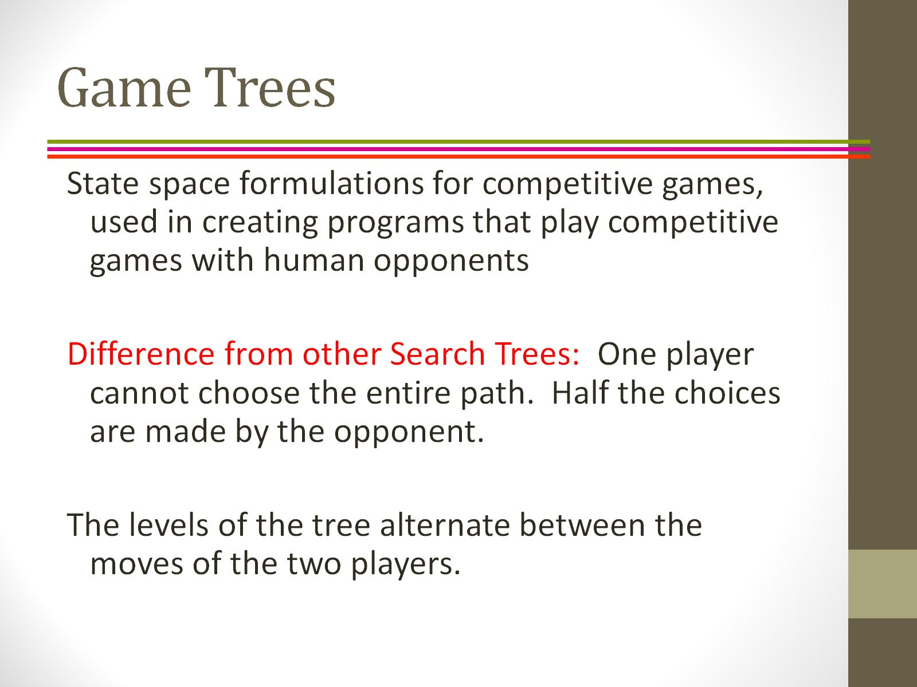
Game Trees

Slide 9
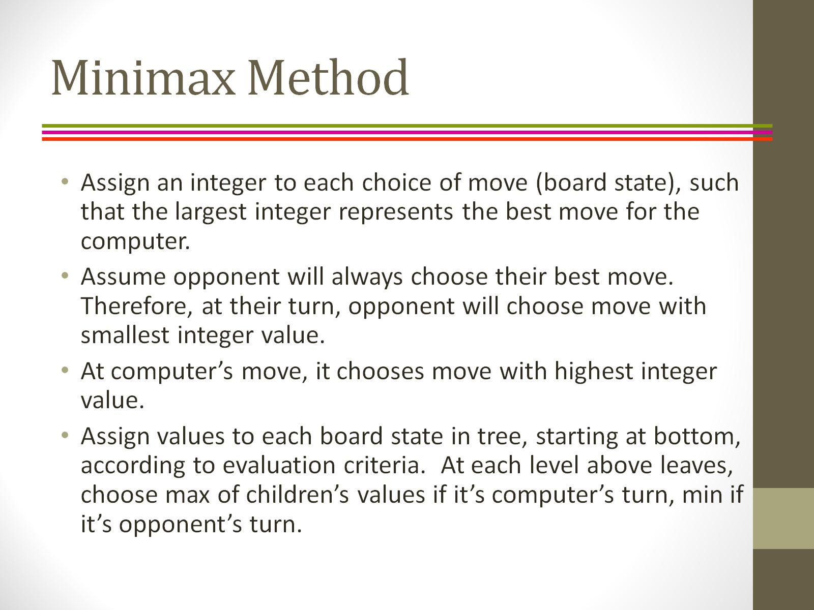
Minimax Method

Slide 10
Min-Max Method
Mini-max algorithm is a recursive or backtracking algorithm which is used in decision-making and game theory.
Mini-Max algorithm uses recursion to search through the game- tree.
In this algorithm two players play the game, one is called MAX and other is called MIN.
Both the players fight it as the opponent player gets the minimum benefit while they get the maximum benefit.
The mini-max algorithm performs a depth-first search algorithm for the exploration of the complete game tree.
The mini-max algorithm proceeds all the way down to the terminal node of the tree, then backtrack the tree as the recursion.

Slide 11
Working
An example of game-tree which is representing the two-player game.
In this example, there are two players one is called Maximizer and other is called Minimizer.
Maximizer will try to get the Maximum possible score, and Minimizer will try to get the minimum possible score.
This algorithm applies DFS, so in this game-tree, we have to go all the way through the leaves to reach the terminal nodes.
At the terminal node, the terminal values are given so we will compare those value and backtrack the tree until the initial state occurs.

Slide 12
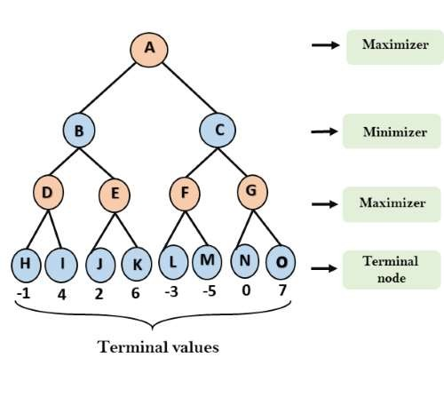

Slide 13
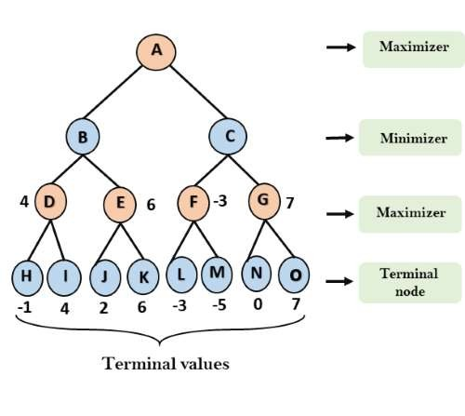

Slide 14
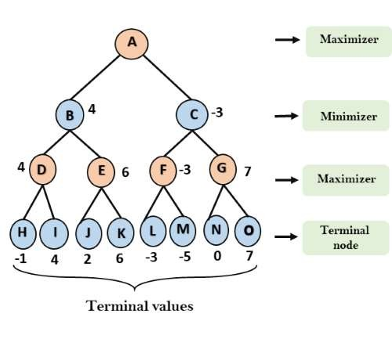

Slide 15
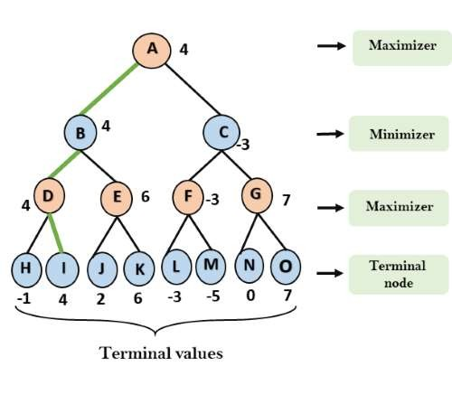

Slide 16
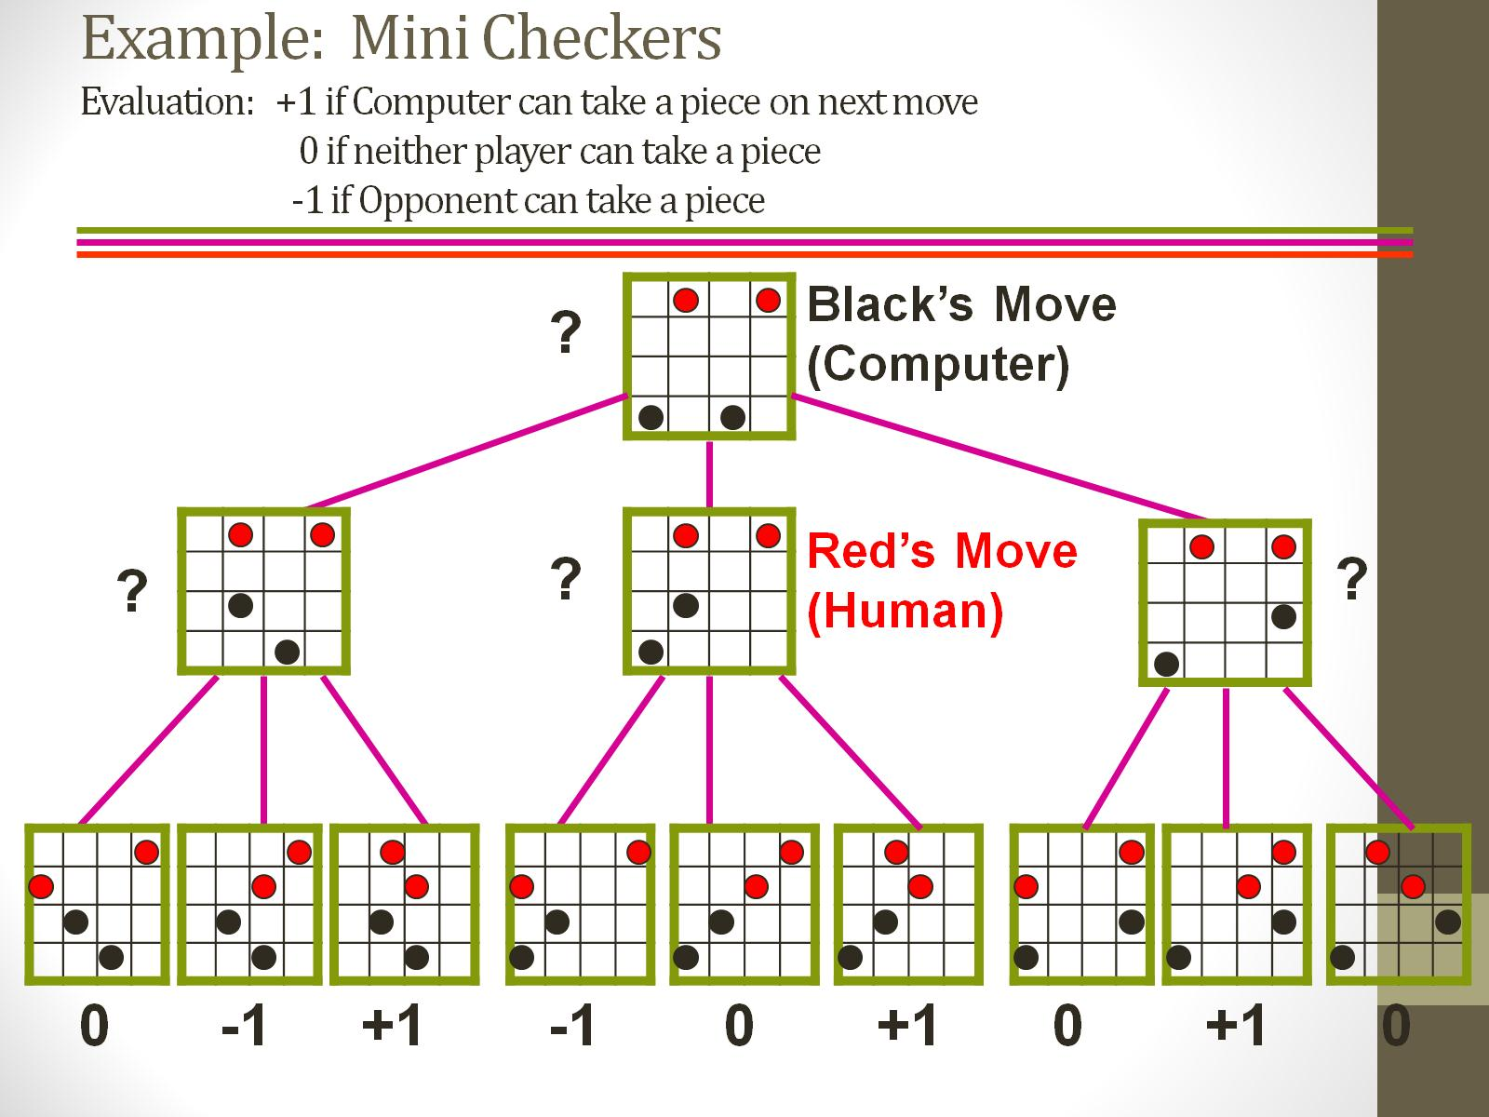
Example: Mini Checkers Evaluation: +1 if Computer can take a piece on next move 0 if neither player can take a piece -1 if Opponent can take a piece

Slide 17
Properties
◆ Complete- Min-Max algorithm is Complete. It will definitely find a solution (if exist), in the finite search tree.
◆ Optimal- Min-Max algorithm is optimal if both opponents are playing optimally.
◆ Time complexity- As it performs DFS for the game-tree, so the time complexity of Min-Max algorithm is O(bm), where b is branching factor of the game-tree, and m is the maximum depth of the tree.
◆ Space Complexity- Space complexity of Mini-max algorithm is also similar to DFS which is O(bm).

Slide 18
Limitation
◆ The main drawback of the minimax algorithm is that it gets really slow for complex games such as Chess, go, etc. This type of games has a huge branching factor, and the player has lots of choices to decide. This limitation of the minimax algorithm can be improved from alpha-beta pruning.

Slide 19
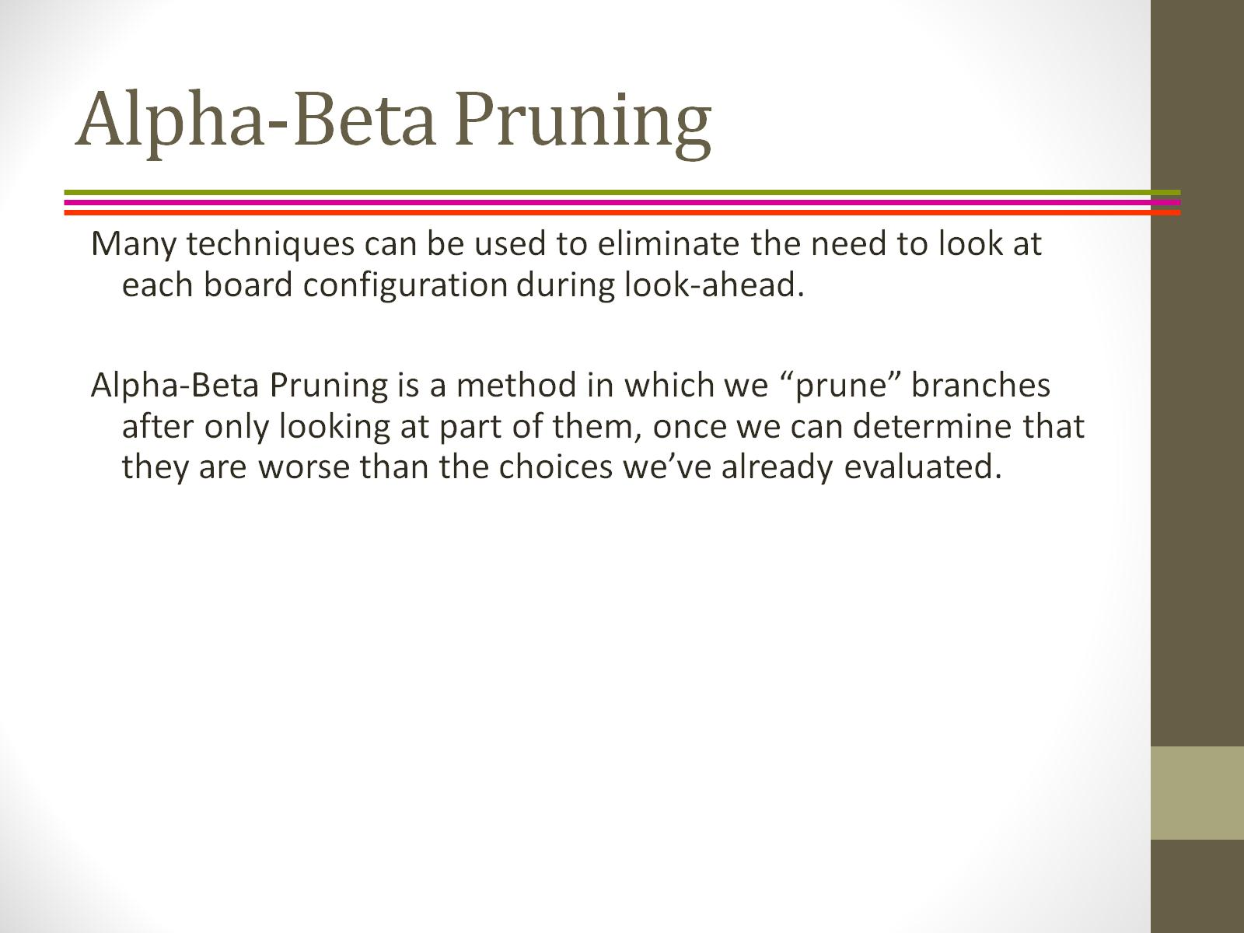
Alpha-Beta Pruning

Slide 20
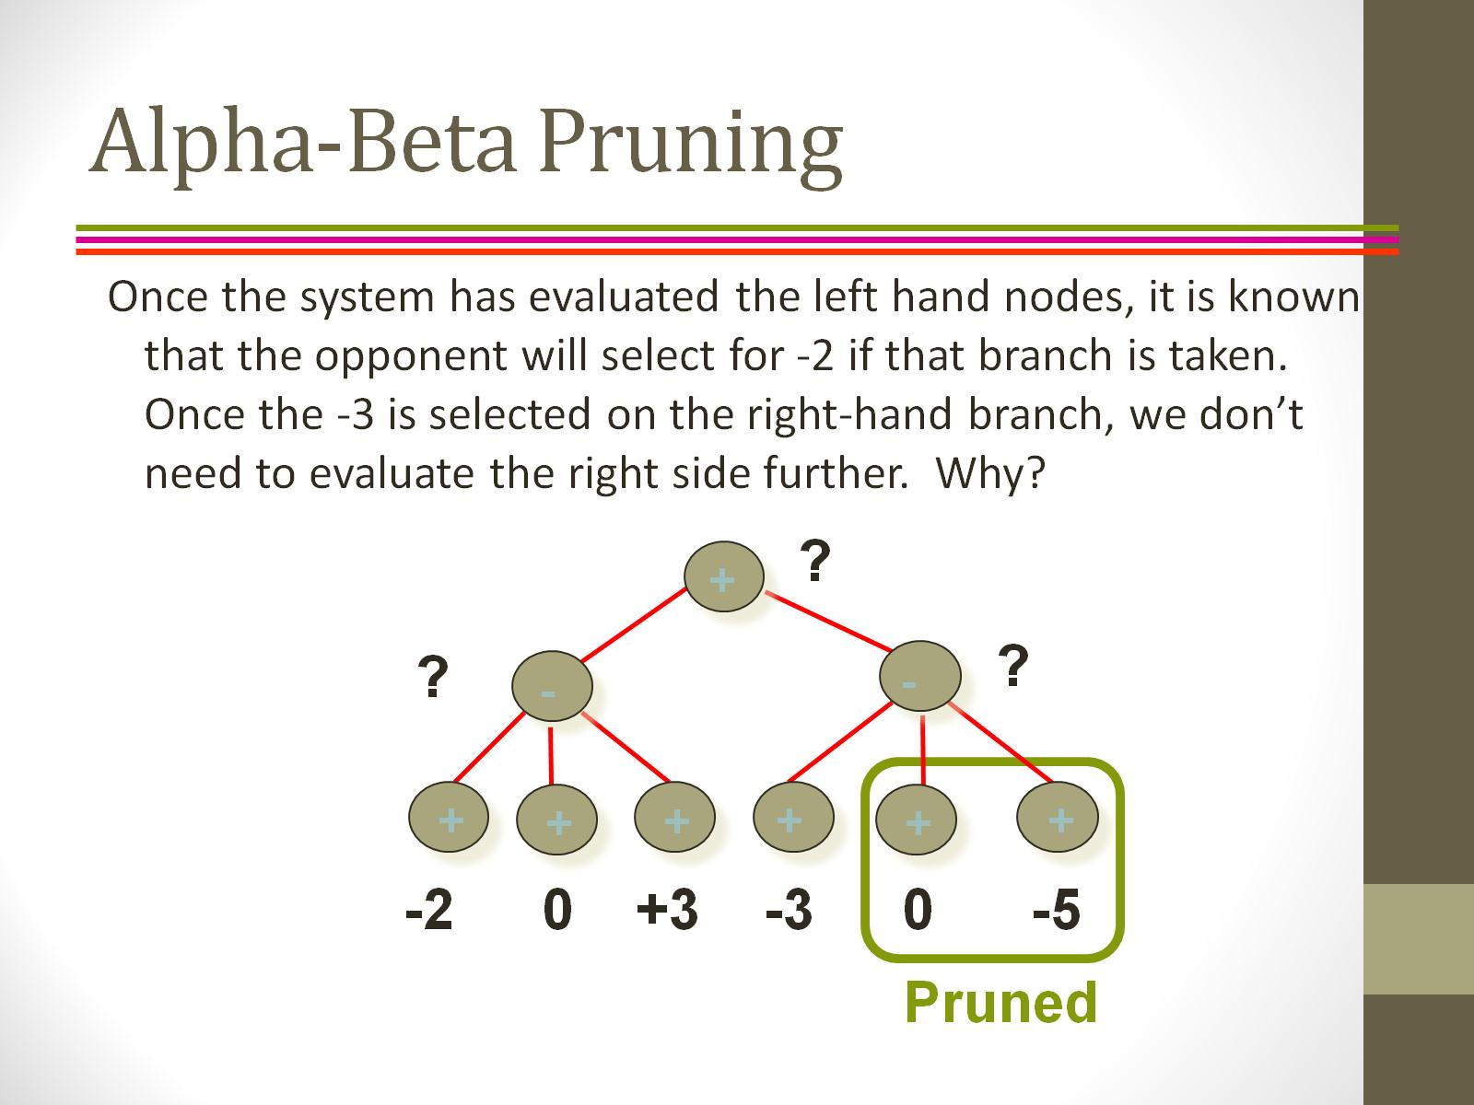
Alpha-Beta Pruning

Slide 21
What is Alpha Beta?
Alpha Beta pruning is advanced part of mini-max.
It is anything but another calculation. We consider it an enhancement strategies for minimax calculation.
Why:-
Because which time limit we required or have to solve a problem of mini-max it will reduce the time.

Slide 22
What happened for reducing the time limit?
It lessen the calculation time, enable us to look a lot quicker.
It cut off branches in the amusement tree which require not be looked (In diversion tree we go to more profound dimension for looking through an esteem).

Slide 23
Advantages:
◆ The principle advantage is that when we influence a diversion tree then it to can remove those branches that we have no need (So we have no compelling reason to go at that dimension to fathom it)
◆ Because we have better move to go there.

Slide 24
What is Alpha ? What is Beta?
Alpha is the best value that maximizer currently can guarantee at that level or above.
Beta is the best value that minimizer currently can guarantee at that level or above.

Slide 25
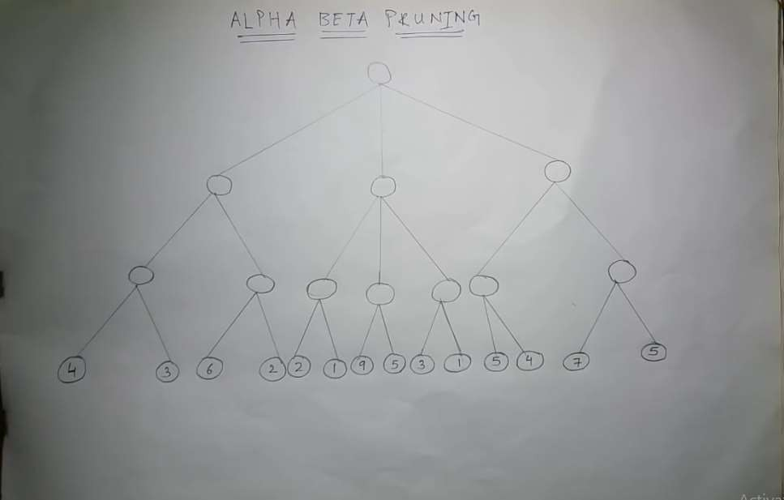

Slide 26
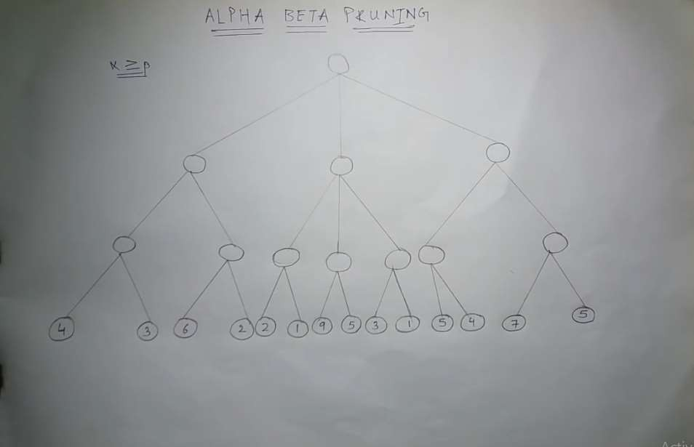

Slide 27
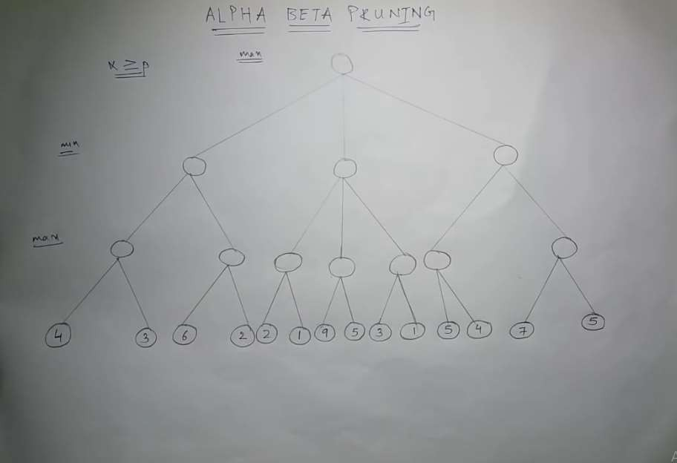

Slide 28
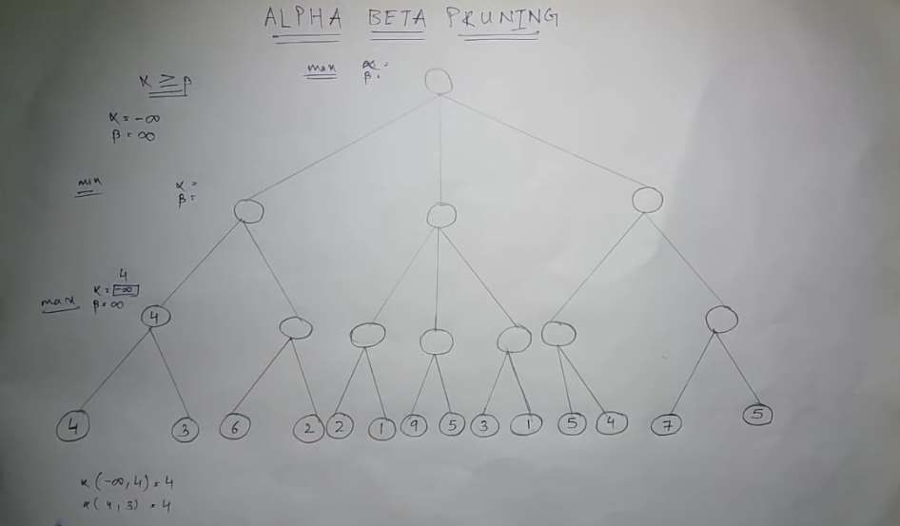

Slide 29
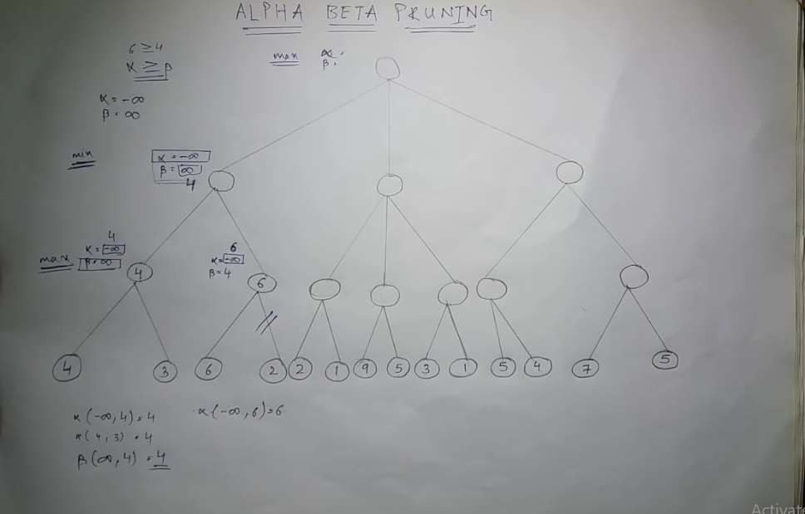

Slide 30
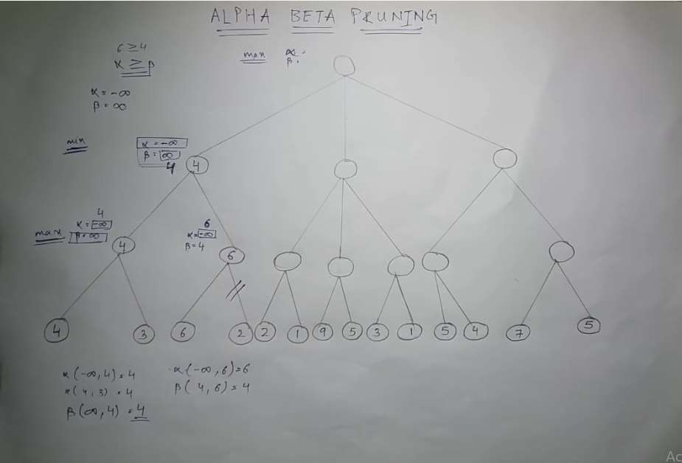

Slide 31
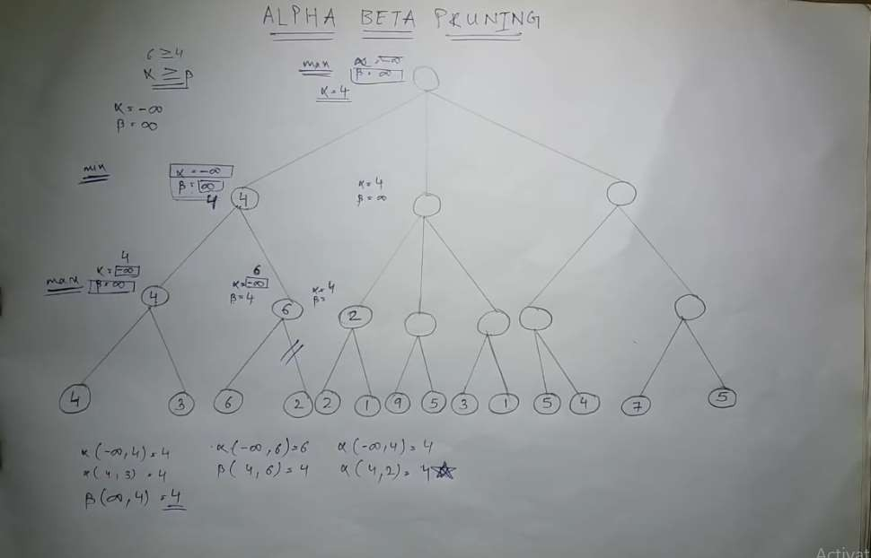

Slide 32
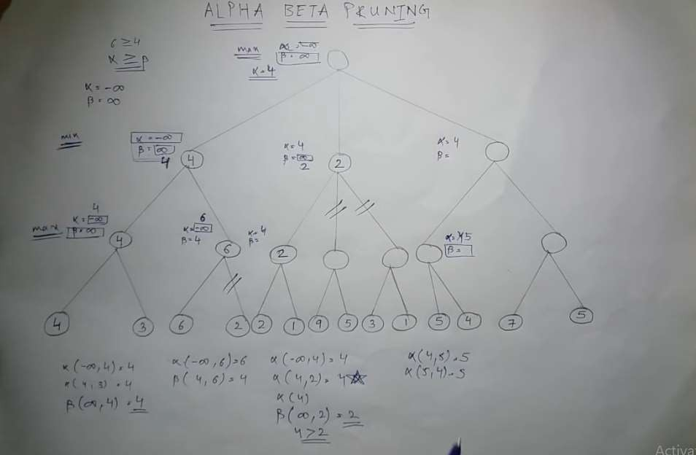

Slide 33
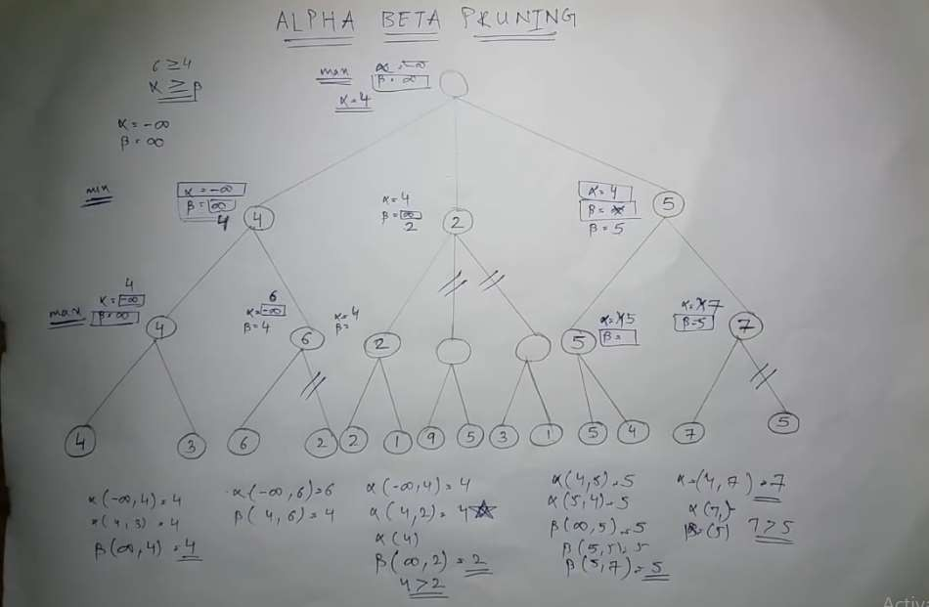

Slide 34
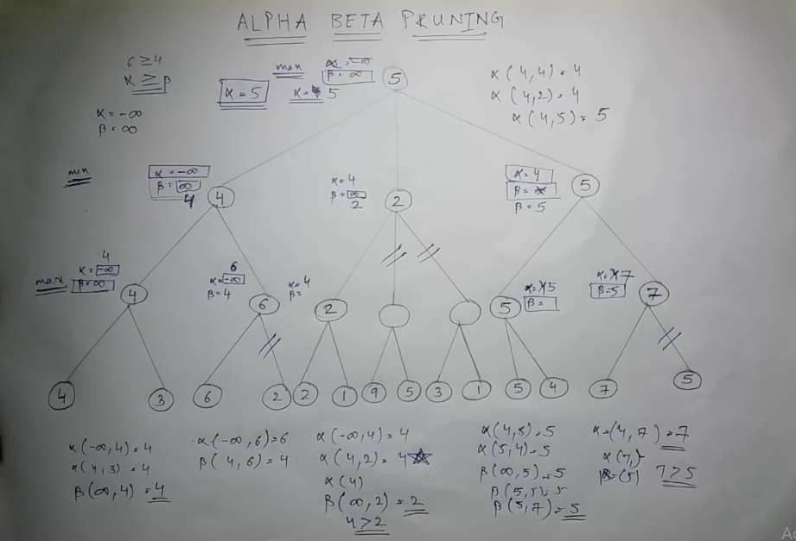

Slide 36
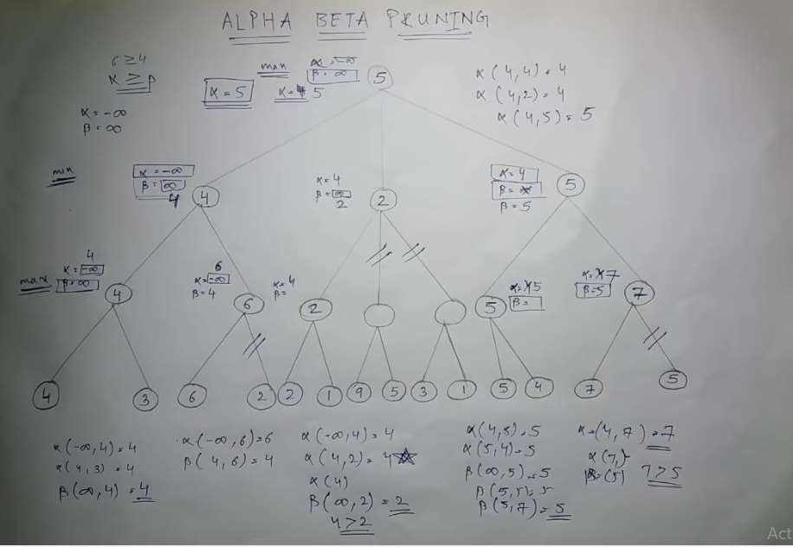

Slide 37
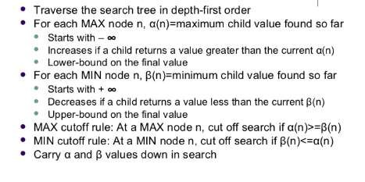
ALPHA-BETA PRUNING (Overview):

