Slide 1

Image Steganography
69. Ashish Yadav, 56. Srishti Shrivastava, 67. Gauri Vispute, 63. Vivek Tiwari
TE SEM VI 2022-2023
Guide:
Prof. Nilesh Mehta
Department Of Computer Engineering
Watumull Institute Of Electronics Engineering And Computer Technology,Ulhasnagar,Thane

Slide 2
Introduction
Steganography is a technique of hiding secret information within a media without altering its perceptual quality. In this mini project, we propose an implementation of steganography using a combination of least significant bit (LSB) substitution and encryption. The secret message is first encrypted using the Advanced Encryption Standard (AES) algorithm to ensure confidentiality. The encrypted message is then embedded into the LSBs of the cover media.
The resulting stego-media appears identical to the original cover media and can be sent through any communication channel without arousing suspicion. The proposed implementation is evaluated using various metrics, including peak signal-to-noise ratio (PSNR) and structural similarity index (SSIM), to measure the quality of the stego-media. The experimental results demonstrate the effectiveness of the proposed method in achieving high security and good visual quality of the stego-media.

Slide 3
Problem Definition
The problem that it aims to address is the need for secure communication of sensitive information over insecure channels. Traditional encryption techniques, such as AES, can provide confidentiality, but they do not hide the fact that a message is being sent.
Steganography addresses this issue by hiding the secret message within an innocent-looking cover image. The challenge lies in embedding the message in a way that is imperceptible to the human eye and difficult to detect by automated analysis.
This project aims to develop an image steganography method that can achieve high security while maintaining the quality of the cover image.

Slide 4
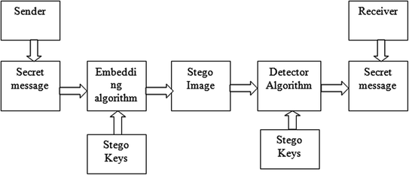
Image Module Flow

Slide 5
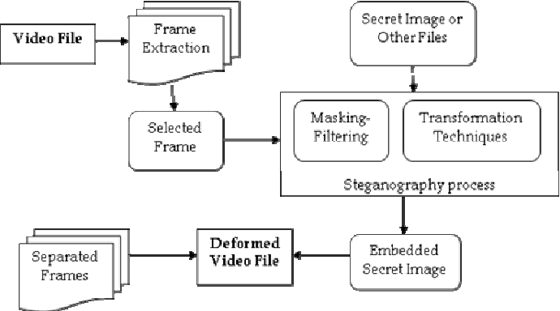
Video Module Flow

Slide 6
Use Case Scenario
Cover Media Files (Image/Video)
Message
Program
Stego-Media Files
Program
Message
Transit
Sender End
Receiver End

Slide 7
Possible Uses
Combine explanatory information with an image
Private Communications
Posting secret communications on Web to avoid transmission
Copyright protection

Slide 8
Technologies Used
Programming language: Python
Image processing libraries: Pillow
GUI development: Tkinter
Development and version control tools: Git, GitHub
IDEs: Visual Studio Code

Slide 9
Conclusion
In conclusion, image and video steganography are effective techniques for hiding information within digital media files. These methods involve embedding data into the least significant bits of the image or video, making it difficult for anyone to detect the presence of the hidden information without the appropriate tools.
Steganography has numerous practical applications in digital forensics, law enforcement, and military intelligence. However, it can also be used for malicious purposes, such as hiding malware or illegal content

