Slide 1
Censorship in INDIA

Slide 2
INTRODUCTION
Censorship is restriction on speech, public communication, or any other information. This may be based on such material being deemed offensive, harmful, sensitive or " inconvenient". Censorship is carried out by governments, private agencies and other regulatory bodies. Censorship also includes censorship of books, plays, films, or reports.
Censorship especially done by government officials or officials of a particular organization on that media which is considered immoral or secret in some way. Censorship is done according to the regulations of each country. There are many reasons to censor something, such as protecting military secrets, stopping immoral or anti-religious activities, and maintaining political power. Censorship is most often used as an insult, and there is a debate about it.

Slide 3
NEED FOR CENSORSHIP
Censorship is an important and essential part of television. Without the presence of censorship, television would be unsuitable for our younger viewers because censorship helps to filter out the appearances of nudity, real-life violence, the use of profanity, and other obscene gestures during the youth viewing hours. However, during prime-time viewing hours, it's a different story.
The method the television stations use is a mere waste of time and money because a little symbol in the corner of the screen is not going to prevent a child from watching the program. The only way this method can work is if the parent or guardian is there to change the channel, but let's be realistic. How many parents or guardians actually have the time to monitor everything their children watch?

Slide 4
CENSORSHIP IN INDIA
India features a score of thirty-nine on a scale from zero (most free) to a hundred (least free), that places Bharat twenty out of the forty-seven countries worldwide that were enclosed within the 2012 report. Bharat ranks fourteen out of thirty-seven countries within the 2011 report. India ranks third out of the eleven countries in Asia enclosed within the 2012 report. Internet users have periodically long-faced prosecution for on-line postings, and personal firms hosting the content area unit duty-bound by law handy over user data to the authorities.
All licensed ISPs area unit duty-bound by law to sign associate degree agreement that enables Indian government authorities to access user information.

Slide 5
Types of Censorship

Slide 6
CULTURAL CENSORSHIP
Background
Censorship depends upon the target audience and the territorial region where it is supposed to be imposed. An act or action may be unethical in some regions and completely ethical in other regions.
An organisation offering service in a particular country should obey the rules and regulations of the country and censor any unwanted text, images, video, or other form of digital media. For example, wearing blue denim jeans and posting pictures of yourself wearing them is against the law in North Korea, whereas it is completely legal in the rest of the world.
This demonstrates how cultural censorship is influenced by a state's perception of certain issues. Another example- anime called shinchan, in one of his movies the character is shown as that he doesn’t like bell peppers but when the movie was released in Japan the animators have changed bell peppers to peas so that children in Japan do not replicate the same action of disliking bell peppers.

Slide 7
CULTURAL CENSORSHIP
Tandav Movie Controversy
Tandav could also be thought of as like, it’s a political drama that's showing the dark aspect of politics that’s being criticized by folks and creates the strain between the folks on the concept of religions and caste that destroy the social material of our country. The scene was showing the Hindu god during a very strange and wonderful means and victimization silly language that affects the spiritual sentiment of the Hindu faith. It conjointly has some statements and dialogues that created the behavior of enmity between the folks supported their caste and religions. It showed the Position of democratic government In such the simplest way that affects the democratic system of our country.
After various rounds of investigation and probing, the censor board of India has ordered Amazon to remove the controversial scene.

Slide 8
EDUCATIONAL CENSORSHIP
Background
The standard of instruction is impacted by educational censorship that is used both locally and nationally. As a result, difficult topics and instructional strategies are avoided in schools. Education professionals steer clear of irritating special interest groups in favour of using their expertise and involving the community.
Impact on Students
Web filters help students stay on track and maintain their learning focus and be secure online. They can help protect pupils from cyberbullying, scammers, hackers, and those looking to steal their personal data.

Slide 9
EDUCATIONAL CENSORSHIP
Children are impressionable and if they are exposed to offensive ideas, they will not think twice about incorporating them into their daily life. Parents may be sure that their children are being exposed to excellent values and concepts in school if a school has a censoring policy.
Censorship in schools has frequently led to conflicts between parents and teachers, who wish to challenge their pupils' minds by allowing them unfettered access to all forms of media. People who oppose censorship point out that when students are denied access to specific books or materials, they miss out on the opportunity to learn about novel concepts.

Slide 10
Media Control and Censorship of TV
Definition
Media control and censorship of programs shown on TV has been a common practice in the recent days. Media control simply means censorship of the information and ideas that are spread to the public through media outlets. Some of the ways through which media control is exercised include barring the display of obscene images and the use of obscene language.
Media control is exercised in almost every country to prevent these obscenities. It is the responsibility of governments with the help of selected bodies to exercise media control. This report will discuss the types of controls imposed on the media and the parties involved in exercising the controls.

Slide 11
Media Control and Censorship of TV
Types of Media Control
The first type of control imposed over the media is control of sexual content, content depicting violence, and content encouraging use of drugs. This is an important type of control that ensures children and families are not exposed to obscene material. Control of pornography material to avoid it being shown on TV is important because the material can be easily accessed through the internet.
It is important for control over display of such material to be exercised because it is harmful to children. Unless display of obscene content and other questionable material is controlled, children and families will be affected negatively by the content (O’Shaughnessy and Stadler 156).

Slide 12
Media Control and Censorship of TV
Types of Media Control
The second type of control imposed on the media is the control of information that may put the security of a country at risk. Control of military information is used to guard information which should only be possessed by the military. The media may be used by politicians and other powerful personalities fighting the government to spread information which poses a threat to the security of a country.
For instance, cases have been witnessed where the media is used to spread information causing citizens to start fighting. It is important to have media control over spread of information that may put the security of a country at risk.

Slide 13
Media Control and Censorship of TV
Types of Media Control
The third type of control imposed over the media is religious control. In most countries there are different religious groups who subscribe to different faiths. It is therefore important for all religious groups in a country to be respected. Religious control refers to the control of any information that is considered offensive to particular religious groups.
For example, cases may arise where the dominant religious groups start interfering with the freedom of minority religions. It is important to exercise media control to ensure that there is no spread of information that might cause religious animosity (Gaddy 289).

Slide 14
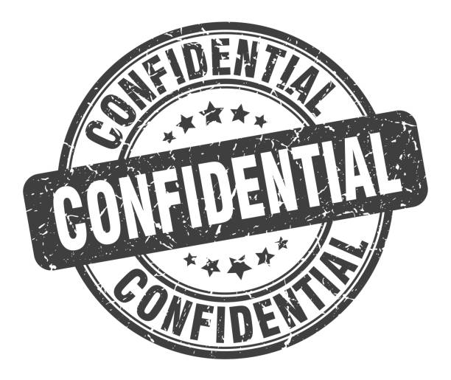
DEFENSE CENSORSHIP
Background
Military censorship, often known as defense censorship, is a form of censorship that involves keeping military intelligence and tactics secret and out of the enemy's hands. This is employed to thwart espionage. Wartime saw a rise in military censorship. As there is a danger of confidential information being leaked, this also includes abstracting the information from the local nationals.

Slide 15

DEFENSE CENSORSHIP
Incident of Defense Censorship
The controversy over the purchase of 36 fighter jets for about 7.8 billion euros has been one of the most significant issues facing the government of Prime Minister Manmohan Singh since coming to power in India's capital, Delhi, in 2014.
India's single largest defence transaction, with the Defence Ministry allocating Rs 55,000 crore (USD 7.7 billion) for the procurement of Rafale fighter jets. Dassault Rafale won the 2012 Medium Multi-Role Combat Aircraft (MMRCA) competition. The competition was to bridge the gap between its future Light Combat Aircraft and its operational Sukhoi Su-30MKI air superiority fighter.

Slide 16
DEFENSE CENSORSHIP
One of the major allegations by opposition parties, is that why Dassault choose Anil Ambani's company, rather choose other big MNC corporations which have much more experienced and involved in defense manufacturing. One cannot arrive at a conclusion, whether corruption has taken place or not, but there is a clearly signs of favourtism. Besides, many defence experts feel that the government is hiding some information behind the secrecy clause to give out the financial information.
Many leaders in India are asking the government to make rafale deal details available in the public domain. This cannot be done as it may go into the hands of unethical people, which may harm India's image internationally. So the deal details were not made public and censored.

Slide 17
LAWS IN INDIA FOR CENSORSHIP
Background
Over the past century, India's entertainment sector has expanded dramatically. The amount and scope of content created by the entertainment business have only increased with the development of digital platforms. Censorship is all about balancing the two, i.e., the restriction offered on the one hand and the freedom of speech and expression on the other.
Censorship laws for online content
During-the-top (OTT) platform usage has increased dramatically over the past ten years. The most popular platforms, Netflix and Amazon Prime, are among those that are growing daily. OTT platforms have adopted self-regulation in this area by classifying their programming according to violence, nudity, and strong language. Both sides of the dispute in this regard have strong points to make.

Slide 18
LAWS IN INDIA FOR CENSORSHIP
Censorship laws for television
Cable Television Networks (Regulation) Act of 1995 and Cable Television Networks Rules of 1994 regulate the content on television. Laws prohibit the broadcast of any programme or commercial that does not adhere to the Program Code and Advertising Code. The Program Code forbids the television transmission of movies that haven't received the CBFC's "U" certificate. In addition to controlling the violence and nudity in children's programming, cable operators have the added duty of presenting women in a positive way.

Slide 19
LAWS IN INDIA FOR CENSORSHIP
Censorship laws for film certification
Currently, in India, films must get certification before being screened in theatres. The Central Board of Film Certification (CBFC), a statutory organization created in accordance with the Cinematographic Act of 1952, issues the certificates in this regard. The Cinematographic Rules of 1983, the Act of 1952, and the Central Government Guidelines of 1991 specify how films are to be shown in the nation. The CBFC divides films into the following groups before putting them on display

Slide 20
LAWS IN INDIA FOR CENSORSHIP
Censorship laws for film certification
The movie may be screened publicly without restriction. is suitable for a "U" certificate. The movie is appropriate for unrestricted public screening, but with the endorsement of caution that the parents or guardians of any children under the age of twelve should think carefully before allowing them to watch the movie. is suitable for a "UA" certificate. The movie is appropriate for adult-only public viewing, or a "A" certificate. Given the nature, content, and theme of the movie, it is appropriate for public screening that is only open to members of any profession or class of people, or fit for a "S" certificate.

Slide 21
SURVEY ANALYTICS
Most people already know what censorship is, while others have heard of it but don't know much about it. 90% of the people who answered the survey believe that censorship provides safety to the public from harmful content.
The remaining 10% of people believe that it neither provides safety nor oppression. No one thinks censorship is an oppression of freedom of speech.
80% of people responded that censorship is good for a healthy society. The removal of controversial content is good for preventing unwanted disharmony.
People have mixed opinions in terms of what information or content should be censored. Most people think religious content that can harm communal peace should be hidden or taken down as it can cause chaos.

Slide 22
SURVEY ANALYTICS
Abstraction of state secrets and classified documents is their second priority. The rest believe that political propaganda and unethical behavior should be kept hidden.
70% of people agree that information should be presented as it is without any modification or alteration.
By looking at the responses received to the question "are you satisfied with the steps taken by the administration in tackling unethical information?" 30% of the people are satisfied with the steps taken by the administration.
The remaining 70% of the people were divided into neutral and disappointed.
80% of people practice anonymity while surfing the internet sometimes, and others always. This means they do not share personal information about themselves much, hence censoring themselves on the internet.

Slide 23
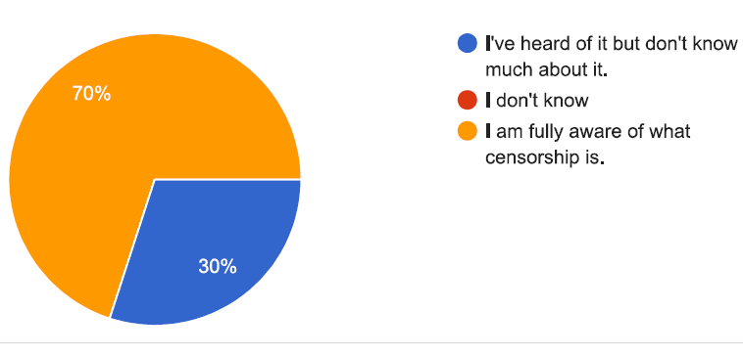
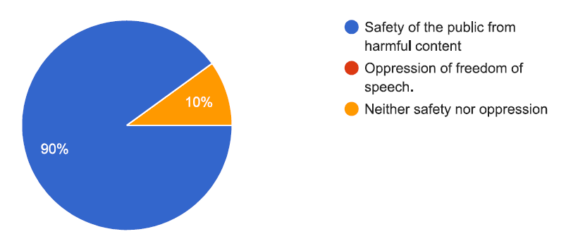
SURVEY ANALYTICS
Most people already know what censorship is, while others have heard of it but don't know much about it.
90% of the people who answered the survey believe that censorship provides safety to the public from harmful content. The remaining 10% of people believe that it neither provides safety nor oppression. No one thinks censorship is an oppression of freedom of speech.

Slide 24
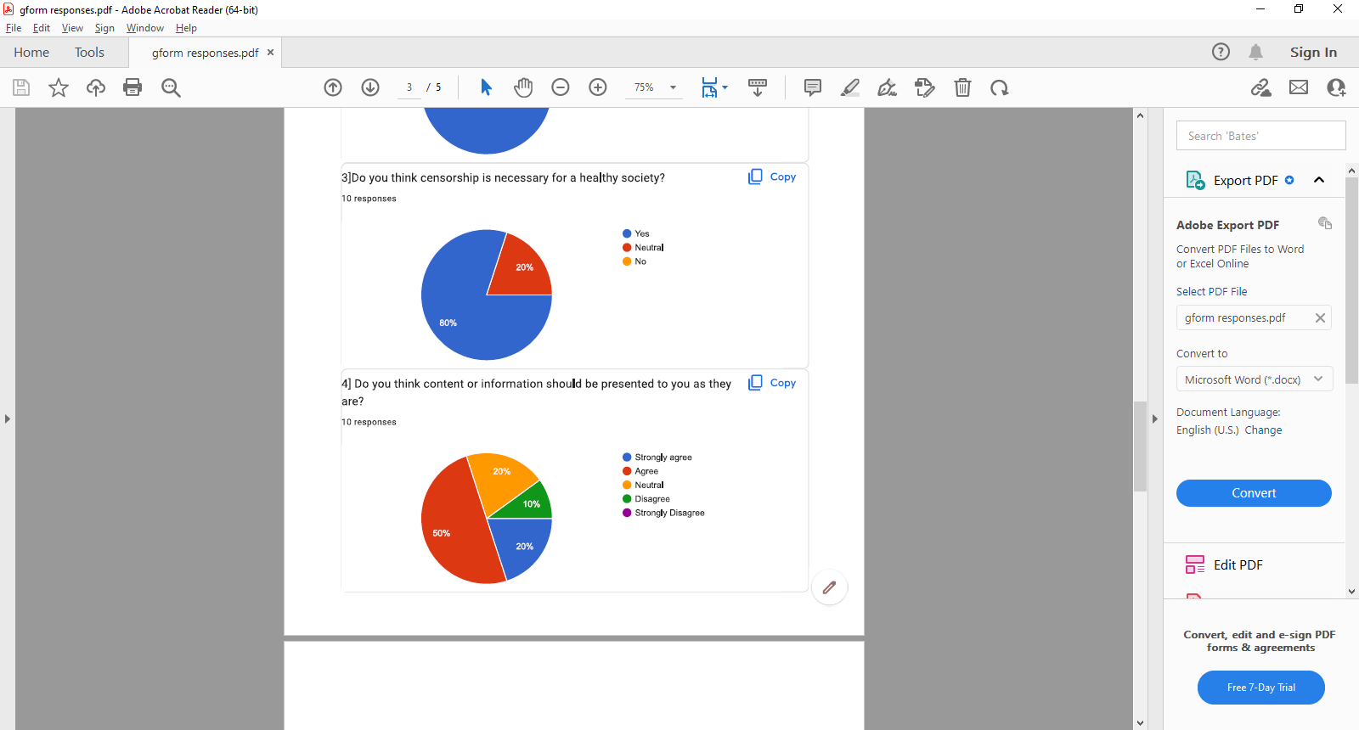

SURVEY ANALYTICS
80% of people responded that censorship is good for a healthy society. The removal of controversial content is good for preventing unwanted disharmony.
People have mixed opinions in terms of what information or content should be censored. Most people think religious content that can harm communal peace should be hidden or taken down as it can cause chaos. Abstraction of state secrets and classified documents is their second priority. The rest believe that political propaganda and unethical behavior should be kept hidden.

Slide 25
SURVEY ANALYTICS
70% of people agree that information should be presented as it is without any modification or alteration.

Slide 26
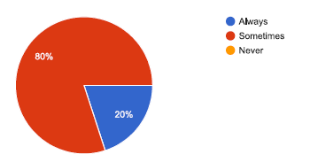
SURVEY ANALYTICS
By looking at the responses received to the question "are you satisfied with the steps taken by the administration in tackling unethical information?" 30% of the people are satisfied with the steps taken by the administration. The remaining 70% of the people were divided into neutral and disappointed.
80% of people practice anonymity while surfing the internet sometimes, and others always. This means they do not share personal information about themselves much, hence censoring themselves on the internet.

Slide 27
CONCLUSION
Censorship has been implemented in the past decades since Galileo Galilei, and now in movies, education, defense, and many more fields. The Central Board of Film Certification (CBFC) issues certificates in this regard to any unethical sense in films that morality. In education, pupils must give a proper account of their strengths, weaknesses, and interests to decide what exactly they want to achieve in life.
Finally, we conclude that censorship in India is not heavily imposed. There are various loopholes in the laws governing censorship that need to be fixed.

