Slide 1
Group Members
02. Rahman Choudhary
10. Siddharth Joshi
16. Nikhil Nooli
30. Ashish Yadav
Guide:

Slide 2
Fake News Detection Using Machine Learning

Slide 3
Introduction
Fake news exist way before from social media but it multifold when social media was introduced.
Fake news is a news designed to deliberately spread hoaxes, propaganda and misinformation
Fake News stories usually spread through social media sites like Facebook, Twitter etc.

Slide 4
Problem Statement
By clicking on a clickbait, users are led to app page that contains false information.
Fake news influences people’s perceptions
The rise of Fake news has become a global problem that even major tech companies like Facebook and Google are struggling to solve. It can be difficult to determine whether a text is factual without additional context and human judgement.

Slide 5
Purpose
This project aims to develop a method for detecting and classifying fake news stories using Natural Language Processing.
The main goal is to identify fake news, which is a classic text classification issue.
Our goal is to develop a model that classifies a given news article as either fake or true.

Slide 6
Workflow
Data Set loading
Data Pre-Processing (remove stop words, Drop duplicate and remove meaningless character from the text)
Feature Selection
Applying Classification and model construction
Classifying the new data.

Slide 7
Technologies To Be Used
Python
Pandas (Data Analysis)
NumPy (Support for Multidimensional Array)
Sklearn (Library For Machine Learning)

Slide 8
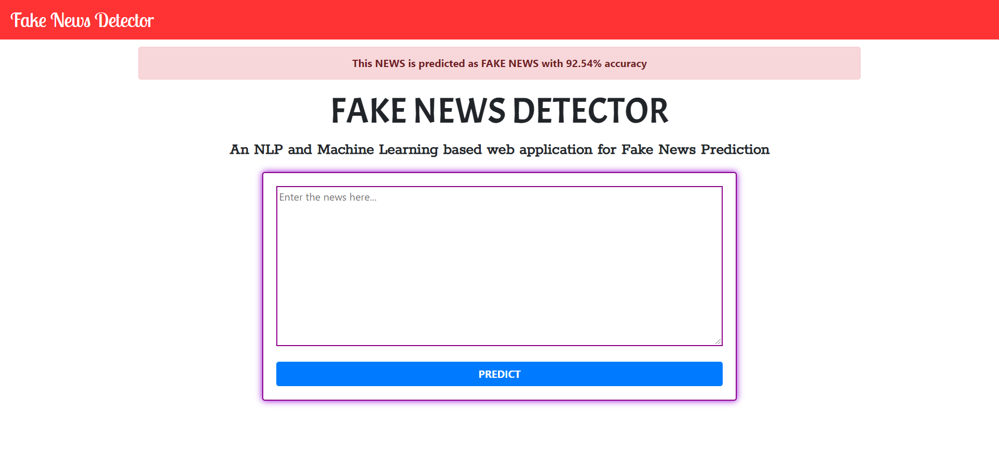
Sample Illustration

Slide 10
Social Media
Website

Slide 11
Problem Statement
The problem is that young people are too strongly influenced by social media in negative ways and we offer solutions with suggestions to solve that problem by proposing ways that social media can have a positive impact on young people as well as ways to avoid the negative impacts.

Slide 12
Technologies To Be Used
Front End: HTML,CSS,JavaScript
Backend: Node JS, Express
Database: MongoDB

Slide 13
Skills To Be Learned
Node-js -> Runtime environment for JS
Express -> Framework
EJS -> Template Engine for JS
Mongodb -> NoSQL DataBase
Socket.IO -> Will be used to build live chat communication in the website
Heroku -> Will be used for deployment of the website.

Slide 14
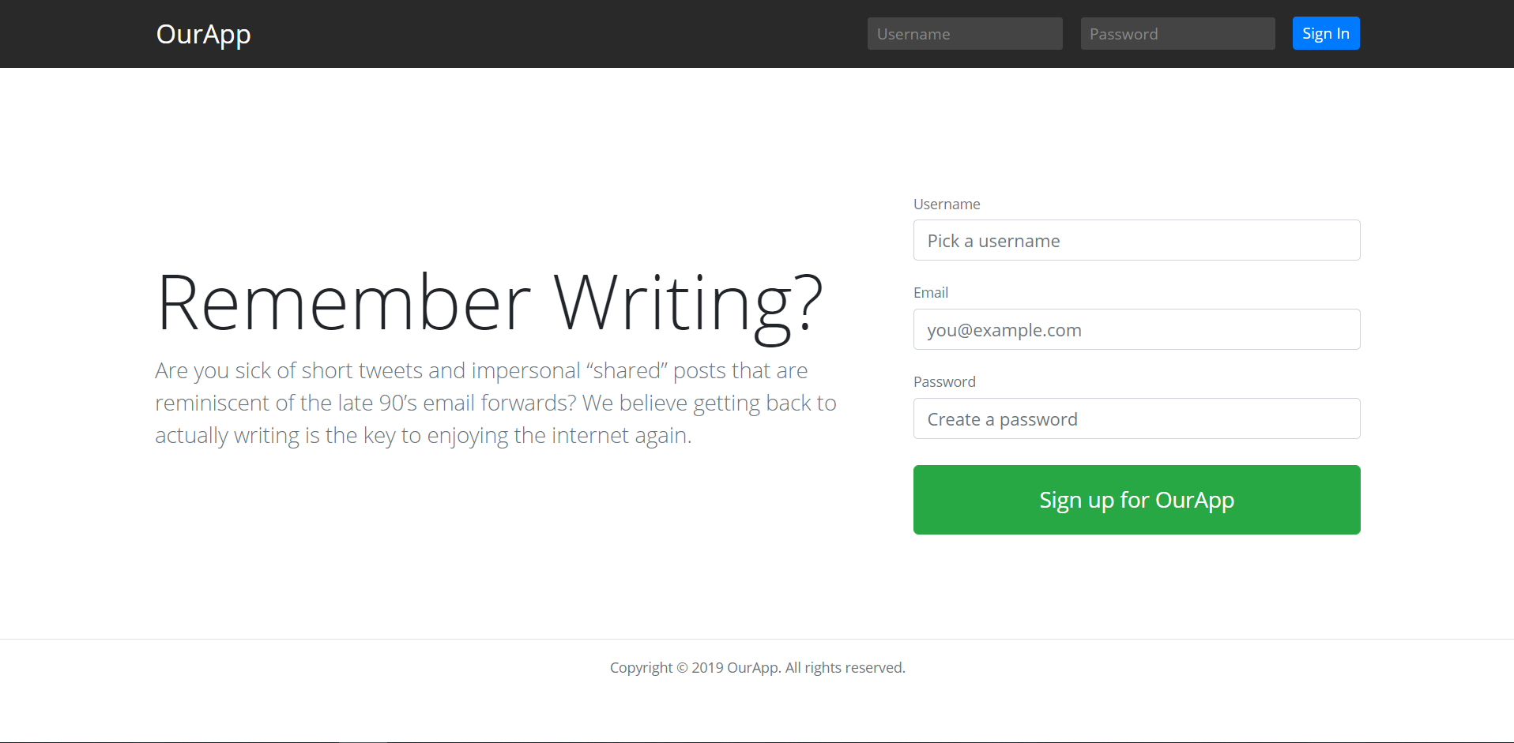
Sample Illustration

Slide 15
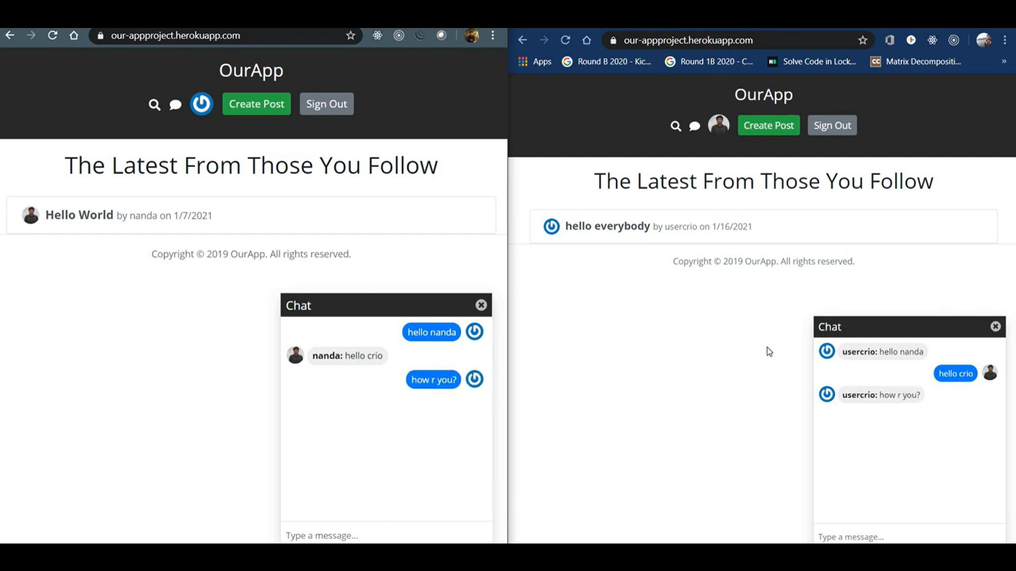

Slide 17
News Website
Using Python WebScraper

Slide 18

Problem Statement
A news-sharing website help users find relevant and important news easily every day and also deliver them to using email and notifications

Slide 19

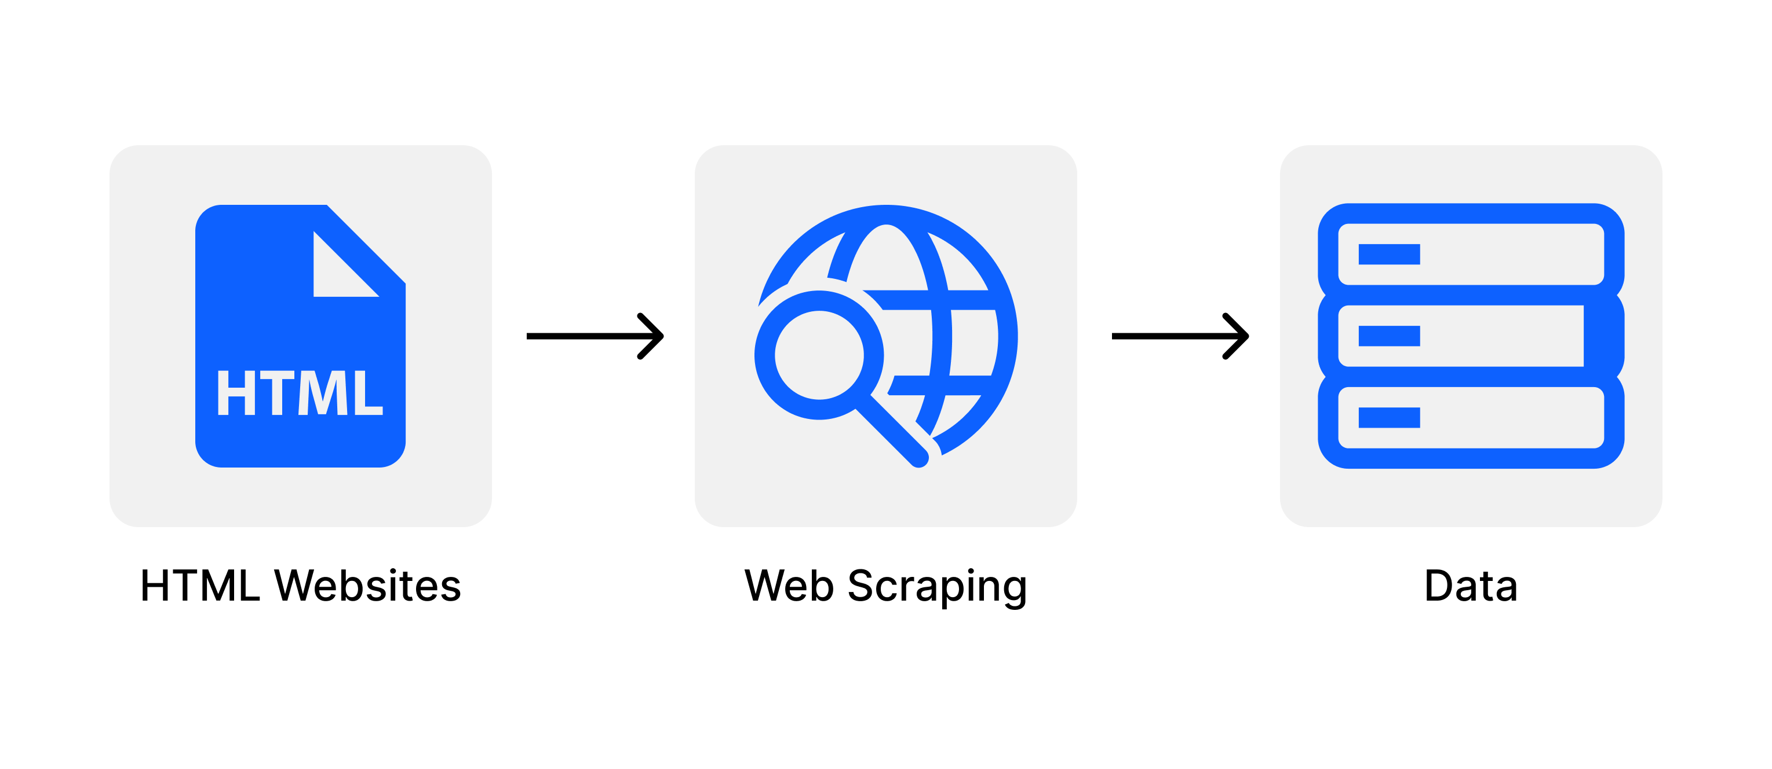
Workflow
User Interaction with the webpage
Using python web scraping will fetch news from various sources
Compiling and making JSON file
Using AJAX request displaying news articles asynchronously

Slide 20
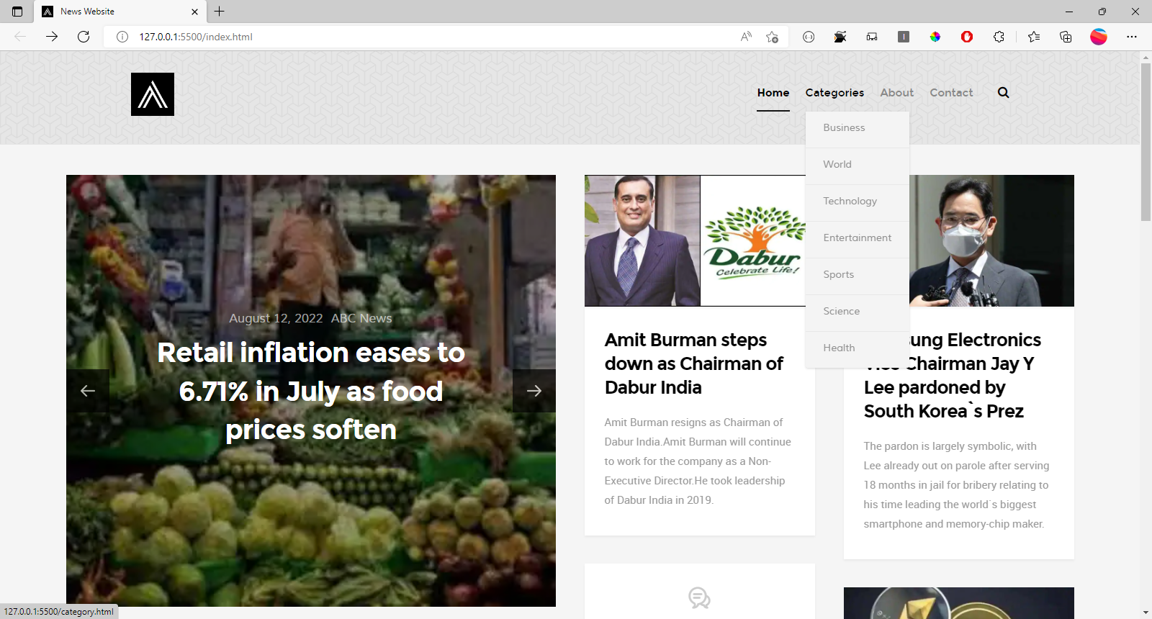
Sample Screenshot

Slide 21
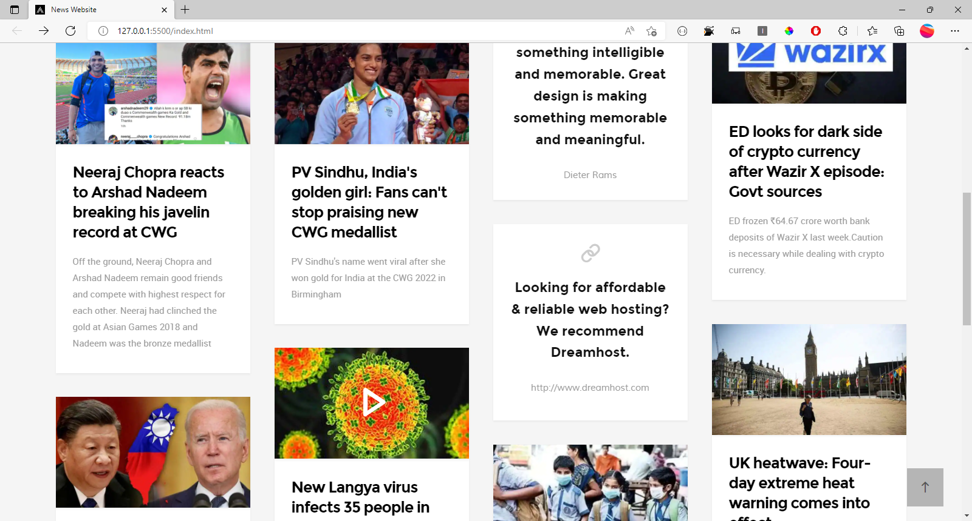
Sample Screenshot

