Slide 1
Group Members
02. Rahman Choudhary
10. Siddharth Joshi
16. Nikhil Nooli
30. Ashish Yadav
Project Guide: Professor Sandeep More

Slide 2

Fake News Detection Using Machine Learning

Slide 3
Problem Statement
By clicking on a clickbait, users are led to app page that contains false information.
Fake news influences people’s perceptions
The rise of Fake news has become a global problem that even major tech companies like Facebook and Google are struggling to solve. It can be difficult to determine whether a text is factual without additional context and human judgement.

Slide 4
Project Status
PassiveAggressive Algorithm

Slide 5
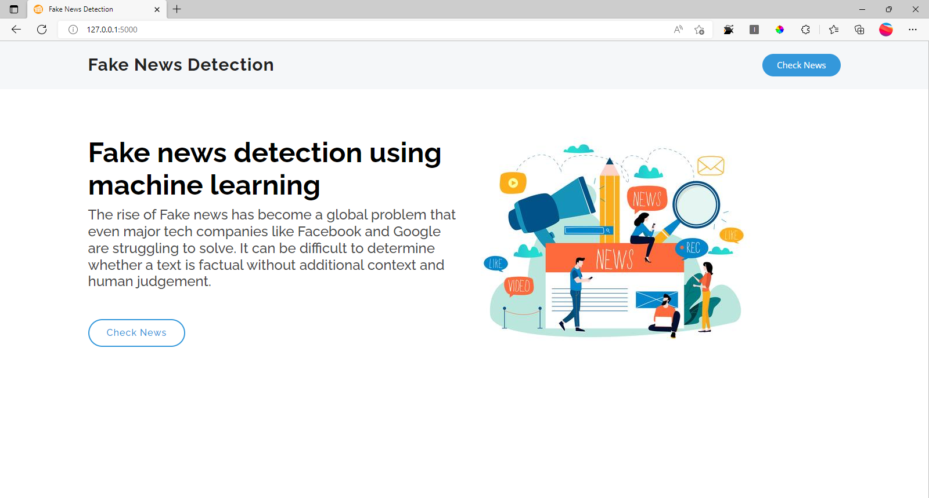

Slide 6
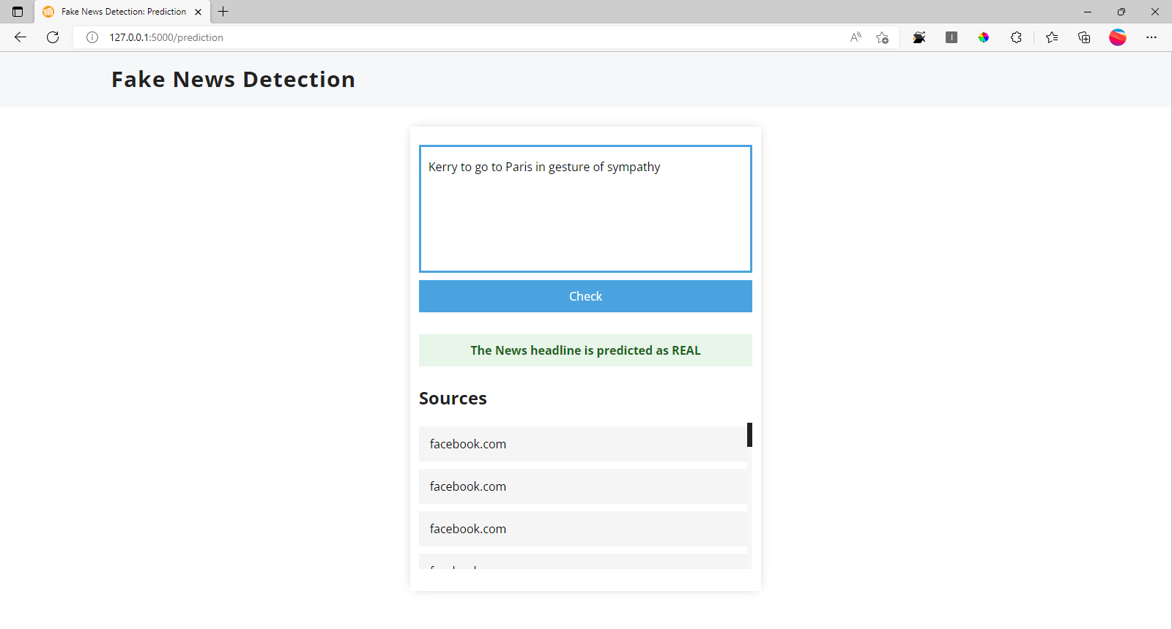

Slide 7
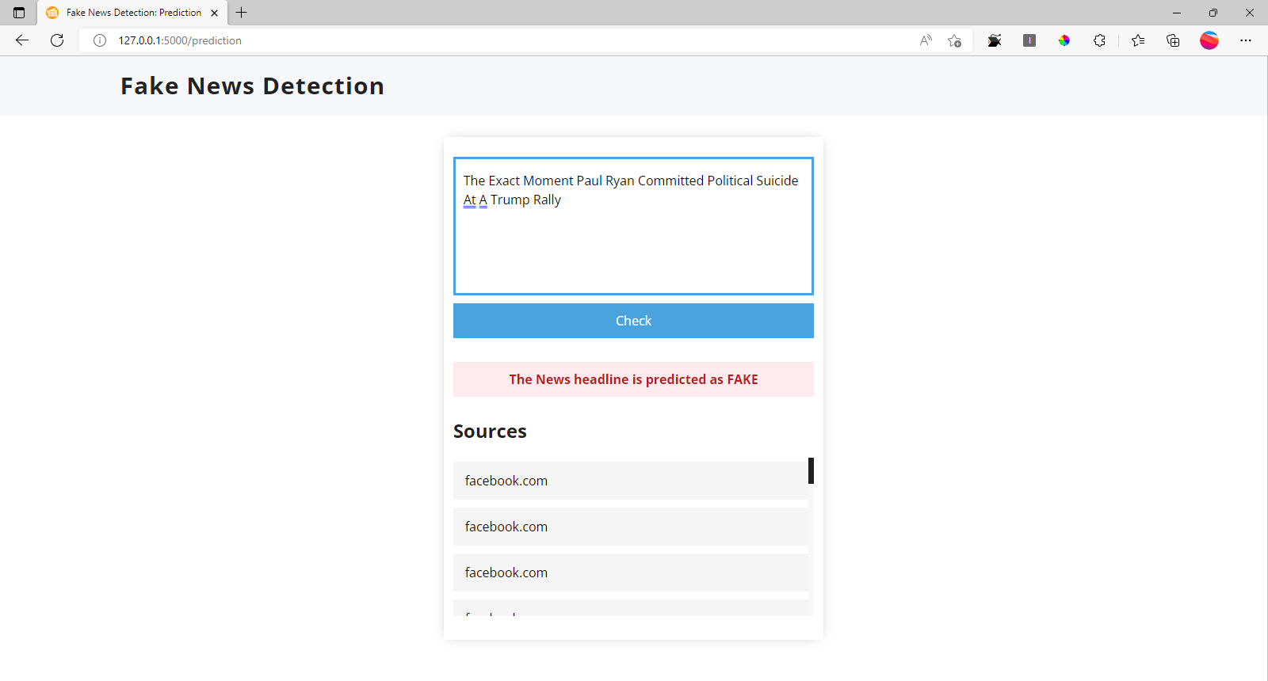

Slide 8
Future Scope

Slide 9
Future Scope
Providing results for news headlines that are not present in historical data sets
Hosting on Heroku so that it is available over the internet for public access.

Slide 10
Snippet of fetching news from the internet
from unittest import result
import requests,json
url = "https://google-search55.p.rapidapi.com/search"
text = "google"
querystring = {"page":"1","q":"","safe":"false","language":"en","time":"default","as_sitesearch":"default"}
querystring['q'] = text
headers = {
"X-RapidAPI-Key": "2d2dea647fmsh577c57bb54abd69p13249djsn06827c6f1fe8",
"X-RapidAPI-Host": "google-search55.p.rapidapi.com"
}
response = requests.request("GET", url, headers=headers, params=querystring)
results = json.dumps(response.json(),indent = 4)
print(response.json()['top_stories'])

