Slide 1
Bus Ticketing System

Slide 2

Team Members
30. Ashish Yadav
05. Atreya Ganguly
13. Harshit Mishra
14. Mitesh Munankar
Technologies Used
JavaScript
Project Guide
Prof. Dhananjay Raut
Project Genre
Web Based Project

Slide 3
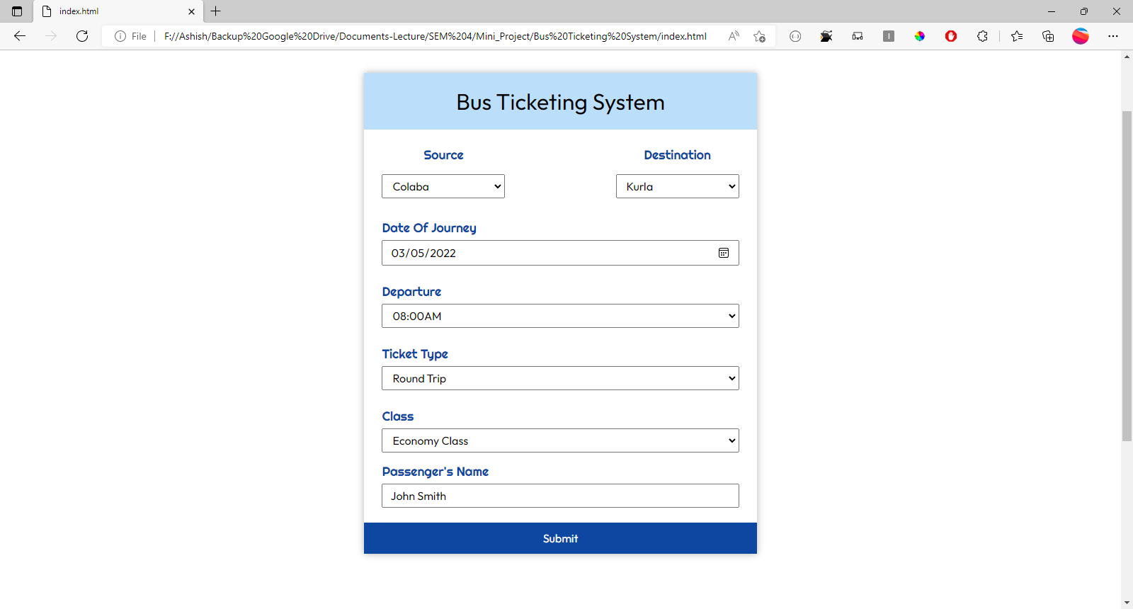

Slide 4
User Can Select Source and destination using drop down menu
Date of journey can be chosen using calendar dialog box
User can select departure time using dropdown menu of predefined timings
Type of class and ticket type can be chosen using respective menus
User’s name will be entered in the last text box
After entering all the necessary details submit will be clicked by the user and printable ticket will be generated

Slide 5
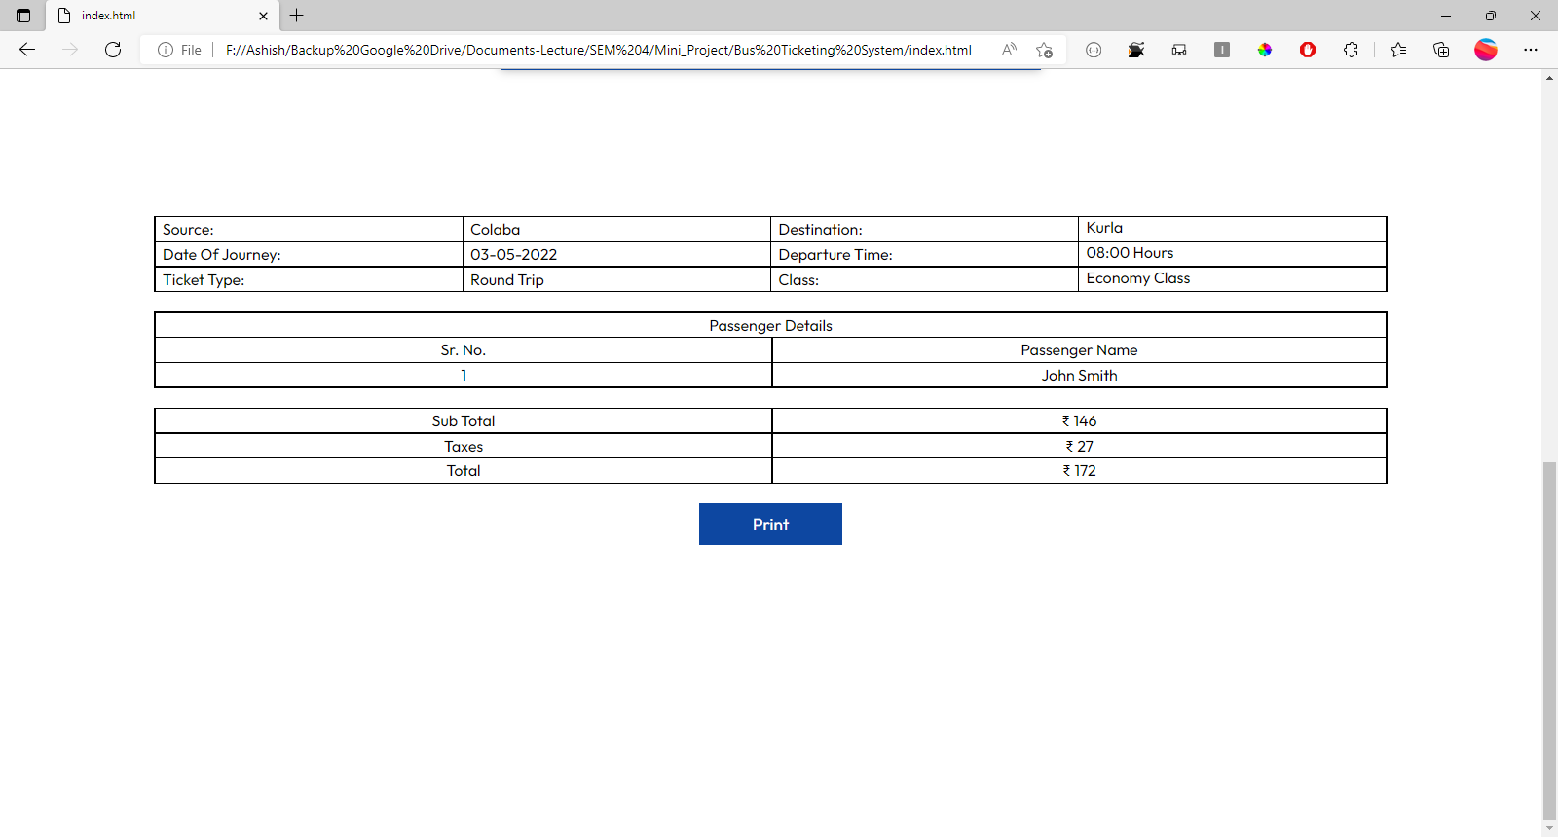

Slide 6
All the details entered in the form above is structured in the e-ticket tabular data

Slide 7
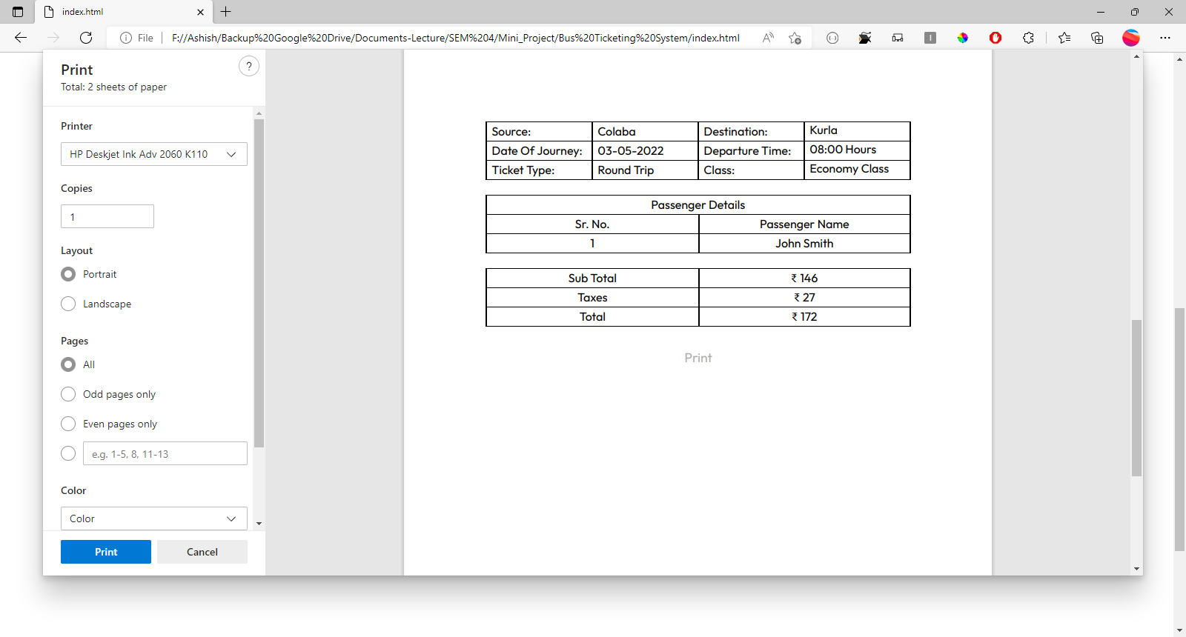

Slide 8
This is a print dialog box from where e-ticket can be printed

