Slide 1
PROPCRACK
- The invincibles
“In the depth of winter, I finally learned that there was in me, an invincible summer” – Albert Camus

Slide 2











The Problem
The Hack
The Future

Slide 3

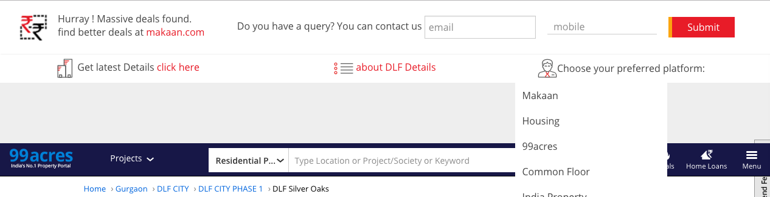
The Problem
The Hack
The Future
A chrome web extension that understands the intent of the user, and defines the most logical forward flows that will make sense to the user.
The extension belongs to a third party, and is complete unbiased
Have any query about this project? Let us know and we’ll find out for you !
See updated information on DLF Silver Oaks
View details about the builder DLF

Slide 4
The Problem
The Hack
The Future
If we were to cover a broader range of websites and pages, we would be able to encourage the ordinary user to
install and keep this while he searches for any property.
Due to its neutral stand, it will inspire trust in the guy. And due to it being an extension, it will only show up when
the customer is on a real estate website, but not bother him at any other time. This increases the likeliness that this
will never be uninstalled.
For the roadmap, we would recommend the following
Analyze and support the SERP pages across websites
Add similar project/properties to the forward flow
Capture the filters applied by the user and preserve them across websites (tested)
Allow users to fill in filters directly in the extension (including projects), which he gets comfortable with
Comparison across websites for the same projects
Allow shortlisting of projects/listing into the extension, esp similar listings across websites
Sharing of listings on social networks
The End
? Or the beginning?

