Slide 1
Test Automation Using Selenium

Slide 2
Test Automation
Test automation is the use of software
    To set test preconditions.
    To control the execution of tests.
    To compare the actual outcomes to predicted outcomes.
    To report the Execution Status.
Commonly, test automation involves automating a manual process already in place that uses a formalized testing process.

Slide 3
Why and When To Automate?
Frequent regression testing
Repeated test case Execution is required
User Acceptance Tests
Faster Feedback to the developers
Reduce the Human Effort
Test same application on multiple environments

Slide 4
Test Automation Tools
  Quick Test Professional By HP
  Rational Functional Tester By Rational (IBM Company)
  Silk Test By Borland
  Test Complete By Automated QA
  QA Run (Compuware )
  Watir ( Open Source)
  Selenium ( Open Source)
  Sahi (Open Source)

Slide 5
Selenium
Selenium is a robust set of tools that supports rapid development of test automation for web-based applications.
Selenium provides a rich set of testing functions specifically geared to the needs of testing of a web application.
Selenium operations are highly flexible, allowing many options for locating UI elements and comparing expected test results against actual application behavior.

Slide 6
Selenium Features
Supports Cross Browser Testing. The Selenium tests can be run on multiple browsers.
Allows scripting in several languages like Java, C#, PHP and Python.
Assertion statements provide an efficient way of comparing expected and actual results.
Inbuilt reporting mechanism.

Slide 7
Selenium Components
Selenium IDE
Selenium Remote Control
Selenium Grid

Slide 8
Selenium IDE
Selenium IDE is an integrated development environment for Selenium tests.
It is implemented as a Firefox extension, and allows you to record, edit, and replay the test in firefox
Selenium IDE allows you to save tests as HTML, Java, Ruby scripts, or any other format
It allows you to automatically add assertions to all the pages.
Allows you to add selenese commands as and when required

Slide 9
Assertions
Assertions are same as Verifications. The only difference is, if the assertions fail the script will abort. But the script will continue run in case a verification point fails.
The steps for inserting the assertions is same as that of verification point.
While recording Right Click → Show all commands → select an assertion.

Slide 10
Limitations of Selenium IDE
Can run the test only on Firefox
No Programming login (like loops, conditional statements) can be applied
Selenium IDE can execute scripts created in Selenese only.
It is difficult to use Selenium IDE for checking complex test cases involving dynamic contents

Slide 11
Selenium RC
A solution to cross browser testing.
A server, written in Java and so available on all the platforms.
Acts as a proxy for web requests from them.
Client libraries for many popular languages.
Bundles Selenium Core and automatically loads into the browser

Slide 12
Installing Selenium RC
Software Required
JDK 1.6 , selenium-remote-control-1.0.3 (this can be downloaded from http://seleniumhq.org/download/)
Installation Procedure
Selenium RC is simply a jar file and to run it we need java installed. (JDK 1.6 is preferred)
Once the Java is installed just unzip the selenium-remote-control-1.0.3. zip which was downloaded from the selenium site to a directory.

Slide 13
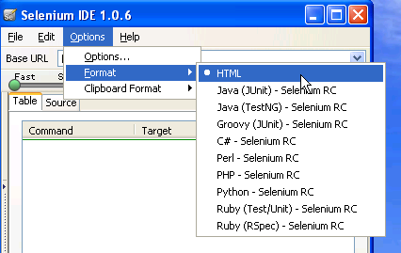
Selenium Test Automation Process
First Generate the Script using selenium IDE in the firefox IDE
Once the Scripts are recorded add assertions where ever required
Now format the Selenese test into the language of your choice. Please refer to the Image

Slide 14
Selenium Test Automation Process
Once the Selenese script is converted into your preferred language you can you can run them using Selenium Server.
For running the script you also need the client driver for that particular language.
To enhance the script we will require IDE like netbeans or Eclipse IDE
To Integrate the script and run them as a suite we will require build integration tools like Maven or Ant.

Slide 15
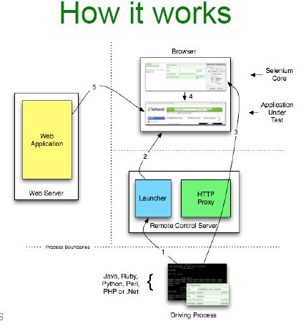
How Selenium Works

Slide 16
Selenium Test Case Development Using Java
Required Software
Selenium Java Client Driver jar , JDK 1.7 +, Eclipse (or any other IDE), Junit jar and testng jar
For building the frame work we require continuous build integration tools like Ant, Maven or cruise control.

Slide 17
Client Drivers
Enables communication with Selenium Remote Control Server.
Functionality of Selenium is exposed via these drivers.
Available in Ruby, Python, Java, C-Sharp …and so on.
Give access to the rich features and libraries of the language, including their unit testing framework.
Makes it possible to develop automated scripts in the same language as product.
Which one you should use?
    Whatever make sense in your context. Most Popular is java and for the training we will use java

Slide 18
Process of Developing Selenium Java Scripts.
Following are the steps for generating the
test scripts in java
Record the Script in Selenium IDE and format them into Java
Create a Selenium Java project in Eclipse and load all the necessary jar files.

Slide 19
Setting Up an Eclipse Project for Selenium Automation
Eclipse is an open source community whose projects are focused on building an extensible development platform for building Java applications and frameworks. Eclipse is one of the best Java IDE and as a matter of face Eclipse is much more than a Java IDE.
We can configure a selenium project in eclipse and even run the scripts from eclipse.
Using eclipse its easy to enhance the recorded script. We can add power to the recorded script by parameterizing the test inputs and even validate the back values.
Eclipse also allows us to write reusable code for efficient test automation.

Slide 20

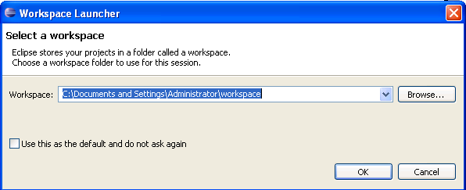
Installing Eclipse
Download the “Eclipse IDE for Java Developers” from the http://www.eclipse.org/downloads/ page.
Unzip the downloaded zip file from the above site into a directory.
Once the unzipping is over open the folder and double click on the icon and it will open a dialog box as shown below.

Slide 21
Setting up the workspace
Create a folder say (selenium) in any one of the directory and change the workspace location to the directory created by you. Then click ok button.
On doing so you will see the eclipse welcome screen if you are doing it for the first time. On the welcome screen click on the workbench icon to open the project explorer.
When you to try to open the eclipse from next time it will directly show the project explorer as shown in the next slide.

Slide 22
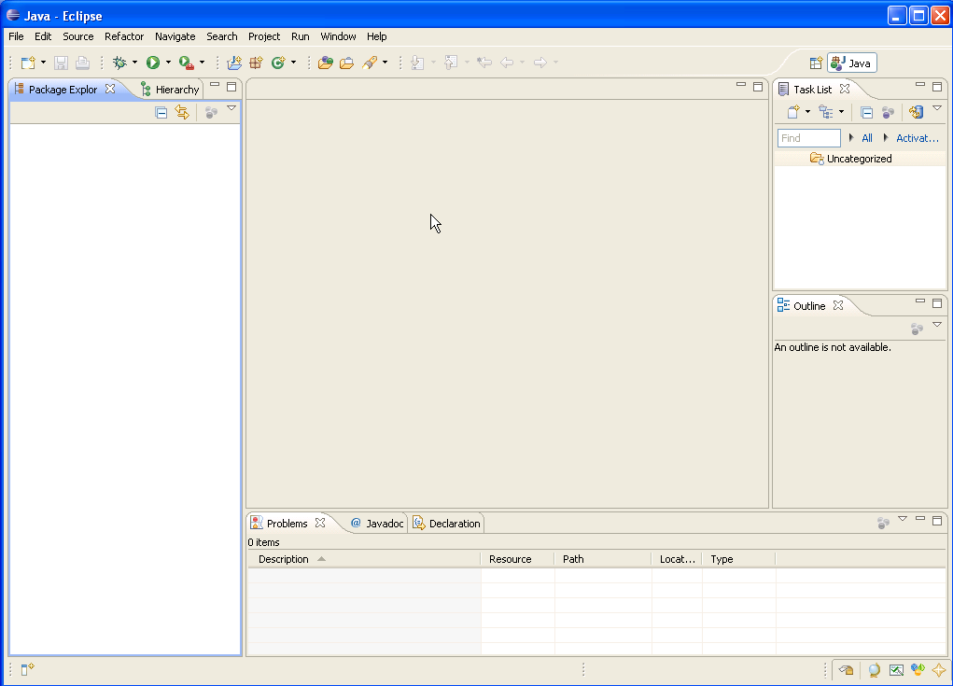
Eclipse IDE
Scrip View
Package
Explorer
console

Slide 23
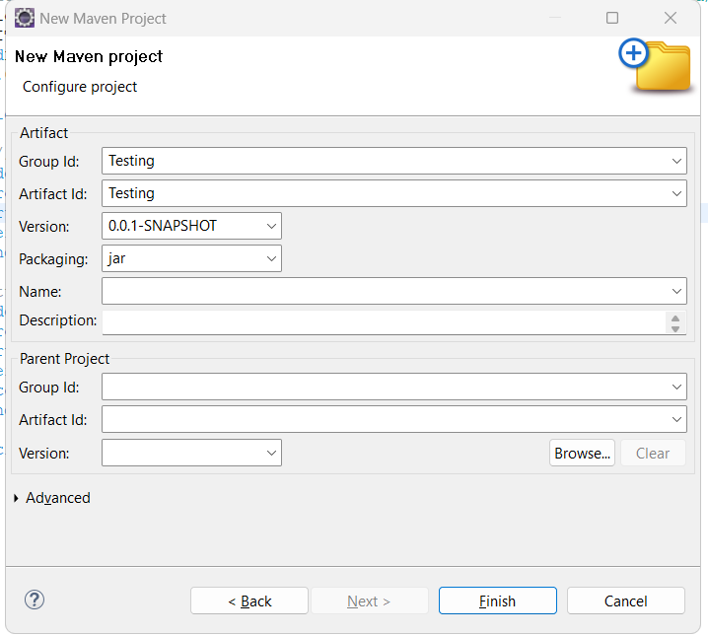
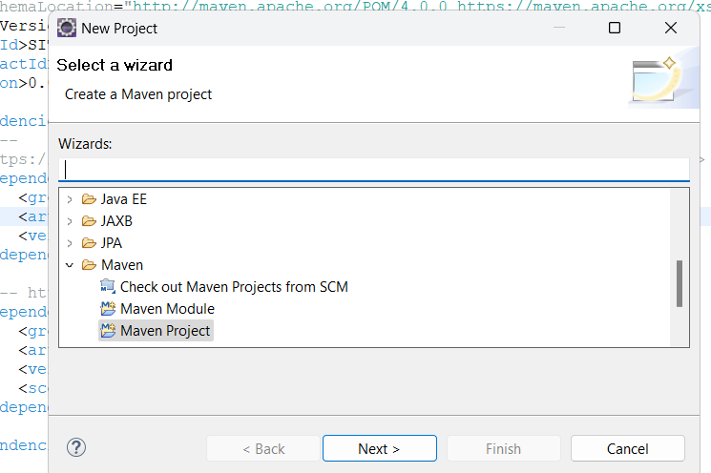
Create a Project In eclipse
File → New → Maven Project
Specify the project name and click finish

Slide 24
Components of the Selenium test Script
setUp method
This method prepares the selenium server to run the test. This method basically hooks to the selenium server and opens up the base URL of the application
test*** method
The methods with the name test will actually run the tests on the application. There can be any number of test methods in the app
tearDown method
This method will run after the end of the test. This test will disconnect with the server and makes room for the next tests to run the tests.

Slide 25
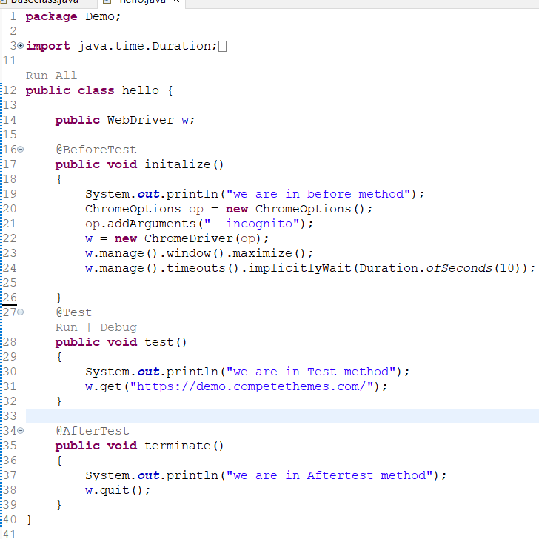
Script View

Slide 26
Enhancing the Selenium commands
The generated selenium command can be enhanced by writing java commands. Using java methods we can do parameterization and data base validation.
More over java methods can be used for to perform some complex validations and testing activities.
The best way to use java methods is used to is have a Java IDE like eclipse.

Slide 27
Some Java Basics
Java Data Types
Int, float, String, char, Boolean and double
Declarations
String s = “Selenium”;
Int i = 20;
float cur = 3.35;
Operators
* ,/ ,% ,+, - are the mathematical operators
* ,/, %, have a higher precedence than + or -

Slide 28
Relational Operators
== Equal (careful)
!= Not equal
>= Greater than or equal
<= Less than or equal
> Greater than
< Less than

Slide 29
Programming Elements
If Condition
if (name != “selenium”)
{
  System.out.print(“Tool Changed”);
  }
  Else
  {
  System.out.print(“Tool is ok”);
  }
Loop n times
  for ( i = 0; i < n; n++ )
  {
  // this code body will execute n times
  // I from 0 to n-1
  }

Slide 30
Example 1 – Get the values from the list box and check if the value “HTML” is present in it
Implementation Steps
First get the values from the list box
To get the values from the list box or any other HTML element we need to know its Xpath. (use Xpath checker)
The values taken from the list box are stored in a variable.
Use the indexOf method to find if “HTML” is present in the extracted variable.

Slide 31
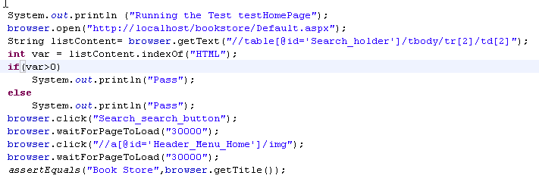
Screen Shot of the Example Script
Xpath Locator

