Slide 2
Agenda- Session 1
Monolithic vs Microservices Architecture
Benefits/drawbacks of Monolithic and Microservices Architecture
Microservices Architecture
What are Microservices?
What is Cloud Enabled?
Challenges with Building Microservices
What is Spring Cloud ?
Solutions for Microservice Architecture
Hands On

Slide 3
Benefits of Monolithic Architecture
Simple to develop
Simple to test
End-to-end testing by simply launching the application and testing the UI with Selenium
Simple to deploy
Copy the packaged application to a server
In the early stages of the project it works well
Basically most of the applications which exist today were started as a monolith

Slide 4
Drawbacks of Monolithic Architecture
Application is too large and complex to fully understand and made changes fast and correctly
Size of the application can slow down the start-up time
Continuous deployment is difficult and takes huge time
You must redeploy the entire application on each update
Monolithic applications has a barrier to adopting new technologies

Slide 5
Benefits of Microservices Architecture
Enables each microservice to be deployed independently
Continuous deployment will be faster
New Process and Technology adaption
Faster boot up time
Faster Release Cycles
Easy to scale up and scale down

Slide 6
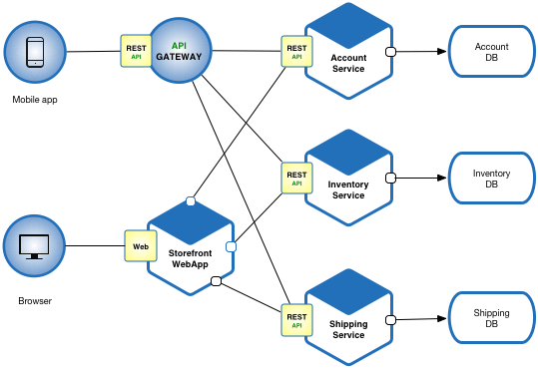
Microservices Architecture

Slide 7
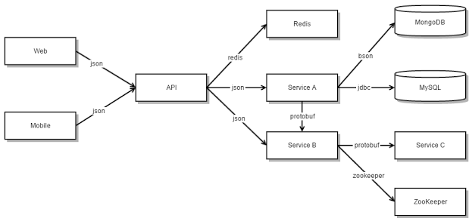
Microservices Architecture

Slide 8
What are Microservices?
Small Autonomous Services that work together
Light weight processes using HTTP
Built around business capabilities
Independently deployable and fully automated
Centralized monitoring

Slide 9
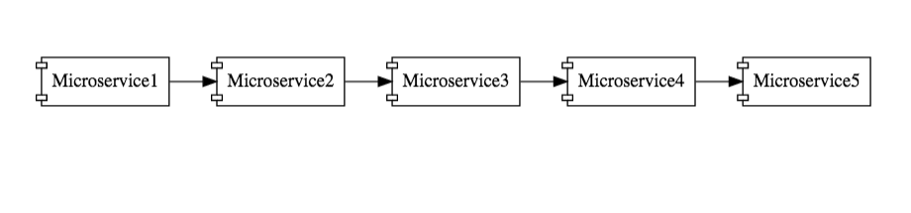
Microservices Architecture
Microservices
Services are exposed by REST
Small well chosen deployable units
Cloud Enabled

Slide 10
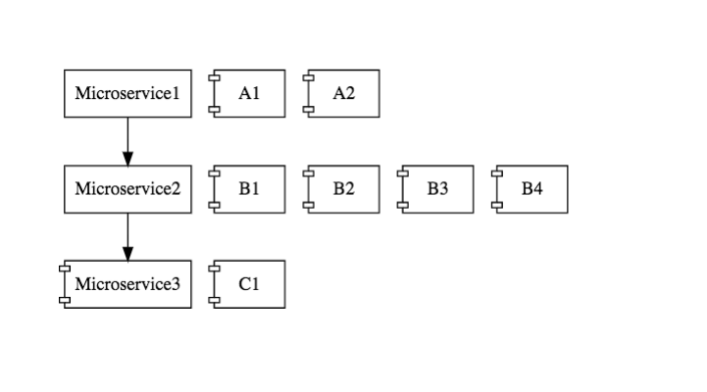
What is Cloud Enabled?
Set of Microservcies
Each having multiple instances
If there is load on one of the instance then auto scalable(bring up one more instance)
Dynamically bring up and bringing down

Slide 11
Challenges with Building Microservices
Bounded Context
Deciding boundaries with microservice is huge task
Its a evolutionary process

Slide 12
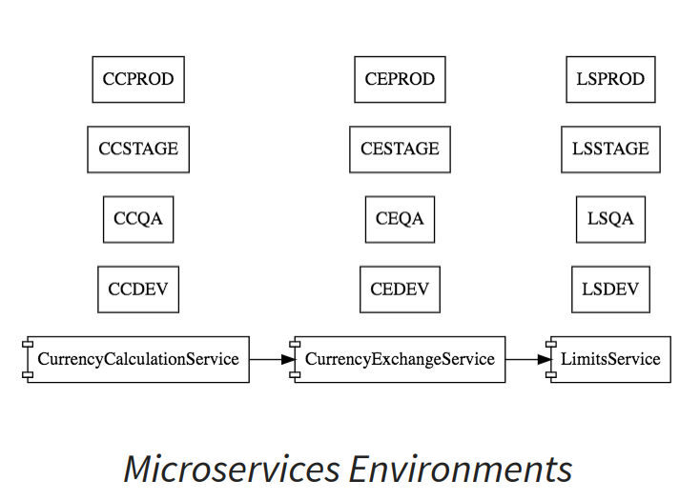
Challenges with Building Microservices
Configuration Management
10 Microservice
5 Envs
50 Instances

Slide 13
Challenges with Building Microservices
Dynamic Scale Up and Down
Scale up and scale down the instances according to load
Distribute load among all the available instances

Slide 14
Challenges with Building Microservices
Visibility
10 microservices
Bug in one of microservice
Centralized monitoring of logs -> Which microservice is causing the problems
Continuously Monitoring if any service is down or enough disk space

Slide 15
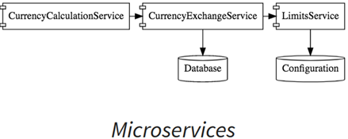
Challenges with Building Microservices
Pack of Cards
If not well designed everything will be collapsed
Chain of microservices will collapsed
One fundamental microservice go down then whole chain of microservice will go down

Slide 16
What is Spring Cloud ?
http://projects.spring.io/spring-cloud/
Spring cloud provides tools for building common patterns in distributed systems
Wide variety of projects under Spring Cloud umbrella
Imp is Spring Cloud Netflix

Slide 17
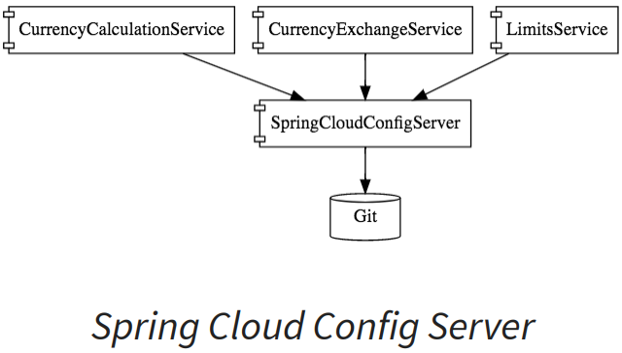
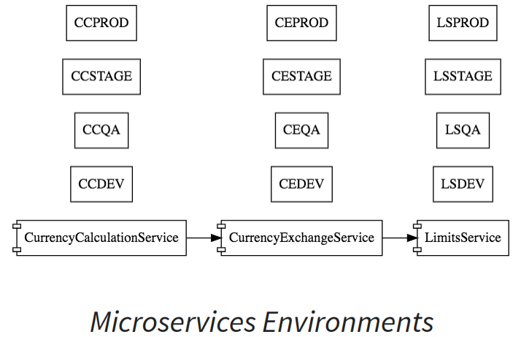
Solutions for Microservice Architecture
Spring Config Server
Managing conf centrally by storing in git repo for all the services

Slide 18
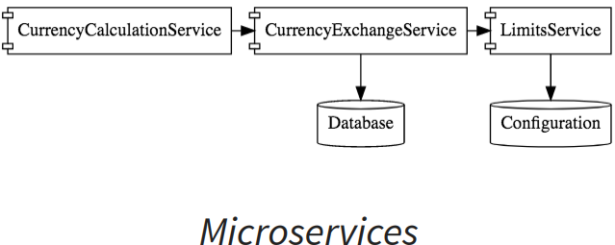
Dynamic Scale up and Scale down
Netflix Feign REST Client
Used for writing RESTFul clients

Slide 19
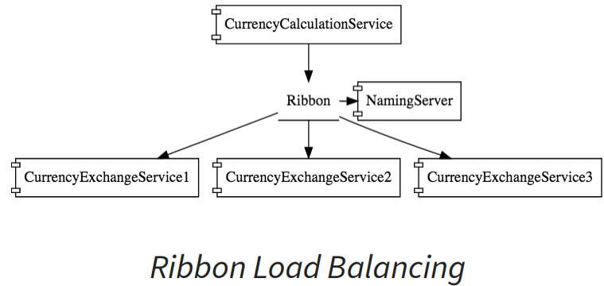
Netflix Ribbon Load Balancing
Ribbon client side load balancing
Ribbon will used to distribute the load equally among the available instances

Slide 20
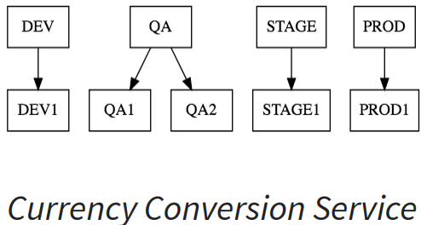
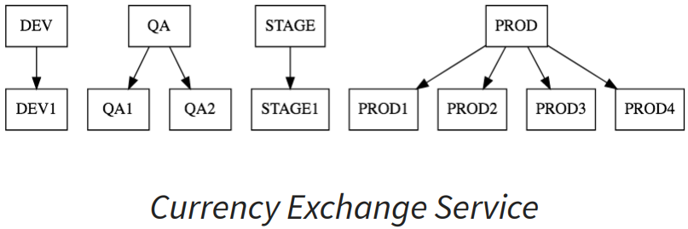
Netflix Ribbon Load Balancing

Slide 21
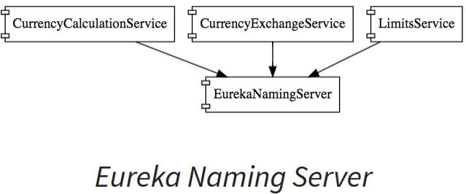
Dynamic Scale up and Scale down
Netflix Eureka Naming Server
All the instances of all the microservices will be registered with Eureka
Service Registration
Service Discovery
Currency Calculation service can ask the naming server give me current available instances of Curr Exchange service

Slide 22
Visibility and Monitoring
Netflix Zuul API Gateway
Common features like Logging, security, analytics
No need to implement manually
API gateway provides solutions for these kind of things
Netflix Sleuth and Zipkin Tracing server
Sleuth assigns the unique-id for req/res
Zipkin is used to trace the logs across the microservices

Slide 23
Netflix Zuul API Gateway

Slide 24
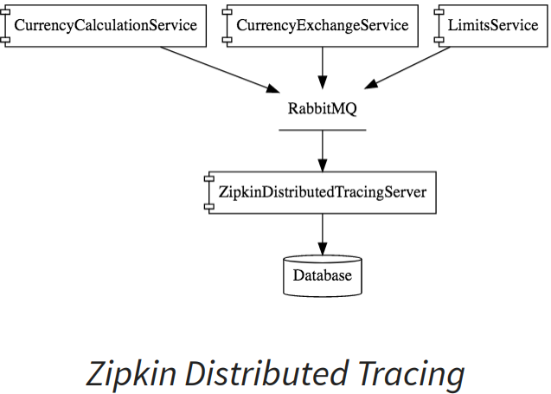
Slueth and Zipkin Tracing server

Slide 25
Fault Tolerance with Netflix Hystrix
Chain of microservice will fall
Hystrix is used to provide the default response if service if down

Slide 26
Lets Hands get Dirty
Set up Limits Service
Set Up Spring Cloud Config Server
Set up Local Git repo
Externalize all the properties to Git repo
Connect Spring Cloud Config Server to Git repo
Connect Limits Service to Spring Cloud Config

Slide 27
Session 1

Slide 28
Session 2

