Slide 1

employee payroll Management System
Batch-2

Slide 2

Batch -02
Front End
Arul Dandapani 2486793
Apoorva Srinivas 2486631
Arikila Sreekanth 2485462
Ashis Kumar Samal 2482151
Ammineni Sai Guna Vardhani 2484961
Back End
Apurva Charudatta Jatala 2484884
Anusha D V 2485089
Ankita Parida 2485079
Amrut Shivukumar Balikai 2484891
Anumalasetty Vinay Babu 2484836

Slide 3
Contents
Introduction
Objective
System Requirements
Tools & Languages Used
Features of Employee Payroll Management System
Advantages
Disadvantages
App Flow
E-R Diagram
Screen Shots Of Output
Future & Scope Improvements
Bibliography
Conclusion

Slide 4
Introduction
Employee payroll management system is an Internet-based Java application that automates the working of a company or work center that manage and maintain records of the employees in the different department.
The proposed project “Employee Payroll Management System” has been developed to overcome the problems faced in the practicing of manual system.
This web application is reduced as much as possible to avoid errors while entering data. It also provides error message while entering invalid data.

Slide 5
objective
The Primary objective of the design is to deliver the requirement as delivered by the feasibility report. There are some objective we kept in mind.
Practically : The system is quite stable and can be operated by the Employees with average intelligence.
Efficiency : We tried to involve accuracy, timeliness and comprehensiveness of system output.

Slide 6

System Requirements
Angular, STS, Postman and MySQL to be installed to the system
572 MB Random Access Memory
200 MB of Free Space on Hard Disk
Microsoft Windows XP or Linux or Equivalent OS
Web Browser

Slide 7
Tools & Languages
Front End
Back End
Visual Studio
Angular
HTML
CSS
BOOTSTRAP
Spring Tool Suite
MySQL
Hibernate
Postman

Slide 8
Features of Employee Payroll Management System
Easy to use.
It is completely secure.
This system is easily compatible with most of the web browsers.
Admin can view all the records whenever necessary with ease.

Slide 9
Advantages
Helps the employee easy way to access their data.
The information related to employee can be added and removed easily.
Store the end-to-end data of the employees

Slide 10

Disadvantages
Data security, loss and theft.
Cyber security and fraud.
Information access, quality and control

Slide 11
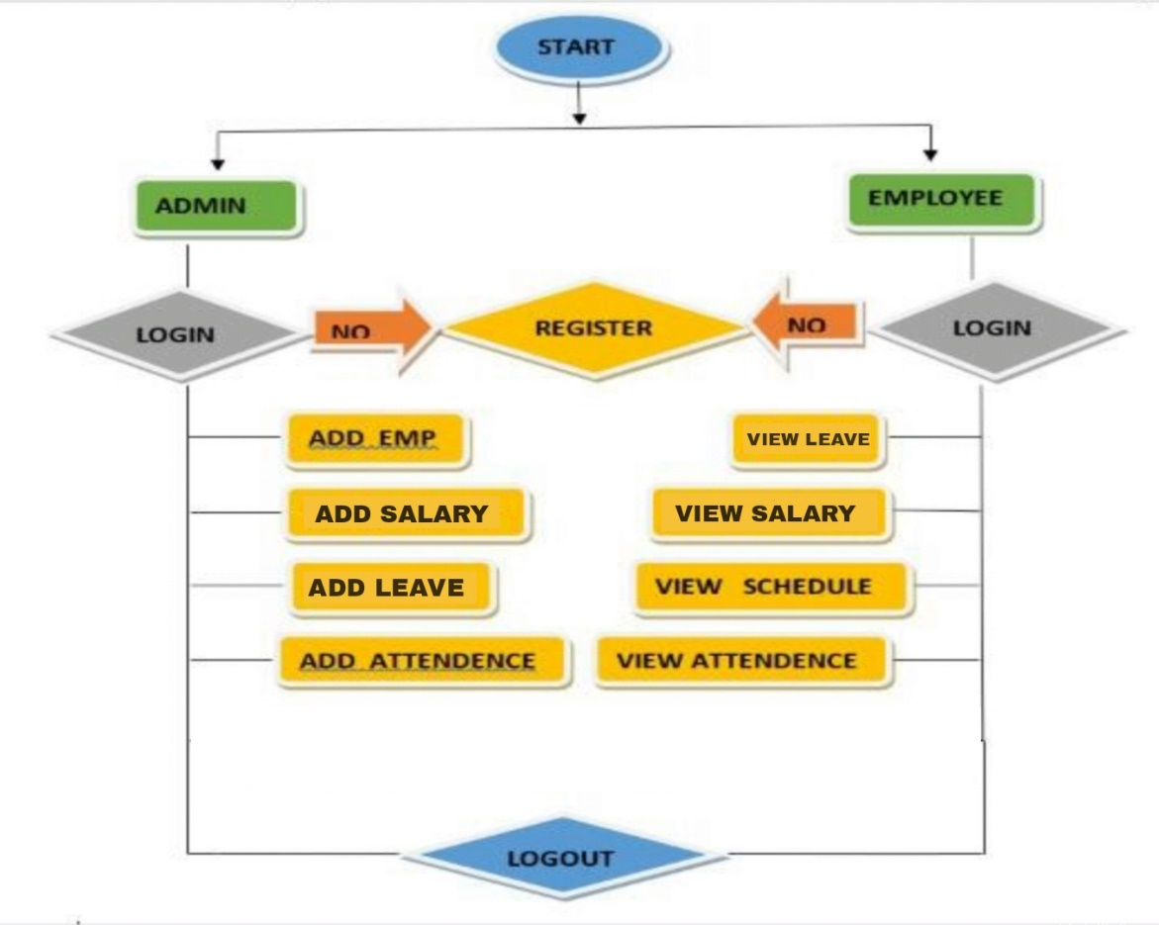
App Flow:

Slide 12
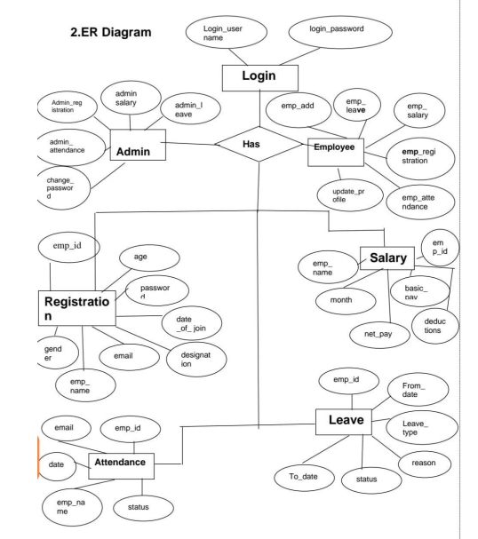
E-R Diagram:

Slide 13
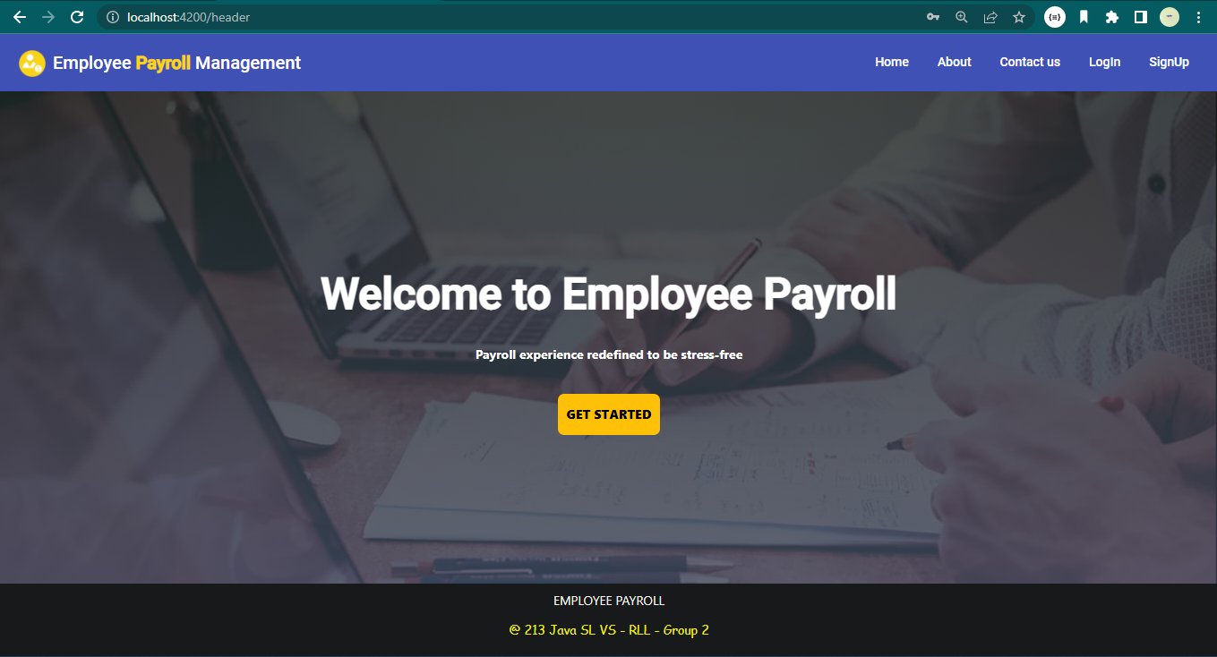
Home Page:
Screenshots Of Output

Slide 14
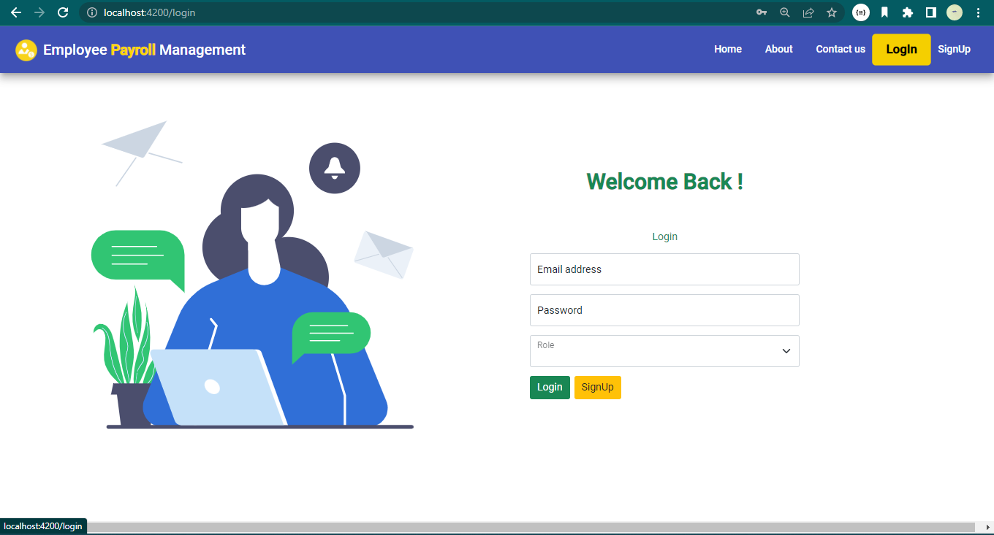
Login Page:

Slide 15
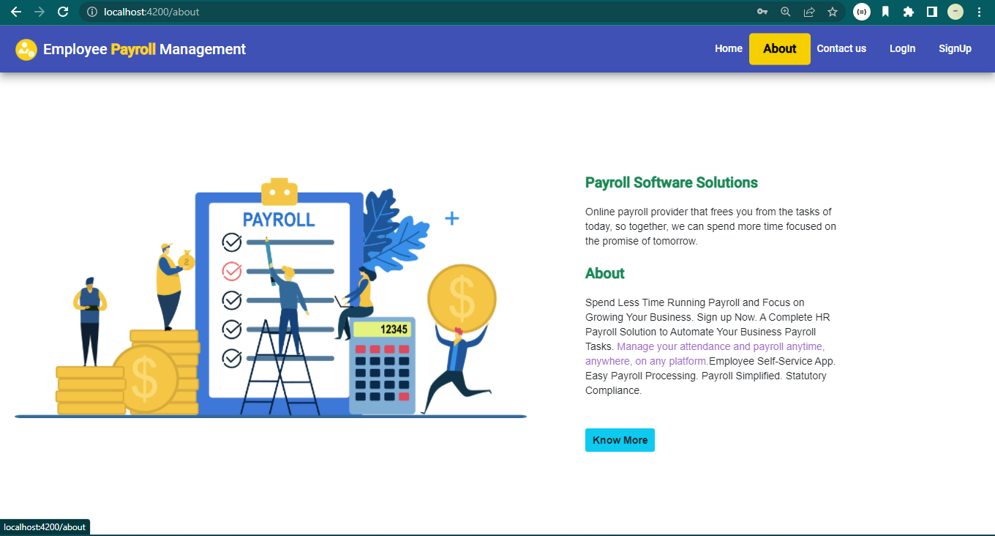
About Page:

Slide 16
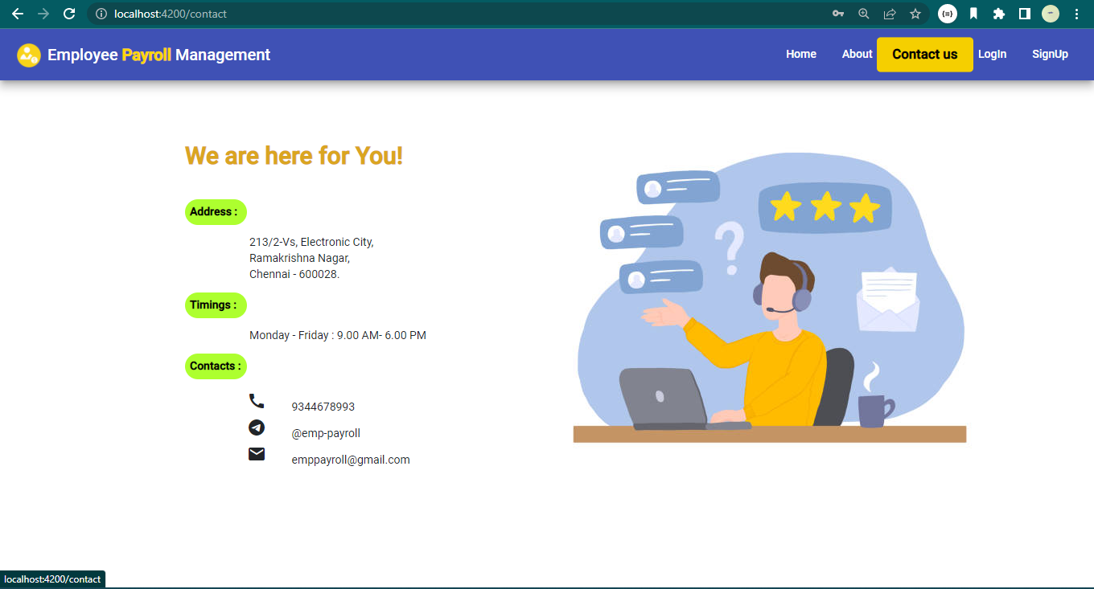
Contact Us Page:

Slide 17
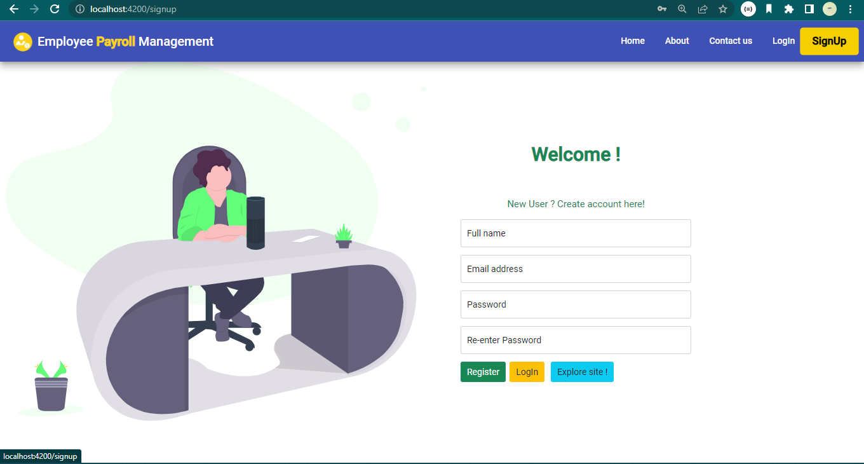
Sign-Up Page:

Slide 18
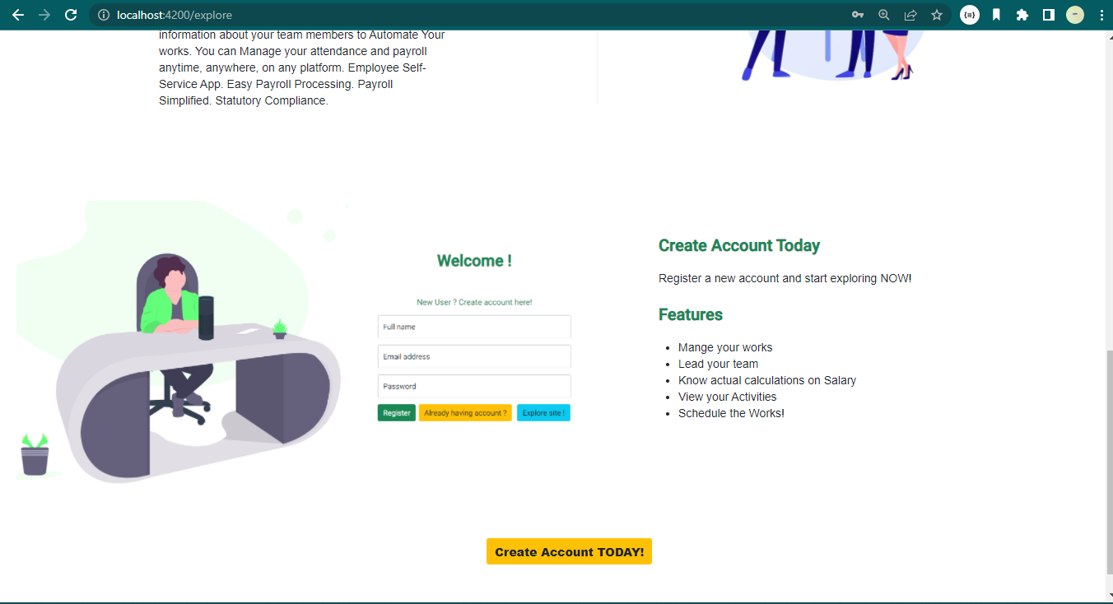
Explore Page:

Slide 19
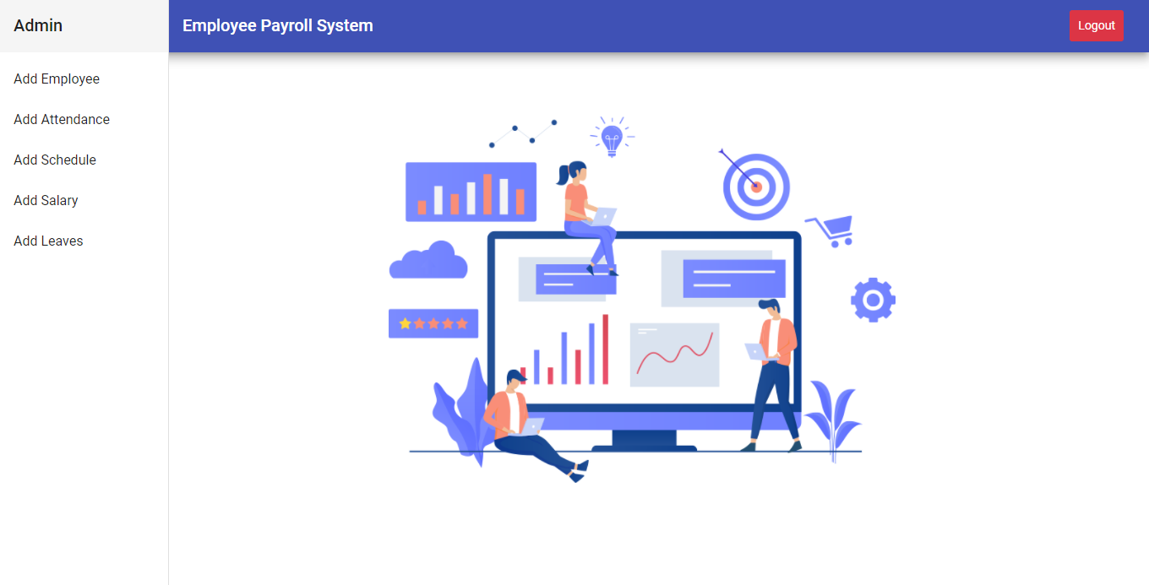
Admin Page:

Slide 20
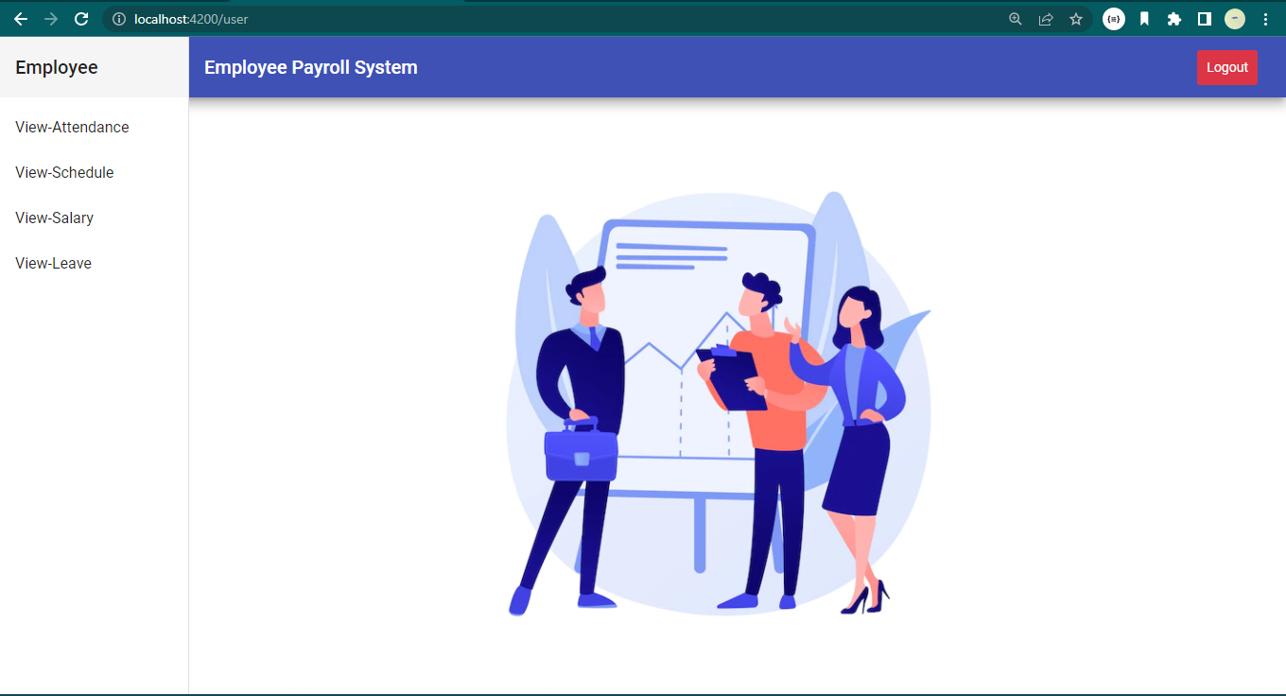
Employee Page:

Slide 21
Future scope and improvements
The option to print the records In future.
This Application works in Multiple PC’s installed on multiple Computers but sharing Same database by which users of different department can use it sitting at different locations simultaneously.
But in future we can make the Application where the database will be hosted in order to manage the all departments which will be located in different places and by keeping domain of Application as Online.

Slide 22
Conclusion
This project is built keeping in mind that it is to use by admin and the employees in an organization . It is built for use in small scale organization where the number of employees is limited. According to the requested requirement the admin can add, manipulate, update and delete all employee data in his organization. The admin can add new Employee and delete them. The Admin can also add predefined pay grades for the employees. The required records can be easily viewed by the admin anytime time he wants in an instant. The payment of the employee is based on monthly basis. Numerous validations implemented would enable the admin to enter accurate data. The main objective of this framework is to save time, make the system cost effective and management records efficiently.

Slide 23
Bibliography:
www.google.com
www.javatpoint.com
www.youtube.com
www.stackoverflow.com
WWW.spring.io

Slide 24

THANK YOU

