Slide 1
TOPIC:
Predicting ground shaking intensities.

Slide 2
Group 1
Group Members:
Ashita Goyal - A1 (11)
Bharti Gautam-A1 (12)
Naina Agrawal-A2 (25)
Nandani Bansal-A2 (28)

Slide 3
Objective
Our objective is to predict ground shaking intensities using DYFI data and estimating event terms to identify induced earthquakes.

Slide 4
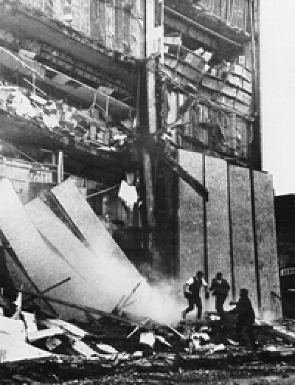
Motivation
There has been a dramatic increase in seismicity level in recent years.
This increase in seismicity has been associated with human activities like wastewater injection, and is referred to as induced seismicity.
The earthquakes are a nuisance for people and some larger magnitude earthquakes have also caused structural damage.
Hence, it is important to quantify seismic hazard and risk from this increased seismicity.

Slide 5
Data Set- Did You Feel It?
DYFI data was collected through personal communication with USGS for all earthquakes from year 2000 to 2014, with a minimum magnitude of 3 and having a minimum of 5 DYFI responses.
This data was collected for earthquakes between latitudes 25◦ and 49◦ , and longitudes −105◦ and −67◦ .
Based on users’ responses, USGS then assigns an intensity level to each report called the Community Decimal Intensity (CDI).

Slide 6
DYFI raw dataset contains these attributes:
Latitude
Longitude
Depth
Mag
MagType
NST
Gap
Dmin
Status
Location
RMS
Net
Id
Updated
Place
Type
Horizontal
DepthError
MagError
MagNST
https://earthquake.usgs.gov/data/comcat/data-eventterms.php#gap

Slide 7
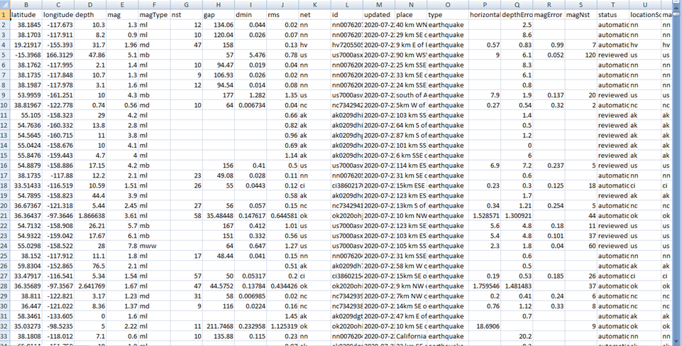
Data Set link:
https://earthquake.usgs.gov/earthquakes/feed/v1.0/csv.php#learn

Slide 8
Algorithm Used:
A mixed-effects regression model is used as our primary prediction model since it allows estimation of random effects associated with earthquakes and regions.
The mixed-effects regression model is also compared to a support vector regression (SVR) model. This is primarily done to assess the effectiveness of mixed-effects regression compared to other popular regression models

Slide 9
Outcomes:
Various regression models were trained for predicting ground motion intensities from an earthquake.
Also, we concluded that a significant difference in event terms could not be observed between induced and natural earthquakes; hence, event terms could not be effectively used to distinguish induced from natural events.

Slide 10
Applications:
The prediction models developed in this study could be ultimately used in Seismic Risk Mitigation.
• Prediction model can be used as an input for hazard and risk calculation.
• Risk estimation can be used as a decision support tool to inform decisions on operations that might cause earthquake.
• It can also be used to examine certain physical properties, for example, the faults causing the earthquakes or the soil conditions at a given region.

Slide 11
Thank You!

