Slide 1
BIG DATA ANALYSIS ON AIRLINES DATASET
- Ashita Mepani

Slide 2
Technologies Used
Psuedo Distributed Mode:
Hadoop HDFS
Pig
Hive
Visualization Tools: Tableau

Slide 3
Scope of the project
Airline Industry is getting competitive day by day with wide variety of Airline carriers.
Customers are always looking for best option where there are chances of less delays and cancellations.
We will be analyzing the different cause for delays and cancellation
We will also get stats related to amount of delay and providing business owners with reports for better future planning's and changes to be taken.

Slide 4
Data information
All the input files are in csv format.
Flight data contains detail about each flight with its year, month, day, time and other related stats and information.
Flight.csv file has 35 Millions Records and it is around 3gb in size
Carrier.csv file contains detail about the flight carrier
Airport.csv file has detail about the Airports between which flights are providing services

Slide 5
Load Files to HDFS
./hdfs dfs -copyFromLocal '/Users/nikit/Ashita/airports.csv' '/’
./hdfs dfs -copyFromLocal '/Users/nikit/Ashita/carriers.csv' '/’
/hdfs dfs -copyFromLocal '/Users/nikit/Ashita/flight.csv' '/'

Slide 6
Pig Implementation
Have implemented Pig in map reduce mode
Flight Data is stored in flightData variable
Carriers data is stored in carrierData variable
Airports data is stored in airportData variable

Slide 7
Analysis
PIG ANALYSIS 1: NUMBER OF FLIGHTS ARRIVED BEFORE TIME
filterFlightData = filter flightData by ArrTime<CRSArrTime;
beforeTimeFlight = foreach (GROUP filterFlightData ALL) GENERATE COUNT(filterFlightData);
store beforeTimeFlight INTO '/Output/PigOutput/Analysis1' USING PigStorage(',');

Slide 8
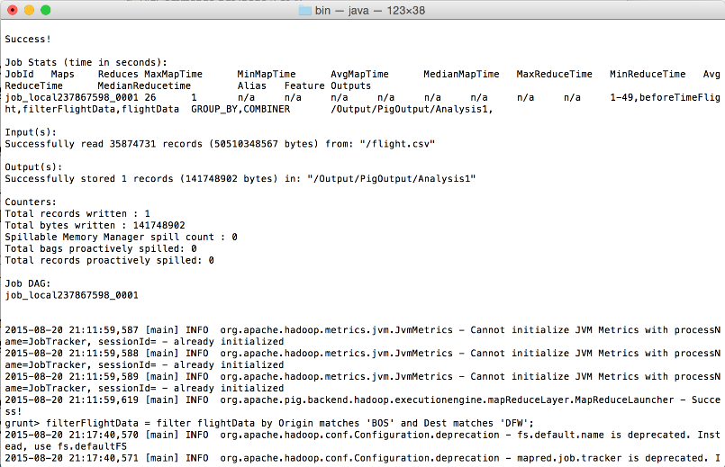

Slide 9
Analysis
PIG ANALYSIS 2: NUMBER OF FLIGHTS BETWEEN 2 AIRPORTS
filterFlightData = filter flightData by Origin matches 'BOS' and Dest matches 'DFW’;
numberOfFlights = foreach (GROUP filterFlightData ALL) GENERATE COUNT(filterFlightData);
store numberOfFlights INTO '/Output/PigOutput/Analysis2' USING PigStorage(',');
Output: 17509

Slide 10
Analysis
PIG ANALYSIS 4: FLIGHTS THAT DEPARTED ON TIME
onTimeFlight = filter seqFlightData by DepTime==CRSDepTime;
onTimeFlightCount = foreach (GROUP onTimeFlight ALL) GENERATE COUNT(onTimeFlight.rank_flightData);
store onTimeFlightCount INTO '/Output/PigOutput/Analysis4' USING PigStorage(',');

Slide 11
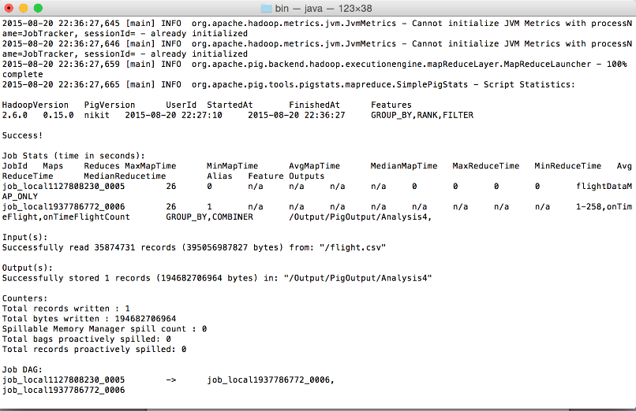

Slide 12
Analysis
PIG ANALYSIS 5: FLIGHTS THAT ARE CANCELLED
flightCancelled = filter seqFlightData by CancellationCode=='B’;
store flightCancelled INTO '/Output/PigOutput/Analysis5' USING PigStorage(',');

Slide 13
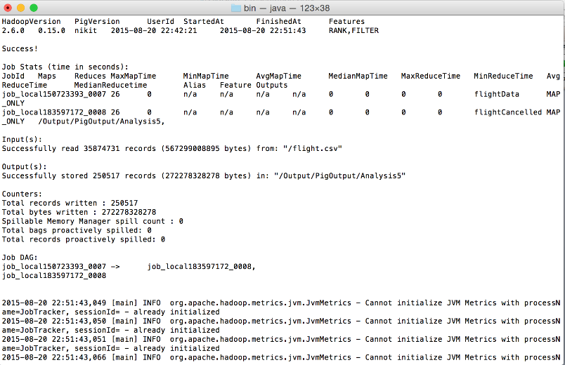

Slide 14
Hive Implementation
Here Airline Data is stored in onTimePerf table
Partitioning is set to True and is done on Year and Month.
Carriers data is stored in carrier table
Airport data in stored in airport table

Slide 15
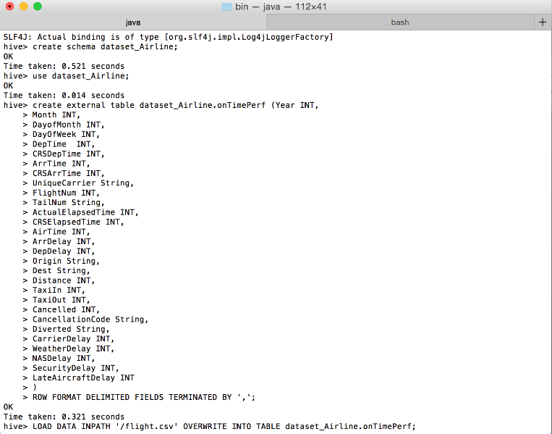

Slide 16
Analysis
ANALYSIS 1: FLIGHTS THAT STARTED LATE BUT REACHED ON TIME
INSERT OVERWRITE DIRECTORY '/FinalProject/output/HiveOutput/Analysis’
selectYear,Month,DayofMonth,Origin,Dest,AirTime,Distance,TaxiIn,TaxiOut from ontimeperf where DepTime>CRSDepTime and ArrTime<=CRSArrTime ;

Slide 17
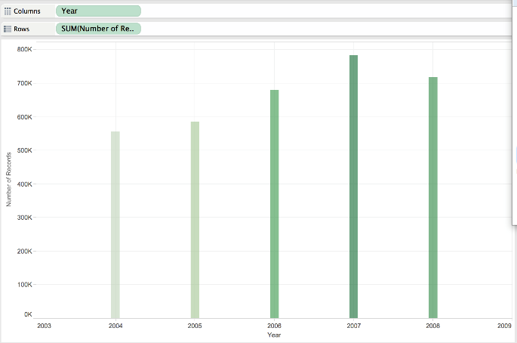
Analysis 1 Output

Slide 18
Analysis
ANALYSIS 2: FLIGHTS THAT TRAVEL LESS/MORE THAN 1000 MILES
INSERT OVERWRITE DIRECTORY '/Output/HiveOutput/Analysis2.0' select count(*) from onTimePerf where Distance > 1000;
OUTPUT: 7978861
INSERT OVERWRITE DIRECTORY '/Output/HiveOutput/Analysis2.1' select count(*) from onTimePerf where Distance < 1000;
OUTPUT: 27895870

Slide 19
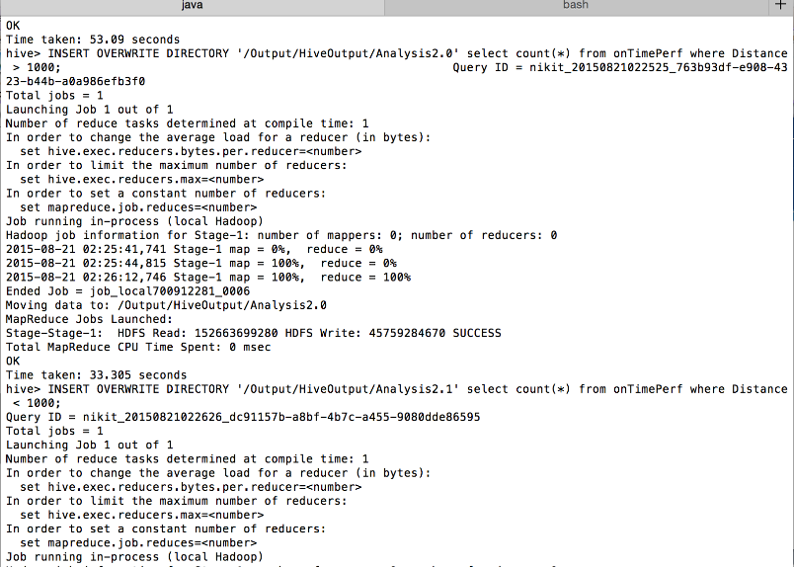

Slide 20
Analysis
ANALYSIS 3: TOTAL COUNT OF FLIGHTS FOR EACH CARRIER AND COUNT CANCELLED

Slide 21
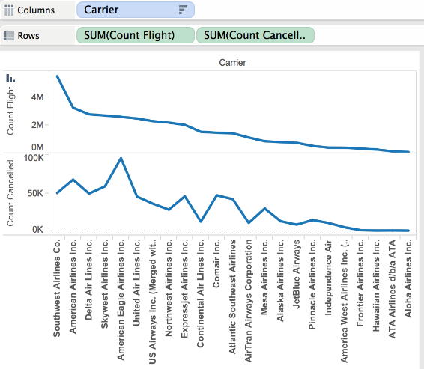
Analysis 3 Output

Slide 22
Analysis
ANALYSIS 4: FLIGHTS THAT TOOK MORE THAN 15 MINS TO TAXIIN AND TAXOUT
select count(*) from ontimeperf where TaxiIn+ TaxiOut>15;
Output: 26291722

Slide 23
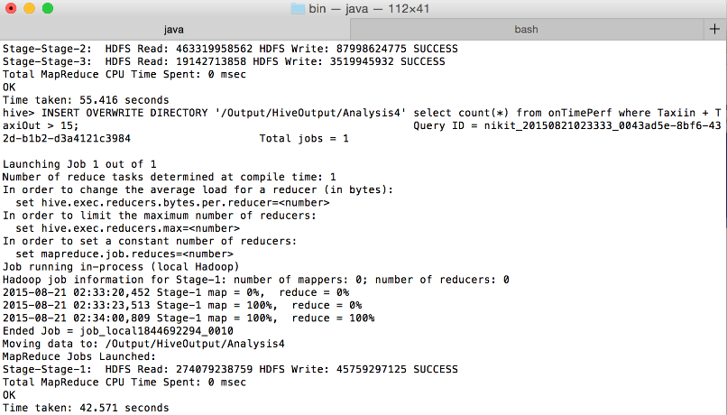

Slide 24
References
http://stat-computing.org/dataexpo/2009/the-data.html

Slide 25
Thank you

