Slide 1

Submitted by Ashitha B P

Slide 2
Abstract
HealthXE is an interactive one-stop site for patients of all stripes.
An all-inclusive healthcare forum, it gives patients a unique platform to share experiences, get advice and support, maintain regular contact with those suffering from similar ailments, talk about day-to-day challenges, and learn more about treatments and medical breakthroughs in different parts of the world.
By educating and empowering the patients, this portal aims to revolutionise the healthcare model, shifting it from a physician-focused environment to a patient-centric one.

Slide 3
Modules
Admin
User
Guest

Slide 4
User module
Sign-up
Sign-in
Search
My profile
Post
My groups
Settings

Slide 5
Sign-up
Option to register a new user by entering the following details: name, nick name, gender, country, state, district, city, postal code, phone number, email address, gender, password, and confirm password.
Sign-in
The registered users can sign-in by entering corresponding email-id and password.
Search
The user can search a forum group, forum topics or anything related on that website using this search.

Slide 6
My profile
User can create a profile.
Option to edit profile (name, gender, email, phone number, profile picture).
Option to upload photo.
Post
Option to publish a new post by entering post title, post image, post description, add tags (multiple tags separated by commas), select category, select forum topic.
Option to view all previous post.
Option to edit post.

Slide 7
My groups
Option to search new groups.
Option to send interest.
Option to edit group.
Settings
Option to change user credential (only password).

Slide 8
User general features
Option to view the post.
Option to view the trending topics.
Option to like a post.
Option to comment on a post.
Option to share a post.
Option to report a post.
Option to reply to a comment.

Slide 9
Admin module
Option to view all users.
Option to view the loyalty point of all users.
Option to filter user based on location and point.
Option to create forum topics.
Option to create blogs

Slide 10
Visitor module
Option to view posts.
Option to view blogs.
Option to view trending topics.

Slide 11
Technology hierarchy
Front-End:
HTML
CSS
Java Script
Twitter Bootstrap
Back-End:
Codeigniter
MySQL
PHP

Slide 12
Codeigniter
Codeigniter is an application development framework, which can be used to develop websites, using PHP.
It is an Open Source framework. It has a very rich set of functionality, which will increase the speed of website development work.If you know PHP well, then Codeigniter will make your task easier.
It has a very rich set of libraries and helpers. By using Codeigniter, you will save a lot of time, if you are developing a website from scratch.
Not only that, a website built in Codeigniter is secure too, as it has the ability to prevent various attacks that take place through websites.
Codeigniter Features
Model-View-Controller Based System
Extremely Light Weight
Full Featured database classes with support for several platforms.
Query Builder Database Support
Form and Data Validation

Slide 13
Introduction to PHP
PHP is a server-side scripting language designed for web development but also used as a general-purpose programming language.
PHP code is usually processed by a PHP interpreter, which is usually implemented as a web server's native module or a Common Gateway Interface (CGI) executable.
After the PHP code is interpreted and executed, the web server sends resulting output to its client, usually in form of a part of the generated webpage; for example, PHP code can generate a web page's HTML code, an image, or some other data.
PHP has also evolved to include a command-line interface (CLI) capability and can be used in standalone graphical applications.

Slide 14
My SQL
Structured Query Language (SQL), in computer science, a database sub language used in querying, updating and managing relational databases. MY SQL Server is a relational database management system for distributed Client-Server computing. Like all other database management systems, it provides the following features:
A variety of user interfaces
Physical data independence
Logical data independence
Query optimization
Data integrity
Concurrency control
Backup and recovery
Security and authorization

Slide 15
NETBEANS
Netbeans is an integrated development environment (IDE) for developing primarily with Java, but also with other languages, in particular PHP, C/C++, and
The NetBeans IDE is written in Java and can run on Windows, OS X, Linux, Solaris and other platforms supporting a compatible JVM.
The Net Beans Platform allows applications to be developed from a set of modular software components called modules
Among the features of the platform are:
User interface management (e.g. menus and toolbars)
User settings management
Storage management (saving and loading any kind of data)
Window management

Slide 16
TABLES

Slide 17
Tbl_blog
Field | Datatype | Description
Post_id | Bigint(20) | Post id
title | Varchar(200) | Post title
content | taxt | Post content
status | Varchar(200) | Post status
tags | text | Post tags
date | datetime | date
category | Bigint(20) | Post category
forum | Bigint(20) | Forum
Post_author | Bigint(20) | Author name

Slide 18
Tbl_category
Field | Datatype | Description
Cat_id | Bigint(20) | Category id
Cat_title | varchar(200) | title
parent | Bigint(20) | parent
Cat_type | Varchar(200) | Category type

Slide 19
Tbl_comment
Field | Datatype | Description
Comment_id | Bigint(20) | Comment id
Post_id | Bigint(20) | Post id
Commment_author | text | Comment author
Commeny_author_Ip | Varchar(100) | Authors ip
Coment_author_email | Varchar(100) | Authors email
Comment_content | Varchar(200) | content
date | datetime | date
User_id | Bigint(20) | User id
Comment_type | Int(200) | Comment type
Comment_parent | Bigint(20) | Comment parent

Slide 20
Tbl_countries
field | datatype | Description
Country_id | Int(12) | Country id
Sort_name | Varchar(3) | Sort name
name | Varchar(150) | Country name
Phone_code | Int(11) | Phone code

Slide 21
Tbl_forum
field | datatype | Description
Forum_id | Bigint(20) | Forum id
Forum_title | Varchar(200) | Forum title
tags | Varchar(200) | Forum tags
category | Bigint(20) | Forum category

Slide 22
Tbl_Forum_likes
field | datatype | Description
Like_id | Bigint(20) | Like id
User_id | Bigint(20) | User id
Post_id | Bigint(20) | Post id
Ip_address | Varchar(200) | User ip address
date | datetime | Liked date

Slide 23
Tbl_Forum_cat_relationship
field | datatype | Description
Object_id | Bigint(20) | Object id
Cat_id | Bigint(20) | Category id
Cat_order | Int(11) | Category order

Slide 24
Tbl_forum_user_relationships
field | datatype | constraints
Object_id | Bigint(20) | Object id
Forum_id | Bigint(20) | Forum id
Cat_order | Int(11) | Category order

Slide 25
Tbl_likes
field | datatype | constraints
Like_id | Bigint(20) | Like id
Post_id | Bigint(20) | Post id
User_id | Bigint(20) | User id
date | datetime | date
Ip_address | Varchar(200) | IP address

Slide 26
Tbl_main places
field | datatype | constraints
id | Int(11) | Place id
name | Varchar(30) | Place name
State_id | Int(11) | State id

Slide 27
Tbl_new_post
field | datatype | constraints
Post_id | Bigint(20) | Post id
title | Varchar(200) | Post title
content | text | content
status | Varchar(200) | status
tags | text | tags
date | datetime | date
category | Bigint(20) | category
Forum_id | Bigint(20) | Forum id
Post_author | Bigint(20) | Post author

Slide 28
Tbl_newsletter
field | datatype | constraints
id | Bigint(20) | News letter id
email | Varchar(200) | Email id
status | Varchar(200) | status

Slide 29
Tbl_spam
field | datatype | constraints
id | Bigint(20) | Spam id
User_id | Bigint(20) | User id
Post_id | Bigint(20) | Post id
date | datetime | Date

Slide 30
Tbl_users
field | datatype | constraints
User_id | Bigint(20) | User id
User_name | Varchar(200) | User name
password | Varchar(200) | password
country | Varchar(200) | country
state | Varchar(200) | state
district | Varchar(200) | district
city | Varchar(200) | city
Post_code | Varchar(200) | Post code
email | Varchar(200) | email
phone | int(20) | Phone number
gender | Varchar(20) | gender

Slide 31
Tbl_users
date | datetime | date
User_pic | Varchar(20) | User profile picture
My_group | Varchar(200) | groups
User_role | Varchar(200) | User role

Slide 32
UML
Create category
View users
Create groups
Admin
Create forum topics
Create blogs

Slide 33
UML
Add post
View blogs
Edit profile
User
Like ,comment ,share & report post
Search
Add groups

Slide 34
Activity diagram
admin
login
No
Yes
Manage users
Create category
Create groups
Create forum topics
Create blogs
Log out

Slide 35
Activity diagram
User
login
No
Yes
Add post
View blogs
Edit profile
Like,comment,share,& report post
search
Add group
Log out

Slide 36
FORMS

Slide 37
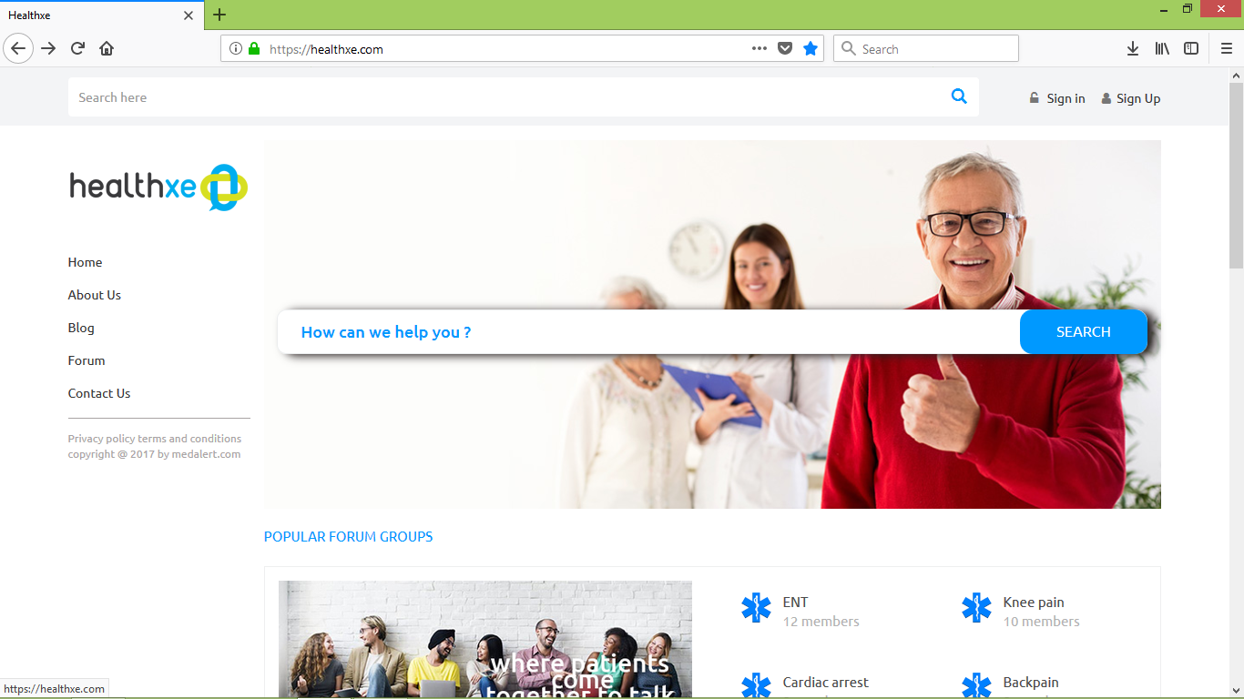
Home page

Slide 38
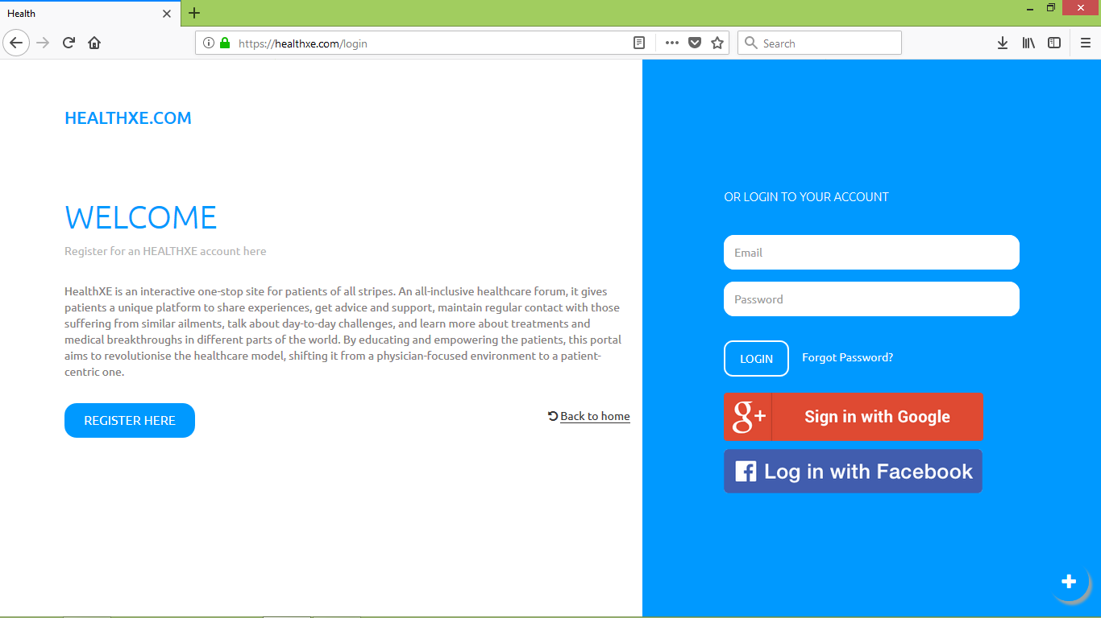
Login

Slide 39
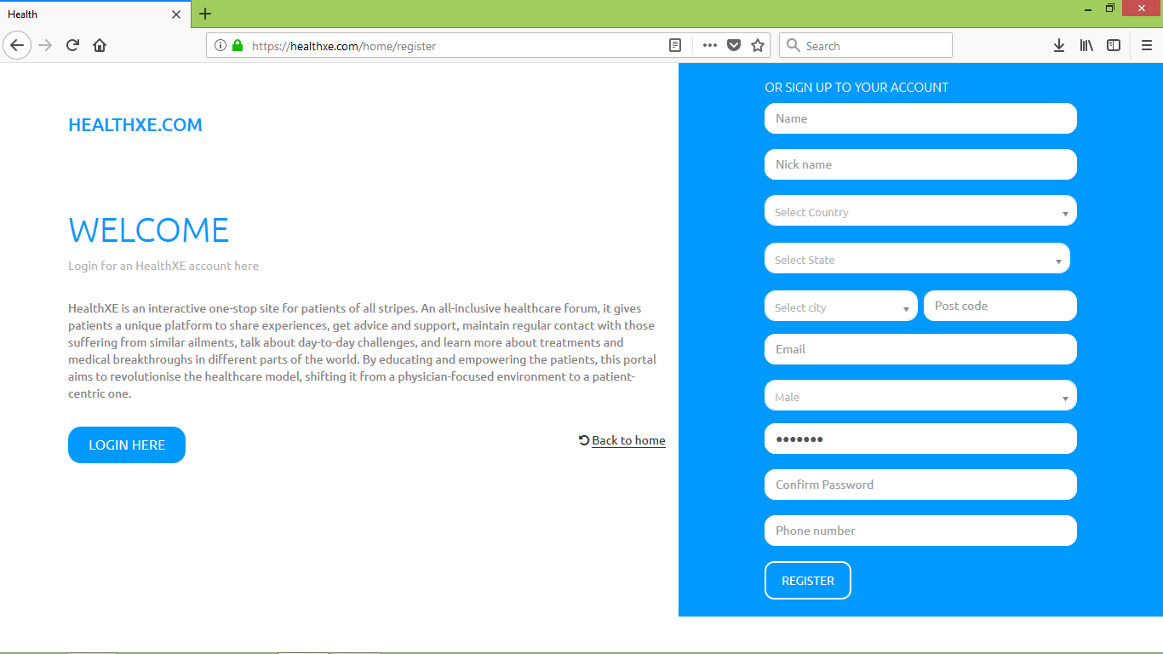
Register

Slide 40
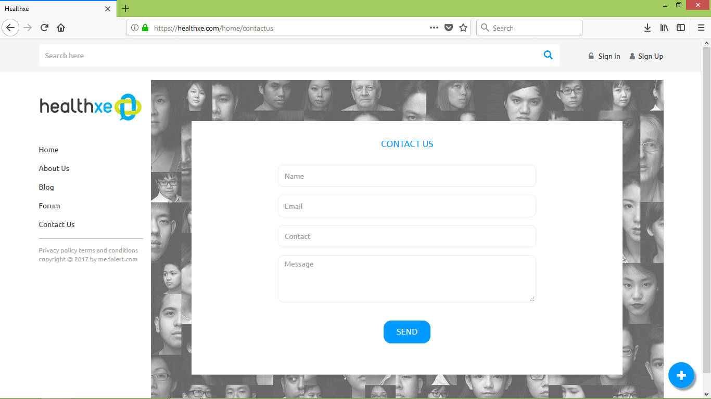
Contact us

Slide 41
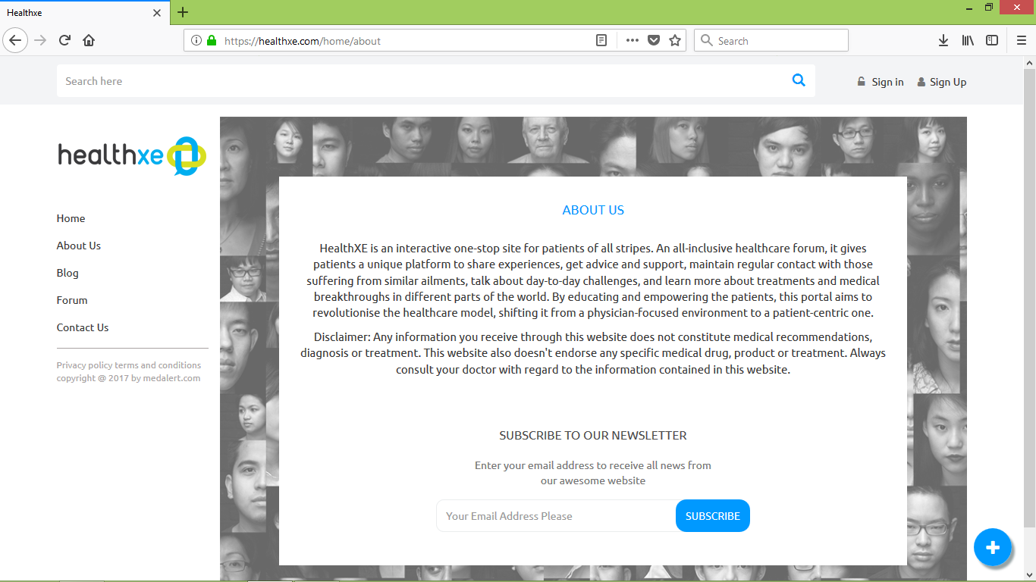
About us

Slide 42
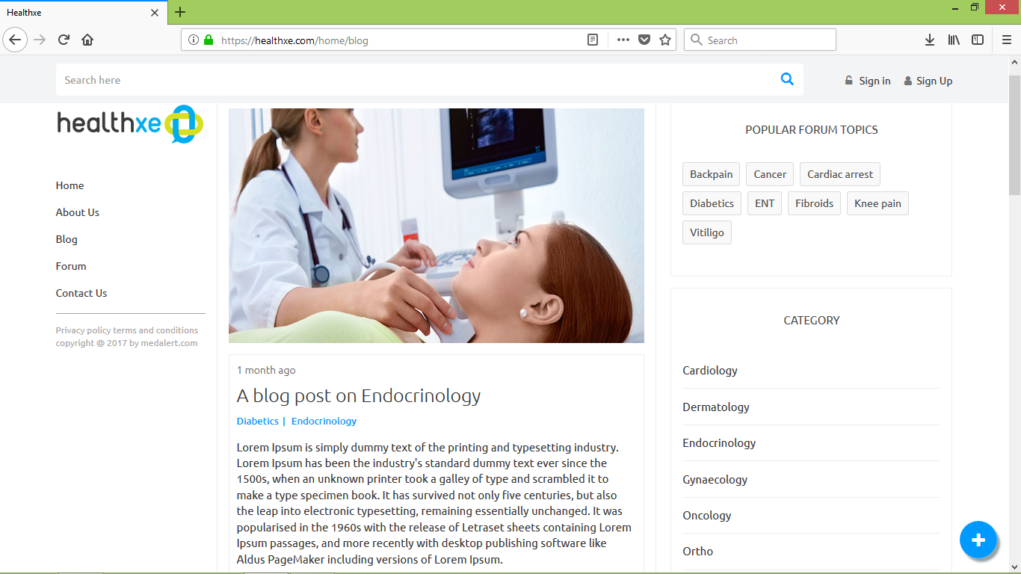
Blogs

Slide 43
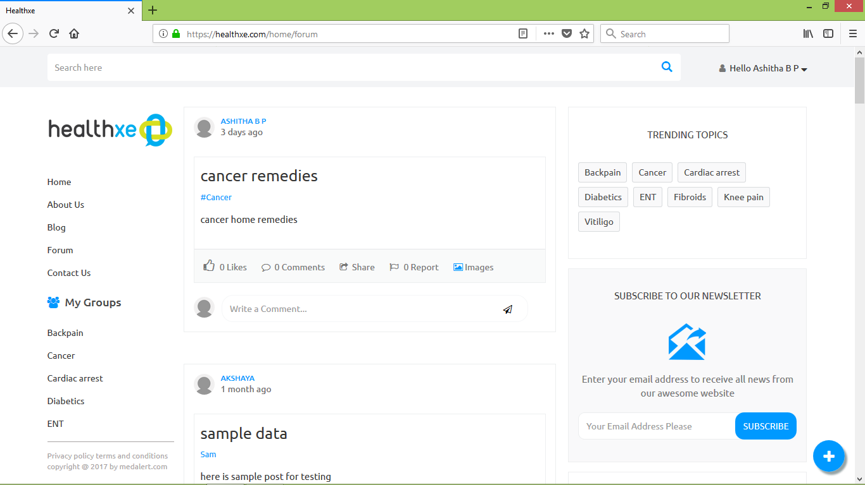
Forum posts

Slide 44
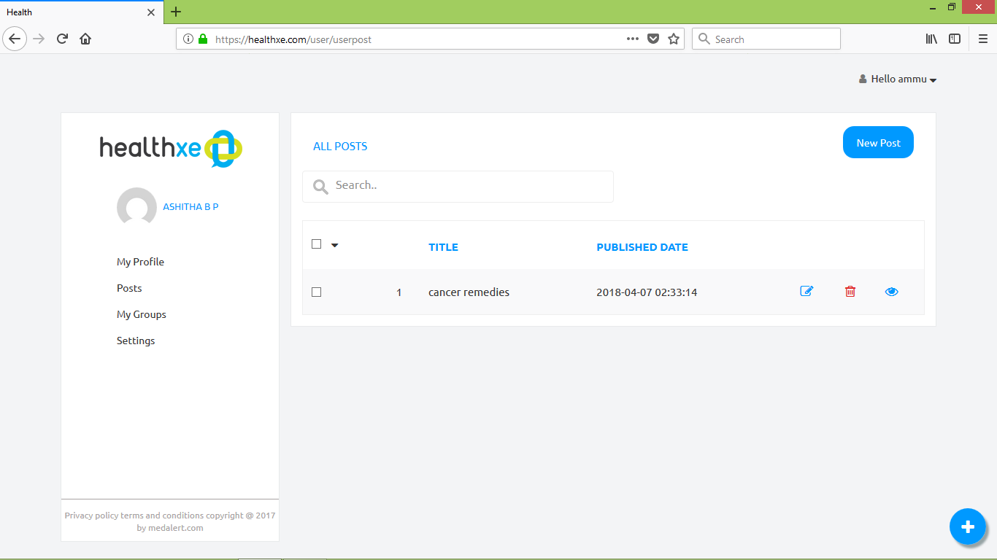
My post

Slide 45
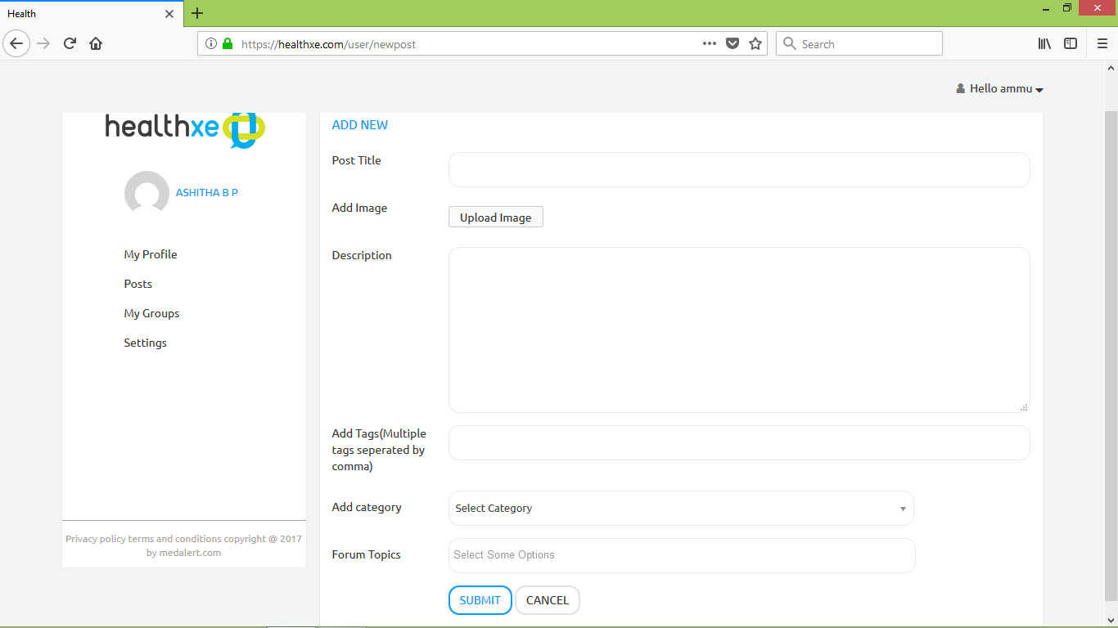
New post

Slide 46
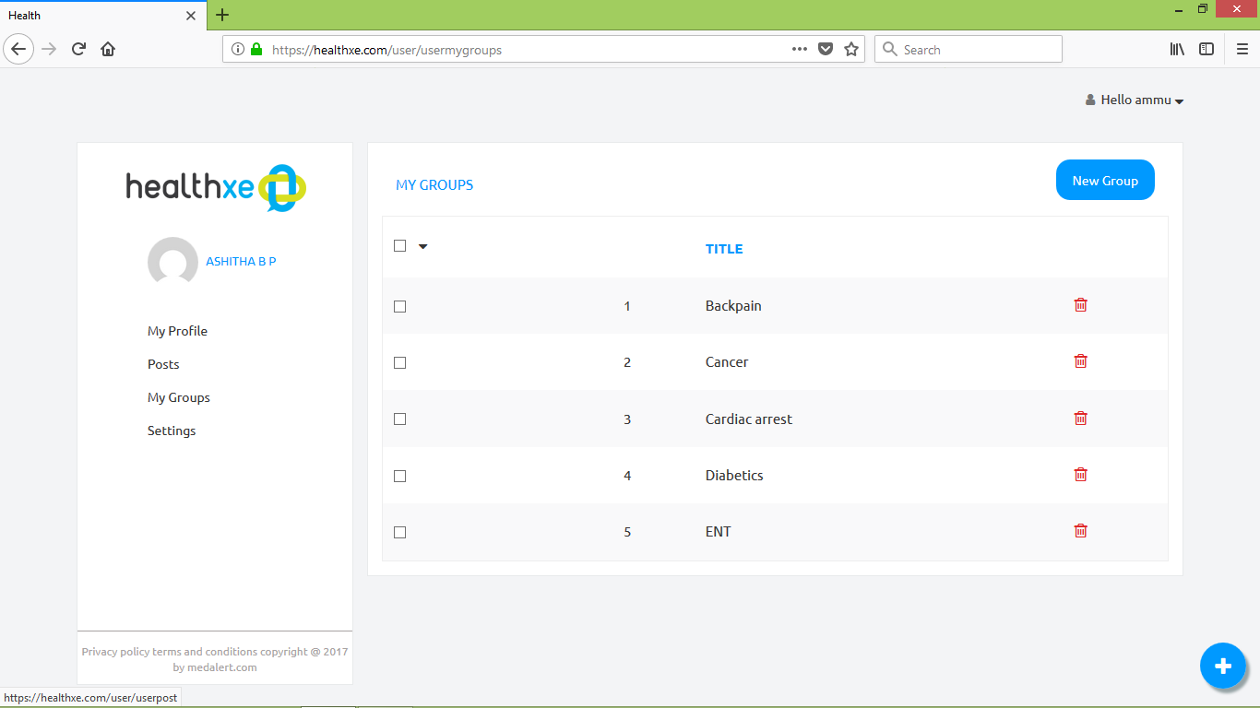
My groups

Slide 47
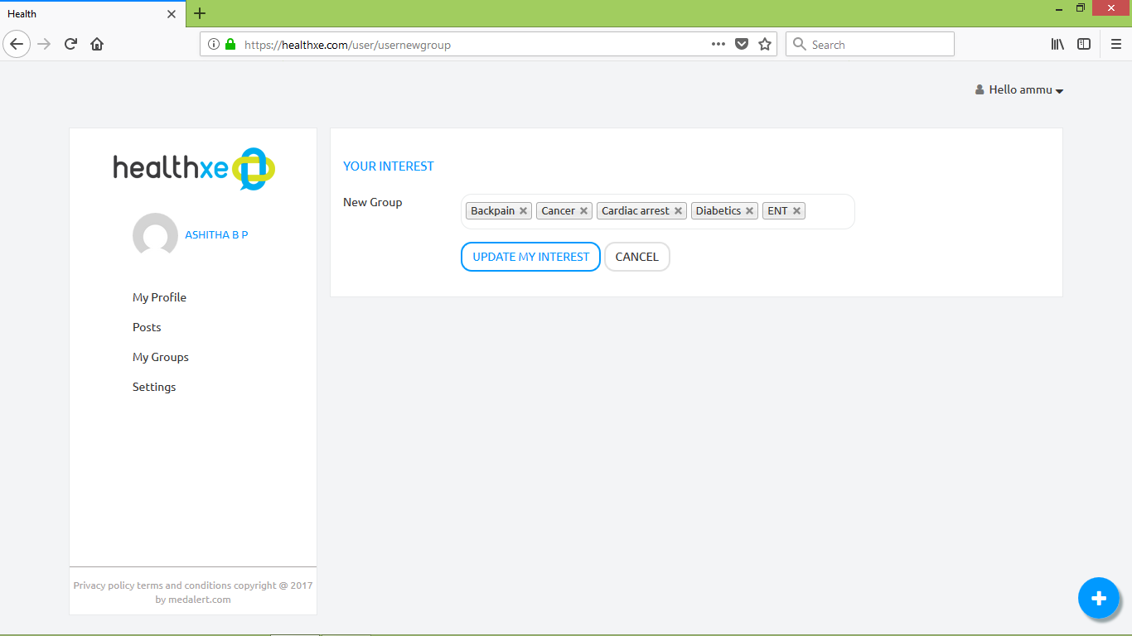
Add groups

Slide 48
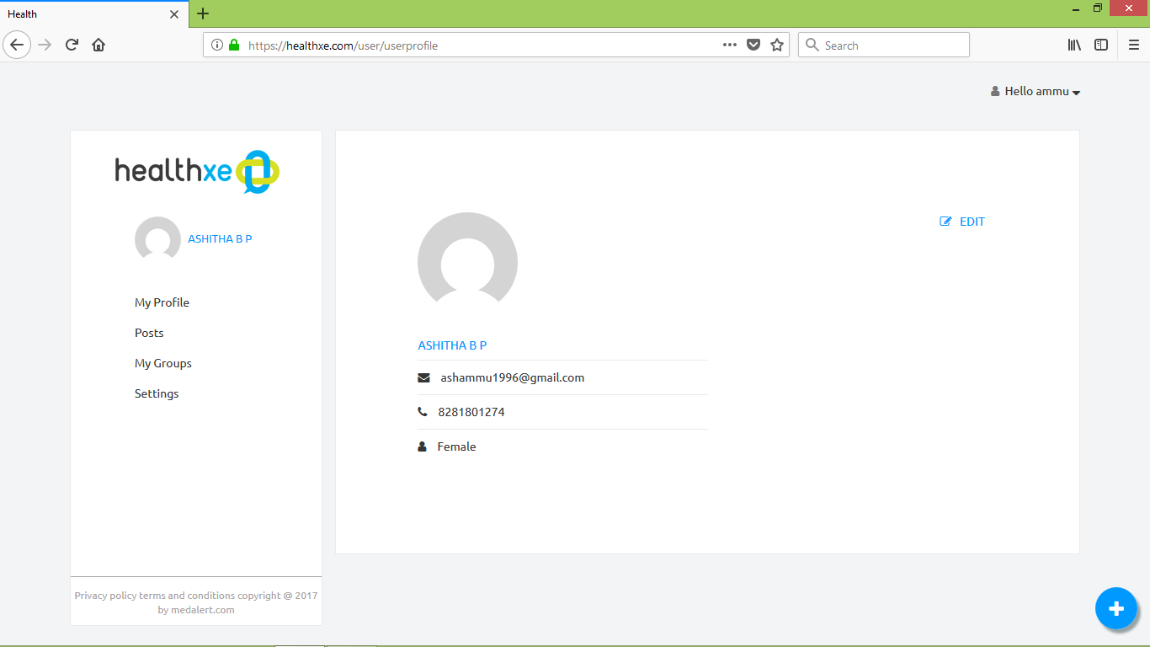
My profile

Slide 49
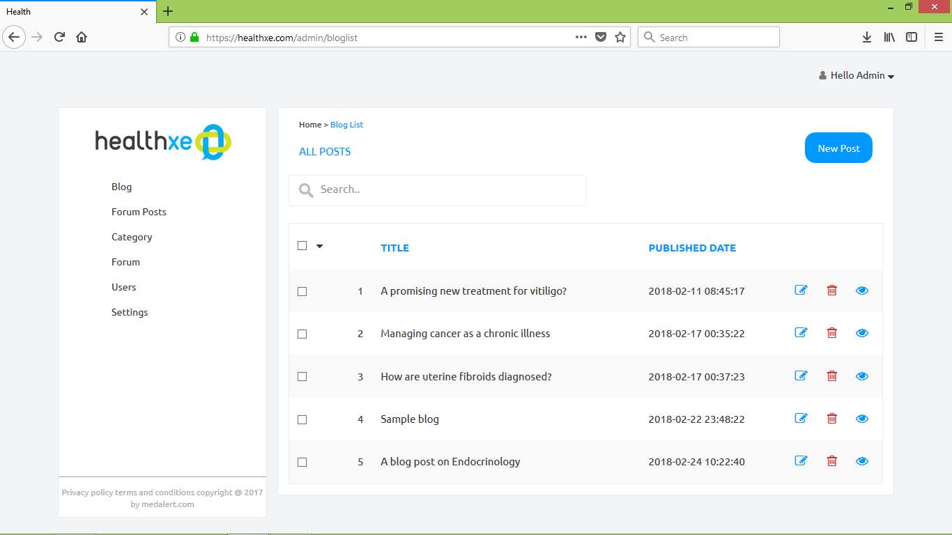
Blogs

Slide 50
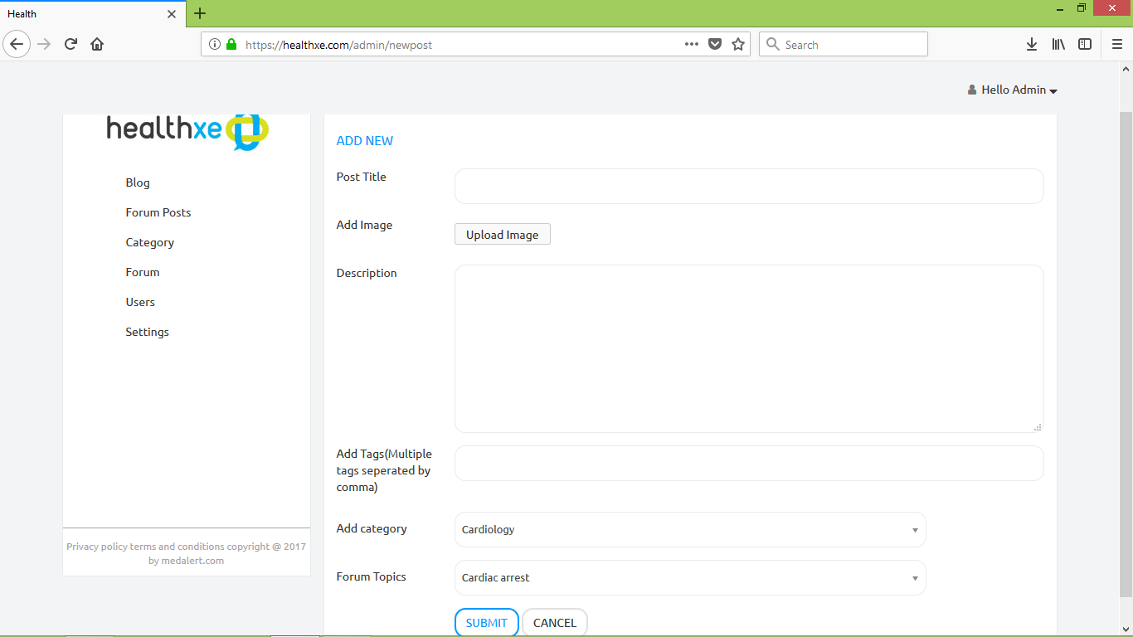
New blog

Slide 51
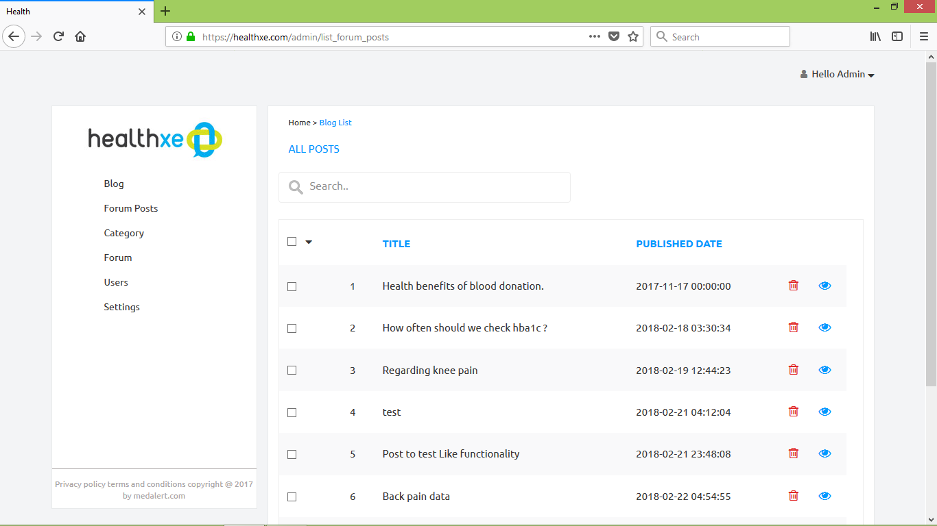
Forum posts

Slide 52
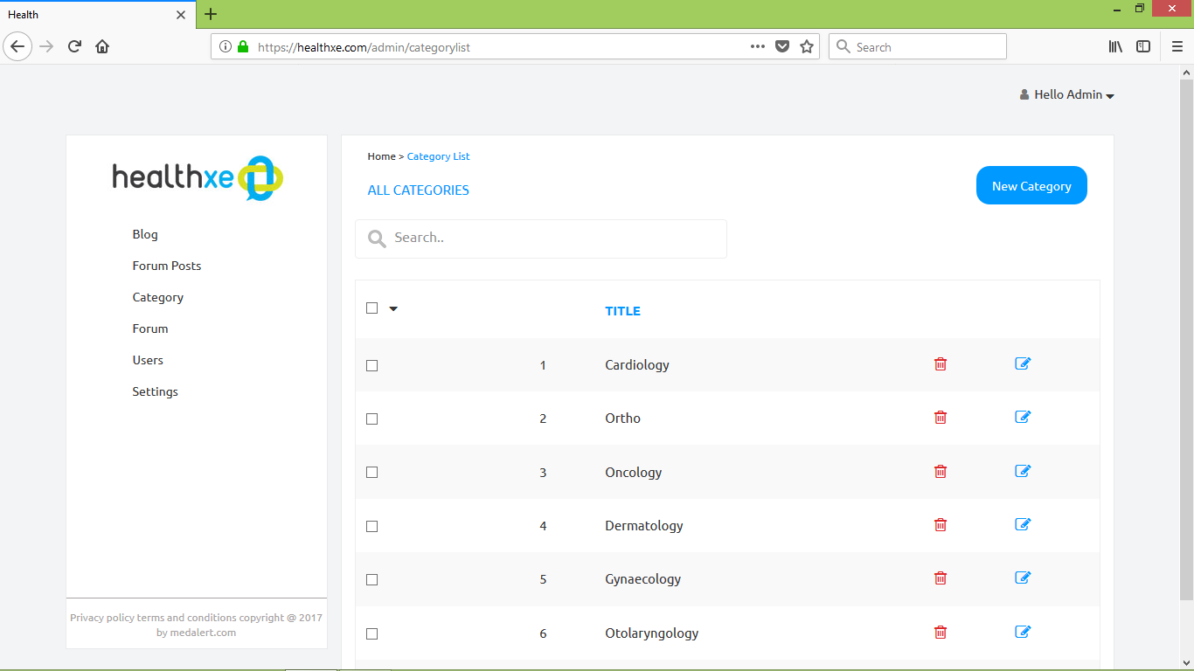
Category

Slide 53
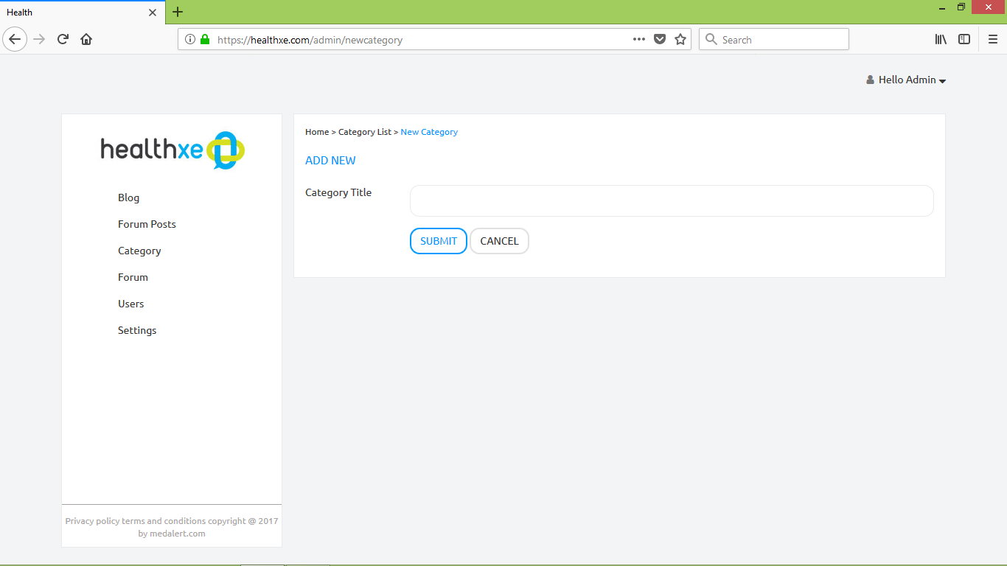
New category

Slide 54
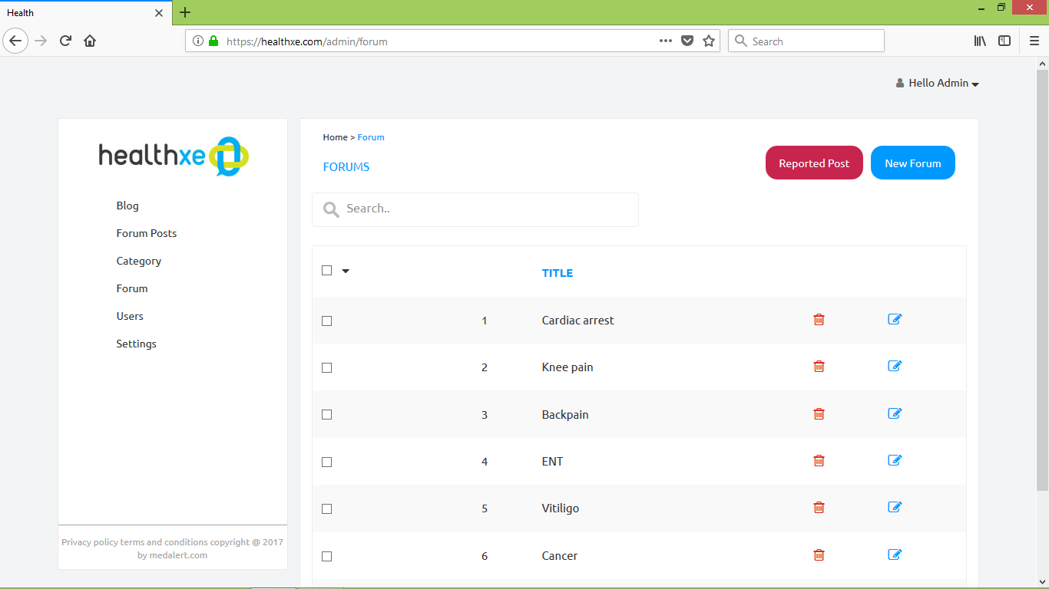
Forum topics

Slide 55
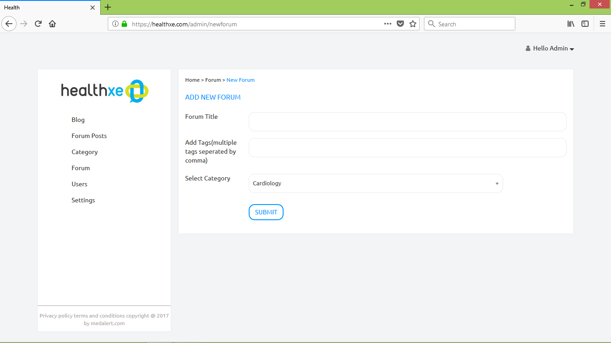
New forum

Slide 56
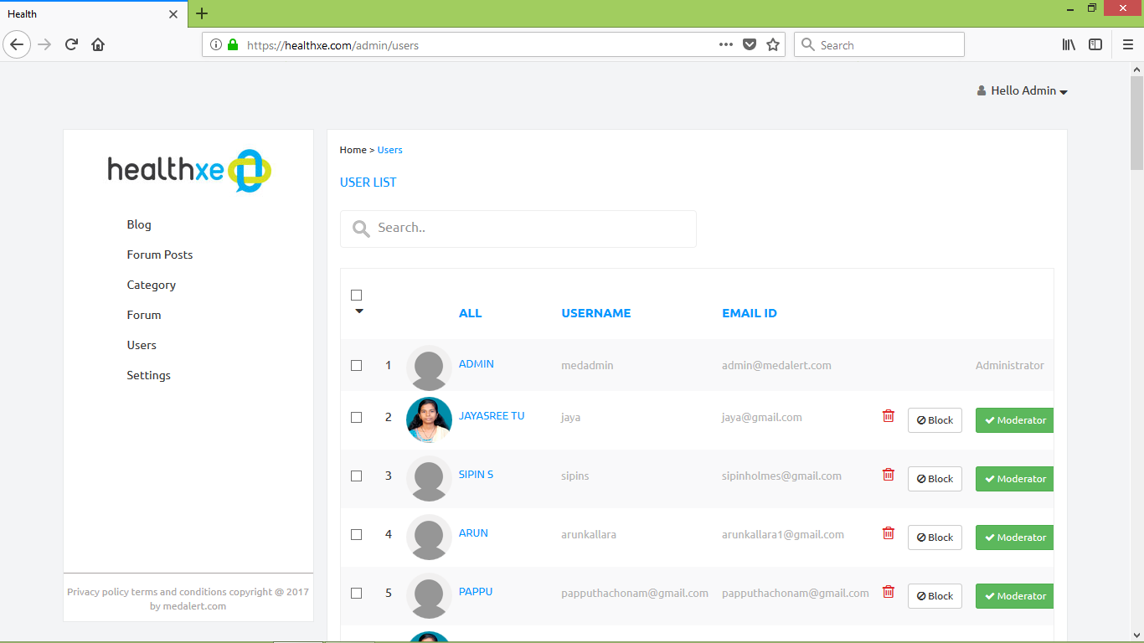
User details

Slide 57
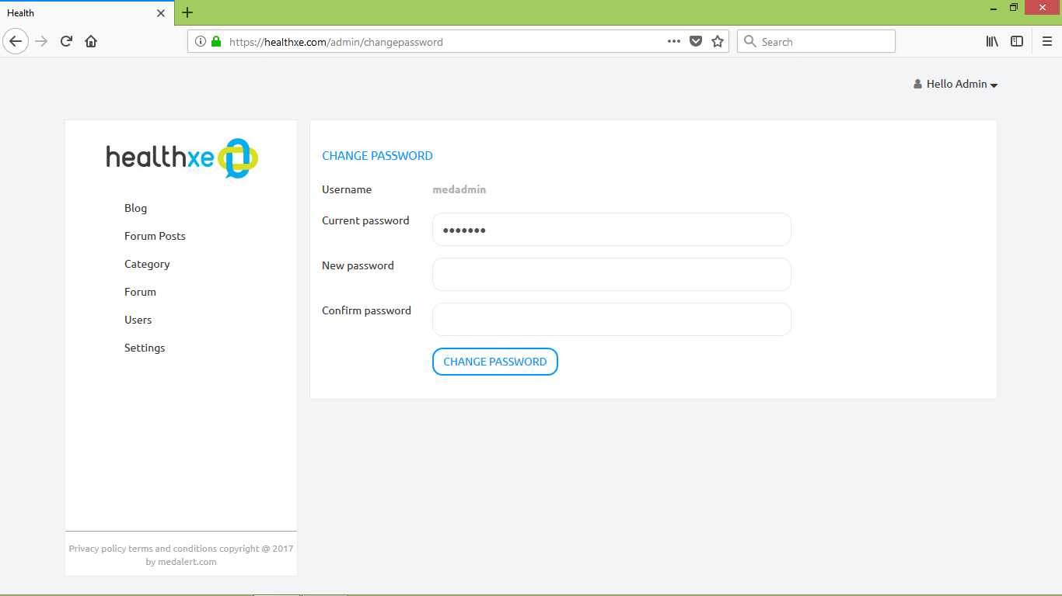
Change password

Slide 58


