Slide 1

Abusive Malayalam Text targeting Women on Social Media (YouTube comments)
Ashitha P
(80521006)
Under the guidance of
Dr Ajees K P

Slide 2
Table of contents
01
02
03
04
05
Introduction
Methodology
Literature Review
06
Results
07
Problem Statement
Future Work
Objective
08
Conclusion

Slide 3
01
Introduction
In recent years, social media platforms like YouTube have become important for communication and entertainment. But they are also being used to post abusive and hurtful comments against women, causing emotional, social, and professional problems.
Our project aims to develop a system to detect abusive comments targeting women, specifically in the Malayalam language. Malayalam, being a low-resource language, lacks sufficient tools and resources for content moderation, making this work especially important for creating safer online environments.
We collected comments from YouTube, mainly from topics where gender-based abuse is common. Each comment was marked as either Abusive or Non-Abusive. The aim of our project is to create and test models that can correctly find abusive Malayalam comments.

Slide 4
02
Literature Review
1. Paper: "Overview of the DravidianLangTech 2021 Shared Task on Offensive Language Identification in Dravidian Languages“
Summary: This study used machine learning models like SVM and Random Forest to detect offensive comments in Dravidian languages, but faced challenges with code-mixed and informal language.
2. Paper: "Offensive Language Identification in Dravidian Languages Using Classical Machine Learning Techniques"
Summary: This study applied classical machine learning models like Logistic Regression and Naive Bayes to detect offensive comments in Tamil, Malayalam, and Kannada, but struggled with noisy and code-mixed user-generated content.

Slide 5
Problem Statement
03
“Online abuse targeting women in Malayalam content is a growing concern, especially given that Malayalam is a low-resource language with limited tools for moderation. This project focuses on leveraging the MuRIL model alongside machine learning models like SVM, Logistic Regression,Linear SVC and XGBoost to effectively detect abusive comments against women, contributin to the creation of safer digital environments. “

Slide 6
Objectives
04
Train MuRIL BERT Model: Train the pre-trained MuRIL BERT model on the abusive comment dataset to accurately detect abusive language.
Compare with Machine Learning Models:Compare the trained Logistic Regression, SVM, and XGBoost models (using TF-IDF features) with the trained MuRIL BERT model based on accuracy, precision, recall, and F1-score to show the effectiveness of the deep learning model.
Evaluate the Model:Evaluate the final saved model using metrics like accuracy, precision, recall, and F1-score to ensure consistent and reliable performance.

Slide 7
05
Methodology
Data
The dataset used in this study contains Malayalam data with 1424 non-abusive and 1366 abusive samples.
The labels in the dataset are categorized as abusive and non-abusive.
The dataset was provided by the Dravidian LangTech 2025 Conference as part of the shared task.

Slide 8
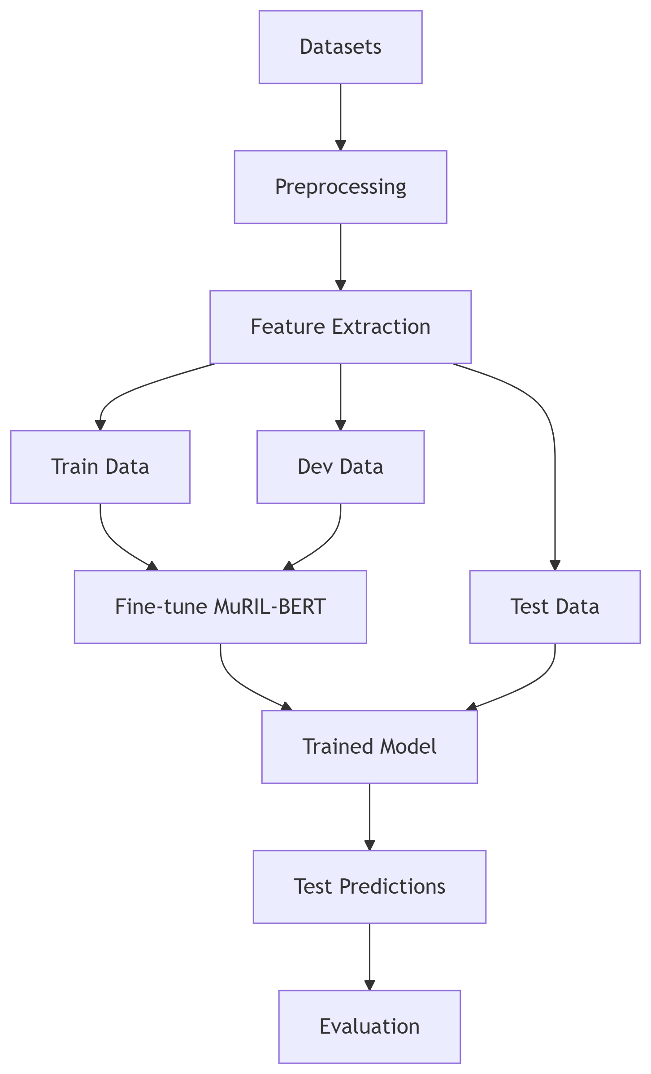
05
Methodology
Workflow

Slide 9
Results
06
Model Performance Metrics:The model achieved an accuracy of 77.76%. and The F1-score of the model was 77.65%.
Best Model Comparison:After evaluating multiple models (Fine-tuned MuRIL, Logistic Regression, SVM, Linear SVC, and XGBoost), the Fine-tuned MuRIL model achieved the highest performance
Visual Representations:

Slide 10
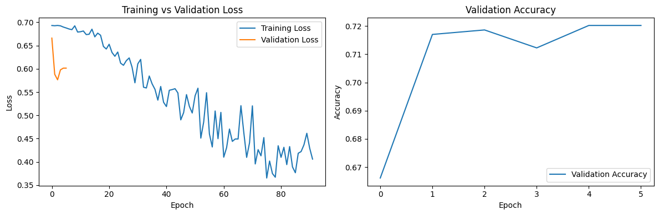
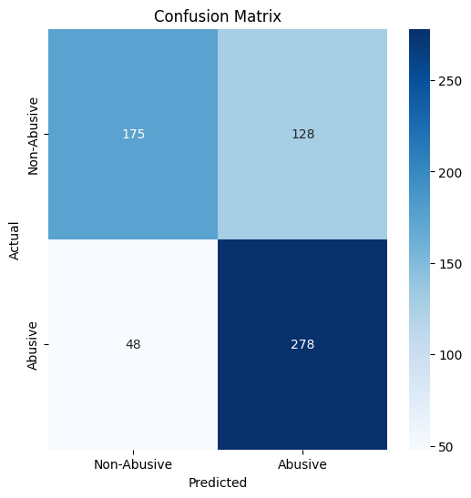

Slide 11

Future Work
07
Model Optimization
Real-time Classification
Exploring More Languages

Slide 12
Conclusion
08
This project focuses on detecting abusive language in text using advanced machine learning models, specifically fine-tuned MuRIL, to improve accuracy and reliability.
By using models like MuRIL, the system can effectively identify abusive content in different text sources, making the detection more reliable.
Ongoing research and improvements are needed to help the model handle different datasets, work in real-time, and adapt to new abusive language patterns.

Slide 13
References
Ruder, S. (2019). Pre-trained Language Models: A Survey. arXiv preprint arXiv:1907.11692. Retrieved from https://arxiv.org/abs/1907.11692
Sanh, V., Debut, L., Chaumond, J., & Wolf, T. (2019). MuRIL: Multilingual Representations for Indian Languages. arXiv preprint arXiv:2003.11080. Retrieved from https://arxiv.org/abs/2003.11080
Zhang, Y., & Wallace, B. C. (2015). A Sensitivity Analysis of (and Practitioners' Guide to) Convolutional Neural Networks for Sentence Classification. In Proceedings of the 8th International Conference on Learning Representations (ICLR 2015). Retrieved from https://openreview.net/forum?id=3P_XAs61
Chakravarthi, P., & Saha, S. (2022). A Survey on Abusive Language Detection in Social Media Texts. In 2022 IEEE 17th International Conference on Intelligent Systems (IS). IEEE. DOI: 10.1109/IS56434.2022.9785879

Slide 14
Thank You !

